Slide 1
Smart Inquiry Triage Assistant
Retrieval-augmented classification with human-in-the-loop escalation
Ankit Ghatole · AI Engineer Case Study · Customer Journey Analytics · 11 September 2026

Slide 2
THE PROBLEM
Every inquiry is sorted by a human before anyone can help
3
Decisions per message
What is it about, how urgent is it, which team owns it before any actual work begins.
The goal
Not AI answering customers.
!
Different people route it differently
Two people can route the same message differently. Quality depends on who opens it.
AI doing the sorting, so specialists spend their time resolving rather than reading.
~
Does not scale
Volume grows, triage time grows with it. Expert hours go to clerical work.

Slide 3
BUSINESS VALUE
Why this matters for an automotive company
Some messages are safety issues
“My brakes are grinding” is not “my invoice is wrong.” If the first one sits in the wrong queue, that's a safety problem.
WHERE THE VALUE LANDS
Response time
minutes of human reading → few seconds
Customers touch a lot of systems
Configurator, ordering, financing, warranty, dealer service, the car's software. Eight categories, eight places to get stuck.
Consistency
same inquiry, same routing, every time
Every interaction counts more
Customer experience
People buy a car once in years, not once a week. One bad experience carries a lot of weight.
right specialist first, fewer handoffs
If this gets something wrong, a ticket lands in the wrong queue and a human notices. If a customer-facing chatbot gets something wrong, the customer gets the wrong answer.

Slide 4
WHAT IT DOES
One message in, a full triage decision out
INPUT · query
“My brakes are grinding and it feels unsafe to drive.”
OUTPUT · six further fields, fixed format
category
service
priority
high
routed_queue
Service Scheduling Team
confidence
0.89
resolution_notes
Contact the customer immediately to book an
emergency brake inspection. Advise them not to drive.
retrieved_cases
5 similar past cases, with labels and scores
escalated — when confidence falls below the threshold, the result is flagged for review. It is never withheld.

Slide 5
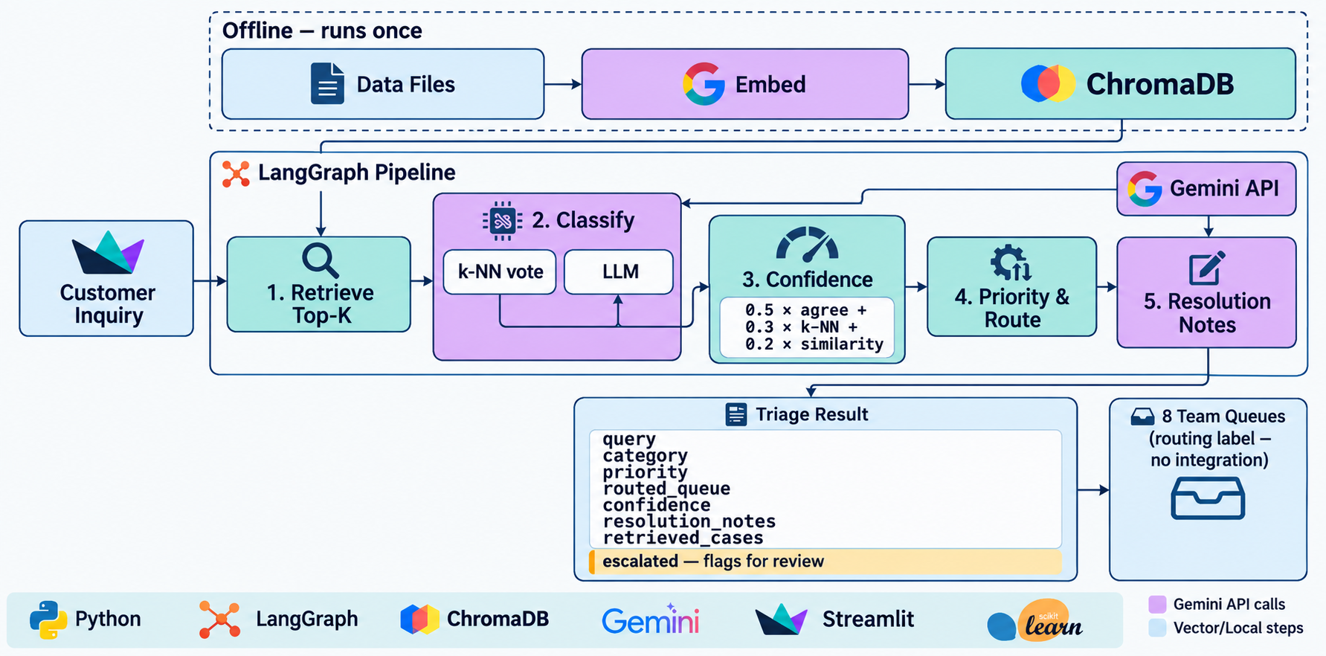
ARCHITECTURE
Offline once, then two API calls per inquiry

Slide 6
CORE DESIGN DECISION
Why the category is predicted twice
With one classifier
With two classifiers that see different things
Now agreement means something. Two methods reached the same answer from different evidence.
And disagreement means the past cases and the written definitions genuinely point different ways
The only confidence signal available is asking the model how sure it is.
Language models are poorly calibrated they report high confidence while being wrong.
That means asking the model to catch its own mistakes.
What it caught
“The price in the configurator does not match what I was invoiced.”
Every retrieved past case by KNN was labelled configurator. The LLM model read “invoiced” and chose billing.
Confidence fell to 0.46 and it was flagged for review. A single classifier would have answered confidently and given no sign anything was ambiguous.

Slide 7
HOW IT WORKS
The two classifiers, and how they fail differently
k-NN vote
LLM classification
Counts the category labels of the retrieved past cases, weighted by similarity.
Reads the inquiry against the eight taxonomy definitions and returns one name.
Sees: 300 labelled past cases
Fully deterministic
Costs nothing - retrieval already happened
Fails when nothing similar exists
Sees: 8 category definitions
Handles a new category immediately
Fails where definitions overlap
Why they must stay independent
If the model saw the past cases, it would just repeat them. Then agreement proves nothing — one opinion counted twice.

Slide 8
THE OPEN QUESTION
Confidence is an observation, not a self-report
confidence = 0.5 × methods agree + 0.3 × k-NN agreement + 0.2 × top similarity
0.5
Methods agree
The only signal drawn from two independent sources. The other two both derive from the same retrieval.
0.3
k-NN agreement
How united the neighbours were. Five out of five is far stronger evidence than three out of five.
0.2
Top similarity
Catches the case where both methods agree but nothing in the knowledge base is actually close.

Slide 9
ARCHITECTURE DECISION
Why a graph?
Inspectable state
The graph
Every node's contribution is visible in one state object. When an inquiry is misrouted, you can see which step produced the wrong value. A chain of function calls hides that.
retrieve
↓ classify
↓ confidence
Extensibility
↓ priority_and_route
Adding a new step means adding a box, not rebuilding the pipeline.
↓ notes
The honest trade-off
Branching is native
For five sequential steps, five function calls would work just as well. LangGraph earns its place in what comes next, not in what exists today.
Sending flagged cases down a different path later is a fork, not a rewrite.

Slide 10
Live demo

Slide 11
RESULTS
How well does it actually work?
Priority accuracy
52 – 53%
against a 48% baseline — barely above guessing “low” every time
Method
The test cases are held out before the vector store is built, so they cannot retrieve their own labels.
NOTE: The 100% is on clean, one-line inquiries that each fit neatly into one category. Real messages have typos and several problems at once.

Slide 12
ASSESSMENT
What does not work, and why
Priority prediction is near baseline
The search matches on what a message is about, not how urgent it sounds. Two brake messages look the same whether one says "unsafe to drive" or "whenever convenient".
The confidence formula is unvalidated
There were no misclassifications in the test set, so nothing for it to catch. Validating it needs a harder or larger evaluation set.
Routing produces a label, not an integration
The system outputs the target queue name. Routing to a real ticketing system is out of scope here.

Slide 13
NEXT
Where this goes from here
1
Fix priority first
Give it a second opinion, the same way category has one. Right now it's the weakest part.
2
Tune the confidence score
The weights are chosen by reasoning. With real data on what turned out right, they can be set properly.
3
Handle more cases
Only embed new cases instead of rebuilding everything. Beyond a hundred thousand cases, the search needs a faster index.
4
Keep data in-house
Inquiries currently go to an outside API. Swapping to a self-hosted model is a small change.
5
Learn from corrections
Every time a human fixes a flagged ticket, that's a new example. Add it, and the system improves with no retraining, because nothing was trained.

Slide 14
Summary
Triage is sorting, not solving
Automating it frees people to do the actual work. And if it gets something wrong, a ticket lands in the wrong queue a human catches it.
The category is decided twice
Two methods that look at different things. One reads past cases, one reads the definitions. They fail in different situations, so their agreement is evidence.
Confidence is measured, not asked
It comes from whether those two agree, not from asking the model how sure it is.
Everything is compared to a baseline
It's what showed me priority needs a different approach.

Slide 15
Thank You !
github.com/ankitghatole08/AI-Engineer-Case-Study

