Slide 1
BY
GROUP IOTERGY
Under the guidance of
Prof. Ashok Sutradhar

Slide 2
GROUP MEMBERS

SUDEV SIRCAR (2023EEB066) ANKIT GHOSAL(2023EEB097)
GOURAV KUMAR SINGH(2023EEB093)
SUJIT MONDAL(2023EEB109) AMIT MUKHERJEE(2023EEB014)

Slide 3
CONTENTS

Acknowledgement Objective Introduction Components Used Circuit Diagram Working procedure
Advantages and Disadvantages Conclusion
Future Prospects References

Slide 4
ACKNOWLEDGEMENTS

We express our sincere gratitude to our supervisor, Dr. Ashok Sutradhar, for his invaluable guidance and support throughout this project. We also thank the Department of Electrical Engineering, IIEST Shibpur, for providing essential resources and opportunities to apply theoretical knowledge to practical experience.
Finally, we appreciate the contributions of all individuals who directly or indirectly supported us in completing this project.

Slide 5
OBJECTIVES

To design and implement a smart energy meter capable of monitoring and tracking real-time energy consumption using IoT integration.
To automate the calculation and communication of
energy bills, eliminating manual errors and delays.
To provide consumers and energy providers with real- time insights into energy usage via a mobile application.
To enhance energy efficiency, reduce costs, and promote sustainable energy usage through advanced monitoring.

Slide 6
INTRODUCTION

Welcome! Our project focuses on designing an innovative
IoT-based Smart Energy Meter.
Traditional energy meters face challenges like manual readings, inaccuracies, and delays in billing.
With IoT integration, our system automates energy monitoring and billing, providing real-time data to both consumers and providers.
This project aims to enhance energy efficiency, reduce costs, and improve user convenience by leveraging modern technology.
Join us as we explore how this smart solution addresses current limitations and shapes the future of energy management.

Slide 7

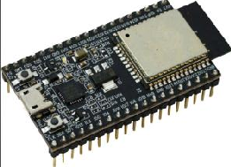


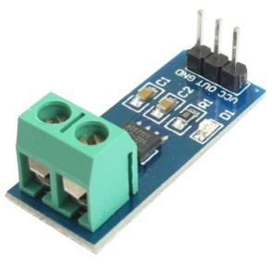


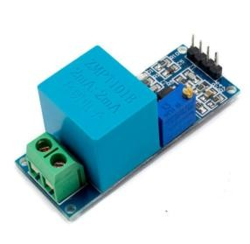
COMPONENTS USED

ESP32 Microcontroller
Serves as the brain of the system with inbuilt Wi-Fi and Bluetooth for IoT connectivity.
ACS712 Current Sensor
Measures the current flowing through the circuit using the Hall Effect.
ZMPT101B Voltage Sensor
Accurately measures AC voltage for energy calculations.
16x2 LCD Display
Displays voltage, current, power, and energy readings locally.

Slide 8


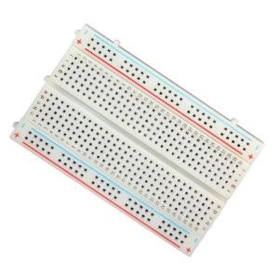


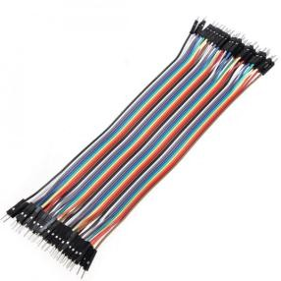
COMPONENTS USED

15-Watt Bulb
Acts as the load for testing energy consumption.
Cloud Platform and Blynk App
Stores and visualizes real-time energy data for remote monitoring.
Arduino IDE
Used for programming the ESP32 and running the system.
Jumper Wires
Facilitates the connection of components in the circuit.
Power Supply
Provides the necessary operating voltage for the circuit.
Breadboard
Used for prototyping and assembling the circuit.

Slide 9
WORKING PROCEDURE

Data Collection:
The ACS712 current sensor measures the current, and the ZMPT101B voltage sensor measures the voltage from the connected load.
Data Processing:
The measured voltage and current values are sent to the ESP32 microcontroller, which calculates power (P=V×I *pf) and energy consumption (E=P×t).
Data Display:
The calculated values of voltage, current, power, and energy consumption are displayed on the 16x2 LCD screen for local monitoring.
Data Transmission:
Using the ESP32’s Wi-Fi capability, the data is transmitted to a cloud server.

Slide 10
WORKING PROCEDURE

Remote Monitoring:
The Blynk app retrieves data from the cloud, allowing users to monitor real-time energy consumption and cost on their smartphones.
Billing Automation:
The system calculates the energy bill based on predefined
tariffs and updates it in the app for easy access.
Load Testing:
The system was tested using a 15-watt bulb to demonstrate functionality and validate accuracy.

Slide 11


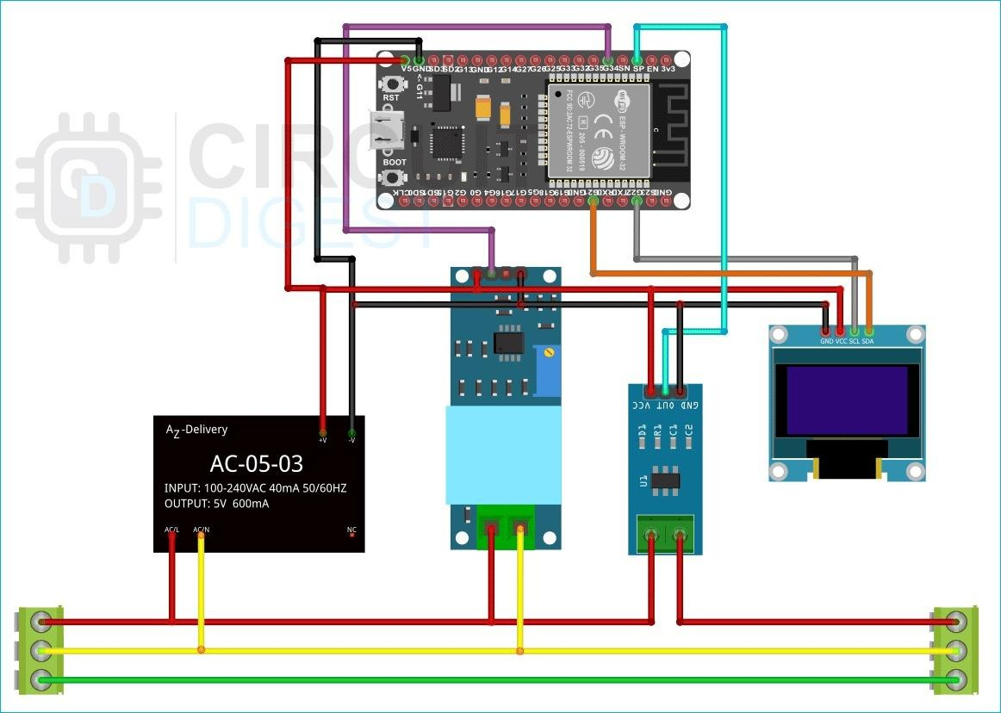
CIRCUIT DIAGRAM


Slide 12
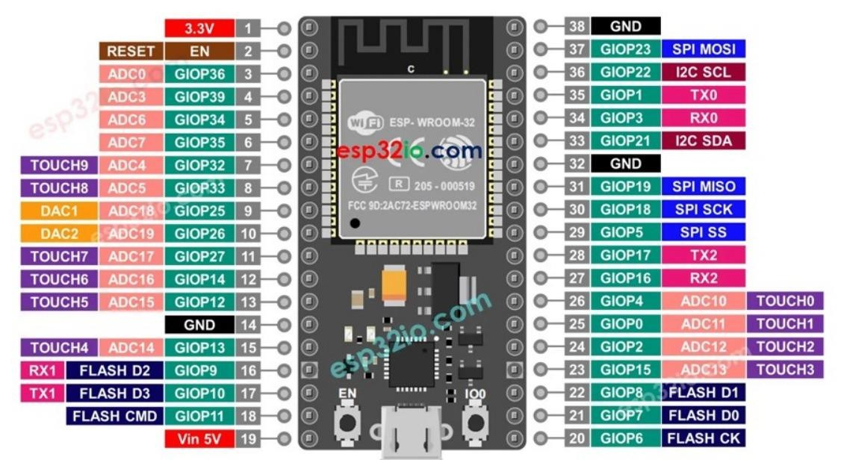
ESP 32


Slide 13


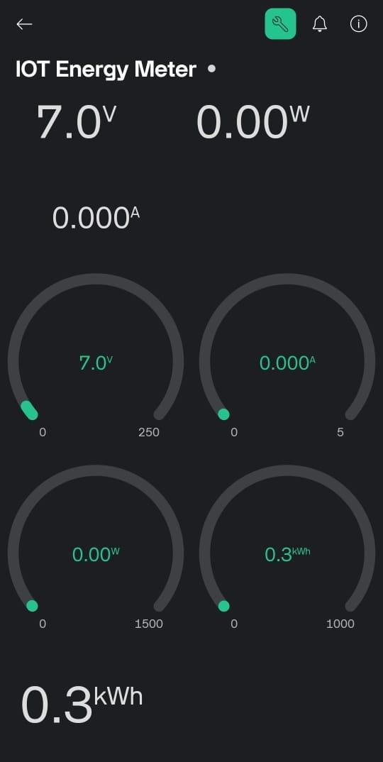
BLYNK INTERFACE


Slide 14


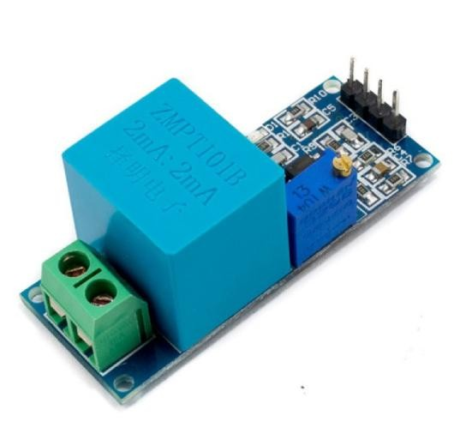
VOLTAGE TRANSFORMER

ZMPT101B AC Voltage Transformer Module

Slide 15


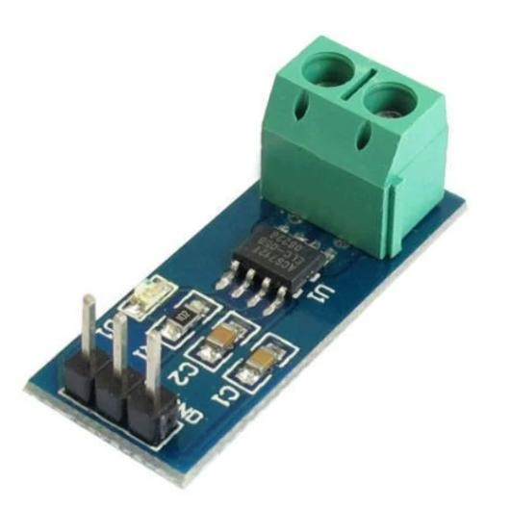
CURRENT SENSOR

ACS712 Current Sensor: The ACS712 current sensor measures current in the range of -5A to +5A with an accuracy of ±1.5% and provides an analog output voltage proportional to the measured current.

Slide 16


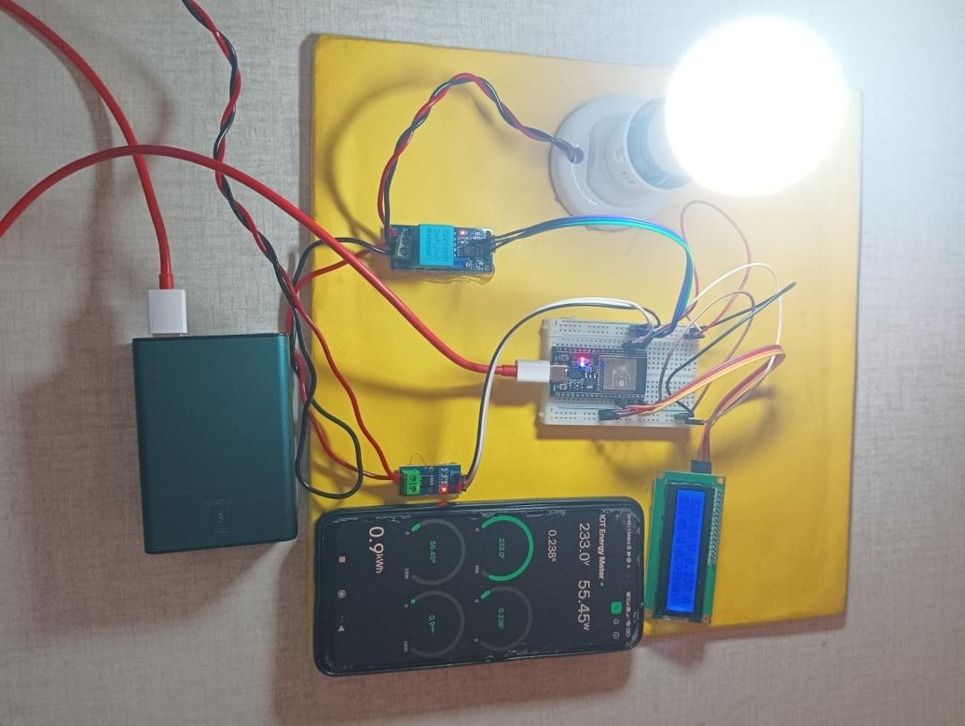
WORKING MODEL


Slide 17
ADVANTAGES

Real-time Monitoring: Unlike traditional meters, which require manual readings, smart meters provide instant, continuous updates on energy usage.
Cost Efficiency: Eliminates manual meter reading and billing, reducing operational costs for energy providers and ensuring accurate billing for consumers.
Energy Conservation: Helps consumers track and optimize their energy usage, unlike traditional meters that offer limited visibility into consumption patterns.
Remote Access: IoT-enabled smart meters allow users to monitor energy
data remotely, a feature not possible with conventional meters.
Accuracy & Automation: Automatic data collection and billing eliminate human error, providing more accurate readings compared to manual meter systems.
Scalability & Future Use: Easily extendable for advanced applications like prepaid metering or smart grids, unlike older meters with limited capabilities.

Slide 18
DISADVANTAGES

High Initial Cost: Installation of smart meters and infrastructure can be expensive.
Internet Dependency: Requires stable internet for data transmission, limiting usage in areas with poor connectivity.
Privacy Concerns: Continuous data transmission raises security and privacy issues.
Complex Installation: Setup requires technical expertise, unlike traditional meters.
Maintenance: Specialized knowledge needed for maintenance and troubleshooting.
Power Consumption: Smart meters may consume more power compared to traditional meters.

Slide 19
CONCLUSION

 The IoT-based Smart Energy Meter offers significant advantages over traditional energy meters, including real-time monitoring, automation, and accuracy.
 It provides cost savings and promotes energy efficiency by enabling both consumers and energy providers to track usage remotely.
 Despite challenges such as initial costs and internet dependency, the benefits of smart meters make them a crucial component of modern energy management systems.
 This system has the potential to revolutionize energy consumption tracking, making it more transparent, efficient, and sustainable.

Slide 20
FUTURE PROSPECTS

Fault Detection: Smart meters can detect if an appliance is consuming more energy than usual, indicating potential damage or malfunction, and alert users for early maintenance.
Prepaid Metering: Integration with prepaid systems allows users to pay in advance, improving cost control and revenue collection.
Smart Grid Integration: Enables optimized energy distribution, better load management, and real-time adjustments.
Renewable Energy Monitoring: Tracks energy from renewable
sources, promoting cleaner energy usage.
Data Analytics: Uses AI to predict energy consumption, identify inefficiencies, and optimize usage.
Wider Adoption: As costs decrease, smart meters will become the standard, driving global energy efficiency and sustainability.

Slide 21
REFERENCES

IEEE Xplore Digital Library - www.ieeexplore.ieee.org
ScienceDirect - www.sciencedirect.com
ResearchGate - www.researchgate.net
MDPI - Sensors Journal - www.mdpi.com/journal/sensors
SpringerLink - www.link.springer.com
Blynk Blog - www.blog.blynk.io
How2Electronics - IoT-based Electricity Energy Meter Using ESP32 & Blynk - www.how2electronics.com
Emonlib

Slide 22

THANK YOU


