Slide 1
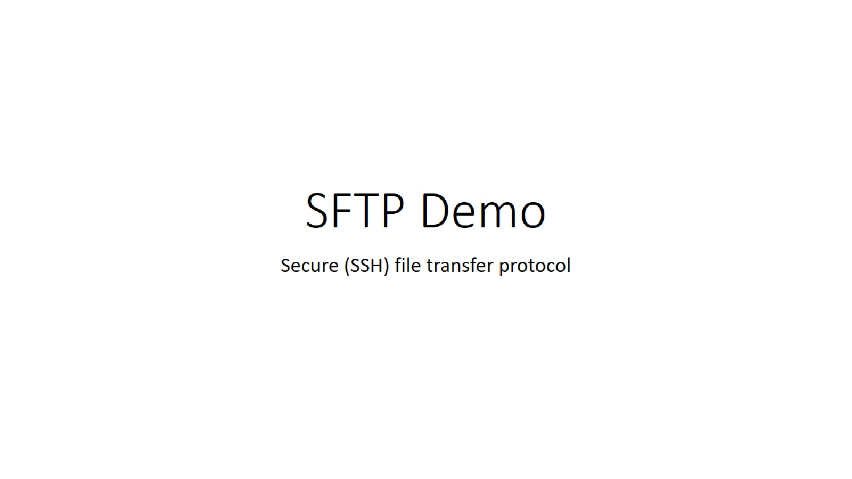
SFTP Demo

Slide 2
FTP Vs FTPS Vs SFTP protocols:
FTP: FTP is a popular file transfer method that has been around longer than the world wide web—and it hasn’t changed much since it’s invention. Back then, it was usually assumed that internet activity was not malicious, so FTP wasn’t created as a secure file transfer protocol to deal with the kind of cybersecurity threats we now see in the news every day.
FTP exchanges data using two separate channels known as the command channel and data channel. With FTP, both channels are unencrypted, leaving any data sent over these channels vulnerable to being intercepted and read.
FTPS: FTPS is an extension to the commonly used File Transfer Protocol that adds support for the Transport Layer Security and, formerly, the Secure Sockets Layer cryptographic protocols.
SFTP: SFTP (SSH File Transfer Protocol) is a secure file transfer protocol. It runs over the SSH protocol. It supports the full security and authentication functionality of SSH.
SFTP has pretty much replaced legacy FTP as a file transfer protocol, and is quickly replacing FTP/S. It provides all the functionality offered by these protocols, but more securely and more reliably, with easier configuration. There is basically no reason to use the legacy protocols any more.

Slide 3
Highlevel topics:
SFTP Port Number
SFTP Client for Windows and Mac
SFTP Server for Linux, Windows, and Mac
SCP Command on Linux
SFTP Command on Linux
SSHFS & Using SFTP for File Sharing
Interactive and Automated Secure File Transfers
Commercial File Transfer Solutions using SFTP
SFTP Libraries for Developers
SFTP Protocol
SFTP vs. FTPS
SFTP screenshot

