Slide 1
Mule
By
Nikhil Sharma
Malav ShaH

Slide 2
Contents
ESB Features
Mule Introduction
Mule Features
Advantages
Architecture
Flows
Mule Setup
Statefarm specific Mule usage
Tools
References

Slide 3
Enterprise Service Bus(ESB) features
Performs data transformation
Intelligent routing
Real time monitoring
Exception handling
Service security

Slide 4
Mule Introduction
Mule is a lightweight Java-based enterprise service bus (ESB) and integration platform that allows developers to connect applications together quickly and easily, enabling them to exchange data.
Rather than creating multiple point-to-point integrations between systems, services, APIs, and devices, you use Mule to create applications that intelligently manage message routing, data mapping, reliability, security, and scalability between nodes

Slide 5
Mule features
It enables easy integration of existing systems, regardless of the different technologies that the applications use, including JMS, Web Services, JDBC, HTTP, and more.
Mule and other ESBs offer real value in scenarios where there are at least a few integration points or at least 3 applications to integrate. They are also well suited to scenarios where loose coupling, scalability and robustness are required.
The ESB manages all the interactions between applications and components transparently, regardless of whether they exist in the same virtual machine or over the Internet, and regardless of the underlying transport protocol used.

Slide 6
Advantage
The key advantage of an ESB is that it allows different applications to communicate with each other by acting as a transit system for carrying data between applications within your enterprise or across the Internet.
Mule has powerful capabilities that include:
Service creation and hosting — expose and host reusable services, using the ESB as a lightweight service container
Service mediation — shield services from message formats and protocols, separate business logic from messaging, and enable location-independent service calls
Message routing — route, filter, aggregate, and re-sequence messages based on content and rules
Data transformation — exchange data across varying formats and transport protocols

Slide 7
Mule is a messaging framework based on ideas from ESB architectures.
Difference between Mule and traditional ESB is Mule only converts data as needed.
For ESB we need to create an adaptor for every application you connect to the bus and convert the applications data into a single common messaging format

Slide 8
When to use ESB
To ESB or not to ESB.
1. Are you integrating 3 or more applications/services?
2. Will you need to plug in more applications in the future?
3. Do you need to use more than one type of communication protocol?
4. Do you need message routing capabilities such as forking and aggregating message flows, or content-based routing?
5. Do you need to publish services for consumption by other applications?

Slide 9
Advantages
Mule provides many advantages over competitors, including:
Mule components can be any type you want. You can easily integrate anything from a "plain old Java object" (POJO) to a component from another framework.
Mule and the ESB model enable significant component reuse. Unlike other frameworks, Mule allows you to use your existing components without any changes.
Components do not require any Mule-specific code to run in Mule, and there is no programmatic API required. The business logic is kept completely separate from the messaging logic.

Slide 10
Cont…
Messages can be in any format from SOAP to binary image files. Mule does not force any design constraints on the architect.
You can deploy Mule in a variety of topologies, not just ESB.
Because it is lightweight and embeddable, Mule can dramatically decrease time to market and increases productivity for projects to provide secure, scalable applications that are adaptive to change and can scale up or down as needed.
Mule's stage event-driven architecture (SEDA) makes it highly scalable.

Slide 11
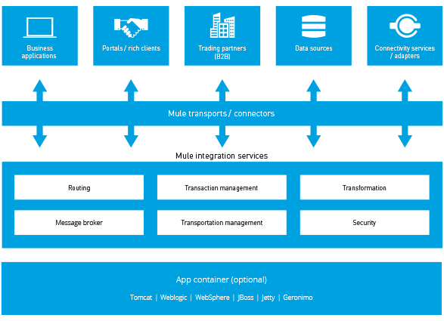
Architecture

Slide 12
Flows
Flows provide the most powerful and flexible way to construct Mule applications.
At the simplest level, Flows are sequences of message-processing events.

Slide 13
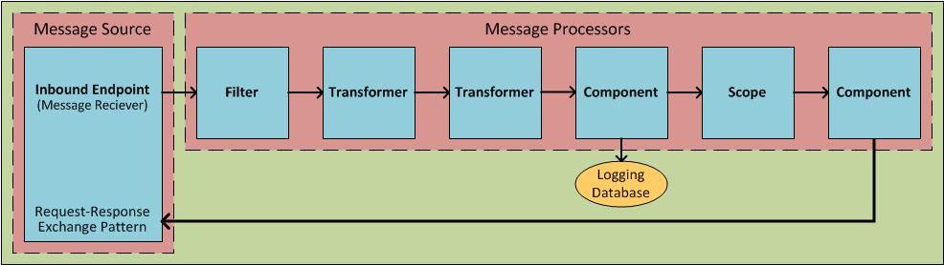
Flow

Slide 14
As the following schematic illustrates, a message that enters a flow may be:
validated (filtered)
enriched (appended)
transformed into a new format
processed by custom-coded business logic
logged to a database
evaluated to determine what sort of response gets returned to party that submitted the original message

Slide 15
Mule Setup
Step 1: Download STS form http://s.f/ost
Version - spring-tool-suite-3.8.4.RELEASE-e4.6.3-win32-x86_64
Step 2:
Run sts 3.8.4 version from sts bundle in C:/Dev
Create a new workspace
Import the mule project as Maven project->Existing project->path form SVN checkout(trunk).

Slide 16
Cont…
Step 3:
Goto Windows->Preferences->General->Network Connections->Active Provider-Manual
In Http and Https change proxy Host and port.
Host: in00pxy1.opr.statefarm.org
Port:8000
Change Sf net password

Slide 17
Cont…
Step 4:
Help->Install new Software->
Mule studio: https://nexus.opr.statefarm.org/repository/MuleStudioPlugin-6.3.0/
Mule Runtime: http://nexus.opr.statefarm.org/repository/mule-studio-plugin-runtimes/
Select versions->3.8.5.
Deselect version 3.4.1, 3.6.2 .

Slide 18
Cont…
Step 5:
Right Click on project select->Mule->Anypoint Studio
Then select->mule->enableSupport
Run As-> Mule Application with Maven(configure) ->In Arguments
(VM Argument: -XX:PermSize=128M -XX:MaxPermSize=256M -Dmule.srstatus=true -Dspring.profiles.active=default )
For versions 3.8.2+ (-Dmule.srstatus=true) is no more required.
If Mule is using RabbitMQ – (Dspring.profiles.active=default, rabbit) is used
Jre version: jdk 1.8

Slide 19
Statefarm specific Mule Usage
Why we are using Mule!
For Communication between On-Platforma nd Off-Platform
For common URL between different Environments
For Transformation of object
For MQs (RabbitMQ)

Slide 20
Tools helpful for Mule
CMP (Cloud Management Portal) (s.f/cmp)
Needed for deploying Mule
For Mule URLs
Trackit (s.f/trackit)
To Deploy Mule
Tpo (s.f/tpops)
To cache endpoints of Mules
Checking Mule Endpoints cache
http://mule0xxx.test.statefarm.com:9002/registry/admin/cache/query/endpoints

Slide 21
References
https://techguide.opr.statefarm.org/index.php/Mule_Jump_Page
https://techforum.test.statefarm.com/viewforum.php?f=21&sid=911c4a23d8c2c9696bbb93b84f99c660
https://techguide.opr.statefarm.org/index.php/Workstation_Setup_Guide:_Mule
https://techguide.opr.statefarm.org/index.php/Mule_Blueprint
https://techguide.opr.statefarm.org/index.php/Mule_Management_Console_(MMC)
https://techguide.opr.statefarm.org/index.php/Mule_Error_Handling_Development_Guide

Slide 22
Thanks :)
Any Questions?

