Slide 1
Facial Expression Recognition System (FERY)
Presenter
Ankit Rajendra Gugale
15210535
School of Computing
ankit.gugale2@mail.dcu.ie
Supervisor:
Dr. Alistair Sutherland

Slide 2
Introduction
Facial expression recognition system (FERY) recognises six different expression of human face.
Facial expression recognition system (FERY) is integrated with a music player, which helps in playing songs as per user expression recognised.
Facial expression recognition system (FERY) is based on 3 phases :
Face Detection
Feature Extraction
Classification

Slide 3
Related Work
Prof. Jayshsree proposed a system that “Tries to provide an interactive way for the user to carry out the task of creating a playlist. The author states that the working of the system is based on different mechanisms carrying out their function in a pre-defined order to achieve the expected output.
S. L; Routray proposed a framework “ for expression recognition by using appearance features of selected facial patches.”
Omar Khan proposed system based on facial expression extracted will generate a playlist automatically thereby reducing the effort and time involved in rendering the process manually

Slide 4
Proposed System

Slide 5
Data set
Facial expression recognition system (FERY) is based on JAFFE Dataset. Japanese female facial expression (JAFFE) dataset contains Images of six facial expressions posed by 10 Japanese female model.
For the development of the system, we have used 60 images from the dataset which have different expression like anger, disgust, fear, happy, sad, surprise,
The dataset was produced by Michael Lyons, Miyuki Kamachi, and Jiro Gyoba and images were taken at Psychology Department in Kyushu University

Slide 6
Components
1. Face Detection
Pre-Processing
Eyes and Nose Localisation
Lip detection
Eyebrow detection
Extraction of Patches
2. Feature Extraction
3. Classification

Slide 7
Music Player
Music player consists of songs based on the expression recognised.
As the expression of the user is recognised, songs related to that expression are displayed on the screen.
Once the expression is classified it acts like input to the music player and on the expression recognised by the system, list of songs is displayed to the user where the user can select any music file of the desired choice from the list.

Slide 8
Results
The testing for the system is performed on JAFFE Database
Images from JAFFE Database were used, which are a combination of different expression images like happy, sad, disgust, fear, anger.
The proposed system FERY accepted and recognised images with different expressions. The accuracy obtained by proposed system is 86.66 percent.

Slide 9
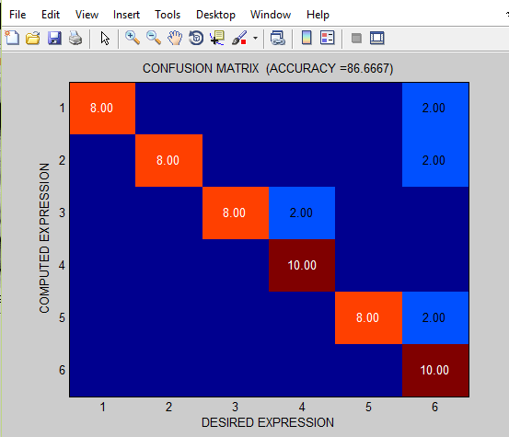
Accuracy of the System The accuracy obtained by proposed system is 86.66 percent

Slide 10
Deliverables
Code
Presentation
Demo of system
Report
All the deliverables are available at :
https://github.com/ankitgugale/FERY

Slide 11
Conclusion
Exact grouping of the six general expressions.
Providing users with a less expensive, extra equipment free and exact expression recognition based music player..
Good accuracy and performance of system..
Help for the music treatment to therapize a patient

Slide 12
Future Scope
Attain more accuracy.
Launching FERY across various platforms
Making Real time image capture and recognition feasible
Integration Facial expression recognition system (FERY) with other applications in the field of medical, science and crime investigation.
More Enhancements in next version of music player for patients needing music therapy.

Slide 13
Thank You.

