Slide 1
IBM University Engagement Project Submission
“Automated Medical Insurance Claim Denial & Appeals Agent”

Slide 2

Project Tile – [Automated Medical Insurance Claim Denial & Appeals Agent]
Domain of Project – [ Healthcare ]
Student Name | Recent Passport Photo | Email ID | Mobile number [WhatsApp]
ANKIT GUPTA |  | ankitguptaramnage@gmail.com | 9752111277

Slide 3
Problem Statement -
Problem Statement : Automated Medical Insurance Claim Denial & Appeals Agent
The Challenge: Healthcare administrators and patients lose billions annually to complex health insurance claim denials. Reviewing dense insurance policy rules, matching them to clinical charts, and drafting valid medical appeal letters manually is a slow, error-prone bureaucratic roadblock. Valid claims are frequently abandoned, causing massive revenue leaks for providers and unexpected out-of-pocket medical debt for patients.
The Objective
Build an AI-powered Multi-Agent Claim Denial & Appeals Agent that automates the end-to-end audit, evidence gathering, and appeal generation pipeline using:
Policy Audit Agent: Identifies contractual rule violations from insurance denial codes.
Clinical Data Agent: Scans unstructured patient notes for supporting biometric evidence.
Appeal Strategy Agent: Automatically formulates legally structured appeal documents with success probability metrics.

Slide 4
Proposed Solution -
Proposed Solution: Multi-Agent Appeals Automation
The proposed solution is an autonomous Multi-Agent Enterprise Workspace built using IBM Bob, IBM watsonx.ai, and IBM Granite models to dynamically parse, audit, and reverse health insurance denials.
  Features a Live Streaming Reasoning Console that visually tracks the model's cognitive thought process and inter-agent coordination steps in real time before rendering results.
  Integrates an Interactive Medical AI Playground that allows hospital administrators to chat directly with the underlying Granite LLM to query complex policy rules (insurance_policies.txt) on the fly.
  Includes a full Data Admissions Desk that allows hospital administrators to manually submit new case entries, append records to the active database file (denial_records.csv), and scale the multi-agent processing pipeline dynamically.

Slide 5
Technology Used
IBM Bob Platform: For designing, testing, and generating modular file codebases autonomously.
IBM Granite Model (ibm-granite-3-2-8b): Powers deep natural language understanding, policy rule parsing, and legal brief synthesis.
IBM watsonx.ai & Cloud: Provides enterprise-grade model execution infrastructure and structural data governance.

Slide 6
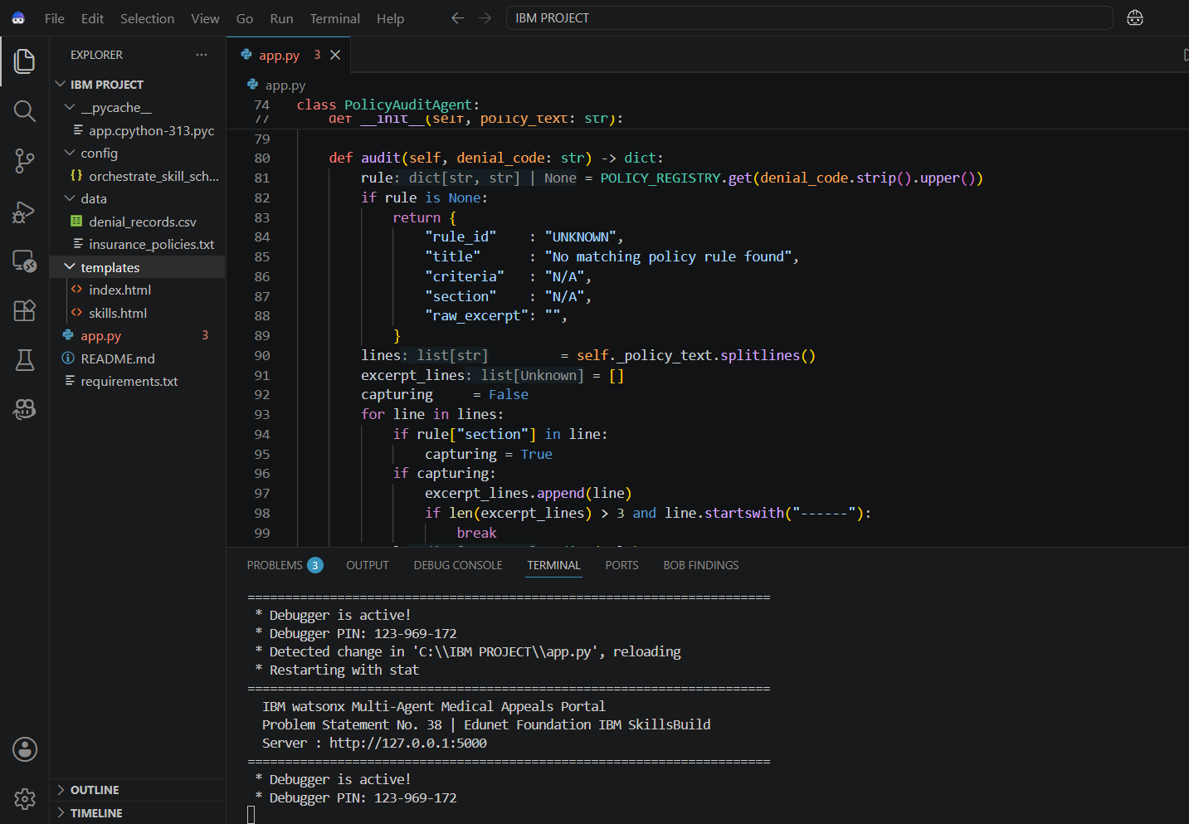
Required Files created using IBM bob -
app.py
data/denial_records.csv
data/insurance_policies.txt
templates/index.html
Templates/skills.html
config/orchestrate_skill_schema.json
requirements.txt & README.md

Slide 7
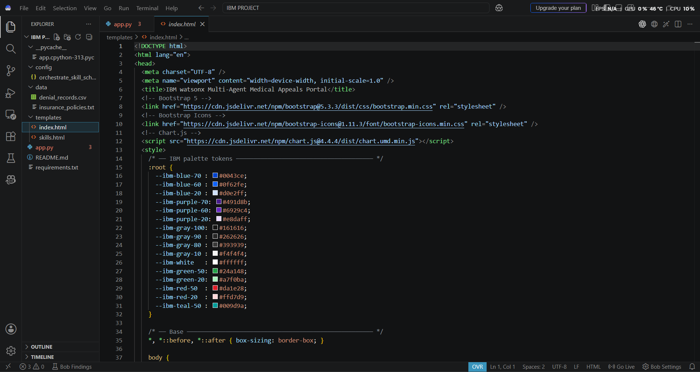
IBM Bob Screenshots:

Slide 8
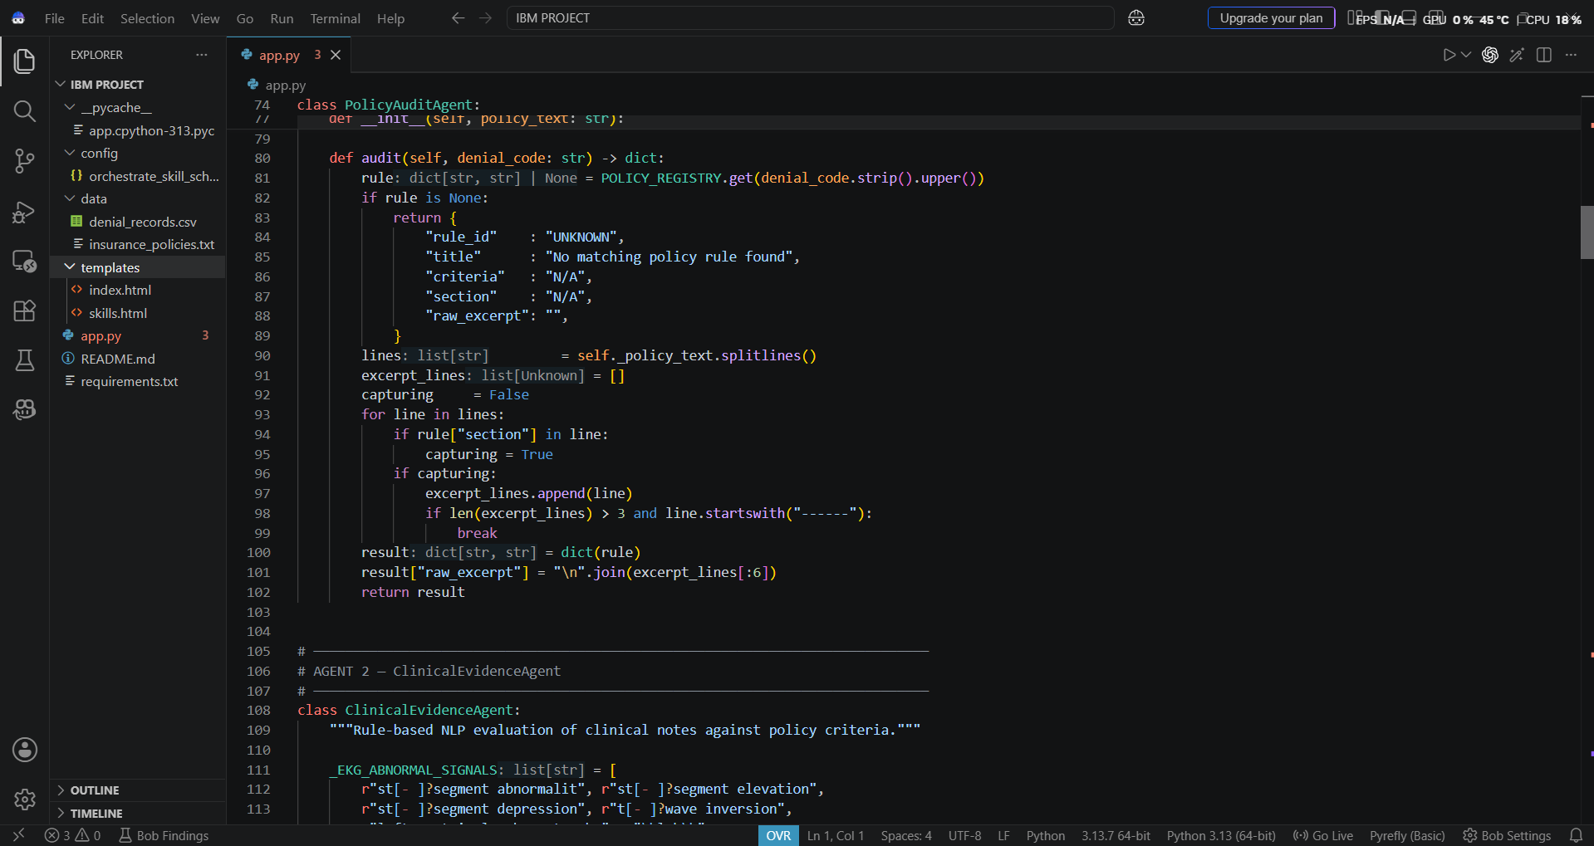

Slide 9

Role of Agentic AI in the solution
Autonomous Multi-Agent Orchestration
Decoupled Boundary Logic: Converts a singular text generation loop into a cooperative network of specialized cognitive nodes working independently.
Asynchronous Message Passing: The Policy Audit Agent automatically generates criteria metrics and passes them directly to the Clinical Data Agent to verify patient chart lines.
Factual Grounding & Context-Anchoring
Deterministic RAG Pipelines: Anchors all model generation directly to internal reference data (insurance_policies.txt) to eliminate text hallucinations.
Factual Timeline Extraction: Guarantees that the Appeal Strategy Agent only uses verified patient facts (e.g., verifying a 6-month therapy record) without fabricating regulatory codes.
Transparent Cognitive Reasoning
Live Thought Tracing: Streams the underlying model decision tree directly into the dashboard console interface to reveal the inter-agent logic steps.
Hybrid Workflow Integration: Simultaneously runs background batch processing loops over raw files while handling an interactive conversational workspace.

Slide 10
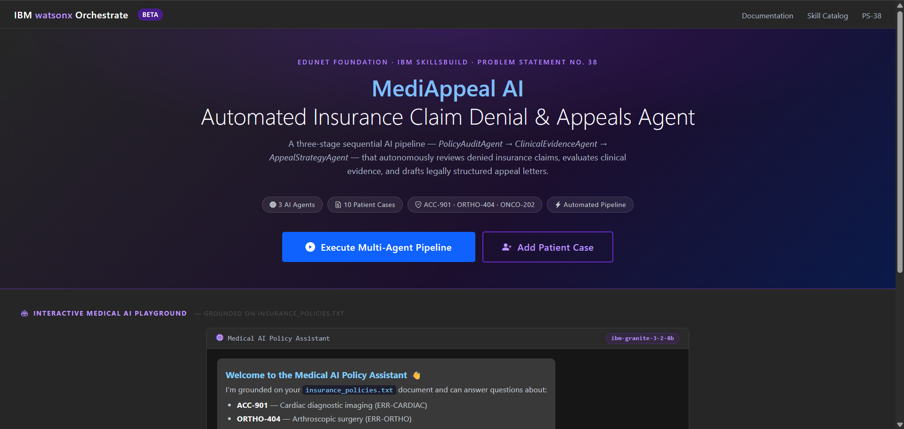
Project Output Screenshot
Please put IBM Bob output screenshots with 2-3 prompts.
You can take 2-3 more slides for each screenshot
·
·
·

Slide 11
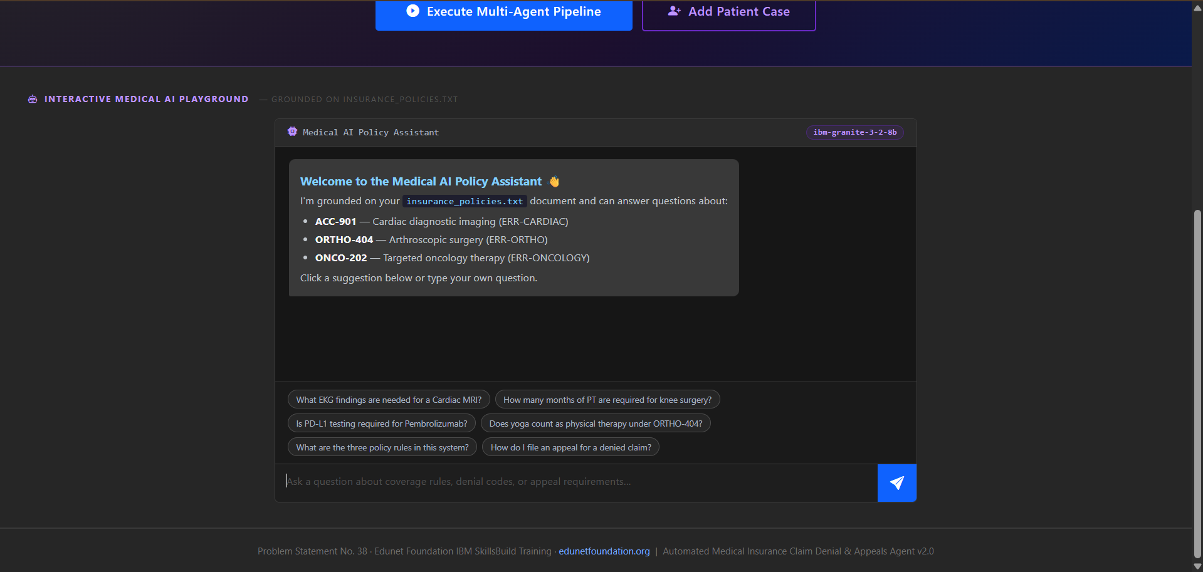
Project Output Screenshot
Please put IBM Bob output screenshots with 2-3 prompts.
You can take 2-3 more slides for each screenshot
·
·
·

Slide 12
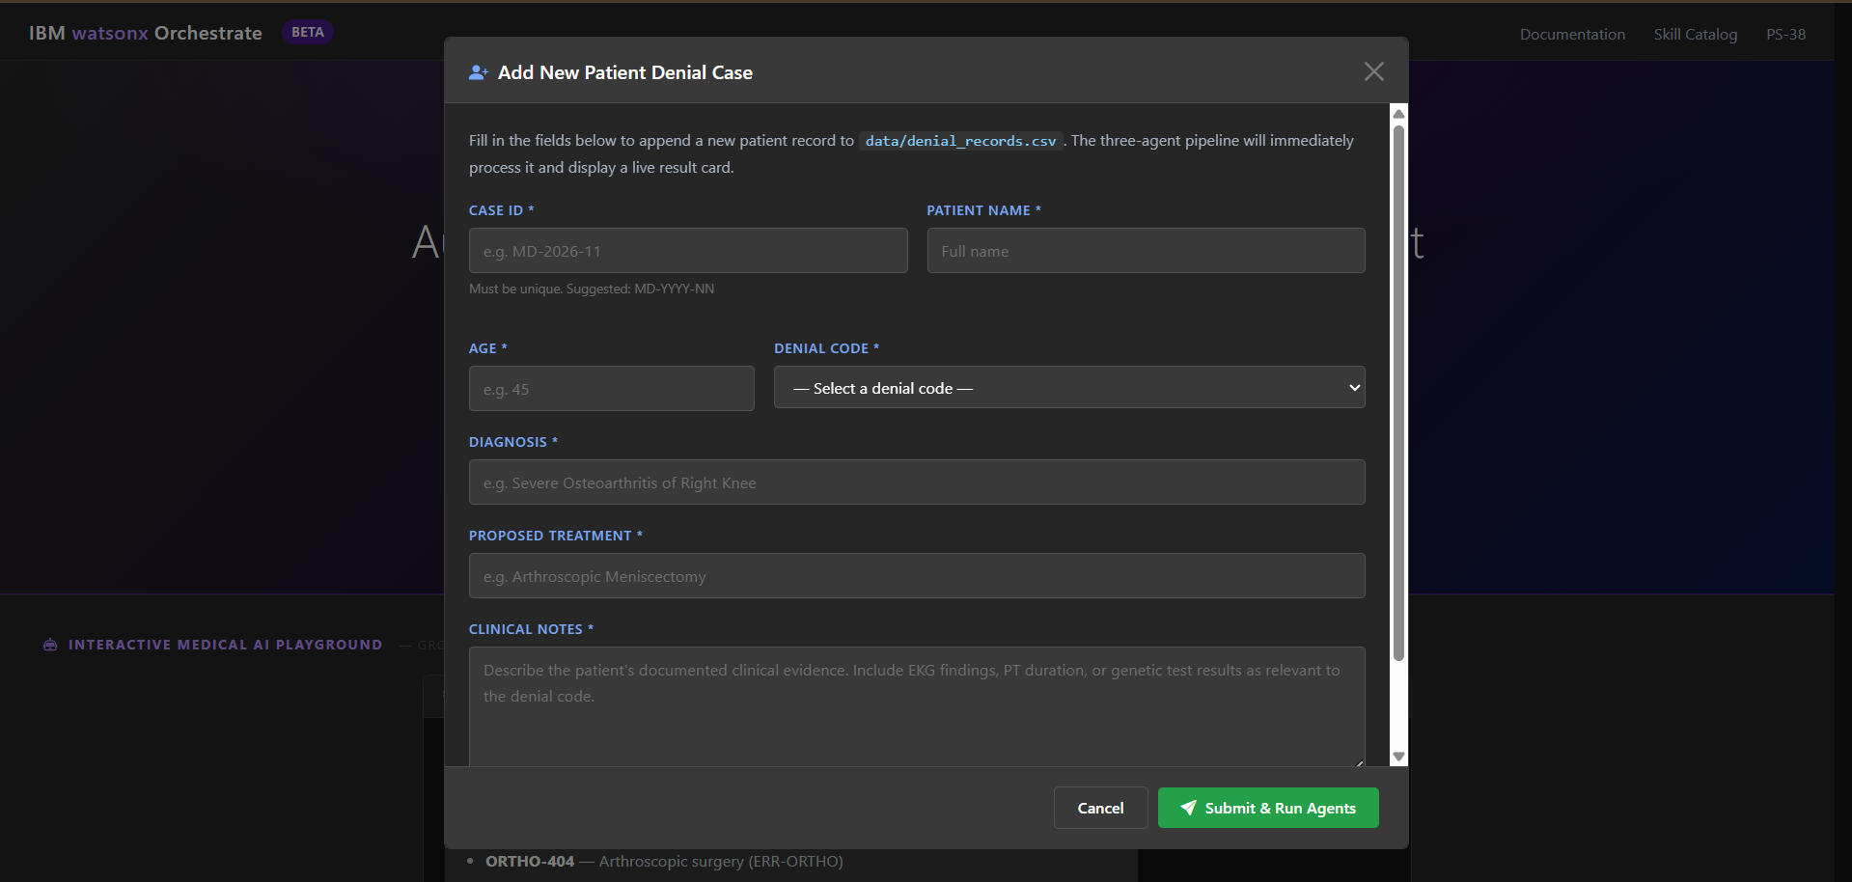
Project Output Screenshot
Please put IBM Bob output screenshots with 2-3 prompts.
You can take 2-3 more slides for each screenshot
·
·
·

Slide 13
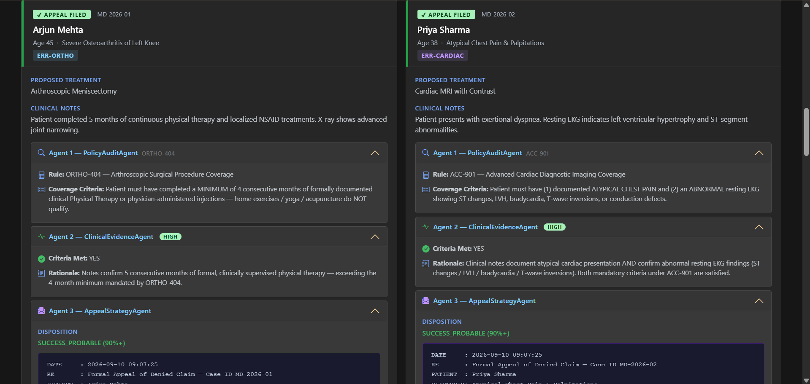
Project Output Screenshot

Slide 14
Novelty and Uniqueness
Title: Project Uniqueness & Innovation Matrix
  Human-in-the-Loop Operational Volume: Moves beyond static text prompts into a stateful, interactive workspace allowing manual overrides and real-time database inputs.
  Multi-Agent Thought Tracing Console: Elevates user trust by displaying animated terminal logs detailing how individual agent boundaries interact behind the scenes.
  Native IBM Orchestrate Readiness: Houses an embedded OpenAPI JSON skill schema mapping, allowing the entire pipeline to deploy as a corporate automation asset.
  Production-Grade Output Utility: Implements direct JavaScript print-frame hooks, enabling instant one-click PDF document generation for physical submission to insurers.
Bidirectional Interactive Core Framework: Transitions the platform from a linear processing model into an interactive sandbox environment. Users can chat directly with the IBM Granite cognitive layer to query insurance policy configurations on the fly.
Context-Aware Guardrails Integration: The chat playground intercepts input phrases, anchoring response properties strictly to the internal structured data documents (insurance_policies.txt) to block hallucinations.
Asynchronous Interface Elements: Employs optimized client-side JavaScript streaming components, allowing operators to run heavy batch operations while concurrently engaging the conversational chat frame smoothly without thread freezes.

Slide 15
Git Hub Link
https://github.com/ankitgupta-spec/medical-insurance-denial-agent
·
·
·

Slide 16
Future Scope
Future Scope & Advanced AI Cloud Scalability
EHR Cloud Ingestion Pipelines: Scaling the application infrastructure away from static local databases (.csv records) into secure cloud environments by utilizing encrypted IBM Cloud Object Storage hooks coupled with live FHIR/HL7 hospital database protocols.
Automated Cross-Agent Federated Learning: Implementing dynamic task validation triggers where the Success Predictor Agent learns from real-world claim outcome parameters, progressively tuning internal prompt weights to refine approval forecast accuracy automatically.
watsonx Governance Expansion: Integrating automated Granite Guardian security filters to verify compliance criteria on unstructured doctor dictation files, automatically blacking out sensitive patient data fields during public transmission.
·
·
·

Slide 17
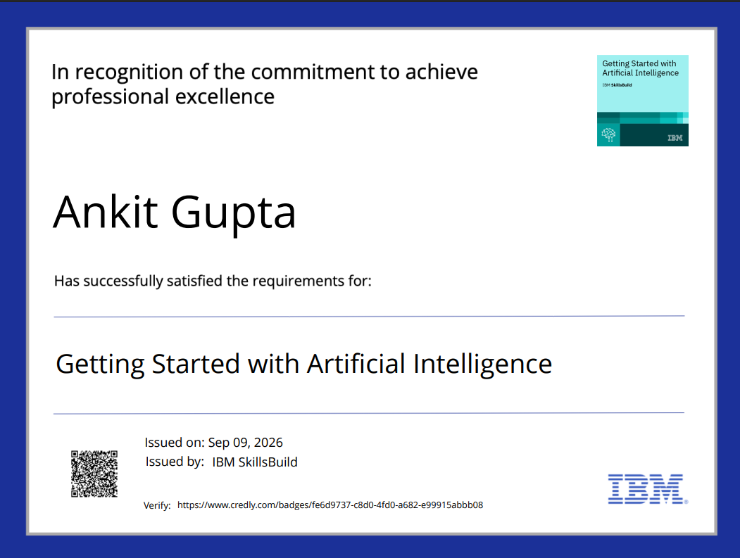
Certificates Earned:

Slide 18
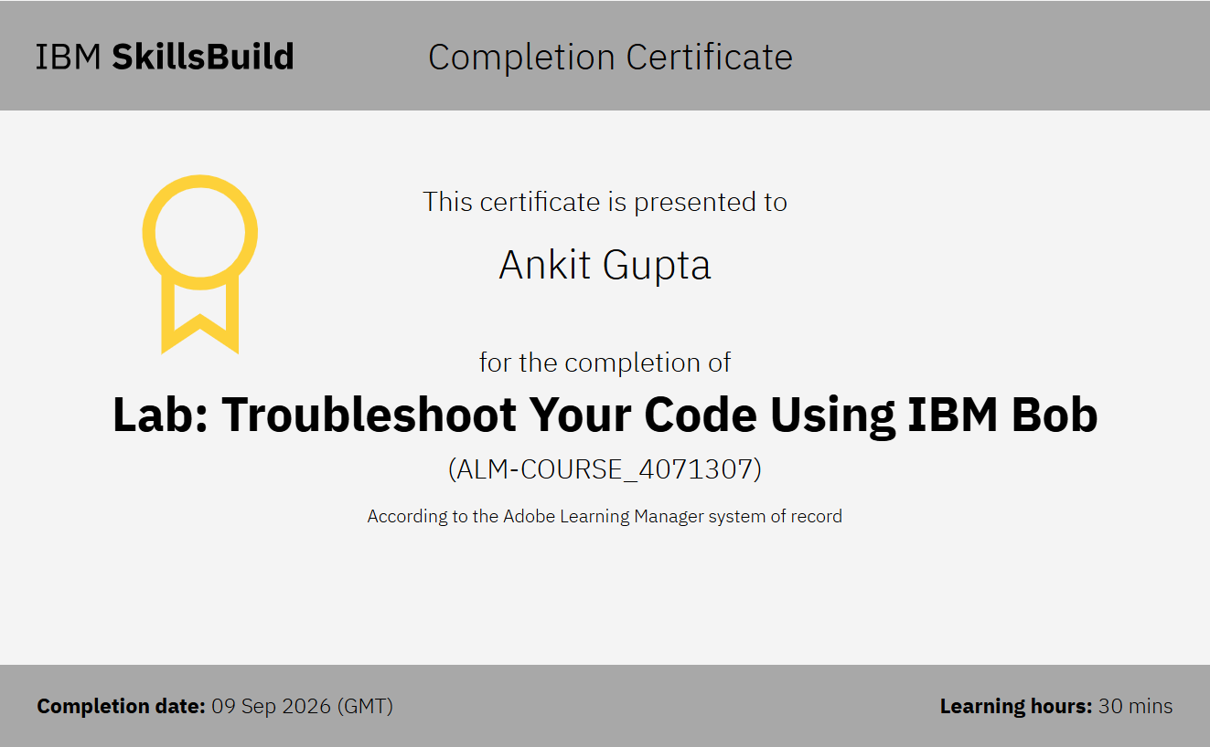
Certificates Earned:​

Slide 19


