Slide 1
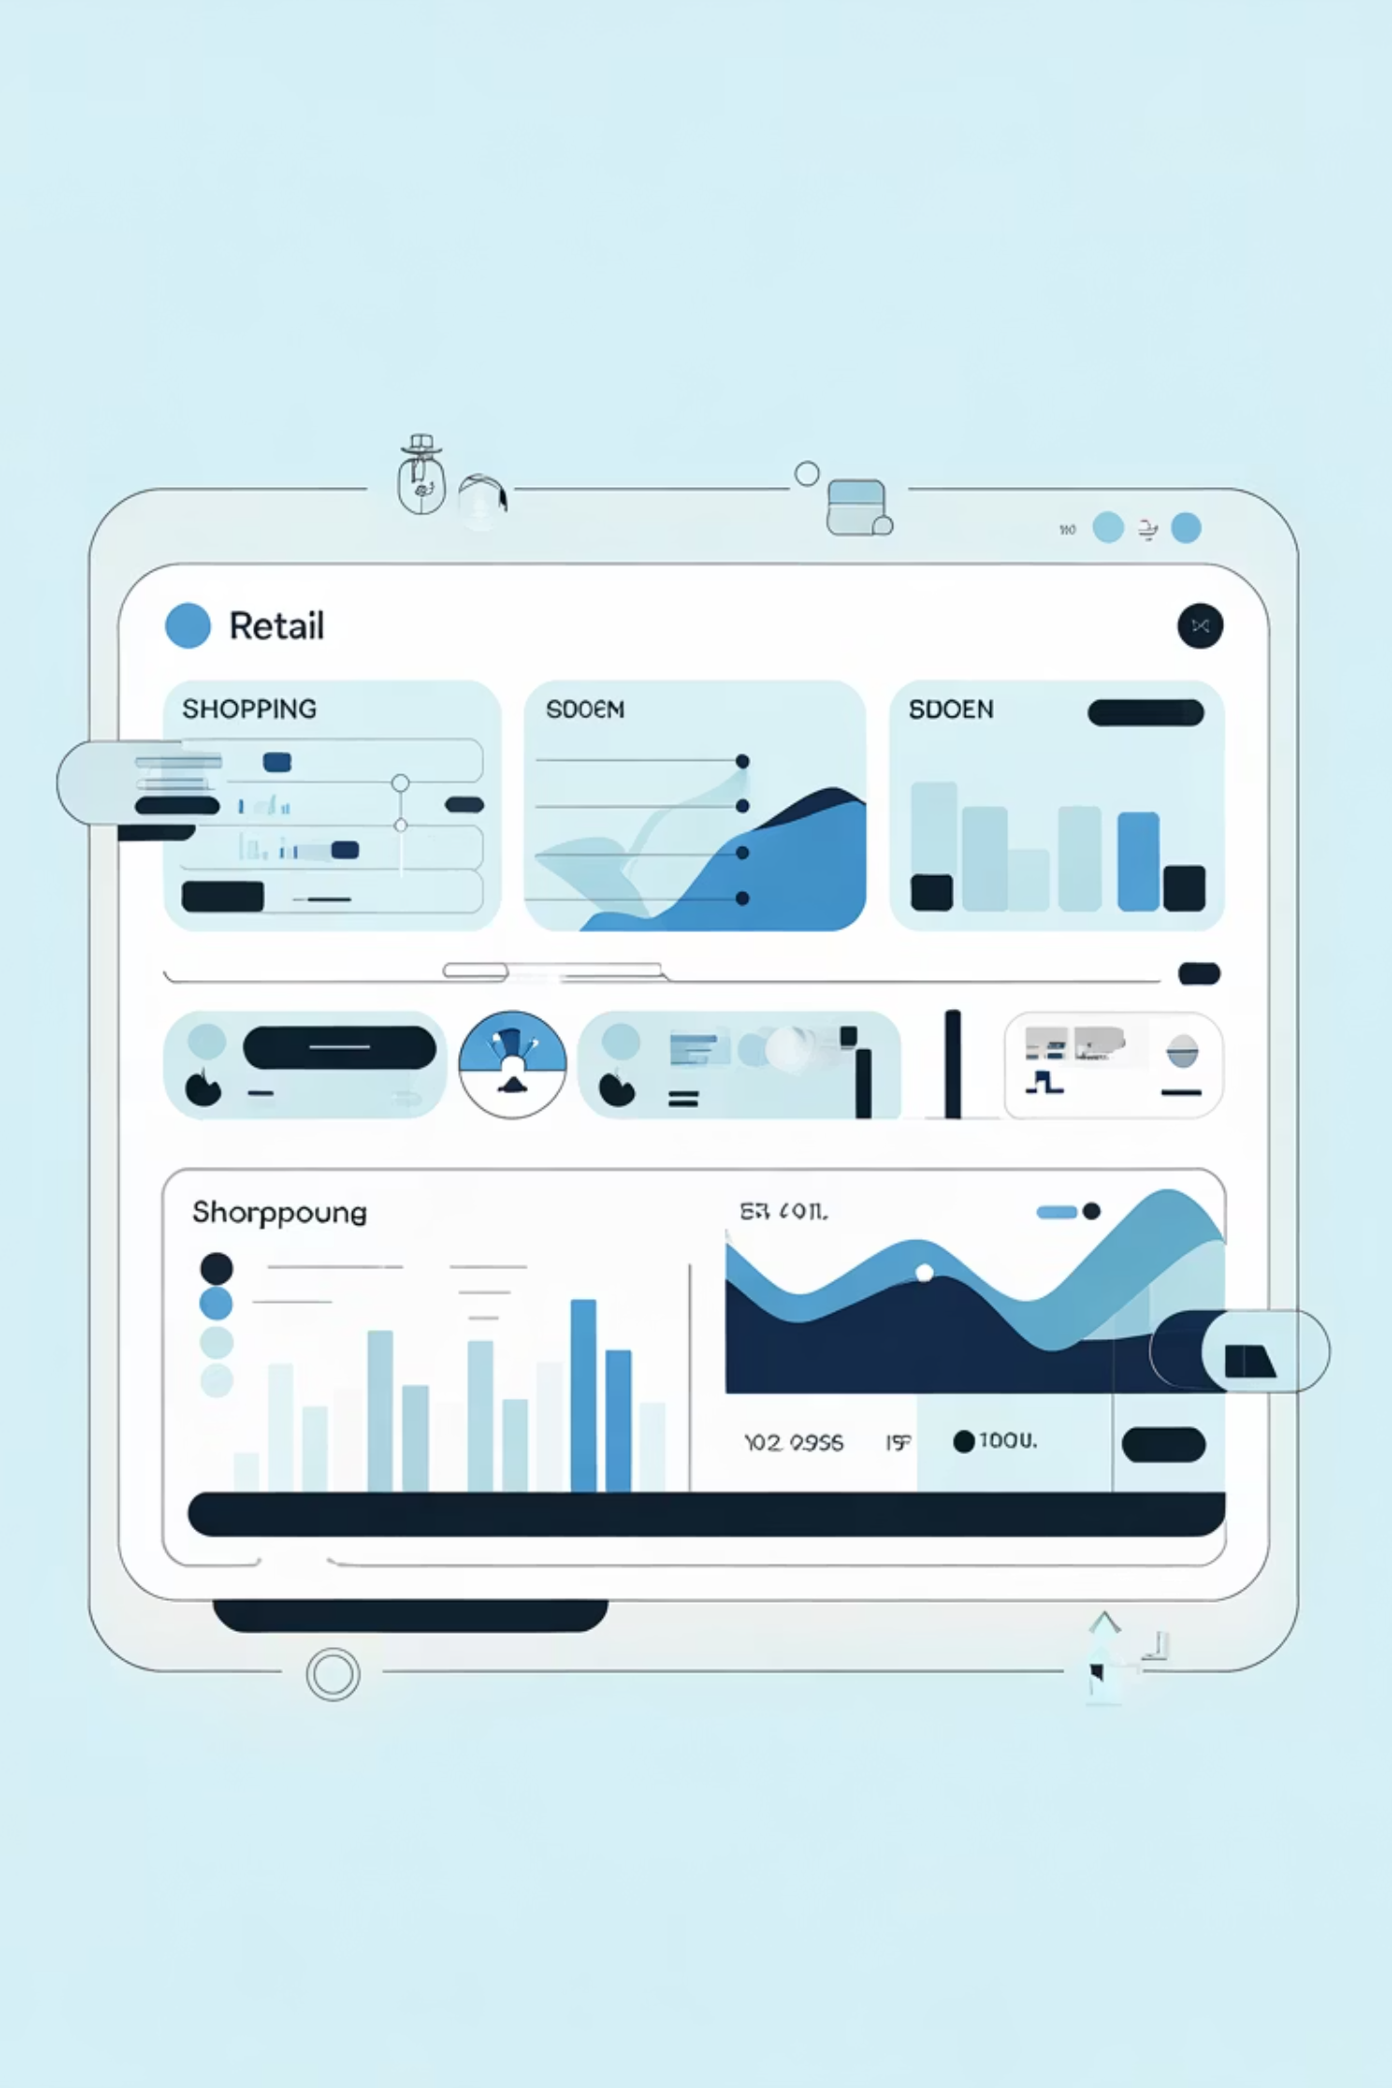
Customer Shopping Behavior Analysis
Uncovering insights from 3,900 purchases to drive strategic business decisions

Slide 2
Dataset Overview
3,900
18
50
25
Total Purchases
Data Points
Locations
Products
Transactions analyzed across all categories
Columns tracking customer behavior
Geographic coverage nationwide
Unique items purchased
Customer Demographics
Shopping Behavior
Age, Gender, Location
Purchase patterns & frequency
Subscription Status
Discount usage & ratings

Slide 3
Data Preparation Journey
01
02
03
Data Loading
Initial Exploration
Missing Data Handling
Imported dataset using pandas for analysis
Checked structure and summary statistics
Imputed 37 missing review ratings using median
04
05
Feature Engineering
Database Integration
Created age groups and purchase frequency columns
Connected to PostgreSQL for SQL analysis

Slide 4
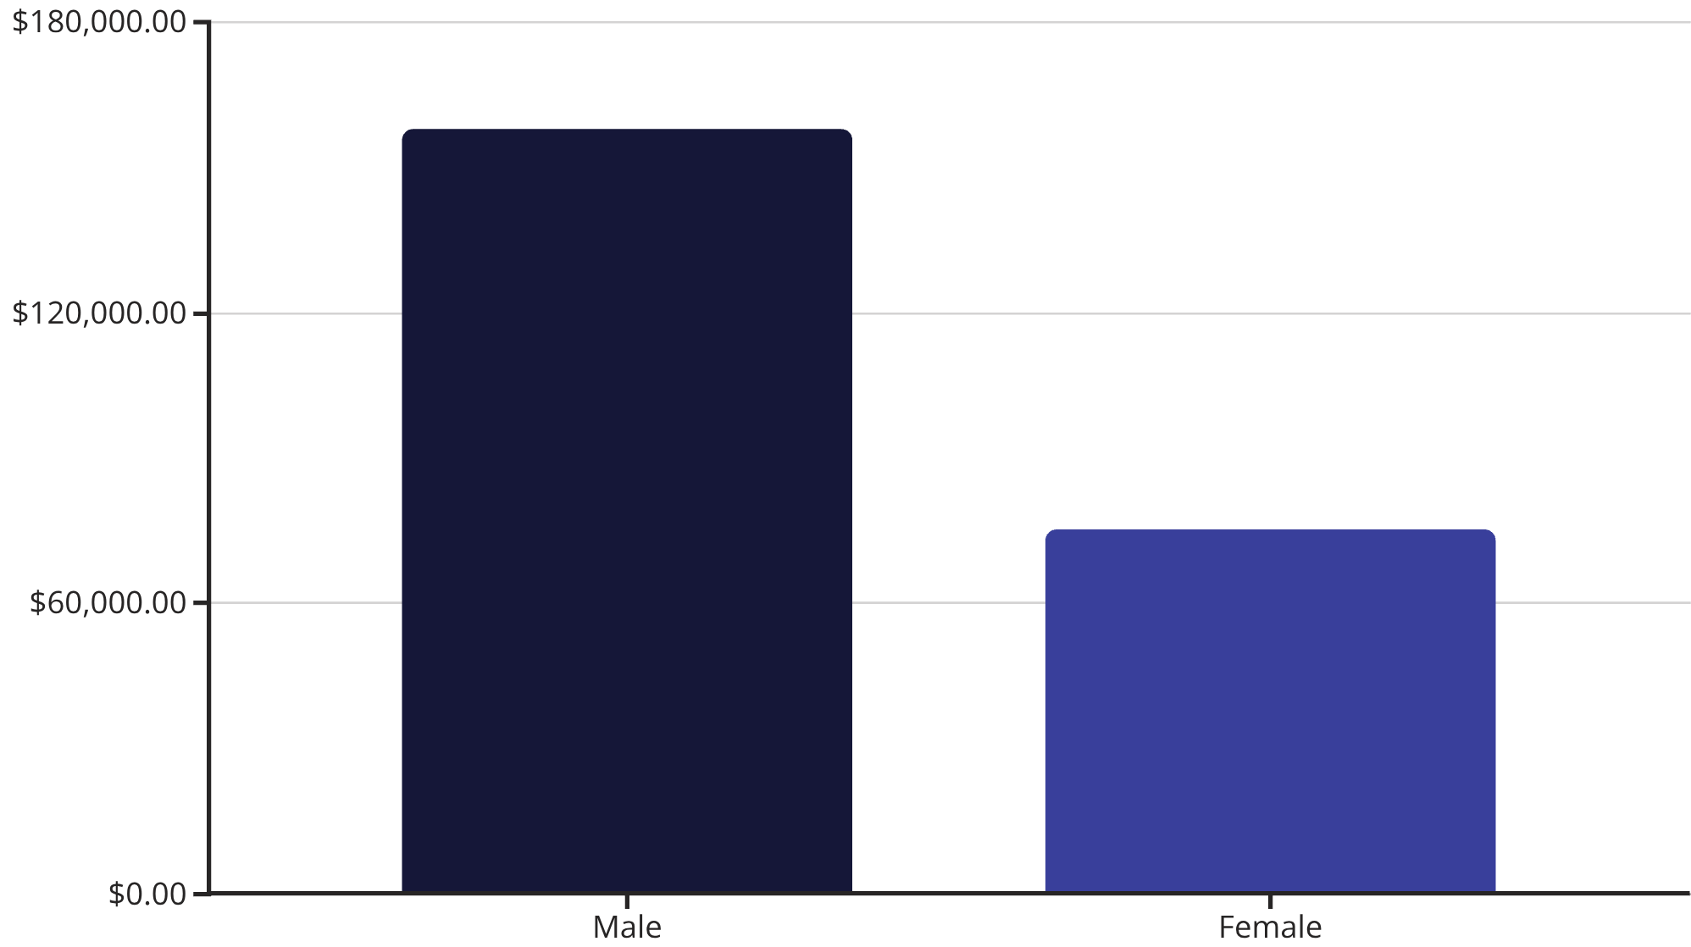
Revenue Insights
Gender Revenue Gap
Male customers generate 2.1x more revenue than female customers
Opportunity to boost female customer engagement

Slide 5

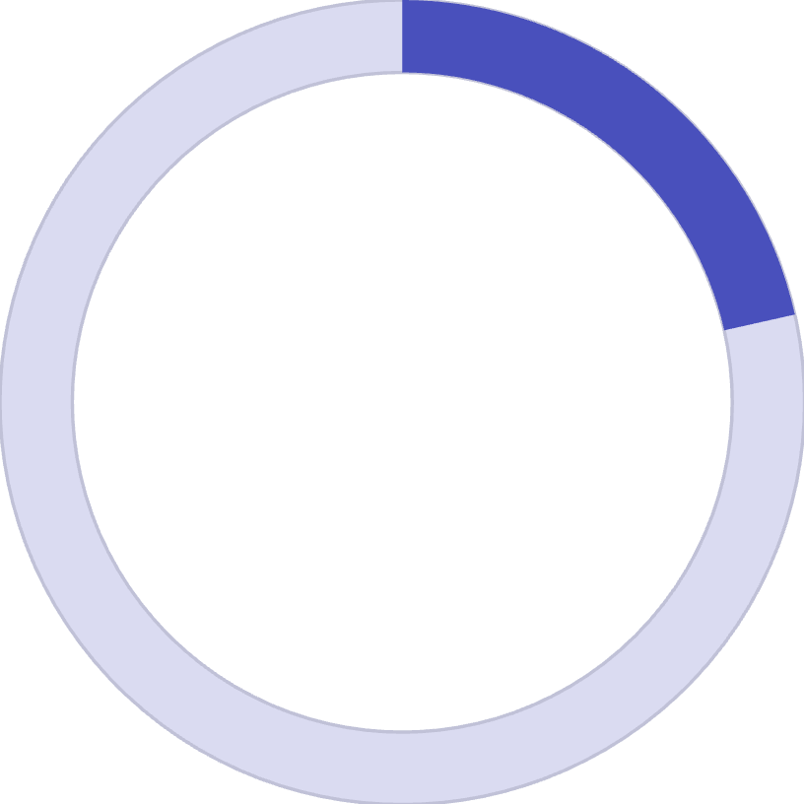
Smart Discount Users
839
21.5%
High-Value Discount Shoppers
Percentage of Total
Customers using discounts while spending above average
Strategic discount users who maximize value
Key Finding
Business Impact
Discounts don't always mean lower revenue—many high spenders use promotions strategically
Discount policy should balance sales volume with margin protection

Slide 6


Top-Rated Products
Gloves
Sandals
Boots
3.86 average rating
3.84 average rating
3.82 average rating
Hat
Skirt
3.80 average rating
3.78 average rating
Marketing Opportunity: Highlight these top-rated products in campaigns to drive conversions

Slide 7



Customer Segmentation
New
83 customers
Returning
701 customers
Loyal
3,116 customers
80% of customers are loyal — strong retention foundation with opportunity to convert returning customers

Slide 8
Subscription Analysis
Subscribers
Non-Subscribers
1,053 customers
2,847 customers
$59.49 average spend
$59.87 average spend
$62,645 total revenue
$170,436 total revenue
31%
Repeat Buyers with Subscriptions
958 of 3,116 loyal customers subscribe
Massive opportunity: 69% of loyal customers don't subscribe

Slide 9
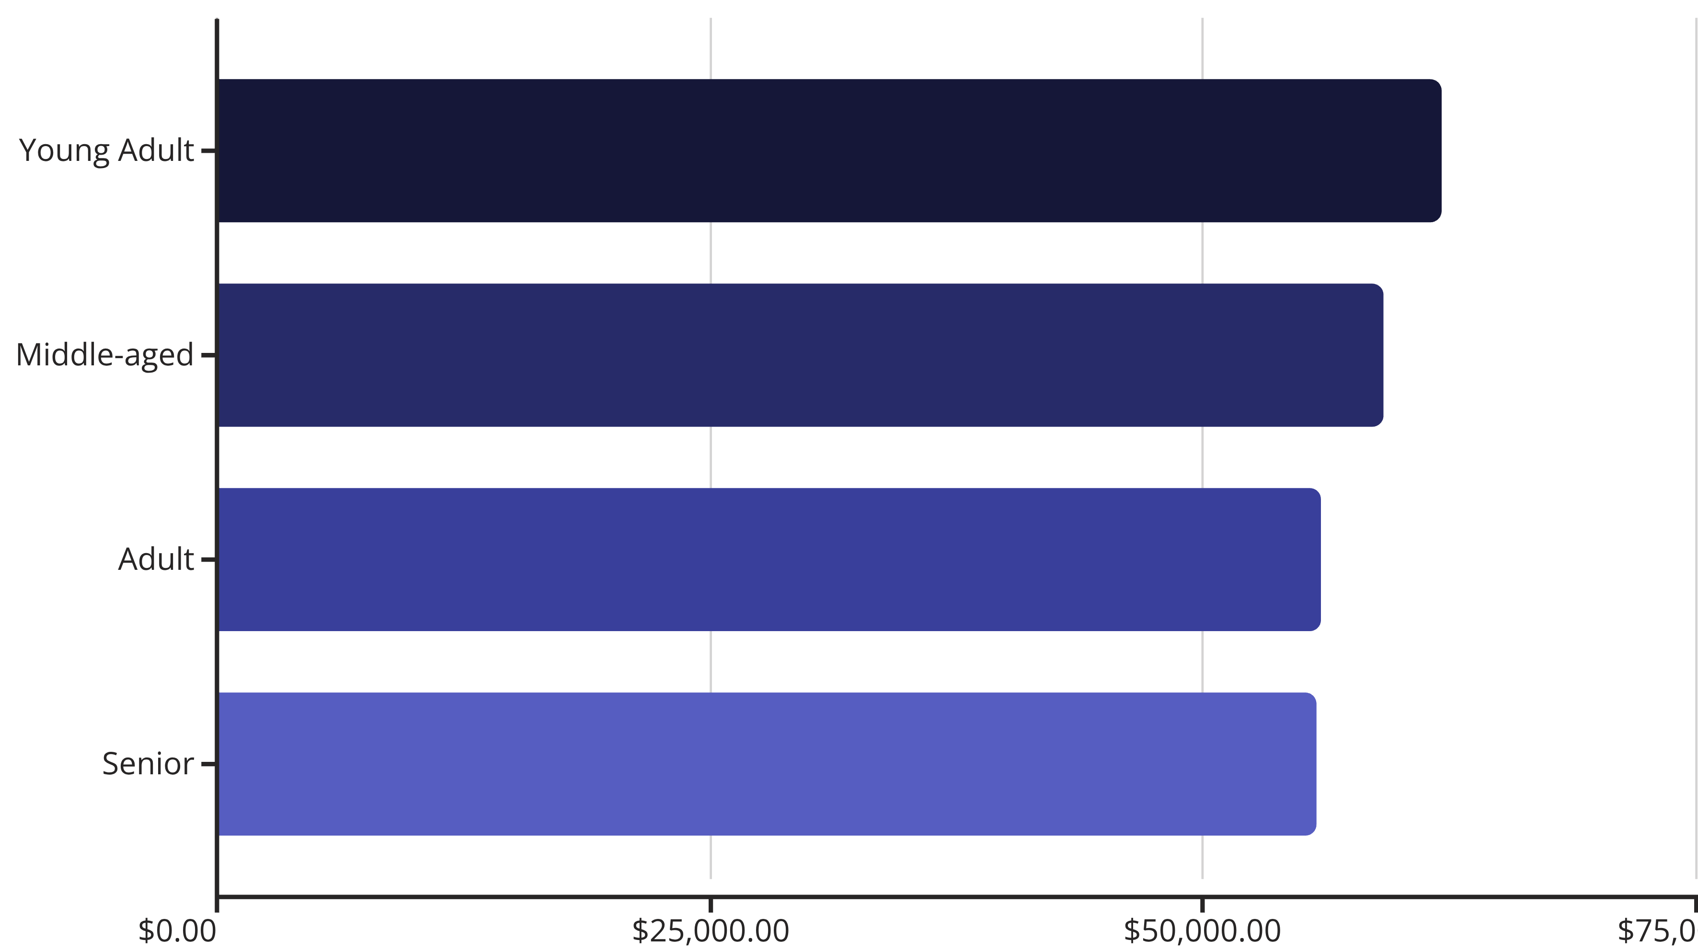
Revenue by Age Group
Young adults drive highest revenue—target marketing efforts toward this demographic

Slide 10
Strategic Recommendations
Boost Subscriptions
Customer Loyalty Programs
Review Discount Policy
Promote exclusive benefits to convert 2,158 loyal non-subscribers
Balance promotional sales boosts with margin control strategies
Reward repeat buyers to accelerate movement into loyal segment
Product Positioning
Targeted Marketing
Highlight top-rated products like gloves and sandals in campaigns
Focus on young adults and express shipping users for maximum ROI

