Slide 1
Terraform – BackendS
Local backend

Slide 2

Terraform with azure
v0.1.0
Zero to hero
Ravikanth Chaganti

Slide 3
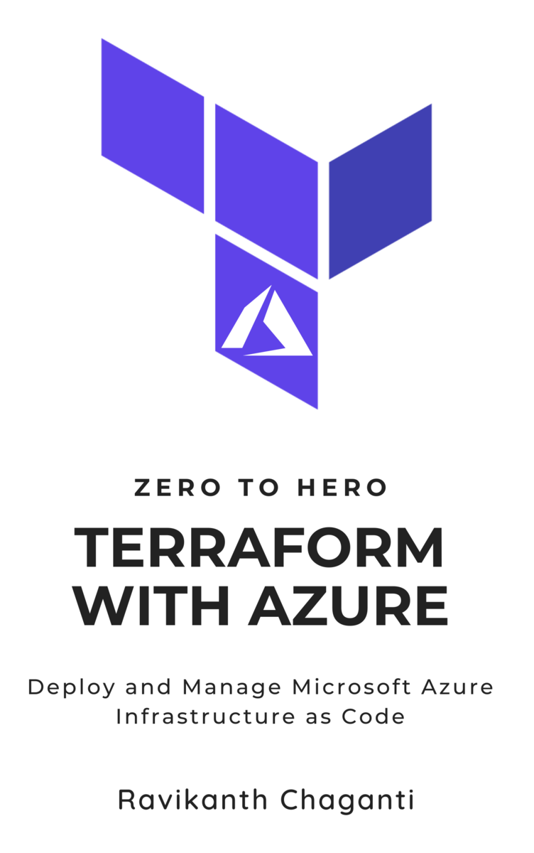
About me
Distinguished Member Technical Staff at Dell EMC
Automation fanatic
Microsoft MVP
Published Author
https://leanpub.com/tfaz02h

Slide 4
Agenda
Infrastructure As Code (IaC)
Terraform – Basics
Terraform with Azure
Authentication
Basic Configuration
Expressions
Modules
Workspaces
Backends
Testing and CI & CD

Slide 5
Prerequisites
Terraform
Microsoft Azure Subscription
Contributor level access
Azure CLI
Visual Studio Code
Hashicorp Terraform extension
Azure Terraform extension
GitHub account for Ci & CD
Demo code from https://github.com/rchaganti/tfaz02h

Slide 6





Module 01 – Infrastructure as code
Why terraform?

Slide 7

Devops and infrastructure as code
Knight Capital lost ~$440 million in 45 minutes
Planned to replace legacy unused code with improved pricing algorithm
New code repurposed an old flag that was used to activate legacy unused code
New code was manually deployed all servers except one!
All hell broke loose when the 8th server activated the legacy code and resulted in Knight Capital losing millions of dollars!
Source: Knightmare: A DevOps Cautionary Tale – Doug Seven

Slide 8
Devops and infrastructure as code
Lesson Learned:
Deploying to production the rightway is as important as building a great product
Eliminate human error: deployments have to be totally automated
Implementing DevOps practices could have prevented this Knightmare
Source: Knightmare: A DevOps Cautionary Tale – Doug Seven

Slide 9
Devops and infrastructure as code
Build
Deploy
Test
Release
Develop
DevOps is a set of practices that combines software development (Dev) and IT operations (Ops). It aims to shorten the systems development life cycle and provide continuous delivery with high software quality. DevOps is complementary with Agile software development; several DevOps aspects came from Agile methodology.

Slide 10
Devops and infrastructure as code
Build
Deploy
Test
Release
Develop
Apart from collaboration and effective communication between Development and Operations, automation is key to realizing goals of DevOps
Automation in the DevOps == Infrastructure as Code (IaC)
IaC can be classified as:
Ad-hoc scripts
Configuration management
Server Templating
Provisioning

Slide 11
IAC - Principles
Imperative vs Declarative
Idempotency
Immutability
Modularized
Version controlled

Slide 12
Module 02 – Terraform
Getting started

Slide 13
Terraform - Introduction
Provisioning tool
Single binary download
Currently v0.13.5
Supports provisioning to multiple clouds and on-premises infrastructure through plugin model
Uses HashiCorp Configuration Language (HCL)
Two editions: Free and Enterprise
Terraform cloud enables complete end-to-end workflow

Slide 14
Hands On
Download and Install terraform

Slide 15

Terraform Overview
Terraform Registry
Plugins
Providers
Provisioners
azurerm
remote_exec
Resources
Data Sources
azure_resource_group
azurerm_image
azure_virtual_machine
azurerm_public_ips

Slide 16
Terraform - Concepts
Configuration file components
Execution Plan
Resource Graph
State

Slide 17
Terraform configuration
provider "provider-type" {
attribute = "value"
}
variable "variable-identifier" {
description = "some variable"
default = "something"
type = "supported-type"
}
locals {
some-name = "some-value"
}
resource "resource-type" "resource-identifier" {
attribute = "value"
}
data "data-source-type" "data-source-identifier" {
attribute = "value"
}
output "output-identifier" {
value = "some-expression"
}
Provider defines the type of infrastructure you are deploying
Variable is an input parameter; equivalent to parameters in ARM templates
Locals are local key-value pairs in a configuration; equivalent to variables in ARM templates
Resource identifies what resource within the infrastructure you want to provision or configure
Data defines any dependent data set that you need in the configuration
Output identifies the values that you want to return after the configuration is provisioned

Slide 18
Hands On
Basic Terraform configuration

Slide 19



configuration lifecycle
init
.terraform
plan
destroy
apply
main.tf
main.tfplan
main.tfstate
terraform.tfvars

Slide 20
Hands On
Terraform configuration workflow

Slide 21
Module 03 – Terraform with azure
authentication

Slide 22
Authenticating with Azure
Azure Cloud Shell
Azure CLI
Azure Service Principal – Client Secret
Azure Service Principal – Client Certificate
Azure Managed System Identity (MSI)

Slide 23
Azure Cloud Shell
Built into the Azure portal
Can be accessed via Visual Studio Code
Pre-authenticated
Comes with latest provisioning and configuration management tools
Terraform
Ansible
Azure CLI
Azure PowerShell
For interactive use!

Slide 24
Hands On
Terraform in Cloud Shell

Slide 25
Azure Service Principal – Client Secret
Uses Azure Active Directory application service principal
Client secret and client ID are required
Specified as a part of provider configuration
Specified as environment variables
Good for automated deployments via CI & CD

Slide 26
Hands On
Terraform and client secret authentication

Slide 27
Azure Service Principal – Client Certificate
Uses Azure Active Directory application service principal with client ceritificate
Client secret and certificate PFX are required
Specified as a part of provider configuration
Specified as environment variables
Good for automated deployments via CI & CD

Slide 28
Hands On
Terraform and client Certificate authentication

Slide 29
Azure Service Principal – Managed System Identity
Uses Managed System Identity Endpoint in an Azure resource
Can either be user assigned or system assigned
Terraform configuration must execute in the context of the Azure resource with assigned identity
Good for interactive use

Slide 30
Hands On
Terraform and Managed system identity

Slide 31
Module 04 – Terraform with azure
Basic azure configuration

Slide 32
Hands On
Terraform – Basic Linux VM Configuration

Slide 33
Module 05 – Terraform with azure
Expressions and Functions

Slide 34
Terraform - Expressions and Functions
Conditional and loop expressions can be used to create dynamic configurations
Conditionals : Expressions - Configuration Language - Terraform by HashiCorp
For : Expressions - Configuration Language - Terraform by HashiCorp
Count parameter can be used to create multiple instances of a resource
HCL supports a wide range of built-in functions: Functions - Configuration Language - Terraform by HashiCorp

Slide 35
Terraform - Conditionals
Uses ternary operator syntax
Syntax: condition ? true_val : false_val
If condition is true then the result is true_val. If condition is false then the result is false_val.
Example: var.a != "" ? var.a : "default-a”
Any of the equality, comparison, and logical operators can be used to define the condition

Slide 36
Hands On
Terraform – Conditionals

Slide 37
Terraform – For Expression
A for expression creates a complex type value by transforming another complex type value
The type of brackets around the for expression decide what type of result it produces.
[] produces a tuple : [for s in var.list : upper(s)]
{} produces an object: {for s in var.list : s => upper(s)}
A for expression can also include an optional if clause to filter elements from the source collection
[for s in var.list : upper(s) if s != ""]

Slide 38
Hands On
Terraform – For Expression

Slide 39
Module 06 – Terraform with azure
Modules

Slide 40
Terraform - Modules
A module is a container for multiple resources that are used together
Every Terraform configuration has at least one module – root module.
A module can call other modules
Modules can also be called multiple times within same or separate configurations
Must re-run terraform init after adding/removing/updating module blocks

Slide 41
Hands On
Terraform – Modules

Slide 42
Module 07 – Terraform with azure
Backends & Workspaces

Slide 43
Terraform - BAckends
Terraform state file contains the information that Terraform “knows” about your infrastructure
Stored in terraform.tfstate file
DON’T EVER DELETE STATE FILE!
Local state file may be good enough for local / personal projects
When in a team, you will run into:
Shared storage for state files
Locking of state files
Isolating state files
Remote backends solve these issues

Slide 44
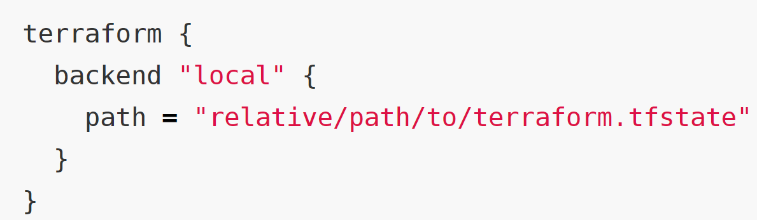
Terraform – BackendS
Local backend
Remote backend
Azure
AWS S3
Consul
….

Slide 45
Hands On
Terraform – Azure backend

Slide 46
Terraform – Workspaces
Remote backends solve the problem of locking and enable collaboration
However, state isolation is still a problem.
Especially, when there are multiple environments to deploy to.
This is where workspaces play a role
Default workspace always exists and cannot be deleted.
New workspaces can be created
Backend initialization must be complete

Slide 47
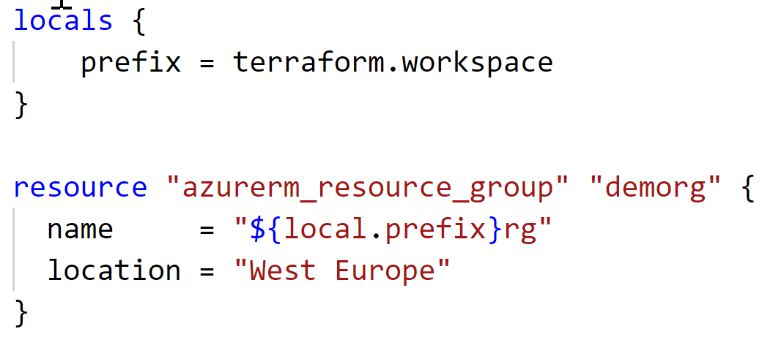
Terraform – Workspaces
Workspaces can be used to dynamically change configuration parameters.
For example count = terraform.workspace == “staging” ? 4 : 6

Slide 48
Hands On
Workspaces

Slide 49
Module 08 – Terraform with azure
Testing and CI & CD

Slide 50
Terraform - TEsting
Built-in “terraform validate” ensures that the syntax is correct
You must perform test deployment to ensure that the configuration is functionally correct
Use state isolation
You must have CI & CD implemented for Terraform configurations
GitHub actions is a good place to start

Slide 51
Hands On
Testing, CI & CD

Slide 52

Thank You
@ravikanth

