Slide 1
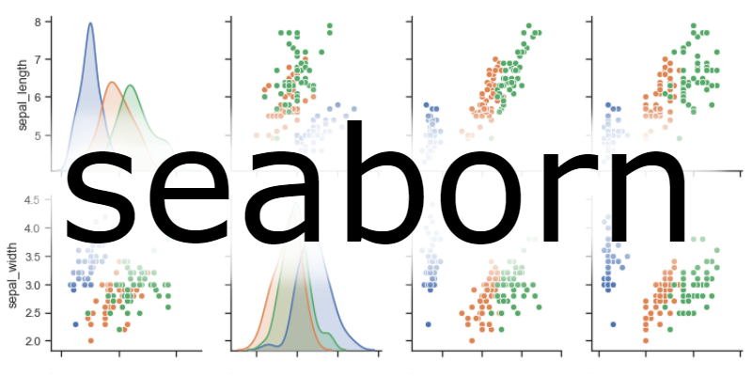

Slide 2

Seaborn: Python
Seaborn is a library in Python predominantly used for making statistical graphics.
Seaborn is a data visualization library built on top of matplotlib and closely integrated with pandas data structures in Python

Slide 3
Seaborn offers the following functionalities
Dataset oriented API to determine the relationship between variables.
Automatic estimation and plotting of linear regression plots.
It supports high-level abstractions for multi-plot grids.
Visualizing univariate and bivariate distribution.

Slide 4
Seaborn offers wide varieties of plots
Distribution Plots
Pie Chart & Bar Chart
Scatter Plots
Pair Plots
Heat maps

