Slide 1
Classification

Slide 2
Classification Algorithm
The Classification algorithm is a Supervised Learning technique that is used to identify the category of new observations based on training data.
In Classification, a program learns from the given dataset or observations and then classifies new observation into several classes or groups. Such as, Yes or No, 0 or 1, Spam or Not Spam, cat or dog, etc.
Classes can be called as targets/labels or categories.
Unlike regression, the output variable of Classification is a category, not a value, such as "Green or Blue", "fruit or animal", etc.

Slide 3
Classification Algorithm
Since the Classification algorithm is a Supervised learning technique, hence it takes labeled input data, which means it contains input with the corresponding output.
In classification algorithm, a discrete output function(y) is mapped to input variable(x).
y=f(x), where y = categorical output
The best example of an ML classification algorithm is Email Spam Detector.
The main goal of the Classification algorithm is to identify the category of a given dataset, and these algorithms are mainly used to predict the output for the categorical data.

Slide 4
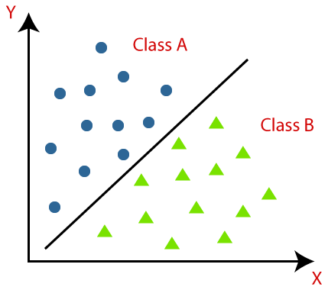
Classification Algorithm
Classification algorithms can be better understood using the diagram. In the diagram, there are two classes, class A and Class B. These classes have features that are similar to each other and dissimilar to other classes.

Slide 5
Classification Algorithm
The algorithm which implements the classification on a dataset is known as a classifier.
There are two types of Classifications:
Binary Classifier: If the classification problem has only two possible outcomes, then it is called as Binary Classifier.
Examples: YES or NO, MALE or FEMALE, SPAM or NOT SPAM, CAT or DOG, etc.

Slide 6
Classification Algorithm
The algorithm which implements the classification on a dataset is known as a classifier.
There are two types of Classifications:
Multi-class Classifier: If a classification problem has more than two outcomes, then it is called as Multi-class Classifier.
Example: Classifications of types of crops, Classification of types of music.

Slide 7
Learners in Classification Problems
Lazy Learners:
Lazy Learner firstly stores the training dataset and wait until it receives the test dataset.
In Lazy learner case, classification is done on the basis of the most related data stored in the training dataset.
It takes less time in training but more time for predictions.
Example: K-NN algorithm, Case-based reasoning

Slide 8
Learners in Classification Problems
Eager Learners:
Eager Learners develop a classification model based on a training dataset before receiving a test dataset.
Opposite to Lazy learners, Eager learners take more time in training and less time in prediction.
Example: Decision Trees, Naïve Bayes, ANN.

Slide 9
Types of Classification Algorithms
Linear Models
Logistic Regression
Support Vector Machines
Non-linear Models
K-Nearest Neighbours
Kernel SVM
Naïve Bayes
Decision Tree Classification
Random Forest Classification

Slide 10
Evaluating a Classification model
Log Loss or Cross-Entropy Loss:
It is used for evaluating the performance of a classifier, whose output is a probability value between the 0 and 1.
For a good binary Classification model, the value of log loss should be near to 0.
The value of log loss increases if the predicted value deviates from the actual value.
The lower log loss represents the higher accuracy of the model.

Slide 11

Evaluating a Classification model
2. Confusion Matrix:
The confusion matrix provides us a matrix/table as output and describes the performance of the model.
It is also known as the error matrix.
The matrix consists of predictions result in a summarized form, which has a total number of correct predictions and incorrect predictions.
 | Actual Positive | Actual Negative
Predicted Positive | True Positive | False Positive
Predicted Negative | False Negative | True Negative

Slide 12
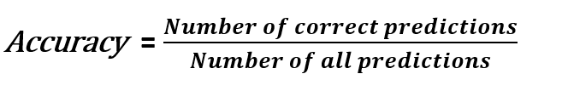
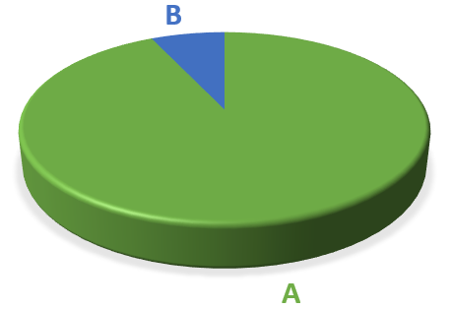
Evaluating a Classification model
3. Classification accuracy :
Classification accuracy shows how many of the predictions are correct.
We have a model that only predicts class A. It is hard to even call it a “model” because it predicts class A without any calculation. However, since 93% of the samples are in class A, the accuracy of our model is 93%.
What if it is crucial to detect class B correctly and we cannot afford to misclassify any class B samples (i.e., cancer prediction)? In these cases, we need other metrics to evaluate our model.

Slide 13



Evaluating a Classification model
4. Precision and Recall:
Precision measures how good our model is when the prediction is positive.
The focus of precision is positive predictions. It indicates how many positive predictions are true.
Recall measures how good our model is at correctly predicting positive classes.
The focus of recall is actual positive classes. It indicates how many of the positive classes the model is able to predict correctly.

Slide 14

Evaluating a Classification model
5. F1 Score:
F1 score is the weighted average of precision and recall.
F1 score is a more useful measure than accuracy for problems with uneven class distribution because it takes into account both false positive and false negatives.
The best value for f1 score is 1 and the worst is 0.

Slide 15
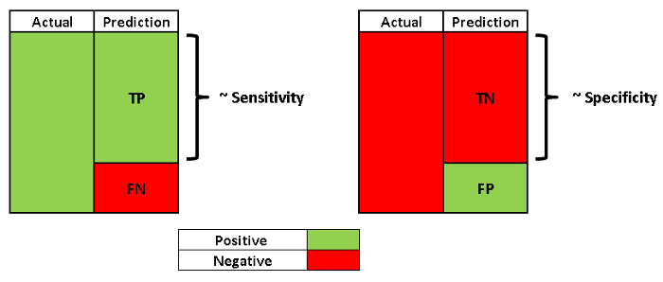
Evaluating a Classification model
6. Sensitivity and Specificity:
Sensitivity, also known as the true positive rate (TPR), is the same as recall. Hence, it measures the proportion of positive class that is correctly predicted as positive.
Specificity is similar to sensitivity but focused on negative class. It measures the proportion of negative class that is correctly predicted as negative.

Slide 16
Evaluating a Classification model
7. AUC-ROC curve:
ROC curve stands for Receiver Operating Characteristics Curve and AUC stands for Area Under the Curve.
It is a graph that shows the performance of the classification model at different thresholds.
To visualize the performance of the multi-class classification model, we use the AUC-ROC Curve.
The ROC curve is plotted with TPR and FPR, where TPR (True Positive Rate) on Y-axis and FPR(False Positive Rate) on X-axis.

Slide 17
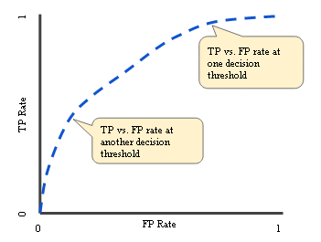
Evaluating a Classification model
7. AUC-ROC curve:
The ROC curve is plotted with TPR and FPR, where TPR (True Positive Rate) on Y-axis and FPR(False Positive Rate) on X-axis.

Slide 18
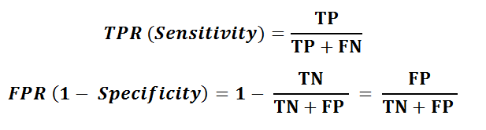
Evaluating a Classification model
7. AUC-ROC curve:
If the threshold is set to 0, the model predicts all samples as positive. In this case, TPR (sensitivity) is 1. However, FPR(1-specificity) is also 1 because there is no negative prediction. If the threshold is set to 1, both TPR and FPR become 0. Hence, it is not a good choice to set the threshold to 0 or 1.

Slide 19
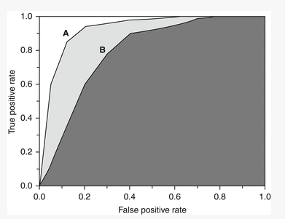
Evaluating a Classification model
7. AUC-ROC curve:
We can use another metric called AUC (Area under the curve).
AUC is the area under ROC curve between (0,0) and (1,1) which can be calculated using integral calculus.
AUC basically aggregates the performance of the model at all threshold values. The best possible value of AUC is 1 which indicates a perfect classifier.
The closer the AUC is to 1, the better the classifier is. In the figure below, classifier A is better than classifier B.

Slide 20
Use cases of Classification Algorithms
Email Spam Detection
Speech Recognition
Identifications of Cancer tumor cells.
Drugs Classification
Biometric Identification, etc.

