Slide 1

Decision Tree Classification

Slide 2
Decision Tree Classification
It is a tree-structured classifier, where internal nodes represent the features of a dataset, branches represent the decision rules, and each leaf node represents the outcome.
In a Decision tree, there are two nodes, which are the Decision Node and Leaf Node. Decision nodes are used to make any decision and have multiple branches, whereas Leaf nodes are the output of those decisions and do not contain any further branches.
The decisions or the test are performed on the basis of features of the given dataset.

Slide 3
Decision Tree Classification
It is a graphical representation for getting all the possible solutions to a problem/decision based on given conditions.
It is called a decision tree because, similar to a tree, it starts with the root node, which expands on further branches and constructs a tree-like structure.
In order to build a tree, we use the CART algorithm, which stands for Classification and Regression Tree algorithm.
A decision tree simply asks a question and based on the answer (Yes/No), it further split the tree into subtrees.

Slide 4


Decision Tree Classification

Slide 5
Why use Decision Trees?
Decision Trees usually mimic human thinking ability while making a decision, so it is easy to understand.
The logic behind the decision tree can be easily understood because it shows a tree-like structure.

Slide 6
Decision Tree Terminologies
Root Node: Root node is from where the decision tree starts. It represents the entire dataset, which further gets divided into two or more homogeneous sets.
Leaf Node: Leaf nodes are the final output node, and the tree cannot be segregated further after getting a leaf node.
Splitting: Splitting is the process of dividing the decision node/root node into sub-nodes according to the given conditions.

Slide 7
Decision Tree Terminologies
Branch/Sub Tree: A tree formed by splitting the tree.
Pruning: Pruning is the process of removing the unwanted branches from the tree.
Parent/Child node: The root node of the tree is called the parent node, and other nodes are called the child nodes.

Slide 8
How does the Decision Tree algorithm Work?
Step-1: Begin the tree with the root node, says S, which contains the complete dataset.
Step-2: Find the best attribute in the dataset using Attribute Selection Measure (ASM).
Step-3: Divide the S into subsets that contains possible values for the best attributes.
Step-4: Generate the decision tree node, which contains the best attribute.
Step-5: Recursively make new decision trees using the subsets of the dataset created in step -3. Continue this process until a stage is reached where you cannot further classify the nodes and called the final node as a leaf node.

Slide 9
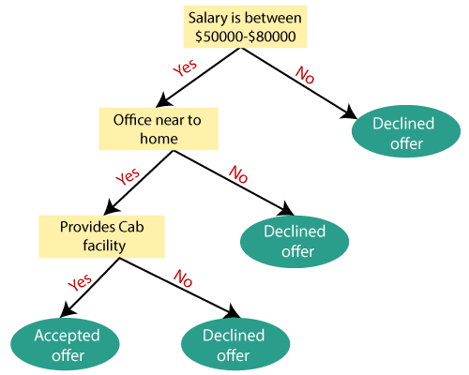
Decision Tree algorithm

Slide 10
Attribute Selection Measures
While implementing a Decision tree, the main issue arises that how to select the best attribute for the root node and for sub-nodes.
So, to solve such problems there is a technique which is called as Attribute selection measure or ASM.
By this measurement, we can easily select the best attribute for the nodes of the tree. There are two popular techniques for ASM, which are:
Information Gain
Gini Index

Slide 11
Attribute Selection Measures
Information Gain:
Information gain is the measurement of changes in entropy after the segmentation of a dataset based on an attribute.
It calculates how much information a feature provides us about a class.
According to the value of information gain, we split the node and build the decision tree.
A decision tree algorithm always tries to maximize the value of information gain, and a node/attribute having the highest information gain is split first. It can be calculated using the below formula:
Information Gain= Entropy(S)- [(Weighted Avg) * Entropy(each feature)

Slide 12
Attribute Selection Measures
Information Gain= Entropy(S)- [(Weighted Avg) *Entropy(each feature)
Entropy: Entropy is a metric to measure the impurity in a given attribute. It specifies randomness in data. Entropy can be calculated as:
Entropy(s)= -P(yes)log2 P(yes)- P(no) log2 P(no)
Where,
S= Total number of samples
P(yes)= probability of yes
P(no)= probability of no

Slide 13
Information Gain & entropy
We can define a function to calculate the entropy of a group of samples based on the ratio of samples that belong to class 0 and class 1.
# calculate the entropy for the split in the dataset
def entropy(class0, class1):
return -(class0 * log2(class0) + class1 * log2(class1))

Slide 14
Information Gain & entropy
consider a dataset with 20 examples, 13 for class 0 and 7 for class 1.
# split of the main dataset
class0 = 13 / 20
class1 = 7 / 20
# calculate entropy before the change
s_entropy = entropy(class0, class1)
print('Dataset Entropy: %.3f bits' % s_entropy)

Slide 15
Information Gain & entropy
Now consider that one of the variables in the dataset has two unique values, say “value1” and “value2.” We are interested in calculating the information gain of this variable.
Let’s assume that if we split the dataset by value1, we have a group of eight samples, seven for class 0 and one for class 1. We can then calculate the entropy of this group of samples.
# split 1 (split via value1)
s1_class0 = 7 / 8
s1_class1 = 1 / 8
# calculate the entropy of the first group
s1_entropy = entropy(s1_class0, s1_class1)
print('Group1 Entropy: %.3f bits' % s1_entropy)

Slide 16
Information Gain & entropy
Now, let’s assume that we split the dataset by value2; we have a group of 12 samples with six in each group. We would expect this group to have an entropy of 1.
# split 2 (split via value2)
s2_class0 = 6 / 12
s2_class1 = 6 / 12
# calculate the entropy of the second group
s2_entropy = entropy(s2_class0, s2_class1)
print('Group2 Entropy: %.3f bits' % s2_entropy)

Slide 17
Information Gain & entropy
The first variable resulted in a group of eight examples from the dataset, and the second group had the remaining 12 samples in the data set. Therefore, we have everything we need to calculate the information gain.
In this case, information gain can be calculated as:
Entropy(Dataset) – (Count(Group1) / Count(Dataset) * Entropy(Group1) + Count(Group2) / Count(Dataset) * Entropy(Group2))
Or:
Entropy(13/20, 7/20) – (8/20 * Entropy(7/8, 1/8) + 12/20 * Entropy(6/12, 6/12))

Slide 18
Information Gain & entropy
Or:
Entropy(13/20, 7/20) – (8/20 * Entropy(7/8, 1/8) + 12/20 * Entropy(6/12, 6/12))
Code:
# calculate the information gain
gain = s_entropy - (8/20 * s1_entropy + 12/20 * s2_entropy)
print('Information Gain: %.3f bits' % gain)

Slide 19
Information Gain & entropy
Or:
Entropy(13/20, 7/20) – (8/20 * Entropy(7/8, 1/8) + 12/20 * Entropy(6/12, 6/12))
Code:
# calculate the information gain
gain = s_entropy - (8/20 * s1_entropy + 12/20 * s2_entropy)
print('Information Gain: %.3f bits' % gain)

Slide 20
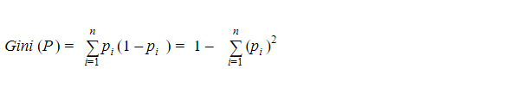
Attribute Selection Measures
Gini Index= 1- ∑_{j}P_{j}²
2. Gini Index:
Gini index is a measure of impurity or purity used while creating a decision tree in the CART(Classification and Regression Tree) algorithm.
An attribute with the low Gini index should be preferred as compared to the high Gini index.
It only creates binary splits, and the CART algorithm uses the Gini index to create binary splits.
Gini index can be calculated using the below formula:
Gini Index= 1- ∑jPj2

Slide 21
Pruning: Getting an Optimal Decision tree
Pruning is a process of deleting the unnecessary nodes from a tree in order to get the optimal decision tree.
A too-large tree increases the risk of overfitting, and a small tree may not capture all the important features of the dataset. Therefore, a technique that decreases the size of the learning tree without reducing accuracy is known as Pruning. There are mainly two types of tree pruning technology used:
Cost Complexity Pruning
Reduced Error Pruning.

Slide 22
Advantages of the Decision Tree
It is simple to understand as it follows the same process which a human follow while making any decision in real-life.
It can be very useful for solving decision-related problems.
It helps to think about all the possible outcomes for a problem.
There is less requirement of data cleaning compared to other algorithms.

Slide 23
Disadvantages of the Decision Tree
The decision tree contains lots of layers, which makes it complex.
It may have an overfitting issue, which can be resolved using the Random Forest algorithm.
For more class labels, the computational complexity of the decision tree may increase.

