Slide 1


Logistic regression

Slide 2
Logistic regression
It is used for predicting the categorical dependent variable using a given set of independent variables.
Logistic regression predicts the output of a categorical dependent variable. Therefore, the outcome must be a categorical or discrete value.
It can be either Yes or No, 0 or 1, true or False, etc. but instead of giving the exact value as 0 and 1, it gives the probabilistic values which lie between 0 and 1.
Logistic Regression is much similar to the Linear Regression except that how they are used. Linear Regression is used for solving Regression problems, whereas Logistic regression is used for solving the classification problems.

Slide 3
Logistic regression
In Logistic regression, instead of fitting a regression line, we fit an "S" shaped logistic function, which predicts two maximum values (0 or 1).
The curve from the logistic function indicates the likelihood of something such as whether the cells are cancerous or not, a mouse is obese or not based on its weight, etc.
Logistic Regression is a significant machine learning algorithm because it has the ability to provide probabilities and classify new data using continuous and discrete datasets.

Slide 4
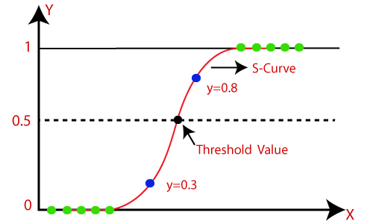
Logistic regression
Logistic Regression can be used to classify the observations using different types of data and can easily determine the most effective variables used for the classification
Note: Logistic regression uses the concept of predictive modeling as regression; therefore, it is called logistic regression, but is used to classify samples; Therefore, it falls under the classification algorithm.

Slide 5
Logistic Function (Sigmoid Function)
The sigmoid function is a mathematical function used to map the predicted values to probabilities.
It maps any real value into another value within a range of 0 and 1.
The value of the logistic regression must be between 0 and 1, which cannot go beyond this limit, so it forms a curve like the "S" form. The S-form curve is called the Sigmoid function or the logistic function.
In logistic regression, we use the concept of the threshold value, which defines the probability of either 0 or 1. Such as values above the threshold value tends to 1, and a value below the threshold values tends to 0.

Slide 6
Assumptions for Logistic Regression
The dependent variable must be categorical in nature.
The independent variable should not have multi-collinearity.

Slide 7


Logistic Regression Equation
We know the equation of the straight line can be written as:
In Logistic Regression y can be between 0 and 1 only, so for this let's divide the above equation by (1-y):
But we need range between -[infinity] to +[infinity], then take logarithm of the equation it will become:

Slide 8
Type of Logistic Regression
On the basis of the categories,
Binomial: In binomial Logistic regression, there can be only two possible types of the dependent variables, such as 0 or 1, Pass or Fail, etc.
Multinomial: In multinomial Logistic regression, there can be 3 or more possible unordered types of the dependent variable, such as "cat", "dogs", or "sheep"
Ordinal: In ordinal Logistic regression, there can be 3 or more possible ordered types of dependent variables, such as "low", "Medium", or "High".

Slide 9
Python Implementation of Logistic Regression (Binomial)
There is a dataset given which contains the information of various users obtained from the social networking sites.
There is a car making company that has recently launched a new SUV car. So the company wanted to check how many users from the dataset, wants to purchase the car.
For this problem, we will build a Machine Learning model using the Logistic regression algorithm.

Slide 10
fit.transform( ) and transform( )
Both are the methods of class sklearn.preprocessing.StandardScaler() and used almost together while scaling or standardizing our training and test data.
We all know that we call fit_transform() method on our training data and transform() method on our test data. But the actual question is why do we do this?
Suppose we are building a k-Nearest Neighbor model and we have to scale our features. The most common way to scale the features is through scikit-learn’s StandardScaler class.

Slide 11

fit.transform( ) and transform( )
Data standardization is the process of rescaling the attributes so that they have mean as 0 and variance as 1.
The ultimate goal to perform standardization is to bring down all the features to a common scale without distorting the differences in the range of the values.
In sklearn.preprocessing.StandardScaler(), centering and scaling happens independently on each feature.
The formula which performs standardization:

Slide 12
fit.transform( )
fit_transform() is used on the training data so that we can scale the training data and also learn the scaling parameters of that data.
Here, the model built by us will learn the mean and variance of the features of the training set. These learned parameters are then used to scale our test data.
The fit method is calculating the mean and variance of each of the features present in our data.
The transform method is transforming all the features using the respective mean and variance.

Slide 13
transform( )
We want our test data to be a completely new and a surprise set for our model. The transform method helps us in this case.
Using the transform method we can use the same mean and variance as it is calculated from our training data to transform our test data.
Thus, the parameters learned by our model using the training data will help us to transform our test data.

Slide 14
Multinomial Logistic Regression

Slide 15
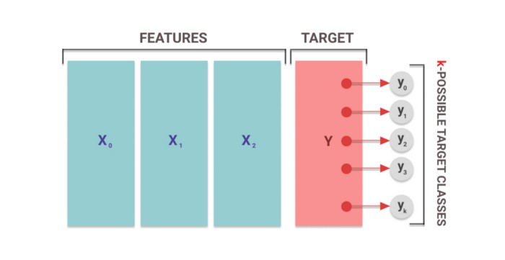
Multinomial Logistic Regression
Multinomial logistic regression as logistic regression (more specifically, binary logistic regression) on steroids.
While the binary logistic regression can predict binary outcomes (eg.- yes or no, spam or not spam, 0 or 1, etc.), the MLR can predict one out of k-possible outcomes, where k can be any arbitrary positive integer.

Slide 16
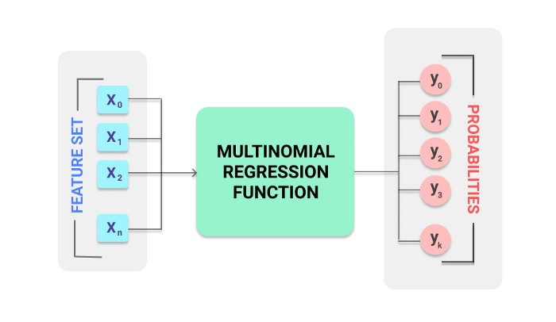
How does MLR work?
Once we feed the function a set of features, the model performs a series of mathematical operations to normalize the input values into a vector of values that follows a probability distribution.

Slide 17
How does MLR work?
The input that we give to the model is a feature vector, X, containing features x1, x2, x3…..xn.
The output we get is a probability vector Y, containing probabilities y1, y2, y3…yk for the k target classes.
Here, y1 + y2 + y3… + yk = 1, since the total probability of all the possible events in a system is always 1.

Slide 18
Thank you

