Slide 1

Random Forest Classifier

Slide 2
Random Forest Classifier
It is based on the concept of ensemble learning, which is a process of combining multiple classifiers to solve a complex problem and to improve the performance of the model.
As the name suggests, "Random Forest is a classifier that contains a number of decision trees on various subsets of the given dataset and takes the average to improve the predictive accuracy of that dataset." Instead of relying on one decision tree, the random forest takes the prediction from each tree and based on the majority votes of predictions, and it predicts the final output.
The greater number of trees in the forest leads to higher accuracy and prevents the problem of overfitting.

Slide 3

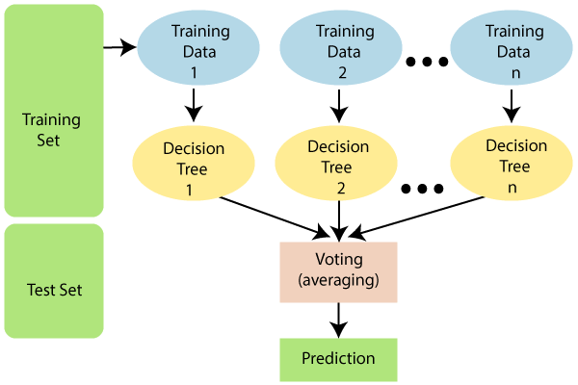
Random Forest Classifier

Slide 4
Assumptions for Random Forest
There are two assumptions for a better Random forest classifier:
There should be some actual values in the feature variable of the dataset so that the classifier can predict accurate results rather than a guessed result.
The predictions from each tree must have very low correlations.

Slide 5
Why use Random Forest?
It takes less training time as compared to other algorithms.
It predicts output with high accuracy, even for the large dataset it runs efficiently.
It can also maintain accuracy when a large proportion of data is missing.

Slide 6
How does Random Forest algorithm work?
Step-1: Select random K data points from the training set.
Step-2: Build the decision trees associated with the selected data points (Subsets).
Step-3: Choose the number N for decision trees that you want to build.
Step-4: Repeat Step 1 & 2.
Step-5: For new data points, find the predictions of each decision tree, and assign the new data points to the category that wins the majority votes.

Slide 7
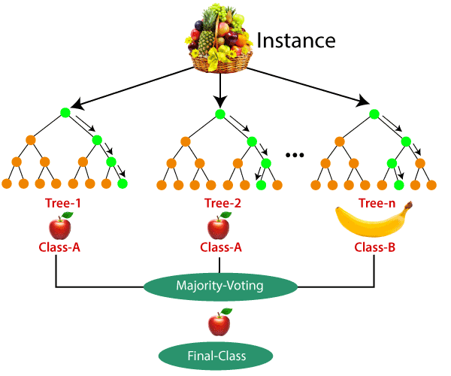
How does Random Forest algorithm work?
Example:
Suppose there is a dataset that contains multiple fruit images.
So, this dataset is given to the Random forest classifier.
The dataset is divided into subsets and given to each decision tree.

Slide 8
How does Random Forest algorithm work?
Example(contd.):
During the training phase, each decision tree produces a prediction result, and when a new data point occurs, then based on the majority of results, the Random Forest classifier predicts the final decision.

Slide 9
Applications of Random Forest
Banking: Banking sector mostly uses this algorithm for the identification of loan risk.
Medicine: With the help of this algorithm, disease trends and risks of the disease can be identified.
Land Use: We can identify the areas of similar land use by this algorithm.
Marketing: Marketing trends can be identified using this algorithm.

Slide 10
Advantages and Disadvantages
Advantages of Random Forest
Random Forest is capable of performing both Classification and Regression tasks.
It is capable of handling large datasets with high dimensionality.
It enhances the accuracy of the model and prevents the overfitting issue.
Disadvantages of Random Forest
Although random forest can be used for both classification and regression tasks, it is not more suitable for Regression tasks.

