Slide 1
Supervised Learning

Slide 2
Regression vs. Classification
The main difference between Regression and Classification algorithms that Regression algorithms are used to predict the continuous values such as price, salary, age, etc.
Classification algorithms are used to predict/Classify the discrete values such as Male or Female, True or False, Spam or Not Spam, etc.

Slide 3
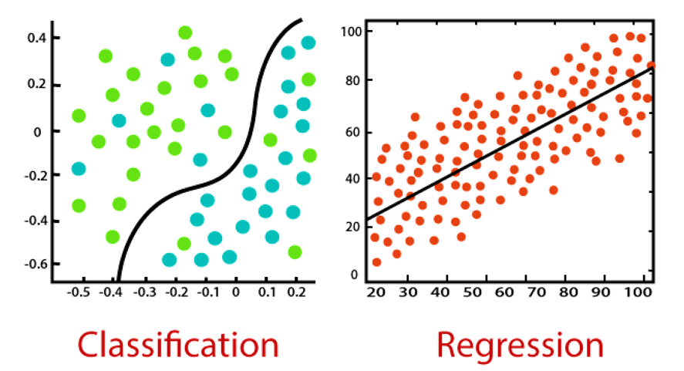
Regression vs. Classification

Slide 4
Classification
Classification is a process of finding a function which helps in dividing the dataset into classes based on different parameters.
In Classification, a computer program is trained on the training dataset and based on that training, it categorizes the data into different classes.
The task of the classification algorithm is to find the mapping function to map the input(x) to the discrete output(y).

Slide 5
Classification - Types
Logistic Regression
K-Nearest Neighbours
Support Vector Machines
Kernel SVM
Naïve Bayes
Decision Tree Classification
Random Forest Classification

Slide 6
Regression
Regression is a process of finding the correlations between dependent and independent variables.
It helps in predicting the continuous variables such as prediction of Market Trends, prediction of House prices, etc.
The task of the Regression algorithm is to find the mapping function to map the input variable(x) to the continuous output variable(y).

Slide 7
Regression - Types
Simple Linear Regression
Multiple Linear Regression
Polynomial Regression
Support Vector Regression
Decision Tree Regression
Random Forest Regression

Slide 8
Difference between Regression and Classification
Regression Algorithm | Classification Algorithm
In Regression, the output variable must be of continuous nature or real value. | In Classification, the output variable must be a discrete value.
The task of the regression algorithm is to map the input value (x) with the continuous output variable(y). | The task of the classification algorithm is to map the input value(x) with the discrete output variable(y).
Regression Algorithms are used with continuous data. | Classification Algorithms are used with discrete data.
In Regression, we try to find the best fit line, which can predict the output more accurately. | In Classification, we try to find the decision boundary, which can divide the dataset into different classes.
Regression algorithms can be used to solve the regression problems such as Weather Prediction, House price prediction, etc. | Classification Algorithms can be used to solve classification problems such as Identification of spam emails, Speech Recognition, Identification of cancer cells, etc.
The regression Algorithm can be further divided into Linear and Non-linear Regression. | The Classification algorithms can be divided into Binary Classifier and Multi-class Classifier.

Slide 9

Linear Regression

Slide 10
Introduction
Example:
Economists are using AI to predict future market prices to make a profit
Doctors use AI to classify whether a tumor is malignant or benign
Meteorologists use AI to predict the weather
HR recruiters use AI to check the resume of applicants to verify if the applicant meets the minimum criteria for the job, etcetera.

Slide 11

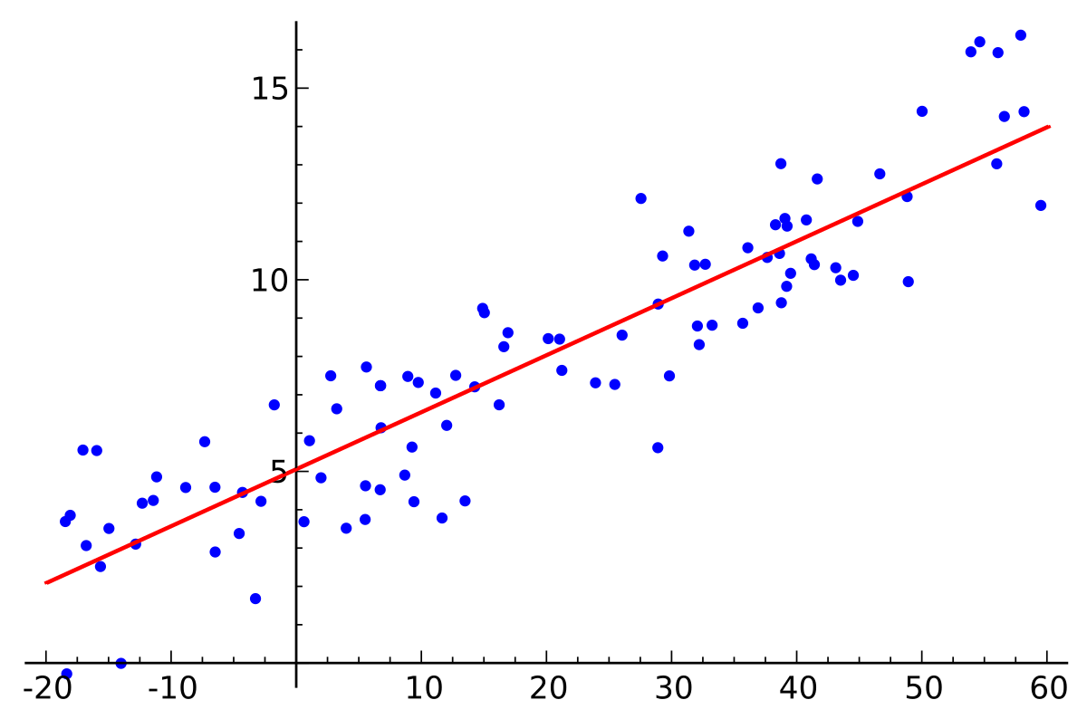
Regression
Regression is a method of modelling a target value based on independent predictors.
This method is mostly used for forecasting and finding out cause and effect relationship between variables.
Regression techniques mostly differ based on the number of independent variables and the type of relationship between the independent and dependent variables.

Slide 12
Linear Regression
Linear Regression is a machine learning algorithm based on supervised learning.
Regression models a target prediction value based on independent variables.
It is mostly used for finding out the relationship between variables and forecasting.
Different regression models differ based on – the kind of relationship between dependent and independent variables, and the number of independent variables being used.

Slide 13
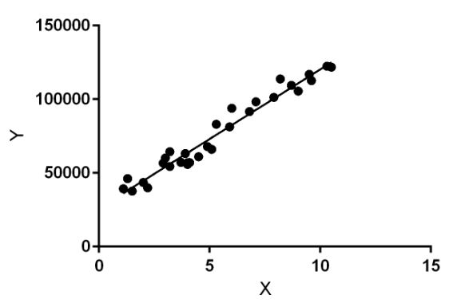
Linear regression
Linear regression performs the task to predict a dependent variable value (y) based on a given independent variable (x).
So, this regression technique finds out a linear relationship between x (input) and y(output). Hence, the name is Linear Regression.
In the figure, X (input) is the work experience and Y (output) is the salary of a person. The regression line is the best fit line for our model.

Slide 14
Simple Linear Regression
Simple linear regression is a type of regression analysis where the number of independent variables is one
And there is a linear relationship between the independent(x) and dependent(y) variable.
The red line in the graph is referred to as the best fit straight line.
Based on the given data points, we try to plot a line that models the points the best.
The line can be modelled based on the linear equation shown below.
y = a_0 + a_1 * x # Linear Equation

Slide 15
Cost Function
The cost function helps us to figure out the best possible values for a_0 and a_1 which would provide the best fit line for the data points.
Since we want the best values for a_0 and a_1, we convert this search problem into a minimization problem where we would like to minimize the error between the predicted value and the actual value.

Slide 16
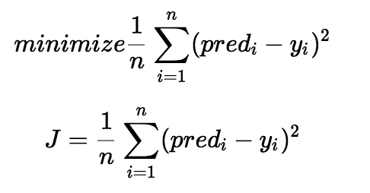
Cost Function
We square the error difference and sum over all data points and divide that value by the total number of data points.
This provides the average squared error over all the data points.
Therefore, this cost function is also known as the Mean Squared Error(MSE) function.
Using this MSE function we are going to change the values of a_0 and a_1 such that the MSE value settles at the minima.

Slide 17
Gradient Descent
Gradient descent is a method of updating a_0 and a_1 to reduce the cost function(MSE).
The idea is that we start with some values for a_0 and a_1 and then we change these values iteratively to reduce the cost.
Gradient descent helps us on how to change the values.

Slide 18
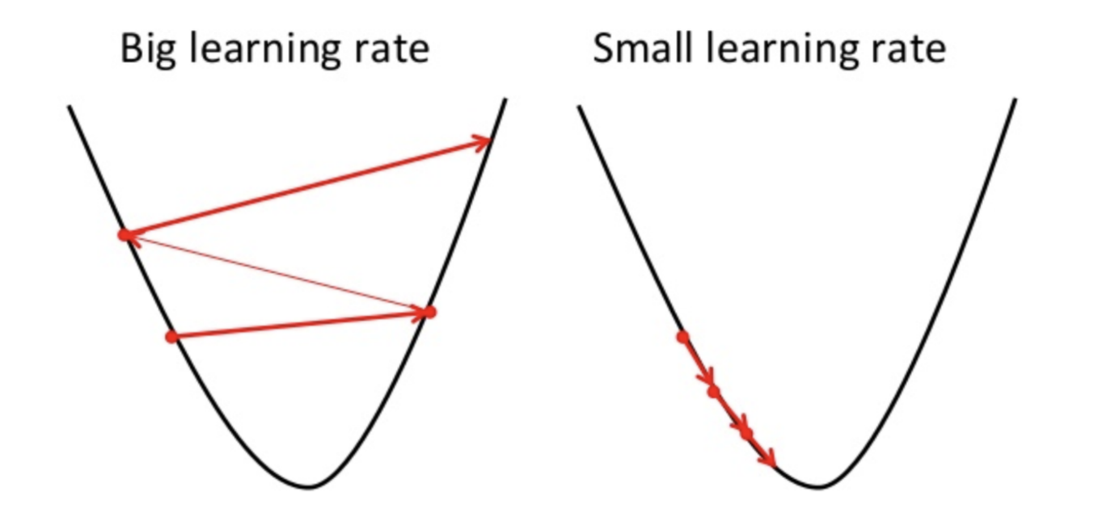
Gradient Descent
Imagine a pit in the shape of U and you are standing at the topmost point in the pit and your objective is to reach the bottom of the pit.
You can only take a discrete number of steps to reach the bottom.
If you decide to take one step at a time you would eventually reach the bottom of the pit, but this would take a longer time.
If you choose to take longer steps each time, you would reach sooner but, there is a chance that you could overshoot the bottom of the pit and not exactly at the bottom.
In the gradient descent algorithm, the number of steps you take is the learning rate.
This decides on how fast the algorithm converges to the minima.

Slide 19
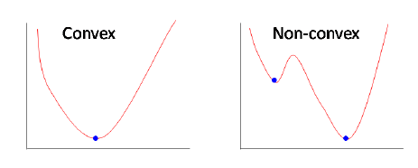
Gradient Descent
Sometimes the cost function can be a non-convex function where you could settle at a local minima but for linear regression, it is always a convex function.
To update a_0 and a_1, we take gradients from the cost function.
To find these gradients, we take partial derivatives with respect to a_0 and a_1.

Slide 20
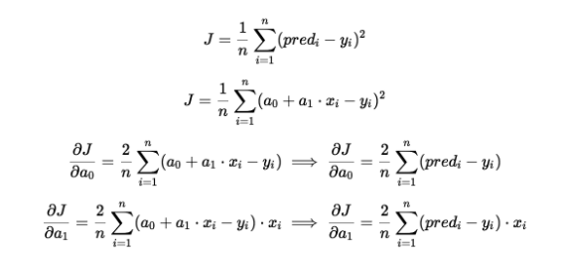
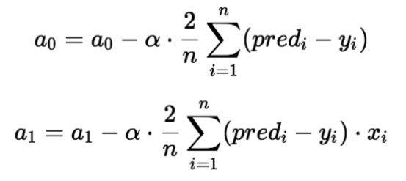
Gradient Descent
The partial derivates are the gradients and they are used to update the values of a_0 and a_1.
Alpha is the learning rate which is a hyperparameter that you must specify.
A smaller learning rate could get you closer to the minima but takes more time to reach the minima, a larger learning rate converges sooner but there is a chance that you could overshoot the minima.

Slide 21
Making Predictions
Imagine we are predicting weight (y) from height (x). Our linear regression model representation for this problem would be:
y = B0 + B1 * x1
or
weight =B0 +B1 * height
where B0 is the bias coefficient and B1 is the coefficient for the height column

Slide 22
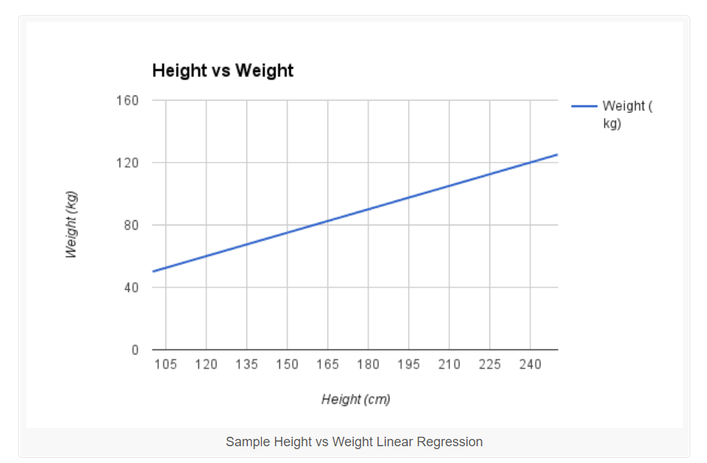
Making Predictions
let's use B0 = 0.1 and B1 = 0.5.
Let’s plug them in and calculate the weight (in kilograms) for a person with the height of 182 centimeters.
weight = 0.1 + 0.5 * 182
weight = 91.1

Slide 23
Model Performance
The Goodness of fit determines how the line of regression fits the set of observations.
The process of finding the best model out of various models is called optimization.
It can be achieved by:
R-squared method

Slide 24

Model Performance: R-squared method
R-squared is a statistical method that determines the goodness of fit.
It measures the strength of the relationship between the dependent and independent variables on a scale of 0-100%.
The high value of R-square determines the less difference between the predicted values and actual values and hence represents a good model.
It is also called a coefficient of determination, or coefficient of multiple determination for multiple regression.

Slide 25
Preparing Data For Linear Regression
Linear Assumption.
Remove Noise
Remove Collinearity
Gaussian Distributions
Rescale Inputs

Slide 26
Assumptions of Linear Regression
Linear relationship between the features and target.
There should be no correlation between the residual (error) terms. Absence of this phenomenon is known as Autocorrelation.
The independent variables should not be correlated. Absence of this phenomenon is known as multicollinearity.
The error terms must have constant variance. This phenomenon is known as homoskedasticity. The presence of non-constant variance is referred to heteroskedasticity.
The error terms must be normally distributed

Slide 27

Simple Linear Regression

Slide 28
Simple Linear Regression
Simple Linear Regression is a type of Regression algorithms that models the relationship between a dependent variable and a single independent variable.
The relationship shown by a Simple Linear Regression model is linear or a sloped straight line, hence it is called Simple Linear Regression.
The key point in Simple Linear Regression is that the dependent variable must be a continuous/real value. However, the independent variable can be measured on continuous or categorical values.

Slide 29
Simple Linear Regression
Simple Linear regression algorithm has mainly two objectives:
Model the relationship between the two variables. Such as the relationship between Income and expenditure, experience and Salary, etc.
Forecasting new observations. Such as Weather forecasting according to temperature, Revenue of a company according to the investments in a year, etc.

Slide 30
Simple Linear Regression
The Simple Linear Regression model can be represented using the below equation:
y= a₀+a₁x+ ε

Slide 31
Implementation of Simple Linear Regression
Problem Statement:
Here we are taking a dataset that has two variables: salary (dependent variable) and experience (Independent variable). The goals of this problem is:
We want to find out if there is any correlation between these two variables
We will find the best fit line for the dataset.
How the dependent variable is changing by changing the dependent variable.

Slide 32

Multiple Linear Regression

Slide 33
Multiple Linear Regression
Multiple linear regression (MLR), is a statistical technique that uses several explanatory variables to predict the outcome of a response variable.
The goal of multiple linear regression (MLR) is to model the linear relationship between the explanatory (independent) variables and response (dependent) variable.
In essence, multiple regression is the extension of ordinary least-squares (OLS) regression because it involves more than one explanatory variable.

Slide 34
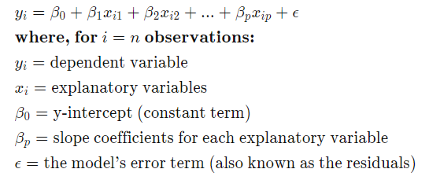
Formula and Calculation of Multiple Linear Regression

Slide 35
What Multiple Linear Regression Can Tell You
The multiple regression model is based on the following assumptions:
There is a linear relationship between the dependent variables and the independent variables
The independent variables are not too highly correlated with each other
yi observations are selected independently and randomly from the population
Residuals should be normally distributed with a mean of 0 and variance σ

Slide 36
R-squared
The coefficient of determination (R-squared) is a statistical metric that is used to measure how much of the variation in outcome can be explained by the variation in the independent variables.
R2 always increases as more predictors are added to the MLR model, even though the predictors may not be related to the outcome variable.
R2 by itself can't thus be used to identify which predictors should be included in a model and which should be excluded.
R2 can only be between 0 and 1, where 0 indicates that the outcome cannot be predicted by any of the independent variables and 1 indicates that the outcome can be predicted without error from the independent variables.

Slide 37

Polynomial Linear Regression

Slide 38
Polynomial Linear Regression

Slide 39
Polynomial Linear Regression

Slide 40
Polynomial Linear Regression
The equation of the polynomial regression for the above graph data would be:
y = θo + θ₁x₁ + θ₂ x₁²
This is the general equation of a polynomial regression is:
Y=θo + θ₁X + θ₂X² + … + θₘXᵐ + residual error

Slide 41
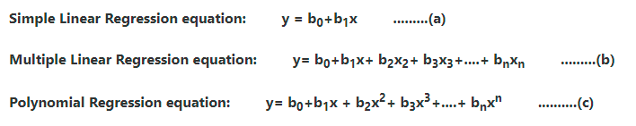
Equation of the Polynomial Regression Model

Slide 42
Polynomial Linear Regression
Advantages of using Polynomial Regression:
Polynomial provides the best approximation of the relationship between the dependent and independent variable.
A Broad range of function can be fit under it.
Polynomial basically fits a wide range of curvature.

Slide 43
Polynomial Linear Regression
Disadvantages of using Polynomial Regression:
The presence of one or two outliers in the data can seriously affect the results of the nonlinear analysis.
These are too sensitive to the outliers.
In addition, there are unfortunately fewer model validation tools for the detection of outliers in nonlinear regression than there are for linear regression.

Slide 44
Thank You

