Slide 1


K-Means Clustering

Slide 2
K-Means Clustering
K-Means Clustering is an Unsupervised Learning algorithm, which groups the unlabeled dataset into different clusters.
Here K defines the number of pre-defined clusters that need to be created in the process, as if K=2, there will be two clusters, and for K=3, there will be three clusters, and so on.
That's what the K stands for and of course, there is a way of finding out what is the best or optimum value of K.

Slide 3
K-Means Clustering
“It is an iterative algorithm that divides the unlabeled dataset into k different clusters in such a way that each dataset belongs only one group that has similar properties”

Slide 4
K-Means Clustering
It allows us to cluster the data into different groups and a convenient way to discover the categories of groups in the unlabeled dataset on its own without the need for any training.
It is a centroid-based algorithm, where each cluster is associated with a centroid. The main aim of this algorithm is to minimize the sum of distances between the data point and their corresponding clusters.
The algorithm takes the unlabeled dataset as input, divides the dataset into k-number of clusters, and repeats the process until it does not find the best clusters. The value of k should be predetermined in this algorithm.

Slide 5
K-Means Clustering
The k-means clustering algorithm mainly performs two tasks:
Determines the best value for K center points or centroids by an iterative process.
Assigns each data point to its closest k-center. Those data points which are near to the particular k-center, create a cluster.
Hence each cluster has datapoints with some commonalities, and it is away from other clusters.

Slide 6

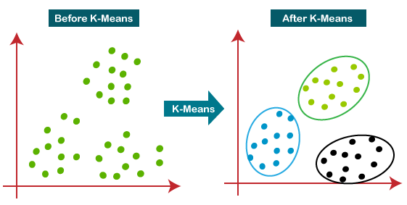
K-Means Clustering
The diagram explains the working of the K-means Clustering Algorithm:

Slide 7
How does the K-Means Algorithm Work?
Step-1: Select the number K to decide the number of clusters.
Step-2: Select random K points or centroids. (It can be other from the input dataset).
Step-3: Assign each data point to their closest centroid, which will form the predefined K clusters.

Slide 8
How does the K-Means Algorithm Work?
Step-4: Calculate the variance and place a new centroid of each cluster.
Step-5: Repeat the third steps, which means reassign each datapoint to the new closest centroid of each cluster.
Step-6: If any reassignment occurs, then go to step-4 else go to FINISH.
Step-7: The model is ready.

Slide 9
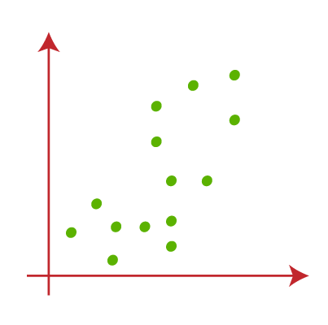
Example
Let's take number k of clusters, i.e., K=2, to identify the dataset and to put them into different clusters.
It means here we will try to group these datasets into two different clusters.

Slide 10
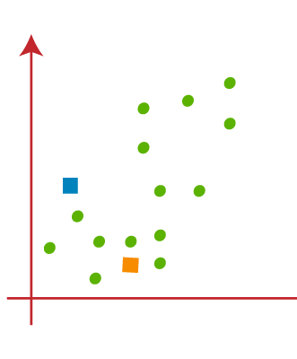
Example
We need to choose some random k points or centroid to form the cluster.
These points can be either the points from the dataset or any other point.
So, here we are selecting the below two points as k points, which are not the part of our dataset.

Slide 11
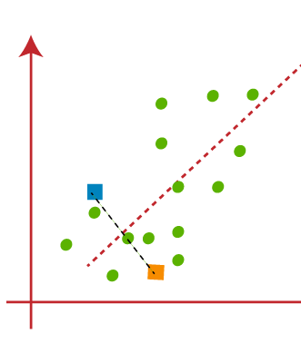
Example
Now we will assign each data point of the scatter plot to its closest K-point or centroid.
We will compute it by applying some mathematics that we have studied to calculate the distance between two points.
So, we will draw a median between both the centroids.

Slide 12
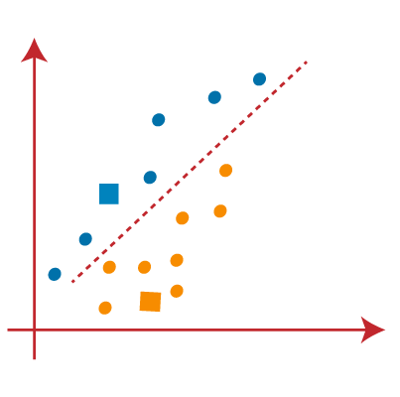
Example
From the above image, it is clear that points left side of the line is near to the K1 or blue centroid, and points to the right of the line are close to the yellow centroid. Let's color them as blue and yellow for clear visualization.

Slide 13
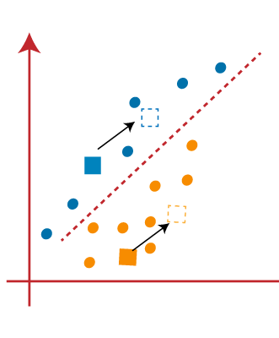
Example
As we need to find the closest cluster, so we will repeat the process by choosing a new centroid.
To choose the new centroids, we will compute the center of gravity of these centroids, and will find new centroids

Slide 14
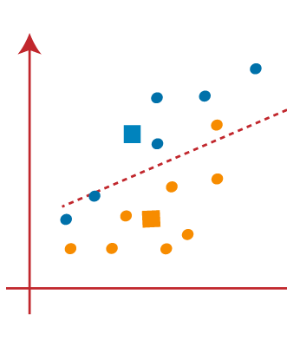
Example
Next, we will reassign each datapoint to the new centroid.
For this, we will repeat the same process of finding a median line. The median will be like in image

Slide 15
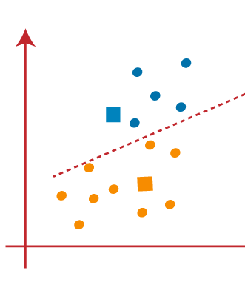
Example
From the above image, we can see, one yellow point is on the left side of the line, and two blue points are right to the line. So, these three points will be assigned to new centroids.

Slide 16
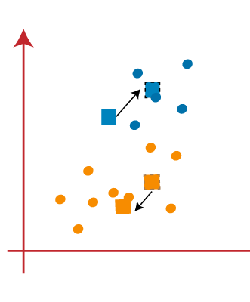
Example
As reassignment has taken place, so we will again go to the step-4, which is finding new centroids or K-points.
We will repeat the process by finding the center of gravity of centroids

Slide 17
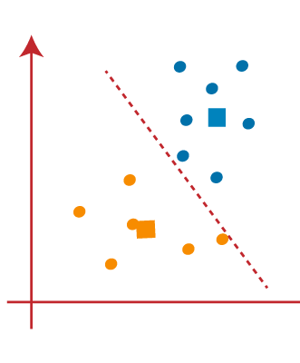
Example
As we got the new centroids so again will draw the median line and reassign the data points.

Slide 18
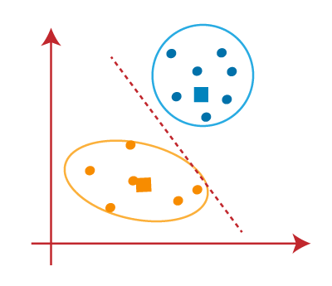
Example
We can see in the above image; there are no dissimilar data points on either side of the line, which means our model is formed.

Slide 19
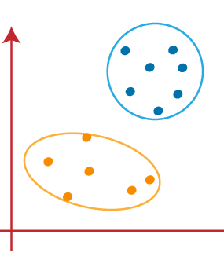
Example
As our model is ready, so we can now remove the assumed centroids, and the two final clusters will be as shown here.

Slide 20
How to choose the value of "K number of clusters" in K-means Clustering?
The performance of the K-means clustering algorithm depends upon highly efficient clusters that it forms. But choosing the optimal number of clusters is a big task.
There are some different ways to find the optimal number of clusters, but here we are discussing the most appropriate method to find the number of clusters or value of K.
The method is:
Elbow Method

Slide 21
Elbow Method
The Elbow method is one of the most popular ways to find the optimal number of clusters. This method uses the concept of WCSS value. WCSS stands for Within Cluster Sum of Squares, which defines the total variations within a cluster.
The formula to calculate the value of WCSS (for 3 clusters) is given below:
WCSS= ∑_{Pi in Cluster1} distance(P_{i} C₁)² +∑_{Pi in Cluster2}distance(P_{i} C₂)²+∑_{Pi in CLuster3} distance(P_{i} C₃)²

Slide 22
Elbow Method
The formula to calculate the value of WCSS (for 3 clusters) is given below:
WCSS= ∑_{Pi in Cluster1} distance(P_{i} C₁)² +∑_{Pi in Cluster2}distance(P_{i} C₂)²+∑_{Pi in CLuster3} distance(P_{i} C₃)²
In the above formula of WCSS,
∑_{Pi in Cluster1} distance(P_{i} C₁)² : It is the sum of the square of the distances between each data point and its centroid within a cluster1 and the same for the other two terms.

Slide 23
Elbow Method
To measure the distance between data points and centroid, we can use any method such as Euclidean distance or Manhattan distance.
To find the optimal value of clusters, the elbow method follows the below steps:
It executes the K-means clustering on a given dataset for different K values (ranges from 1-10).
For each value of K, calculates the WCSS value.
Plots a curve between calculated WCSS values and the number of clusters K.
The sharp point of bend or a point of the plot looks like an arm, then that point is considered as the best value of K.

Slide 24
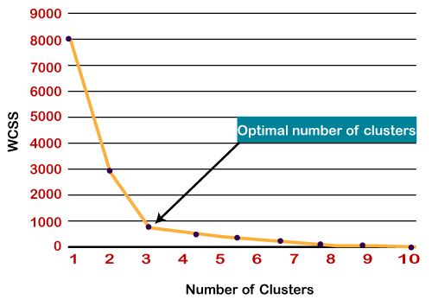
Elbow Method
Since the graph shows the sharp bend, which looks like an elbow, hence it is known as the elbow method.
The graph for the elbow method looks like in the image.

Slide 25
Key Takeaways
The most common form of Unsupervised Learning is Clustering, which involves segregating data based on the similarity between data instances.
K-means is a popular technique for Clustering. It involves an iterative process to find cluster centers called centroids and assigning data points to one of the centroids.
K-means finds clusters by minimizing the within-cluster distance of data points from respective centroids.
The Elbow method is used to determine the most optimum number of clusters.

Slide 26


Thank you

