Slide 1

Probability

Slide 2
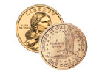

Probability
How likely something is to happen
Eg 1: Tossing a Coin
2 outcomes: heads(H) and tails(T)
probability: $\frac{1}{2}$

Slide 3
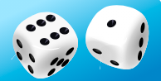

Probability
How likely something is to happen
Eg 2: Throwing Dice
6 possible outcomes: 1,2,3,4,5,6
probability: $\frac{1}{6}$

Slide 4
Probability
$$probability of an event happening=\frac{Number of ways it can happen}{Total number of outcomes}$$

Slide 5

Probability
Eg: Throwing Dice
chances of rolling a "4" with a die
Number of ways it can happen: 1
Total number of outcomes: 6
so, the probability = $\frac{1}{6}$

Slide 6

Probability
Eg: 5 marbles in a bag: 4 are blue, and 1 is red
The probability that a blue marble gets picked is…
Number of ways it can happen: 4
Total number of outcomes: 5
so, the probability = $\frac{4}{5}$ = 0.8

Slide 7

Probability is Just a Guide
Eg: Toss a coin 100 times, how many Heads will come up?
probability = $\frac{1}{2}$ = 50 Heads
we might get 48 heads, or 55 heads…..

Slide 8

Probability terms
Experiment: a repeatable procedure with a set of possible results.
Eg: Throwing dice
we can throw it repeatedly
The set of possible results from any single throw is {1, 2, 3, 4, 5, 6}

Slide 9
Probability terms
Outcome: A possible result of an experiment.
Eg: Throwing dice
The set of possible results are
{1, 2, 3, 4, 5, 6}
Getting a “6” is an outcome.

Slide 10
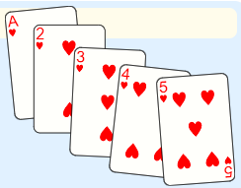
Probability terms
Sample space: All the possible outcomes of an experiment.
Eg: choosing a card from a deck
There are 52 cards in a deck (not including Jokers)
So, the Sample Space is all 52 possible cards: {Ace of Hearts, 2 of Hearts, etc...}

Slide 11
Probability terms
Sample point: Just one of the possible outcomes.
Eg 1: Deck of Cards
the 5 of Clubs is a sample point.
the King of Hearts is a sample point.
"King" is not a sample point. There are 4 Kings, so that is 4 different sample points.
The Sample Space is made up of Sample Points

Slide 12
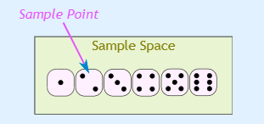
Probability terms
Sample point: Just one of the possible outcomes.
Eg 2:
There are 6 different sample points in the sample space.

Slide 13
Probability terms
Event: One or more outcomes of an experiment.
An event can be just one outcome:
Getting a Tail when tossing a coin
Rolling a "5"
An event can include more than one outcome:
Choosing a "King" from a deck of cards (any of the 4 Kings)
Rolling an "even number" (2, 4 or 6)

Slide 14
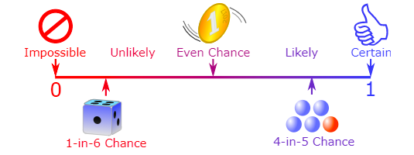
Probability line
The probability of an event occurring is somewhere between impossible and certain

Slide 15
Probability line
We can also use numbers to show the probability of something happening:
• Impossible is zero.
• Certain is one.
We can use fractions, Or percent, Or decimals

Slide 16
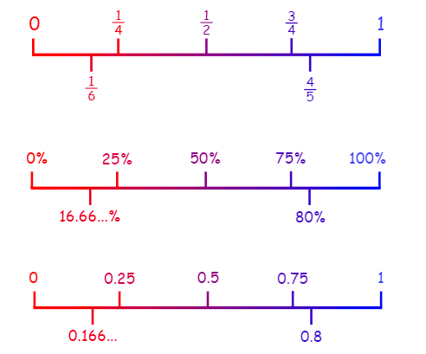
Probability line

Slide 17
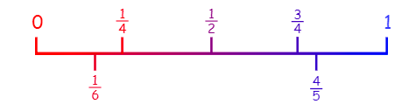
Exercise:
a) The sun will rise tomorrow
b) I will not have to learn mathematics at school
c) If I flip a coin, it will land heads up
d) Choosing a red ball from a bag with 1 red ball and 3 green balls

Slide 18
Basic Counting Principle
When there are m ways to do one thing,
and n ways to do another,
then there is m×n ways of doing both.
Example: you have 3 shirts and 4 pants.
That means 3×4=12 different outfits.
Example: There are 6 flavors of ice-cream, and 3 different cones.
That means 6×3=18 different single-scoop ice-creams you could order

Slide 19
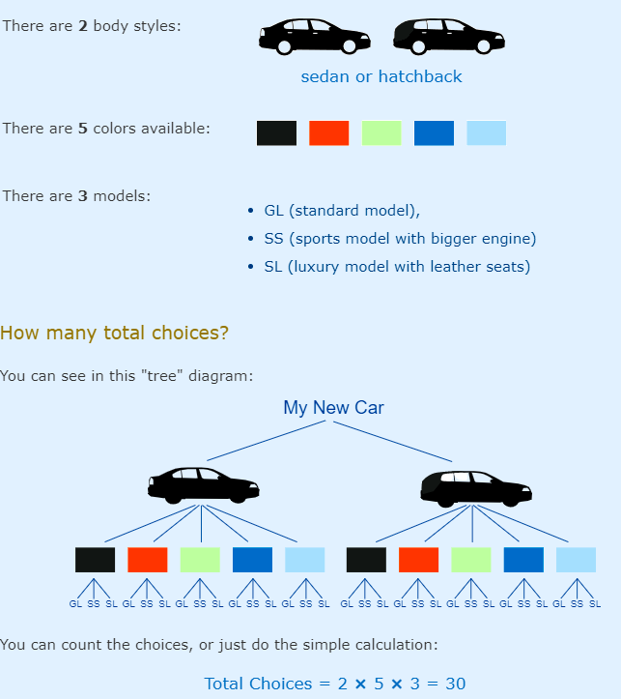
Basic Counting Principle
Example: You are buying a new car.

Slide 20
Basic Counting Principle
Example: You are buying a new car.

Slide 21
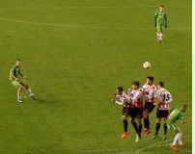

Relative Frequency
How often something happens divided by all outcomes.
Example: Your team has won 9 games from a total of 12 games played:
the Frequency of winning is 9
the Relative Frequency of winning is $\frac{9}{12}$ = 75%

Slide 22
Relative Frequency
Example: Travel Survey
92 people were asked how they got to work:
• 35 used a car
• 42 took public transport
• 8 rode a bicycle
• 7 walked

Slide 23
Relative Frequency
The Relative Frequencies (to 2 decimal places) are:
• Car: 35/92 = 0.38
• Public Transport: 42/92 = 0.46
• Bicycle: 8/92 = 0.09
• Walking: 7/92 = 0.08
0.38+0.46+0.09+0.08 = 1.01
(It would be exactly 1 if we had used perfect accuracy)

Slide 24
Relative Frequency
Example: What kind of music do you like?
20 people like pop music
18 people like dance
26 people like hip-hop / rap
17 people like something else

Slide 25
Relative Frequency
The Relative Frequencies (to 2 decimal places) are:
• Pop music:
• Dance:
• Hip-hop / rap:
• Something else:
=

Slide 26


Probability: Complement
Complement of an Event: All outcomes that are NOT the event.
When the event is Heads, the complement is Tails
When the event is {Monday, Wednesday} the complement is {Tuesday, Thursday, Friday, Saturday, Sunday}

Slide 27
So, together the Event and its Complement make all possible outcomes.
The probability of an event is shown using "P":
P(A) means "Probability of Event A“
The complement is shown by a little mark after the letter such as A' (or sometimes Ac or A):
P(A') means "Probability of the complement of Event A“
The two probabilities always add to 1
P(A) + P(A') = 1

Slide 28
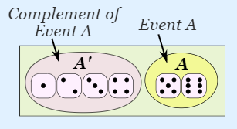

Example: Rolling a "5" or "6“
Event A is {5, 6}
Number of ways it can happen: 2
Total number of outcomes: 6
P(A) =$\frac{2}{6}=\frac{1}{3}$
The Complement of Event A is {1, 2, 3, 4}
Number of ways it can happen: 4
Total number of outcomes: 6
P(A') = $\frac{4}{6}=\frac{2}{3}$
Let us add them:
P(A) + P(A') = $\frac{1}{3}$ + $\frac{2}{3}=\frac{3}{3}$ =1

Slide 29
Why Complement is useful ?
Example. Throw two dice. What is the probability the two scores are different?
Different scores are like getting a 2 and 3, or a 6 and 1. It is a long list:
A = { (1,2), (1,3), (1,4), (1,5), (1,6),
(2,1), (2,3), (2,4), (1,5), (1,6),
(3,1), (3,2), ... etc ! }

Slide 30
Why Complement is useful ?
A' = {(1,1), (2,2), (3,3), (4,4), (5,5), (6,6)}
And its probability is:
P(A') = 6/36 = 1/6
P(A) = 1 − P(A’)
= 1− 1/6
= 5/6
So, in this case it is easier to work out P(A') first, then calculate P(A) = 1 − P(A')

Slide 31
Probability: Types of Events
Events can be:
• Independent (each event is not affected by other events),
• Dependent (also called "Conditional", where an event is affected by other events)
• Mutually Exclusive (events cannot happen at the same time)

Slide 32
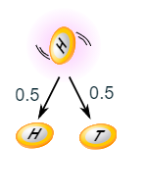
Independent Events
Events can be "Independent", meaning each event is not affected by any other events.
This is an important idea! A coin does not "know" that it came up heads before ... each toss of a coin is a perfect isolated thing.

Slide 33
Independent Events
Example 1:
You toss a coin three times and it comes up "Heads" each time ... what is the chance that the next toss will also be a "Head"?
1/2, or 50%
What it did in the past will not affect the current toss!

Slide 34
Independent Events
Example 2:
What is the probability of getting a "4" or "6" when rolling a die?
Number of ways it can happen: 2 ("4" and "6")
Total number of outcomes: 6 ("1", "2", "3", "4", "5" and "6")
So, the probability = 2/6 = 1/3 = 0.333...

Slide 35
Dependent Events
Some events can be "dependent" ... which means they can be affected by previous events.
Example: Drawing 2 Cards from a Deck
After taking one card from the deck there are less cards available, so the probabilities change!

Slide 36
Dependent Events
Example:
Let's look at the chances of getting a King.
For the 1st card the chance of drawing a King is 4 out of 52
But for the 2nd card:
If the 1st card was a King, then the 2nd card is 3 of the 51 cards left are Kings.
If the 1st card was not a King, then 4 of the 51 cards left are King.
This is because we are removing cards from the deck.

Slide 37
Dependent Events
Replacement: When we put each card back after drawing it the chances do not change, as the events are independent.
Without Replacement: The chances will change, and the events are dependent.

Slide 38
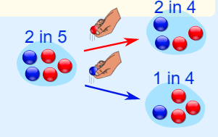
Dependent Events
Example: Marbles in a Bag
2 blue and 3 red marbles are in a bag.
What are the chances of getting a blue marble?
The chance is 2 in 5
Red, then 2 in 4
Blue, then 1 in 4

Slide 39
Notation
P(A) means "Probability Of Event A“
Event A is "get a Blue Marble first" - P(A) = 2/5
And Event B is "get a Blue Marble second" ... but for that we have 2 choices:
• If we got a Blue Marble first the chance is now 1/4
• If we got a Red Marble first the chance is now 2/4

Slide 40
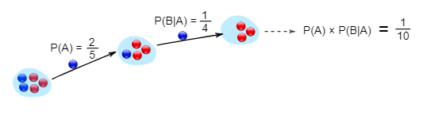
Notation
P(B|A) means "Event B given Event A“
P(B|A) is also called the "Conditional Probability" of B given A
P(B|A) = 1/4
So, the probability of getting 2 blue marbles is

Slide 41
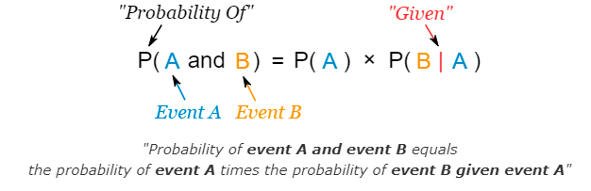
we write it as:

Slide 42
Example: Drawing 2 Kings from a Deck
P(A) = 4/52
P(B|A) = 3/51
And so:
P(A and B) = P(A) x P(B|A) = (4/52) x (3/51)
= 12/2652 = 1/221
chance of getting 2 Kings is 1 in 221, or about 0.5%

Slide 43
Tree diagram
• with Coach Sam your probability of being Goalkeeper is 0.5
• with Coach Alex your probability of being Goalkeeper is 0.3
Sam is Coach more often.... about 6 of every 10 games (a probability of 0.6)

Slide 44
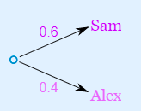
Tree diagram
for Sam (0.5 Yes and 0.5 No), and then for Alex (0.3 Yes and 0.7 No)

Slide 45
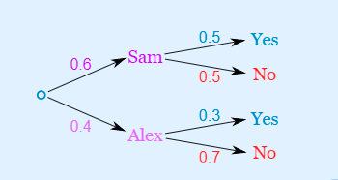
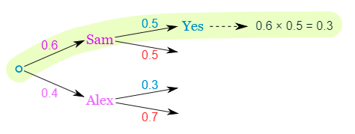
Tree diagram
Here is how to do it for the "Sam, Yes" branch:

Slide 46
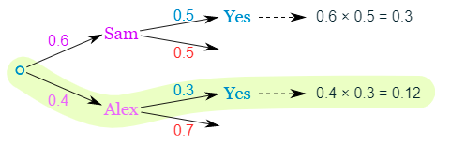
Tree diagram
0.4 chance of Alex as Coach, followed by an 0.3 chance gives 0.12
0.3 + 0.12 = 0.42 probability of being a Goalkeeper today

Slide 47
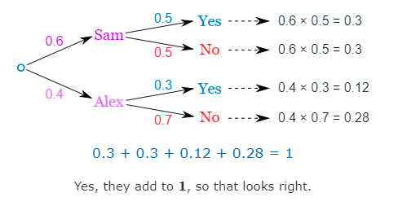
Tree diagram
Final step: complete the calculations and make sure they add to 1

Slide 48
Mutually Exclusive
It means we can’t get both events at the same time.
P(A and B) = 0
Example: King AND Queen
P(A or B) = P(A) + P(B)

Slide 49
Mutually Exclusive
Example: King OR Queen
In a Deck of 52 Cards
P(King)=1/13
P(Queen)=1/13
The probability of a King or a Queen is
(1/13) + (1/13) = 2/13
P(King or Queen) = (1/13) + (1/13) = 2/13
So, we have:
• P(King and Queen) = 0
• P(King or Queen) = (1/13) + (1/13) = 2/13

Slide 50
Mutually Exclusive
Examples:
• Turning left or right are Mutually Exclusive (you cannot do both at the same time)
• Heads and Tails are Mutually Exclusive.
• Kings and Aces are Mutually Exclusive.

Slide 51
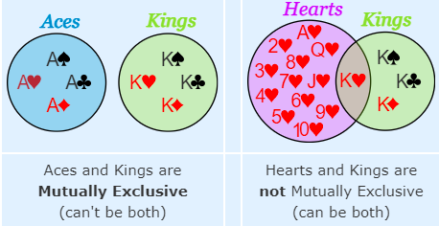
Mutually Exclusive and Not

Slide 52
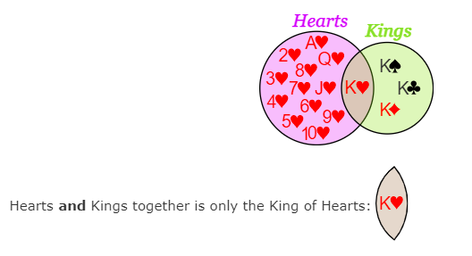
Not Mutually Exclusive
Example: Hearts and Kings

Slide 53
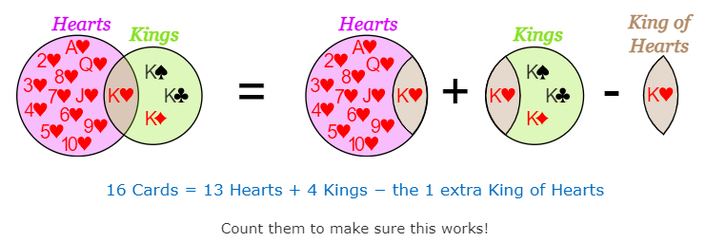
Not Mutually Exclusive
But Hearts or Kings is:
• all the Hearts (13 of them)
• all the Kings (4 of them)

Slide 54
Not Mutually Exclusive
Formula:
P(A or B) = P(A) + P(B) − P(A and B)
Same formula, but using ∪ and ∩:
P(A ∪ B) = P(A) + P(B) − P(A ∩ B)

Slide 55
Summary
Mutually Exclusive
• A and B together is impossible: P(A and B) = 0
• A or B is the sum of A and B:
P(A or B) = P(A) + P(B)
Not Mutually Exclusive
• A or B is the sum of A and B minus A and B:
P(A or B) = P(A) + P(B) − P(A and B)
Symbols
• And is ∩ (the "Intersection" symbol)
• Or is ∪ (the "Union" symbol)

Slide 56
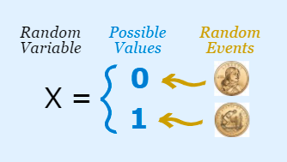
Random Variables
A Random Variable is a set of possible values from a random experiment.
Example: Tossing a coin: we could get Heads or Tails.
X = {0, 1}

Slide 57
Random Variable
A Random Variable has a whole set of values ... ... and it could take on any of those values, randomly.
A Random Variable is given a capital letter, such as X or Z.
Random Variables can be discrete or continuous.

Slide 58
Thank you

