Slide 1
Probability Distribution

Slide 2

False Positives and False Negatives

Slide 3
Examples
Airport Security
Quality Control
Antivirus software
Medical Screening

Slide 4

Example: Allergy or Not?
Have allergy - "Yes" 80% of the time
Do not have allergy - "Yes" 10% of the time ("false positive")

Slide 5
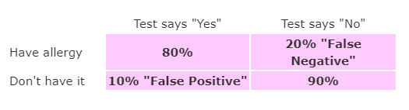

Slide 6
3 different ways
"Imagine a 1000“,
"Tree Diagrams" or
"Bayes' Theorem"

Slide 7

A Thousand People
1000 people, only 10 really have the allergy (1% of 1000 is 10)
8 of those 10 rights
990 do not have the allergy, and the test will say "Yes" to 10% of them
99
(false positive)
"Yes" to (8+99) = 107 people
8/107 = about 7%

Slide 8
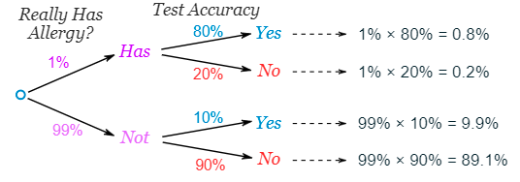
As A Tree
0.8% + 0.2% + 9.9% + 89.1% = 100%
two "Yes" gives - 0.8% + 9.9% = 10.7%, but only 0.8% are correct
0.8/10.7 = 7%

Slide 9
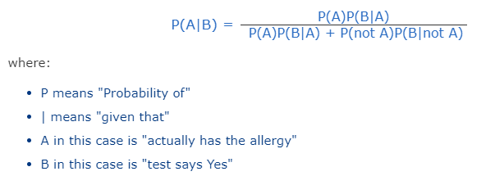
Bayes' Theorem
Has special formula for this kind of thing

Slide 10
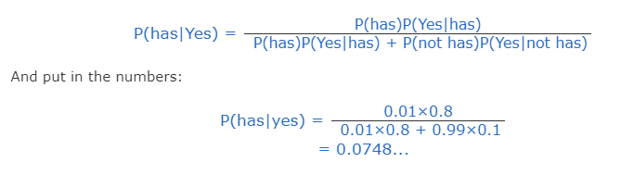
Bayes' Theorem
Which is about 7%

Slide 11


Bayes’ Theorem

Slide 12

Bayes' Theorem
When we know certain other probabilities
Formula:
Which tells us:
how often A happens given that B happens, written P(A|B),
When we know:
how often B happens given that A happens, written P(B|A)
and how likely A is on its own, written P(A)
and how likely B is on its own, written P(B)

Slide 13
Example: Fire and smoke
Let us say P(Fire) means how often there is fire, and P(Smoke) means how often we see smoke, then:
• P(Fire|Smoke) means how often there is fire when we can see smoke.
• P(Smoke|Fire) means how often we can see smoke when there is fire.
So, the formula kind of tells us "forwards" P(Fire|Smoke) when we know "backwards" P(Smoke|Fire)

Slide 14
Example: Fire and smoke
dangerous fires are rare (1%)
but smoke is fairly common (10%) due to barbecues,
and 90% of dangerous fires make smoke
We can then discover the probability of dangerous Fire when there is Smoke:
P(Fire|Smoke) = P(Smoke|Fire) * P(Fire) / P(Smoke)
= 90% x 1% / 10%
= 9%

Slide 15
Example: Picnic Day
50% of all rainy days start off cloudy
40% of days start cloudy
only 3 of 30 days tend to be rainy, or 10%
What is the chance of rain during the day?

Slide 16

Example: Picnic Day
P(Rain|Cloud)
Formula:
P(Rain) is Probability of Rain = 10%
P(Cloud|Rain) is Probability of Cloud, given that Rain happens = 50%
P(Cloud) is Probability of Cloud = 40%

Slide 17

Example: Picnic Day
Formula:
P(Rain) = 10%
P(Cloud|Rain) = 50%
P(Cloud) = 40%
12.5% chance of rain

Slide 18


Example: Allergy or Not?
Have the allergy - "Yes" 80%
Do not have the allergy - "Yes" 10% ("false positive")
P(Allergy|Yes)
Formula:

Slide 19
Example: Allergy or Not?
P(Allergy) = 1%
P(Yes|Allergy) = 80%
P(Yes) ???
99% do not have the allergy - "Yes" to 10%
P(Yes) = 1% × 80% + 99% × 10% = 10.7%
P(Allergy|Yes) = 1% × 80% / 10.7% = 7.48%
P(Allergy|Yes) = about 7%

Slide 20

Expected Value
Example: Lisa plays a game in which there are only two outcomes. The cost to play the game is $100. If she wins, she receives $500. The probability of winning is 20%. What is the expected value for winning a single game on average?
E(x) = $x_{1}P_{1}+ x_{2}P_{2}$
Outcomes: | Wins | loses
Value | $500 | -$100
Probability | 20% | 80%

Slide 21

Expected Value
E(x) = $x_{1}P_{1}+ x_{2}P_{2}$
E(x) = 500(0.20) + (-100)(0.80)
E(x) = 100 – 80
E(x) = $20
Outcomes: | Wins | loses
Value | $500 | -$100
Probability | 20% | 80%

Slide 22
Chi-Square Test
Groups and Numbers
"p" value
p < 0.05
p < 0.01
Important points:
only works for categorical data – Gender , color etc.
5 or more

Slide 23
Chi-Square Test
First step: State the Hypothesis
The two hypotheses are.
Gender and preference for cats or dogs are independent.
Gender and preference for cats or dogs are not independent.
 | Cat | Dog
Men | 207 | 282
Women | 231 | 242

Slide 24
Chi-Square Test
 | Cat | Dog
Men | 207 | 282 | 489
Women | 231 | 242 | 473
 | 438 | 524 | 962
Calculate “Expected value”
Multiply each row total by each column total and divide by the overall total

Slide 25
Chi-Square Test
 | Cat | Dog
Men | =(489*438)/962 | =(489*524)/962 | 489
Women | =(473*438)/962 | =(473*524)/962 | 473
 | 438 | 524 | 962
 | Cat | Dog
Men | 222.642412 | 266.357588 | 489
Women | 215.357588 | 257.642412 | 473
 | 438 | 524 | 962

Slide 26

Chi-Square Test
In other words, use formula,
where
O = Observed (actual) value
E = Expected value
 | Cat | Dog
Men | (207−222.64)2 / 222.64 | (282−266.36)2 / 266.36 | 489
Women | (231−215.36)2 / 215.36 | (242−257.64)2 / 257.64 | 473
 | 438 | 524 | 962

Slide 27
Chi-Square Test
 | Cat | Dog
Men | 1.099 | 0.918 | 489
Women | 1.136 | 0.949 | 473
 | 438 | 524 | 962
1.099 + 0.918 + 1.136 + 0.949 =
Chi-Square is

Slide 28

Chi-Square Test
Chi-Square Formula
Formula for Chi-Square:
Σ means to sum up (see Sigma Notation)
O = each Observed (actual) value
E = each Expected value
So, we calculate for each pair of observed and
expected values then sum them all up.

Slide 29
Degrees of Freedom
Degree of Freedom = (rows − 1) × (columns − 1)
For our example we have 2 rows and 2 columns:
DF = (2 − 1)*(2 − 1) = 1×1 = 1
If we had 3 rows and 2 columns:
DF = (3 − 1)*(2 − 1) = 2×1 = 2

Slide 30
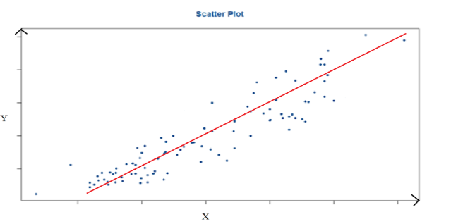
Regression
Simple linear regression is used to find out the best relationship between a single input variable & output variable provided that both variables are continuous in nature.
This relationship represents how an input variable is related to the output variable and how it is represented by a straight line.

Slide 31
Regression
The direction
The strength
The linearity
The above characteristics are between variable Y and variable X.
The scatter plot shows us that variable Y and variable X possess a strong positive linear relationship.

Slide 32
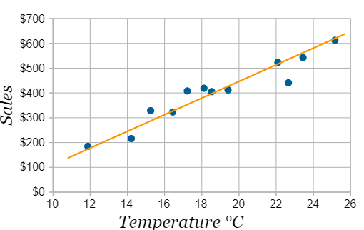
Least Squares Regression
Line of Best Fit

Slide 33
Least Squares Regression
The Line
Our aim is to calculate the values m (slope) and b (y-intercept) in the equation of a line
y = mx + b
Where:
y = how far up
x = how far along
m = Slope or Gradient (how steep the line is)
b = the Y Intercept (where the line crosses the Y axis)

Slide 34


Least Squares Regression - Steps
Step 1: For each (x,y) point calculate x2 and xy
Step 2: Sum all x, y, x2 and xy, which gives us Σx, Σy, Σx2 and Σxy (Σ means "sum up")
Step 3: Calculate Slope m:
(N is the number of points.)
Step 4: Calculate Intercept b:
Step 5: Assemble the equation of a line
y = mx + b

Slide 35
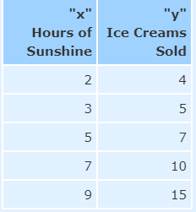
Least Squares Regression - Example
Example: Sam found how many hours of sunshine vs how many ice creams were sold at the shop from Monday to Friday:
Let’s find the best m (slope) and b (y-intercept) that suits that data
y = mx + b

Slide 36
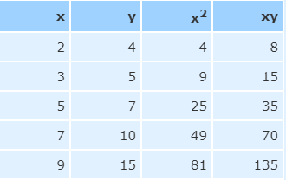
Least Squares Regression - Example
Step 1: For each (x,y) calculate x2 and xy

Slide 37
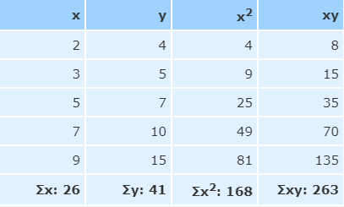
Least Squares Regression - Example
Step 2: Sum x, y, x2 and xy (gives us Σx, Σy, Σx2 and Σxy):

Slide 38
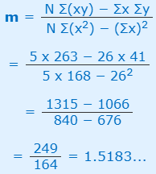
Least Squares Regression - Example
Step 3: Calculate Slope m:

Slide 39
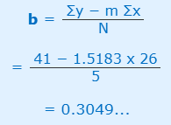
Least Squares Regression - Example
Step 4: Calculate Intercept b:

Slide 40
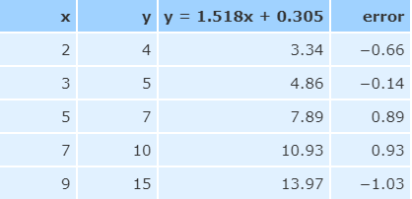
Least Squares Regression - Example
Step 5: Assemble the equation of a line:
y = mx + b
y = 1.518x + 0.305
8 hours of sun tomorrow
y = 1.518 x 8 + 0.305 = 12.45 Ice Creams

Slide 41
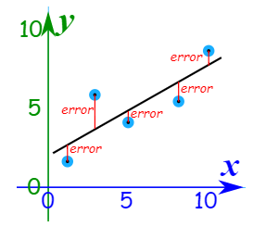
Least Squares Regression
How does it work?
It works by making the total of the square of the errors as small as possible (that is why it is called "least squares"):
The straight line minimizes the sum of squared errors
So, when we square each of those errors and add them all up, the total is as small as possible.

Slide 42
Probability Distributions
Probability Distribution is a statistical function which links
or lists all the possible outcomes a random variable
can take, in any random process, with its
corresponding probability of occurrence.
Example:
Let X be the number of heads that result from the toss of 2 coins. Here X can take values 0,1, or 2. X is a discrete random variable.

Slide 43
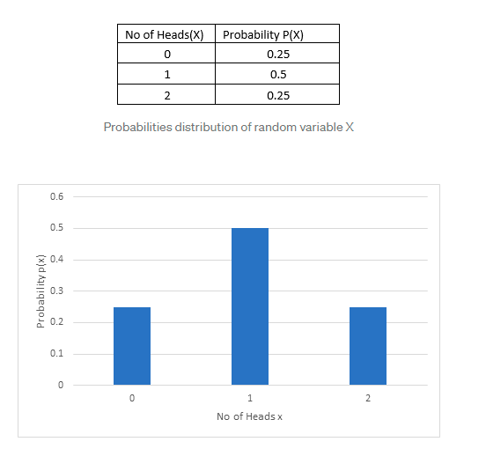

Slide 44
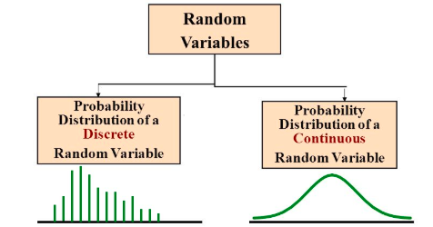
Probability Distributions
Need of Probability Distribution
Different Probability Distributions

Slide 45


Probability Distributions - PMF
If a random variable can take only finite set of values
(Discrete Random Variable), then its probability
distribution is called as Probability Mass Function or PMF.
P(x)= P(X=x)
If X, discrete random variable
takes different values x1, x2, x3……
Then,
And 0 $≤$ p(xi) $≤$1

Slide 46
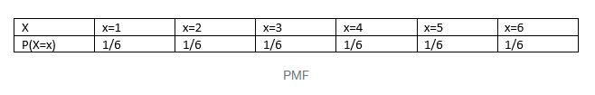
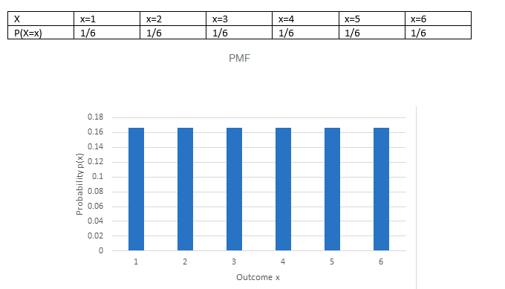
Probability Distributions - PMF
Example: Rolling of a Dice.
PMF of X is given as:

Slide 47

Probability Distributions - PDF
Probability distribution of continuous random variable is
called as Probability Density function or PDF.
where 0 ≤ p(x) ≤ 1 for all x and ∫ p(x) dx =1

Slide 48

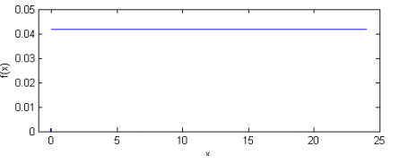
Probability Distributions - PDF
Example: A clock stops at any random time during the day
where 0 ≤ p(x) ≤ 1 for all x and ∫ p(x) dx =1
density curve

Slide 49

Probability Distributions - CDF
All random variables, discrete and continuous have a cumulative distribution function (CDF).
Denoted by F(x)
if f(x) is the PMF of x , then CDF is given as

Slide 50

Probability Distributions - CDF
if f(x) is a continuous random variable and f(x) is the
PDF of x then,

Slide 51
Thank you

