Slide 1
Probability Distribution

Slide 2
Random Variables
If the outcomes are finite (for example the 6 possibilities in a die throwing event) the random variable is said to be discrete.
If the possible outcomes are not finite (for example, drawing a number between 0 and 1 can give an infinite number of values), the random variable is said to be continuous.

Slide 3
Probability Distributions
The description of the probability of each possible value that a random variable can take is called its probability distribution.
This idea of discrete versus continuous variable is important.
The probability distribution of a random variable x describes the probability of each outcome.
It is called the probability mass function for a discrete variable and probability density function for a continuous variable.

Slide 4

Discrete Variable and Probability Mass Function
The probability mass function is the function which describes the probability associated with the random variable x. This function is named P(x) or P(x=x)
Example: Rolling a dice

Slide 5
Discrete Variable and Probability Mass Function
We can write:

Slide 6
Discrete Variable and Probability Mass Function
This distribution shows the same probability for each value: it is called the uniform distribution.

Slide 7
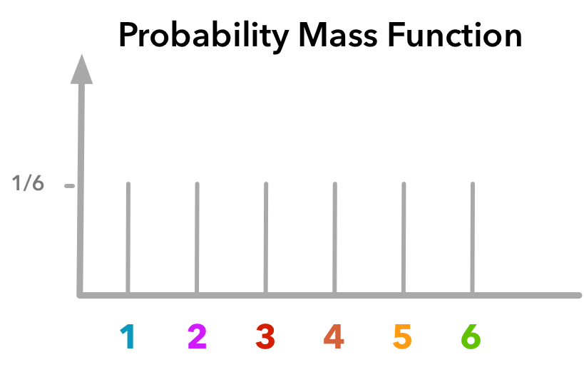
Probability Mass Function
The y-axis gives the probability and x-axis the outcome.

Slide 8
Joint probability distribution
The joint probability distribution is useful in the cases where we are interested in the probability that x takes a specific value while y takes another specific value.
For instance, what would be the probability to get a 1 with the first dice and 2 with the second dice?
The probabilities corresponding to every pair of values are written P(x=x, y=y) or P(x, y). This is what we call the joint probability.

Slide 9

Joint probability distribution
Example:

Slide 10
Continuous Variable and Probability Density Function
The equivalent of the probability mass function for a continuous variable is called the probability density function.
if we draw a number between 0 and 1, we have an infinite number of possible outcomes (for instance 0.320502304…)
To get the probability, we need to calculate the area under the curve.

Slide 11
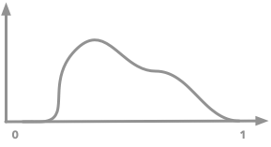
Continuous Variable and Probability Density Function
Example: Let’s say that we have a random variable x that can take values between 0 and 1

Slide 12
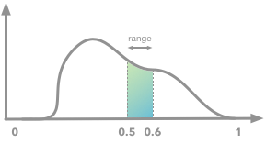
Continuous Variable and Probability Density Function
For example, the probability of drawing a value between 0.5 and 0.6 corresponds to the following area:

Slide 13
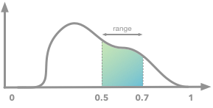
Continuous Variable and Probability Density Function
We can easily see that if we increase the range, the probability (the area under the curve) will increase as well. For instance, for the range of 0.5-0.7:

Slide 14
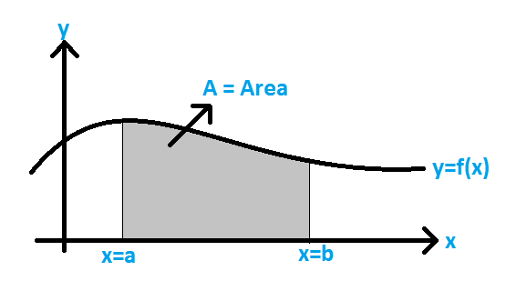
Area under the Curve
The area under a curve between two points is found out by doing a definite integral between the two points. To find the area under the curve y = f(x) between x = a & x = b, integrate y = f(x) between the limits of a and b.

Slide 15
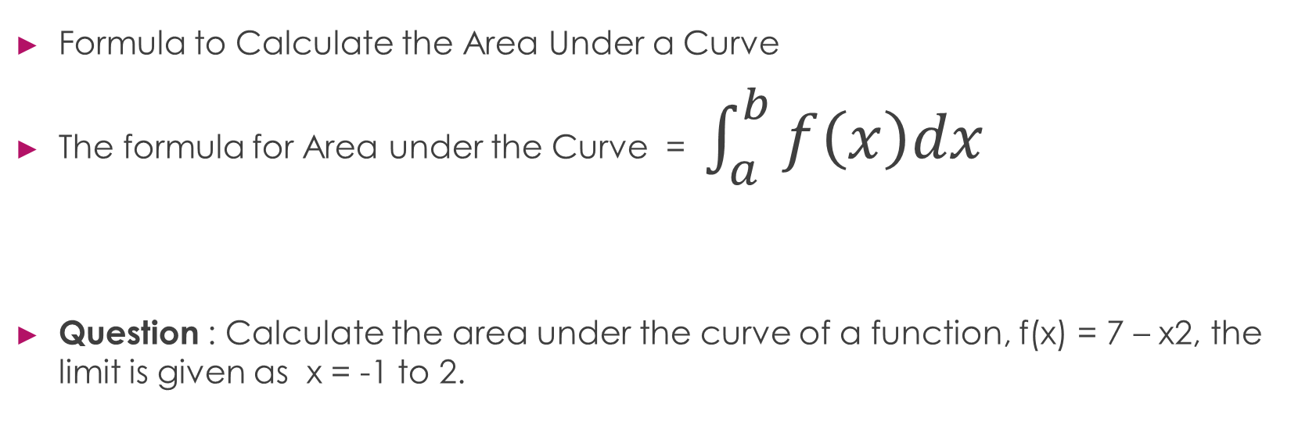
Area under the Curve
Formula to Calculate the Area Under a Curve
The formula for Area under the Curve = $\int_{a}^{b}{f\left(x\right)dx}$
Question : Calculate the area under the curve of a function, f(x) = 7 – x2, the limit is given as x = -1 to 2.

Slide 16
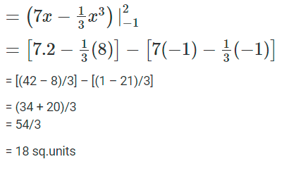

Area under the Curve
The formula for Area under the Curve = $\int_{a}^{b}{f\left(x\right)dx}$
Question : Calculate the area under the curve of a function, f(x) = 7 – x2, the limit is given as x = -1 to 2.
Area = $\int_{−1}^{2}{(7−x^{2})dx}$

Slide 17
Types of Probability Distributions
Normal Distribution
Chi square Distribution
Binomial Distribution
Poisson Distribution
Exponential Distribution etc.
The different probability distributions serve different purposes and represent different data generation processes.

Slide 18
The Binomial Distribution
"Bi" means "two"
Example: Tossing a Coin
H is ½
T is ½

Slide 19
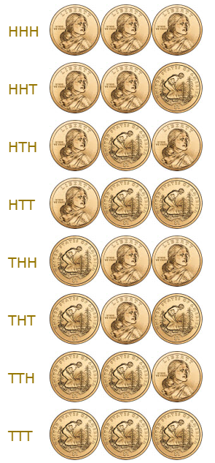
The Binomial Distribution
EXAMPLE: TOSSING A COIN 3 TIMES

Slide 20
The Binomial Distribution
Example: Tossing a Coin 3 times
Which outcomes do we want?
"Two Heads"
So 3 of the outcomes produce "Two Heads".
What is the probability of each outcome?

Slide 21
The Binomial Distribution
Example: Tossing a Coin 3 times
What is the probability of each outcome?
So, each outcome has a probability of 1/8
Number of Probability of
outcomes we want each outcome
3 × 1/8 = 3/8
So, P(2H) is 3/8

Slide 22
The Binomial Distribution
Outcome: any result of three-coin tosses (8 different possibilities)
Event: "Two Heads" out of three-coin tosses (3 outcomes have this)

Slide 23
The Binomial Distribution
3 Heads, 2 Heads, 1 Head, None
The calculations are (P means "Probability of"):
P(Three Heads) = P(HHH) =
P(Two Heads) = P(HHT) + P(HTH) + P(THH) =
P(One Head) = P(HTT) + P(THT) + P(TTH) =
P(Zero Heads) = P(TTT) =

Slide 24
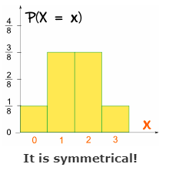
The Binomial Distribution
In terms of a Random Variable, X
P(X = 3) = 1/8
P(X = 2) = 3/8
P(X = 1) = 3/8
P(X = 0) = 1/8

Slide 25

The Binomial Distribution
Making a Formula
5 heads in 9 tosses: 512
Formula made using Pascal’s Triangle
"n choose k“
n = total number
k = number we want
the "!" means "factorial"

Slide 26
The Binomial Distribution - Example
Example: with 3 tosses, what are the chances of 2 Heads?
We have n=3 and k=2

Slide 27
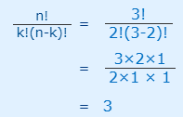
The Binomial Distribution - Example
Example: with 3 tosses, what are the chances of 2 Heads?
We have n=3 and k=2
3 outcomes that have "2 Heads"

Slide 28
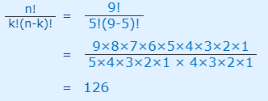
The Binomial Distribution - Example
Example: with 9 tosses, what are the chances of 5 Heads?
We have n=9 and k=5
126 outcomes will have “5 Heads"

Slide 29
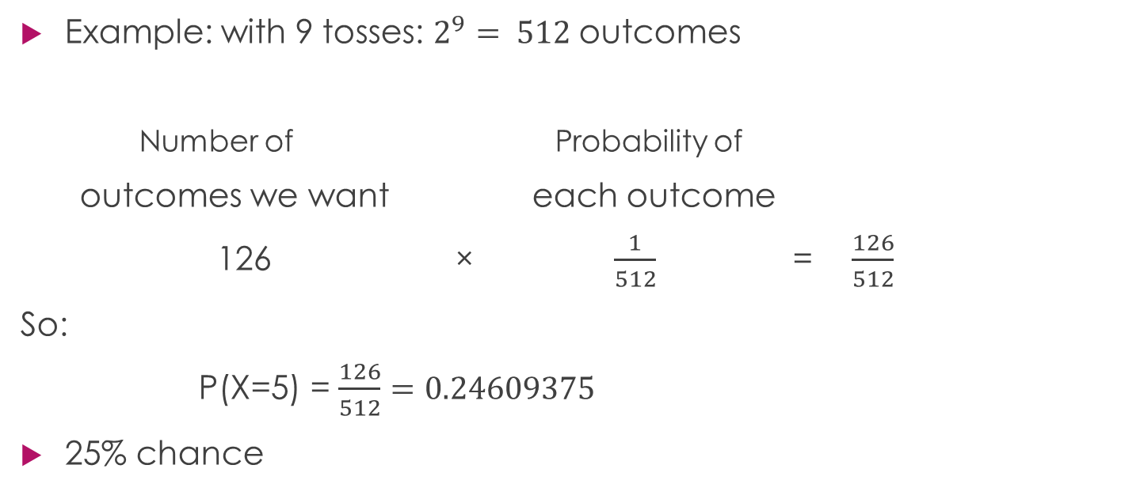
The Binomial Distribution - Example

Slide 30
Bias!
What if the coins are biased
Example: You sell sandwiches. 70% of people choose chicken, the rest choose something else.
What is the probability of selling 2 chicken sandwiches to the next 3 customers?

Slide 31
Bias
0.7
C
0.7 * 0.7 * 0.7 = 0.343
0.7 * 0.7 * 0.3 = 0.147
0.7 * 0.3 * 0.7 = 0.147
0.7 * 0.3 * 0.3 = 0.063
0.3 * 0.7 * 0.7 = 0.147
0.3 * 0.7 * 0.3 = 0.063
0.3 * 0.3 * 0.7 = 0.063
0.3 * 0.3 * 0.3 = 0.027
0.7
C
0.3
E
C
0.7
C
0.7
0.3
E
0.3
E
o
=1.000
0.7
C
0.3
0.7
C
0.3
E
E
0.7
C
0.3
E
0.3
E

Slide 32
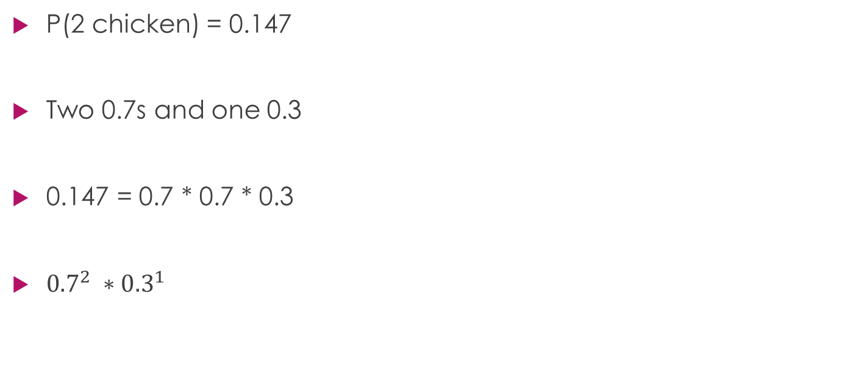
Bias!

Slide 33
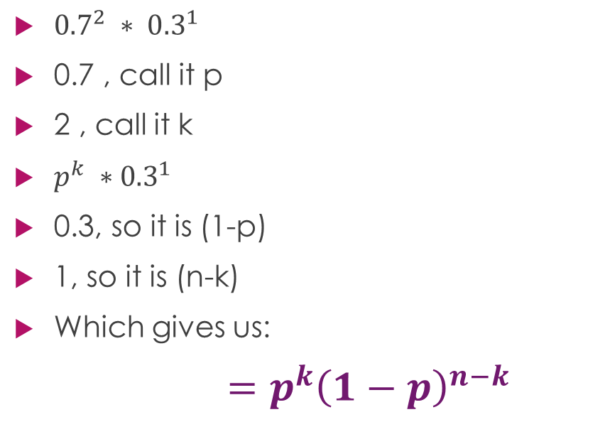
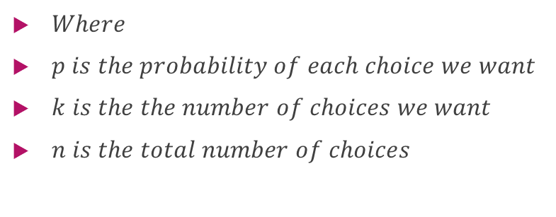
Bias!

Slide 34
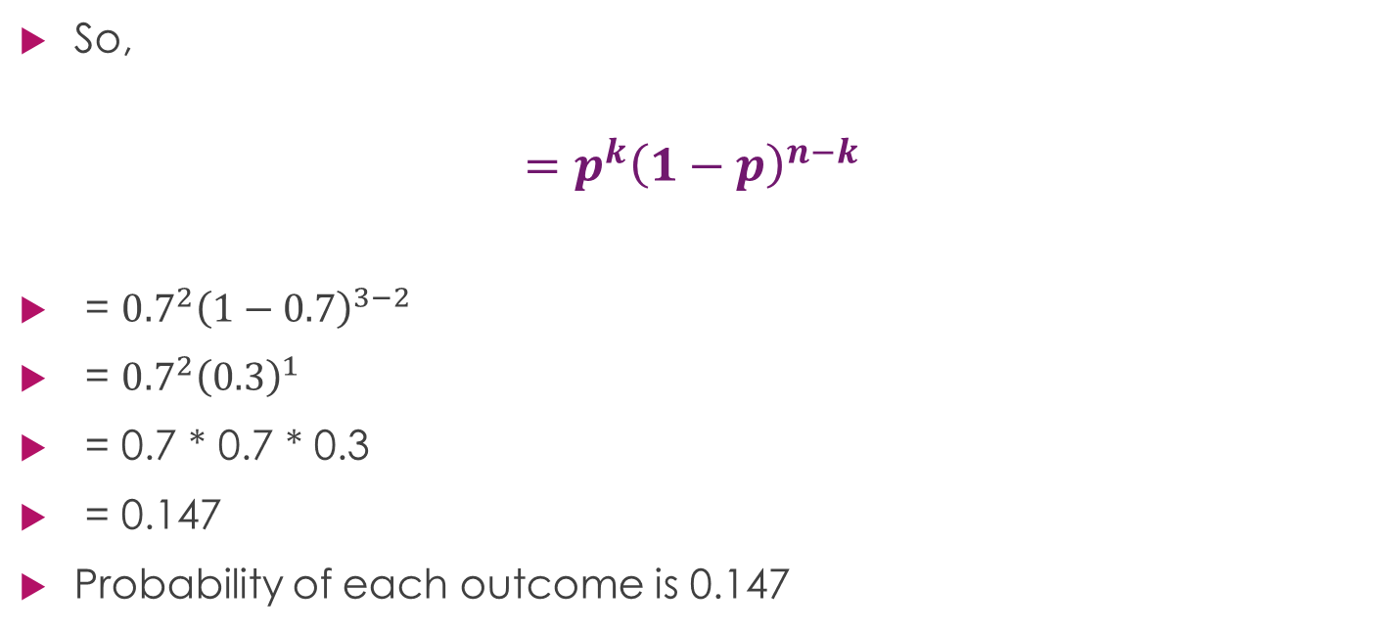
Bias! – Example continued

Slide 35
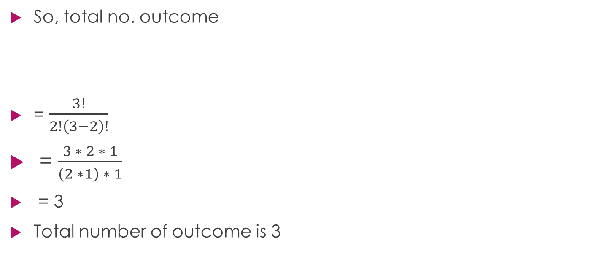
Bias! – Example continued

Slide 36
Bias! – Example continued
Number of Probability of
outcomes we want each outcome
3 × 0.147 = 0.441
Hence, the probability of event "2 people out of 3 choose chicken" = 0.441

Slide 37
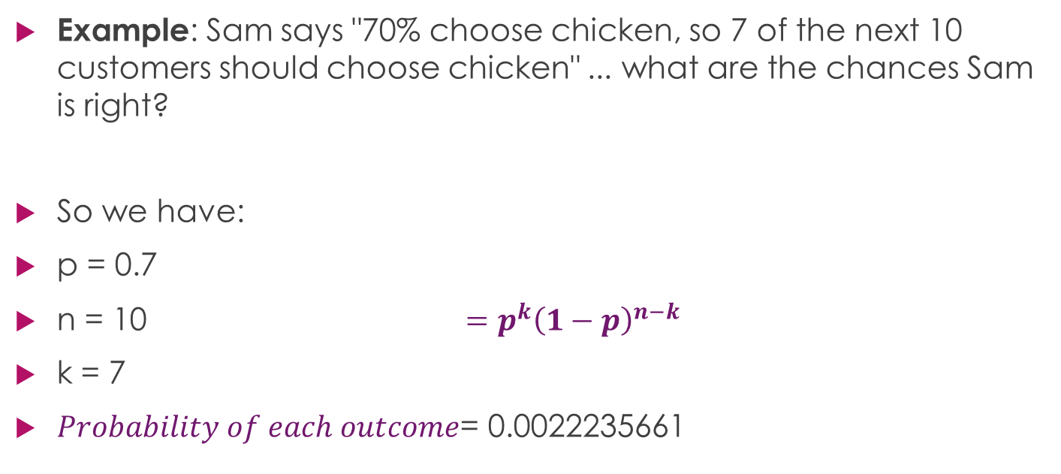
Bias! – Example 2

Slide 38
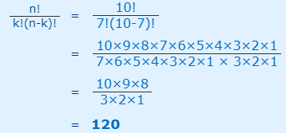
Bias! – Example 2
Total number of outcomes:

Slide 39
Bias! – Example continued
Number of Probability of
outcomes we want each outcome
120 × 0.0022235661 = 0.266827932
Hence, the probability of event “7 people out of 10 choosing chicken" is only about 27%

Slide 40


Putting it Together
Now we know how to calculate how many:
And the probability of each:
When multiplied together we get:
Probability of k out of n ways:

Slide 41
Mean, Variance & Standard deviation
Your company makes sports bikes. 90% pass final inspection (and 10% fail and need to be fixed)
What is the expected Mean and Variance of the 4 next inspections?
n = 4,
p = P(Pass) = 0.9
The mean, or "expected value", is: μ = np
μ = 4 × 0.9 = 3.6

Slide 42
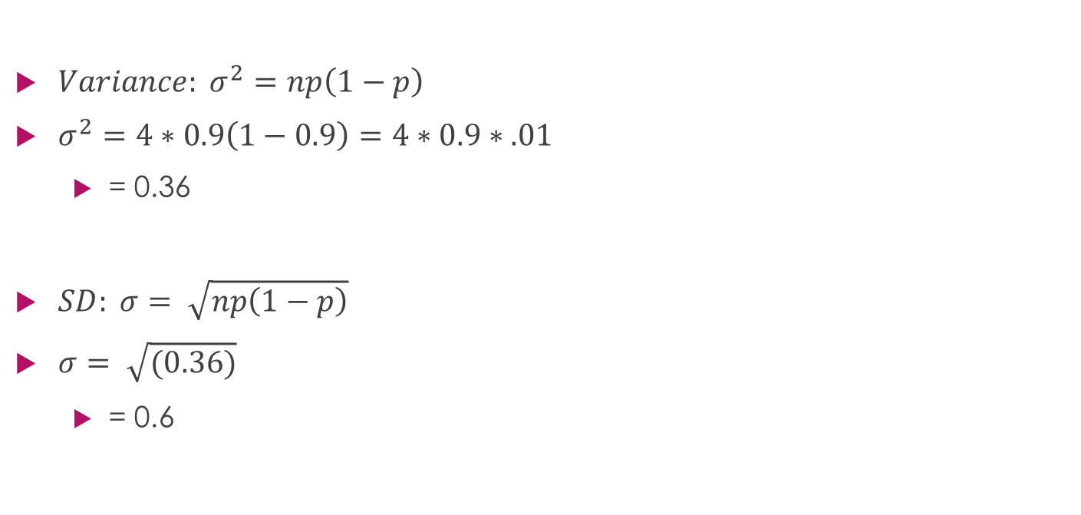
Mean, Variance & Standard deviation

Slide 43
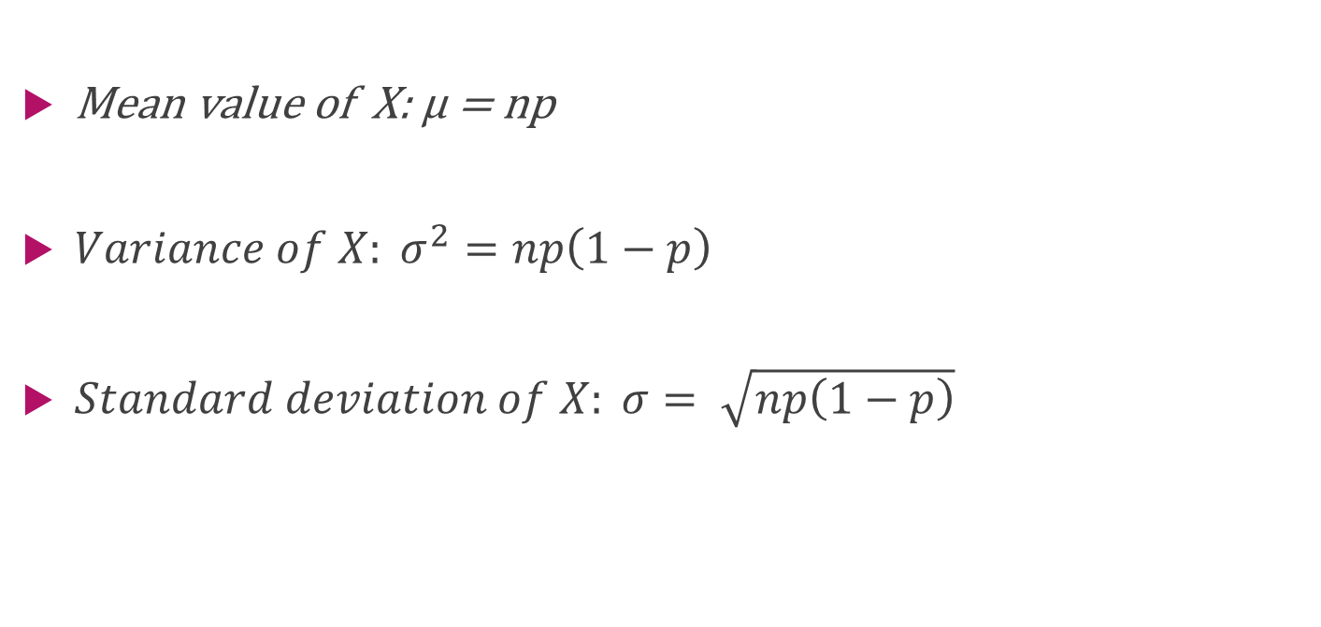
Summary

Slide 44
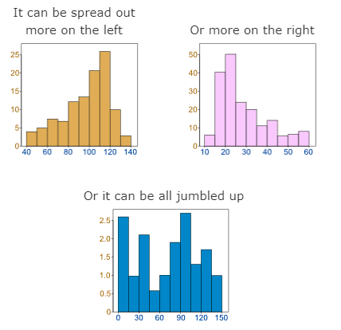
Normal Distribution
Data can be "distributed" (spread out) in different ways.

Slide 45
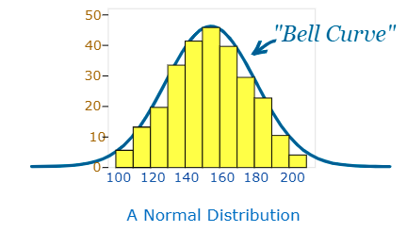
Normal Distribution
“Normal Distribution”
The "Bell Curve" is a Normal Distribution.
And the yellow histogram shows some
data that follows it closely, but not
perfectly (which is usual).

Slide 46
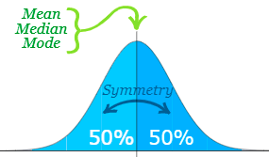
Normal Distribution
“Normally distributed”
The Normal Distribution has:
mean = median = mode
symmetry about the center
50% of values less than the mean
and 50% greater than the mean

Slide 47
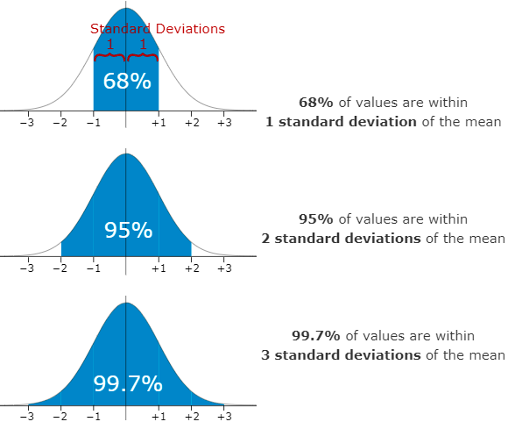
Normal Distribution
Standard Deviations
The Standard Deviation is a measure of how spread out numbers are.

Slide 48
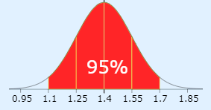
Normal Distribution
Example: 95% of students at school are between 1.1m and 1.7m tall.
Mean = (1.1m + 1.7m) / 2 = 1.4m
95% is 2 standard deviations
= (1.7m-1.1m) / 4
= 0.6m / 4
= 0.15m

Slide 49
Standard Scores
The number of standard deviations from the mean is also called the "Standard Score", "sigma" or "z-score".
Example: 1.85m tall
Z-score of 3.0

Slide 50
Standard Scores
Z-score of 3.0
Mean = 1.85 – 1.4 = 0.45m
SD is 0.15
So, 0.45/0.15 = 3 standard deviations

Slide 51
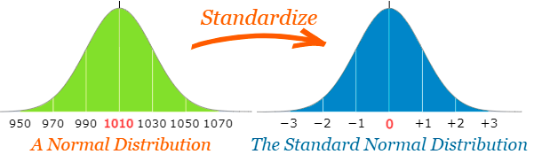
Standard Scores
So to convert a value to a Standard Score ("z-score"):
first subtract the mean,
then divide by the Standard Deviation
And doing that is called "Standardizing":

Slide 52
Example: Travel Time
A survey of daily travel time had these results (in minutes):
26, 33, 65, 28, 34, 55, 25, 44, 50, 36, 26, 37, 43, 62, 35, 38, 45, 32, 28, 34
The Mean is 38.8 minutes, and the Standard Deviation is 11.4 minutes
Convert the values to z-scores ("standard scores").

Slide 53
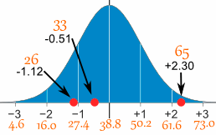
Example: Travel Time
We know, to convert a value to a Standard Score ("z-score"):
first subtract the mean,
then divide by the Standard Deviation

Slide 54

Example: Travel Time
z-score formula
z is the "z-score" (Standard Score)
x is the value to be standardized
μ ('mu") is the mean
σ ("sigma") is the standard deviation

Slide 55
Example: Travel Time
z-score formula
μ = 38.8
σ = 11.4

Slide 56
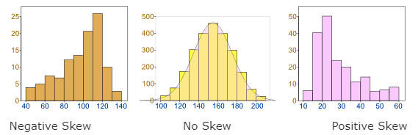
Skewed Data

Slide 57
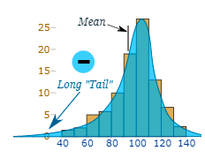
Skewed Data
Negative Skew
Because the long "tail" is on the negative side of the peak (left)

Slide 58
The Normal Distribution has No Skew
It is perfectly symmetrical.

Slide 59
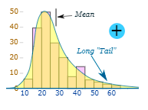
Skewed Data
Positive Skew?
Because the long "tail" is on the positive side of the peak (right)

Slide 60
Thank You

