Slide 1
Probability Distribution

Slide 2
Poisson Distribution
Poisson distribution is a discrete probability distribution
Can take specific values in each list of numbers, probably infinite
It classifies the experiment into two categories, such as success or failure.
Poisson distribution is a limiting process of the binomial distribution.

Slide 3
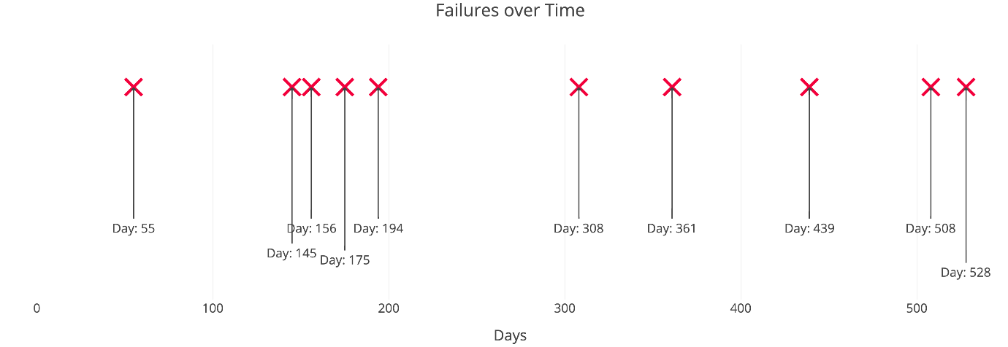
Poisson Process
A Poisson Process is a model for a series of discrete event where the average time between events is known, but the exact timing of events is random.
The arrival of an event is independent of the event before

Slide 4
Poisson Process criteria
Events are independent of each other. The occurrence of one event does not affect the probability another event will occur.
The average rate is constant.
Two events cannot occur at the same time.

Slide 5
Poisson Distribution
Finding the probability of several events in a time period or finding the probability of waiting some time until the next event.
The Poisson Distribution probability mass function gives the probability of observing k events in a time period given the length of the period and the average events per time:

Slide 6

Poisson Distribution Formula
$f\left(X\right)=\frac{e^{−λ}λ^{x}}{x!}$
Where,
e is the base of the logarithm / e is Euler's number (e = 2.71828...)
x is a Poisson random variable / x is the number of occurrences
λ is an average rate of value

Slide 7
Understanding Poisson Distributions
A Poisson distribution can be used to estimate how likely it is that something will happen "X" number of times.
For example, if the average number of people who rent movies on a Friday night at a single video store location is 400, a Poisson distribution can answer such questions as, "What is the probability that more than 600 people will rent movies?"
Examples:
historical, estimating the annual number of Prussian cavalry soldiers killed due to horse-kicks;
modern, estimating the number of car crashes in a city of a given size;
in physiology, this distribution is often used to calculate the probabilistic frequencies of different types of neurotransmitter secretions;

Slide 8

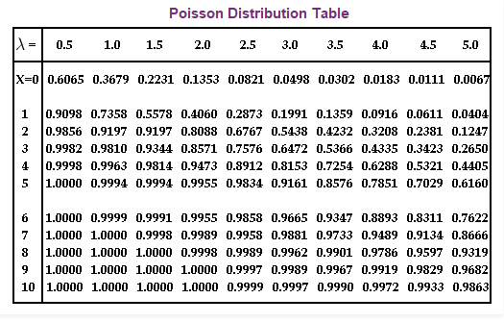
Poisson Distribution table
f(x) = P(X ≥ x)
where X has a Poisson distribution with parameter λ

Slide 9

Poisson Distribution Mean and Variance
In Poisson distribution, the mean of the distribution is represented by
λ and e is constant, which is approximately equal to 2.71828.
$P\left(x, λ\right)=\frac{e^{−λ}λ^{x}}{x!}$
E(X) = λ
E(X) = V(X)

Slide 10

Poisson Distribution Expected Value
The expected value of the Poisson distribution is given as
$E\left(X\right)=μ=\frac{d\left(e^{λ\left(t−1\right)}\right)}{dt}$ , at t=1
E(X) = λ
Expected value (mean) and the variance of the Poisson distribution is equal to λ.

Slide 11
Poisson Distribution Examples
Example 1:
A life insurance salesman sells on the average 3 life insurance policies per week. Use Poisson's law to calculate the probability that in a given week he will sell
a) Some policies
b) 2 or more policies but less than 5 policies.
c) Assuming that there are 5 working days per week, what is the probability that in a given day he will sell one policy?

Slide 12

Poisson Distribution Examples
Here, μ = 3
a) "Some policies" means "1 or more policies“
P(X > 0) = 1 − P(x₀)
Now, $P\left(X\right)=\frac{e^{−λ}λ^{x}}{x!}$
$$=P\left(x_{0}\right)=\frac{e^{−3}3^{0}}{0!}$$
$$=4.9787 ∗{10}^{−2}$$
P(X > 0) = 1 − P(x₀)
= $1−4.9787 ∗{10}^{−2}$
= 0.95021

Slide 13

Poisson Distribution Examples
b) 2 or more policies but less than 5 policies.
$P\left(2≤X≤5\right)$
$$P\left(x_{2}\right)+P\left(x_{3}\right)+P\left(x_{4}\right)$$
$$=\frac{e^{−3}3^{2}}{2!}+\frac{e^{−3}3^{3}}{3!}+\frac{e^{−3}3^{4}}{4!}$$
= 0.61611

Slide 14

Poisson Distribution Examples
c)Average number of policies sold per day:
3/5=0.6
$P\left(X\right)=\frac{e^{−0.6}{0.6}^{1}}{1!}$
= 0.32929

Slide 15


Poisson Distribution Examples
Example 2:
If electricity power failures occur according to a Poisson distribution with an average of 3 failures every twenty weeks, calculate the probability that there will not be more than one failure during a particular week.
$P\left(X=x\right)=\frac{e^{−λ}λ^{x}}{x!}$
Solution:
The average number of failures per week is: µ=3/20=0.15
“ 0 failures" plus “1 failure".
$$P\left(x_{0}\right)+P\left(x_{1}\right)=\frac{e^{−0.15}{0.15}^{0}}{0!}+\frac{e^{−0.15}{0.15}^{1}}{1!}$$
$$=0.98981$$

Slide 16
Poisson Distribution Practical
Priya is recording birds in a national park, using a microphone placed in a tree. She is counting the number of times a bird is recorded singing and wants to model the number of birds singing in a minute. For this task, she’ll assume independence of the detected birds.
Looking at the data of the last few hours, Priya observes that in average, there are two birds detected in an interval of one minute. So the value 2 could be a good candidate for the parameter of the distribution λ. Her goal is to know the probability that a specific number of birds will sing in the next minute.

Slide 17
Chi Square Distribution
The distribution of the chi-square statistic is called the chi-square distribution.
we learn to compute the chi-square statistic and find the probability associated with the statistic.
The Chi-Square Statistic

Slide 18
Chi Square Distribution The Chi-Square Statistic
We select a random sample of size n from a normal population, having a standard deviation equal to σ
We find that the standard deviation in our sample is equal to s.
Χ² = [ ( n - 1 ) * s² ] / σ²
The distribution of the chi-square statistic is called the chi-square distribution.

Slide 19
Chi Square Distribution The Chi-Square Statistic
Probability density function:
Y = Y₀ * ( Χ² ) ^{( v/2 - 1 )} * e^{-Χ2} / 2
Where,
Y0 is a constant that depends on the number of degrees of freedom,
Χ2 is the chi-square statistic,
v = n - 1 is the number of degrees of freedom,
e is a constant equal to the base of the natural logarithm system (approximately 2.71828).
Y0 is defined, so that the area under the chi-square curve is equal to one.

Slide 20
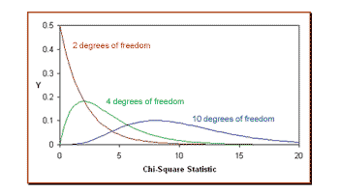
The Chi-Square Statistic
The red curve shows the distribution of chi-square values computed from all possible samples of size 3, where degrees of freedom is n - 1 = 3 - 1 = 2.
The green curve shows the distribution for samples of size 5 (degrees of freedom equal to 4)
The blue curve, for samples of size 11 (degrees of freedom equal to 10).

Slide 21
Chi Square Properties
The mean of the distribution is equal to the number of degrees of freedom: μ = v.
The variance is equal to two times the number of degrees of freedom: σ2 = 2 * v
When the degrees of freedom are greater than or equal to 2, the maximum value for Y occurs when Χ2 = v - 2.
As the degrees of freedom increase, the chi-square curve approaches a normal distribution.

Slide 22
Chi Square Problem 1
The Acme Battery Company has developed a new cell phone battery.
On average, the battery lasts 60 minutes on a single charge. The
standard deviation is 4 minutes.
Suppose the manufacturing department runs a quality control test. They
randomly select 7 batteries. The standard deviation of the selected
batteries is 6 minutes. What would be the chi-square statistic
represented by this test?

Slide 23
Chi Square Problem 1
Solution
The standard deviation of the population is 4 minutes.
The standard deviation of the sample is 6 minutes.
The number of sample observations is 7.
Χ² = [ ( n - 1 ) * s² ] / σ²
Χ² = [ ( 7 - 1 ) * 6² ] / 4²
= 13.5

Slide 24
Chi Square Problem 2
The manufacturing department ran a quality control test, using 7
randomly selected batteries. In their test, the standard deviation was
6 minutes, which equated to a chi-square statistic of 13.5.
Suppose they repeated the test with a new random sample of 7
batteries. What is the probability that the standard deviation in the
new test would be greater than 6 minutes?

Slide 25
Chi Square Problem 2
Solution
The sample size n is equal to 7.
The degrees of freedom are equal to n-1=7-1=6.
The chi-square statistics is equal to 13.5
Cumulative probability: 0.96
The probability that a standard deviation would be less than or equal to 6 minutes is 0.96.
The probability that the standard deviation would be greater than 6 minutes is 1-0.96 or 0.04

Slide 26
Chi Square Distribution Practical
df - (degree of freedom).
size - The shape of the returned array.
Draw out a sample for chi squared distribution with degree of freedom 2 with size 2x3
Visualization of Chi Square Distribution

Slide 27
Thank you

