Slide 1

Introduction to Statistics

Slide 2

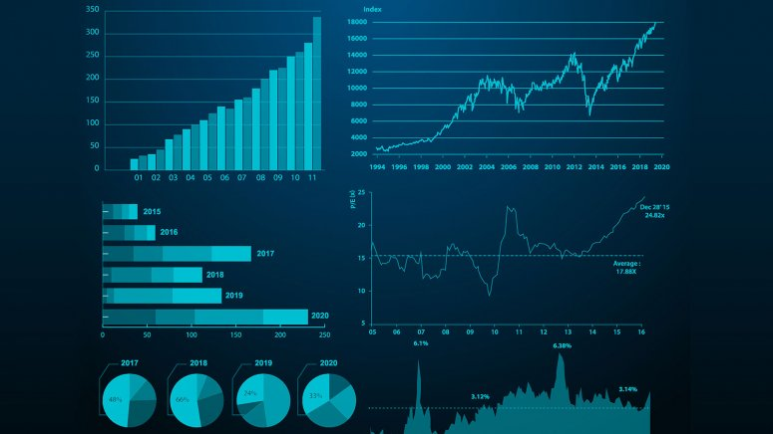
What is statistics?
Statistics is the science of learning from data.
It facilitates a way to gather, describe , process, analyze and present data.
It is a way to understand the data that is collected.
Statistics is to make sense or an inference of or meaningful insights from data

Slide 3
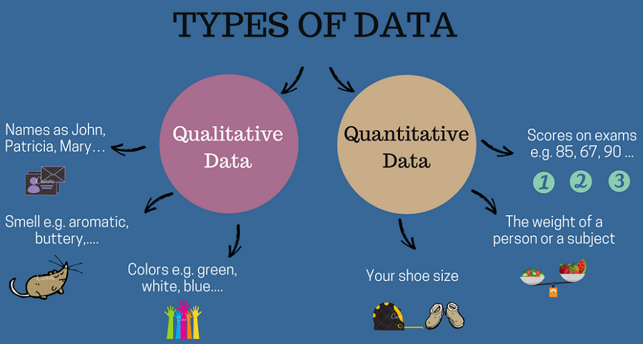
What is data ?
Data is a collection of facts, such as numbers, words, measurements, observations or just descriptions of things.
Social media giants like Facebook, Twitter, WhatsApp, Instagram, search engines like Google , Apps like Google pay have contributed to the unprecedented surge of online data that has caused data to gain monetary value
Data is categorized into two types: Quantitative and Qualitative.
Quantitative data: as the name suggest is rather numbers.
Qualitative is descriptive data.

Slide 4
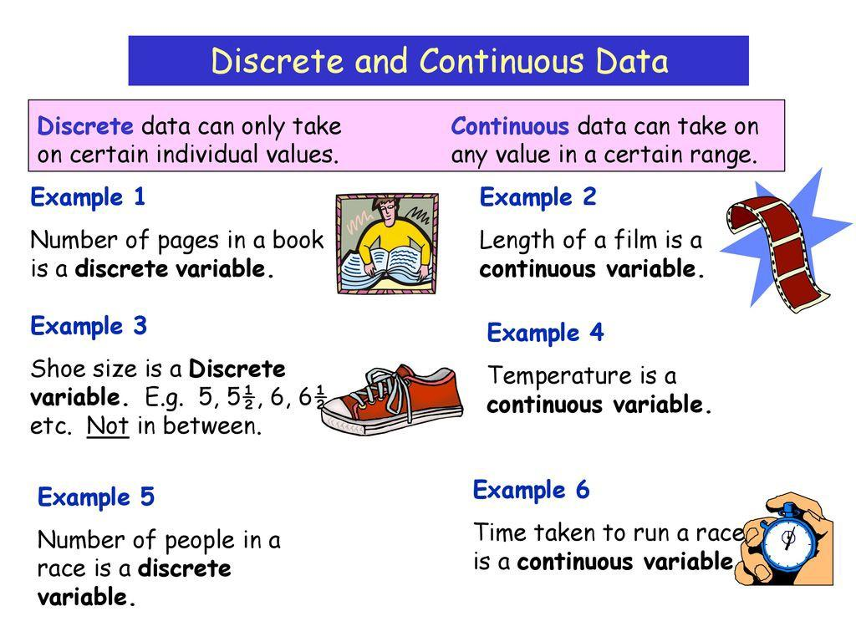
What is data ?
Discrete or whole numbers are the ones that can count and floats or continuous are those that measure.
So, your weight, height are measurements, and they are continuous.
Number of glasses , number of people are discrete because they’re counted.

Slide 5
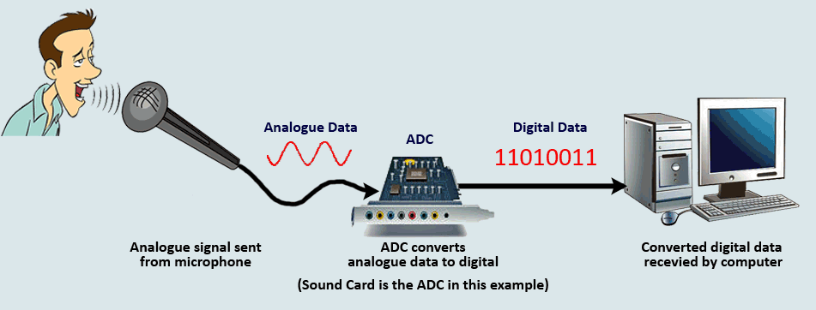
What is data ?
Other types of data: Analog and digital
The computer system transforms it, to make sense of the data and relay it to you, it is first converted to digits and becomes digital data and then is processed by the system and converted back to analog so you can hear it.
The same is true with pictures captured with a camera . The raw picture is stored on a computer or through a processing system in a digital form where numbers of digits are assigned to it in a number of little squares known as pixels.

Slide 6
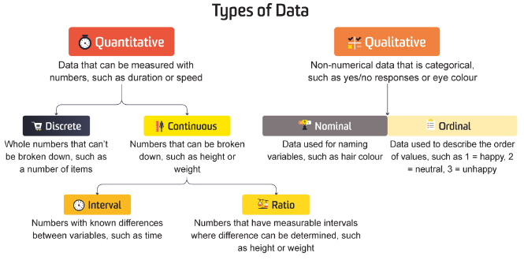
Variables?
Data item that is used to measure or count, like age, country of birth, grades, expenditure , color of your eye are all variables.
Categorical variables can be further classified as ordinal or nominal variables.
Ordinal is order. It allows you to measure the rank or the order of the variables.
A nominal type of variable on the other hand is the opposite of the ordinal where the value of the data item or the variables cannot be organized into an order. It’s a naming scale with no order
Dichotomous variables which have only two categories. For e.g. - “Do you own your phone” the answer can be a yes or a no

Slide 7
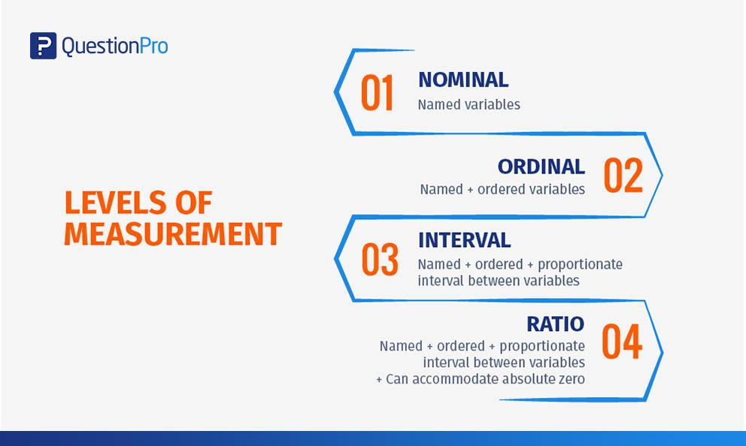
Variables?
Then there are numeric categories of the variables or quantitative variables that produce quantitative data : Interval and Ratio
Intervals are values of variables that are like ordinals or share the property of ordinals where they are ordered. Only that interval variable values have meaningful differences between them
Ratio: They have a natural zero point or absolute Zero where when the variable reaches 0 there is no more of that variable. Ratio is 1:2 you cannot have a 0 ratio.

Slide 8
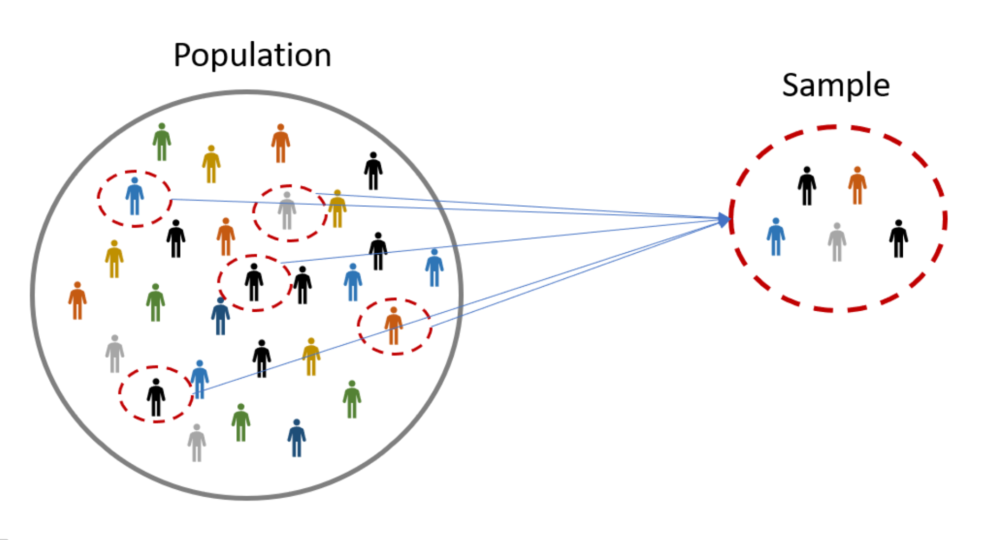
Population and sample
Population is everything you care about or every individual interest.
A population may be a community, organization, production line, weather , animals , property anything really
A sample is a random subset of the population with a smaller number of people or entities to collect data from
Parameter is related to population while statistic to sample : P to P and S to S.
Two main factors that cause the sample and population metrics or statistics to be different are the sampling error and the selection bias.

Slide 9
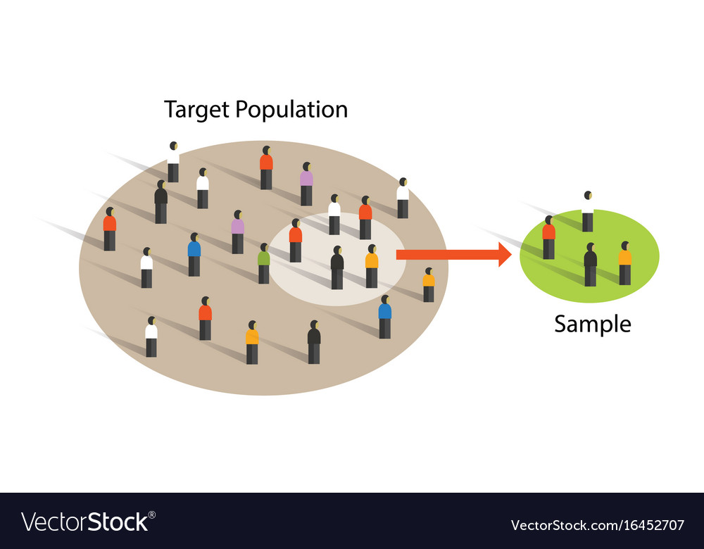
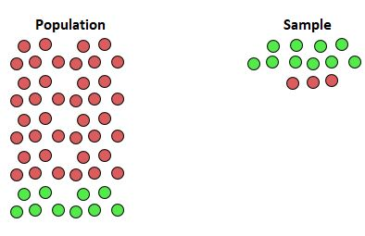
Population and sample
Two main factors that cause the sample and population metrics or statistics to be different are the sampling error and the selection bias.
The sampling error is caused due to the different characteristics
Selection bias is when the sample is not randomly selected

Slide 10
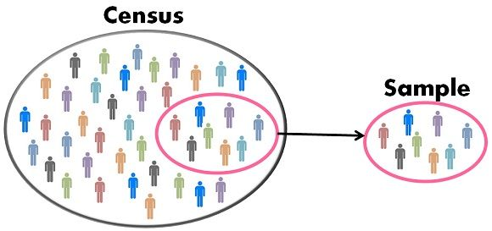
Census?
A census is when the data is collected from every member of the group or the whole target population or who the survey or the data collection is relevant to.
E.g.: 2000 students in a University and you collect data from all 2000 that would be census
Sampling is rather less accurate, however close since the data doesn’t reflect the generics of the entire population but just a part.
Primary data : Data that you collect yourself directly from the source.
Secondary data is data collected you did not collect yourself or someone else like the internet or another data repository like Kaggle.

Slide 11
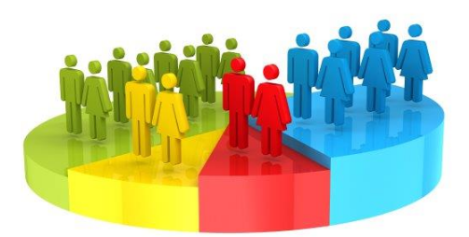
Census?
Our data collection or surveying can also be classified as Reliable or Biased
Bias is where the target audience where we collect our data from conform or emphasis is placed on certain set characteristics
Voluntary response samples are the sample where the people have chosen to contribute to the sampling or surveying where you let the sample come to you for data collection

Slide 12
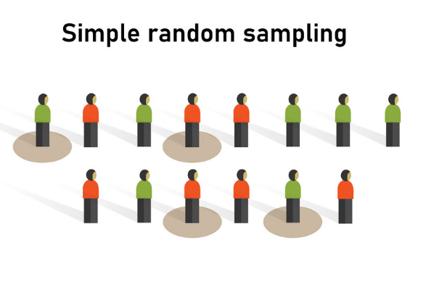
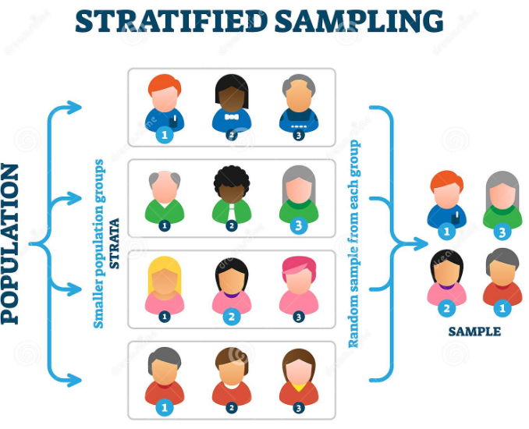
Sample types
Biased samples can be classed into two other types .
Convenience sample
Voluntary response sample
The unbiased sample have three types:
SRS
Stratified random population
Multistage

Slide 13
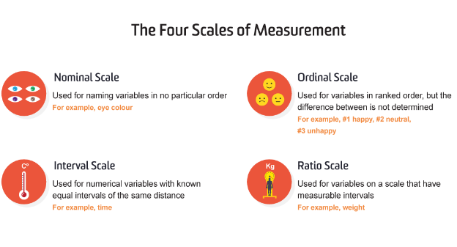
Measurement ?
Measurement is the process of applying numbers to objects according a set of rules.
There are 4 scales of measurement : Nominal, Ordinal , Interval and Ratio
Nominal measurement is where there is no specific meaning to the difference between the objects.
For eg : We assign Apple =1 and Mango = 2. It doesn’t matter what numbers we assign this data if they are different.
Ordinal scale where numbers are assigned to objects however they have a meaningful order
Interval scale of measurement has order and has equal interval between the adjacent categories
Ratios are meaningful and they have a natural zero or a true zero point where the variable means nothing

Slide 14
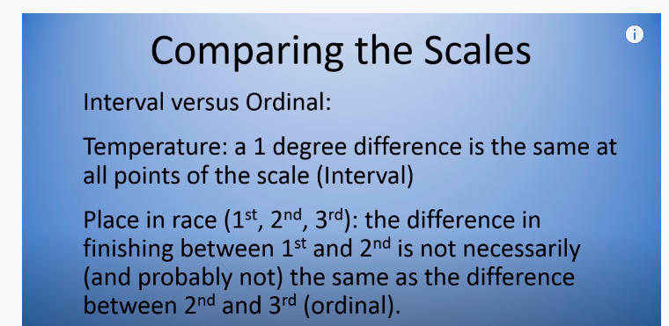
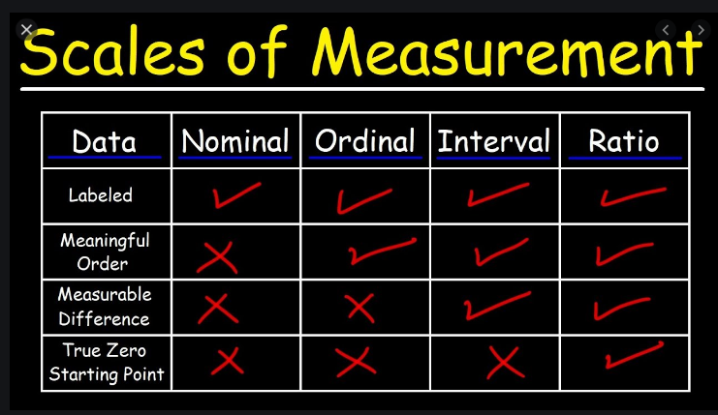
Measurement

Slide 15

Statistic and Parameters
Statistics are characteristics that describe the sample.
Parameters are characteristics describe a population.
A statistic and a parameter are very similar.
A parameter never changes.
Statistics vary.
Parameters are usually Greek letters (e.g. σ) or capital letters (e.g. P).
Statistics are usually Roman letters (e.g. s)

Slide 16
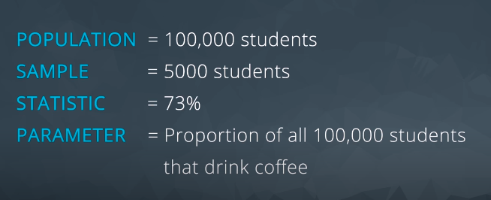
Types of statistics ?
There are two kinds of statistics : Inferential and descriptive
Inferential statistics is taking a sample and analyzing and making judgements
Descriptive statistics refers to getting data and talking about it

Slide 17
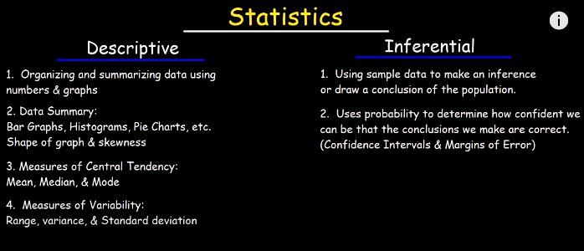
Types of statistics

Slide 18
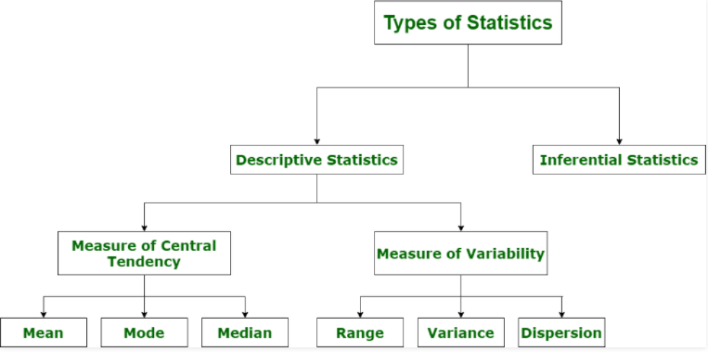

Slide 19
Types of Inferential statistics:-
Various types of inferential statistics are used widely nowadays and are very easy to interpret. These are given below:
One sample test of difference/One sample hypothesis test
Confidence Interval
Contingency Tables and Chi-Square Statistic
T-test or Anova
Pearson Correlation
Bi-variate Regression
Multivariate Regression

Slide 20
Thank you . . . !

