Slide 1
Introduction to Machine Learning

Slide 2
Introduction to Data in Machine Learning
DATA:-
Unprocessed fact, value, text, sound or picture that is not being interpreted and analyzed
Without data, we can’t train any model and all modern research and automation will go vain.
Example: Why did Facebook acquire WhatsApp by paying a huge price of $19 billion?
The answer is very simple and logical – it is to have access to the users’ information that Facebook may not have but WhatsApp will have

Slide 3
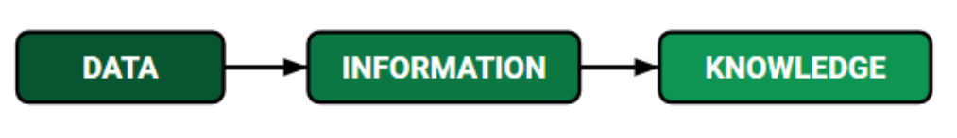
Introduction to Data in Machine Learning
INFORMATION:-
Data that has been interpreted and manipulated and has now some meaningful inference for the users.
KNOWLEDGE:-
Combination of inferred information, experiences, learning and insights.
Results in awareness or concept building for an individual or organization.

Slide 4
How do we split data in Machine Learning?
Example:-
Shopping Mart Owner who conducted a survey for which he has a long list that he had asked from the customers.
This list of questions and answers is DATA.
Now every time when he want to infer anything, he can’t just go through each and every question of thousands of customers to find something relevant as it would be time-consuming.

Slide 5
How do we split data in Machine Learning?
Example(contd.):-
In order to reduce this overhead and time wastage and to make work easier, data is manipulated through software, calculations, graphs etc.
This inference from manipulated data is Information. So, Data is must for Information.
Now Knowledge has its role in differentiating between two individuals having same information. Knowledge is not a technical content but is linked to human thought process.

Slide 6
How do we split data in Machine Learning?
Training Data:-
This is the data which your model actually sees(both input and output) and learn from.
Validation Data:-
The part of data which is used to do a frequent evaluation of model, fit on training dataset along with improving involved hyperparameters.
This data plays its part when the model is training.

Slide 7
Introduction to Data in Machine Learning
Testing Data:
Once our model is completely trained, testing data provides the unbiased evaluation.
When we feed in the inputs of Testing data, our model will predict some values.
After prediction, we evaluate our model by comparing it with actual output present in the testing data.
Data in ML
Training data
Validation data
Testing data

Slide 8
Properties of Data
Volume: Scale of Data.
Variety: Different forms of data – healthcare, images, videos, audio clippings.
Velocity: Rate of data streaming and generation.
Value: Meaningfulness of data.
Veracity: Certainty and correctness in data.

Slide 9
Some facts about Data
As compared to 2005, 300 times i.e., 40 Zettabytes (1ZB=10^21 bytes) of data will be generated by 2020.
By 2011, healthcare sector has a data of 161 Billion Gigabytes
400 Million tweets are sent by about 200 million active users per day
Each month, more than 4 Billion hours of video streaming is done by the users.
30 Billion different types of contents are shared every month by the user.
It is reported that about 27% of data is inaccurate and so 1 in 3 business idealists or leaders don’t trust the information on which they are making decisions.

Slide 10
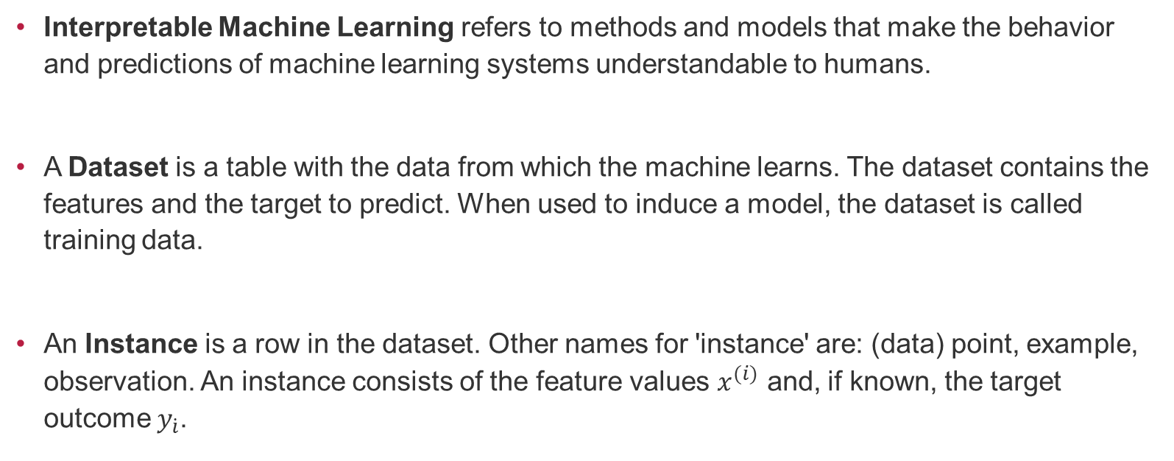
terminology
Interpretable Machine Learning refers to methods and models that make the behavior and predictions of machine learning systems understandable to humans.
A Dataset is a table with the data from which the machine learns. The dataset contains the features and the target to predict. When used to induce a model, the dataset is called training data.
An Instance is a row in the dataset. Other names for 'instance' are: (data) point, example, observation. An instance consists of the feature values $x^{(i)}$ and, if known, the target outcome $y_{\dot{i}}$.

Slide 11
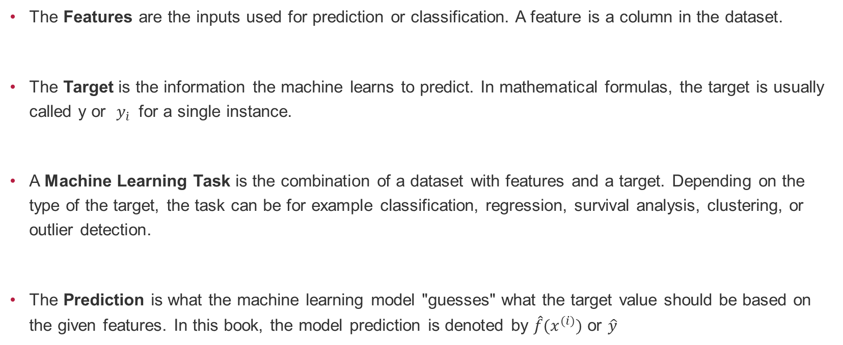
terminology
The Features are the inputs used for prediction or classification. A feature is a column in the dataset.
The Target is the information the machine learns to predict. In mathematical formulas, the target is usually called y or $y_{\dot{i}}$ for a single instance.
A Machine Learning Task is the combination of a dataset with features and a target. Depending on the type of the target, the task can be for example classification, regression, survival analysis, clustering, or outlier detection.
The Prediction is what the machine learning model "guesses" what the target value should be based on the given features. In this book, the model prediction is denoted by $\hat{f}{(x}^{(i)})$ or $\hat{y}$

Slide 12
Introduction to Machine Learning
Uses:
Prediction — Machine learning can be used in the prediction systems.
Image recognition — Machine learning can be used for face detection in an image as well.
Speech Recognition — It is the translation of spoken words into the text. It is used in voice searches and more.
Medical diagnoses — ML is trained to recognize cancerous tissues.
Financial industry and trading — companies use ML in fraud investigations and credit checks.

Slide 13
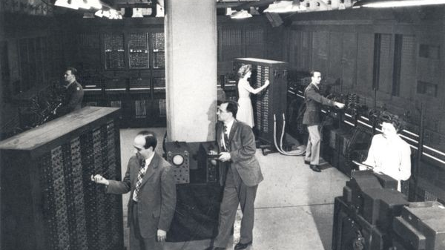
Quick History of Machine Learning

Slide 14
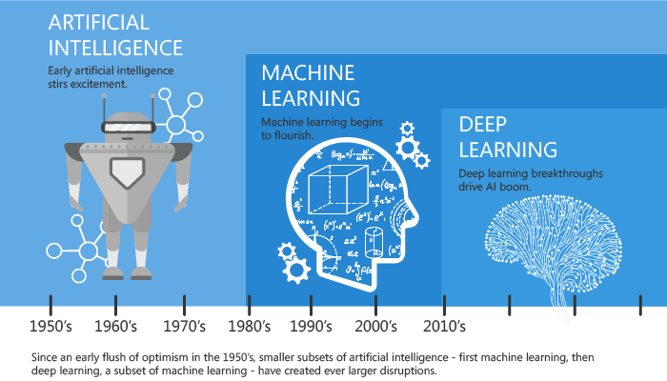
Quick History of Machine Learning

Slide 15
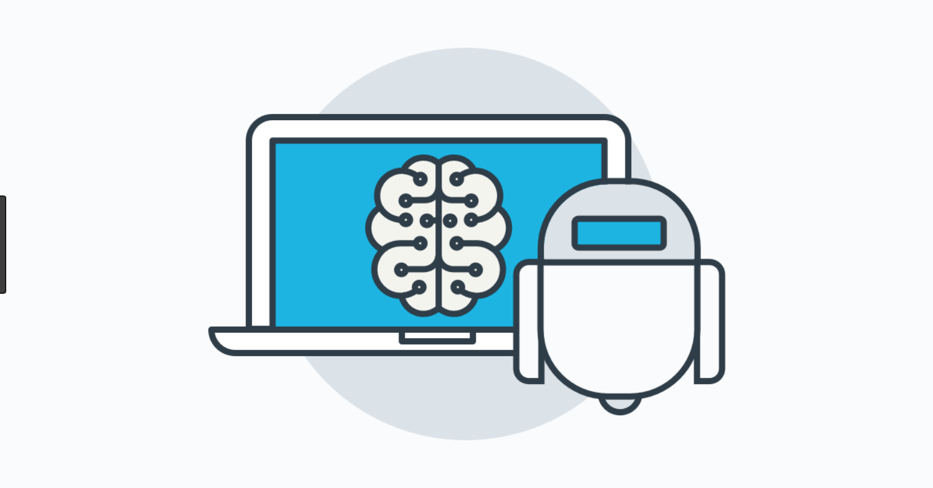
What is Machine Learning?
According to Arthur Samuel, Machine Learning algorithms enable the computers to learn from data, and even improve themselves, without being explicitly programmed

Slide 16
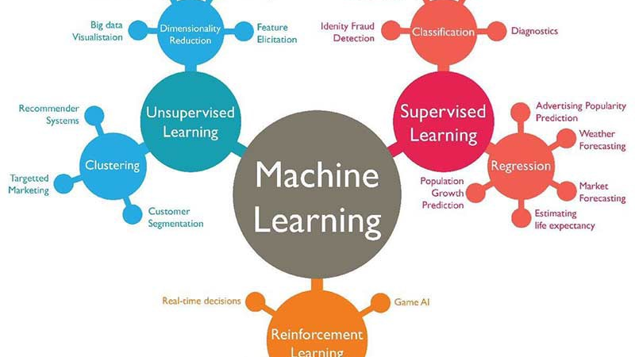
Types of Machine Learning
Supervised Learning
Unsupervised Learning
Reinforcement Learning

Slide 17
Supervised Learning Algorithm
In Supervised learning, a system is presented with data which is labelled, which means that each data tagged with the correct label.
The goal is to approximate the mapping function so well that when you have new input data (x) that you can predict the output variables (Y) for that data.

Slide 18
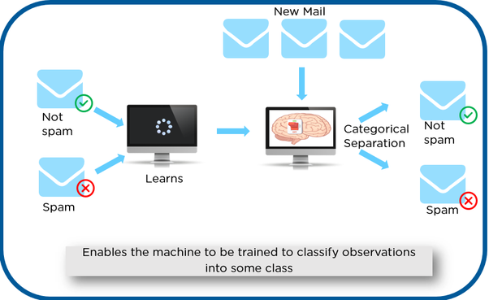
Supervised Learning Algorithm
Example:
We have initially taken some data and marked them as ‘Spam’ or ‘Not Spam’.
Once it is trained, we can test our model by testing it with some test new mails and checking of the model is able to predict the right output.

Slide 19
Supervised Learning Algorithm
Types:-
Classification: A classification problem is when the output variable is a category, such as “red” or “blue” or “disease” and “no disease”.
Regression: A regression problem is when the output variable is a real value, such as “dollars” or “weight”.

Slide 20
unsupervised Learning Algorithm
In unsupervised learning, a system is presented with unlabeled, uncategorized data and the system’s algorithms act on the data without prior training.
The output is dependent upon the coded algorithms.

Slide 21
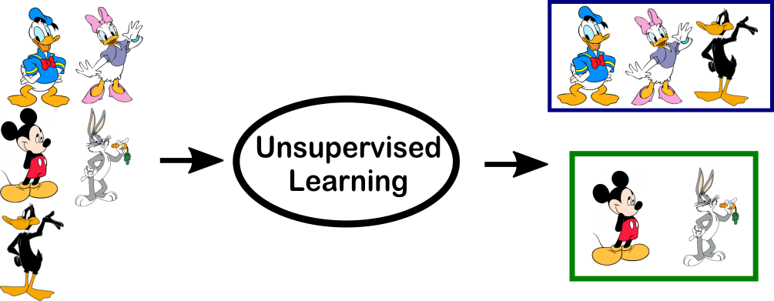
unsupervised Learning Algorithm
Example:
We have given some characters to our model which are ‘Ducks’ and ‘Not Ducks’.
In our training data, we don’t provide any label to the corresponding data.
The unsupervised model can separate both the characters by looking at the type of data and models the underlying structure or distribution in the data in order to learn more about it.

Slide 22
unsupervised Learning Algorithm
Types:-
Clustering: A clustering problem is where you want to discover the inherent groupings in the data, such as grouping customers by purchasing behavior.
Association: An association rule learning problem is where you want to discover rules that describe large portions of your data, such as people that buy X also tend to buy Y.

Slide 23
Reinforcement Learning
A reinforcement learning algorithm, or agent, learns by interacting with its environment.
The agent receives rewards by performing correctly and penalties for performing incorrectly.
It is a type of dynamic programming that trains algorithms using a system of reward and punishment.

Slide 24
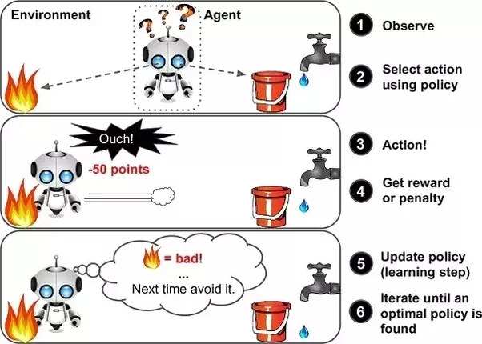
Reinforcement Learning
We can see that the agent is given 2 options i.e., a path with water or a path with fire.
A reinforcement algorithm works on reward a system i.e., if the agent uses the fire path, then the rewards are subtracted, and agent tries to learn that it should avoid the fire path.

Slide 25
Reinforcement Learning
If it had chosen the water path or the safe path then some points would have been added to the reward points, the agent then would try to learn what path is safe and what path isn’t.
It is basically leveraging the rewards obtained, the agent improves its environment knowledge to select the next action.

Slide 26
Thank you

