Slide 1

Department of CSE - Data Science
HEART FAILURE DETECTION USING MACHINE LEARNING
Batch No: 7
218R1A6706 ANKITH SINGH
2. 218R1A6715 B.MANASWI KALYAN
3. 218R1A6738 L.SAI KIRAN
4. 218R1A6754 S. SAI KALPANA
Under the Guidance of
ASSISTANT PROFESSOR MRS.P.SANDHYA REDDY

Slide 2
OUTLINE
Abstract
Introduction
Literature survey
Existing System
Proposed System
Methodology (or) Block Diagram
References

Slide 3
ABSTRACT
The project "Heart Failure Detection Using Machine Learning" presents an innovative approach aimed at leveraging machine learning techniques for the early detection of heart failure. Through the development of a predictive model, trained on extensive medical datasets and machine learning algorithms, the project seeks to accurately identify patterns and indicators associated with heart failure. This endeavor is driven by the goal of enabling timely intervention and improving patient care outcomes. Rigorous experimentation and validation protocols are employed to assess the effectiveness and reliability of the model, demonstrating its potential to enhance healthcare practices. By providing clinicians with a proactive tool for managing heart-related conditions, this research endeavors to contribute to the advancement of healthcare delivery and improved patient outcomes through the integration of machine learning technology into clinical settings.
Keywords:Heart Failure, Machine Learning, Predictive Model, Healthcare, Early Detection, Medical Datasets, Intervention, Patient Care, Clinical Settings, Healthcare Delivery.

Slide 4
INTRODUCTION
Diagnosing heart disease poses a significant challenge due to the multitude of contributory risk factors, including diabetes, high blood pressure, high cholesterol, and abnormal pulse rates, among others. Among various life-threatening ailments, heart disease commands substantial attention in medical research. Automated prediction of heart conditions is imperative for effective treatment, given the complexity of diagnosing the disease. Currently, diagnosis primarily relies on patient signs and symptoms. Severity classification often employs methods such as the K-Nearest Neighbor Algorithm (KNN), Decision Trees (DT), SVM and Naive Bayes (NB). The Complex nature of heart disease necessitates careful handling to mitigate adverse outcomes, including heart complications and premature death.

Slide 5
LITERATURE SURVEY
S. No | Author | Title | Year | Contributions
1. | Mr. Santhana Krishnan.J, Dr. Geetha.S | Prediction of Heart Disease Using Machine Learning Algorithms". | 2018 | Algorithms Used : Decision Tree Naive Bayes Accuracy : Accuracy: 87%
2. | M. Marimuthu, S. Deivarani, Gayathri.R | Analysis of Heart Disease Prediction using Various Machine Learning Techniques | 2022 | Algorithms Used : K-Nearest Neighbor (KNN) Naive Bayes (NB) Decision Tree Accuracy : Accuracy: 75.58%

Slide 6
EXISTING SYSTEM
The existing heart disease prediction system employs Machine Learning for disease classification using patient data.
Challenges include limited interpretability, scalability issues due to resource-intensive algorithms, and overfitting risks.
Dataset quality issues, such as biases and missing values, undermine prediction reliability.
Continuous manual feature engineering and model maintenance add complexity and overhead.
Despite promising results, improvements are needed for enhanced effectiveness and reliability in real-world healthcare settings.

Slide 7
DISADVANTAGES
1. Interpretability: The ability to understand and interpret the reasoning behind the model's predictions or decisions.
2. Scalability: The capability of the system to handle increasing amounts of data or user requests without compromising performance.
3. Overfitting: Occurs when the model learns noise or irrelevant patterns in the training data, resulting in poor generalization to unseen data.
4. Dataset Quality: Refers to the reliability, completeness, and representativeness of the data used to train the model.
5. Maintenance: The ongoing process of updating, monitoring, and refining the model to ensure its accuracy and relevance over time.
6. Adaptability: The ability of the system to adjust and evolve in response to changing environments, requirements, or trends.
7. Generalization: The ability of the model to perform well on unseen data from the same distribution as the training data.
8. Transparency: Refers to the clarity and openness of the model's decision-making process, enabling users to understand and trust its outputs.
9. Integration: The process of incorporating the model seamlessly into existing systems, workflows, or infrastructure.
10. Complexity: The degree of intricacy or sophistication in the model's architecture, algorithms, or implementation.

Slide 8
Proposed System for Heart Disease Prediction
Advanced Algorithm Integration: Utilize cutting-edge algorithms like deep learning, ensemble methods, and probabilistic graphical models to enhance prediction accuracy and robustness.
Explainable AI Techniques: Implement methodologies to improve model interpretability and transparency, enabling healthcare professionals to trust predictions.
Continuous Learning Framework: Develop a system that adapts to evolving data distributions and healthcare trends, ensuring long-term effectiveness.
Automated Feature Engineering: Utilize techniques to identify relevant features from raw data, reducing manual effort and improving prediction performance.
Model Monitoring and Maintenance: Establish protocols for continuous evaluation, drift detection, and model updates to ensure ongoing accuracy.
Personalized Medicine Integration: Tailor predictions to individual patient characteristics, enhancing precision and effectiveness.
Scalable Infrastructure Deployment: Deploy scalable infrastructure to handle large data volumes and user requests, ensuring responsiveness.
This proposed system aims to improve prediction accuracy, interpretability, and adaptability for heart disease prediction, ultimately enhancing patient outcomes and quality of care.

Slide 9
ADVANTAGES
1. Enhanced Prediction Accuracy
2. Improved Interpretability
3. Adaptability to Changing Trends
4. Efficiency and Automation
5. Personalized Healthcare
6. Scalability and Responsiveness
7. Ethical Compliance and Data Privacy

Slide 10
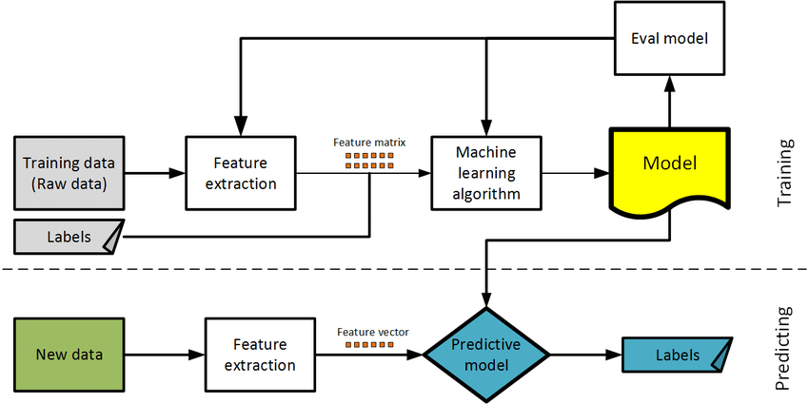
Methodology

Slide 11
ALGORITHMS USED
Naive Bayes: Simple and efficient for modeling conditional probabilities, ideal for text classification and categorical features.
Support Vector Machine (Linear): Robust binary classifier for linearly separable data, resistant to overfitting and effective in high-dimensional spaces.
K-Nearest Neighbours: Non-parametric classifier suitable for complex decision boundaries and noisy data, easy to implement.
Decision Tree: Interpretable model handling both numerical and categorical data, often used in ensemble methods.
Random Forest: Robust ensemble of decision trees, effective in reducing overfitting and improving prediction accuracy, especially for large datasets.

Slide 12
HARDWARE REQUIREMENTS
SOFTWARE REQUIREMENTS
Operating System : Windows11
Coding Language : Python 3.7
Interpreter : Anaconda
System : 6 cores processer
Drive (Storage) : 25mb - 500mb
Ram : 512 Mb

Slide 13
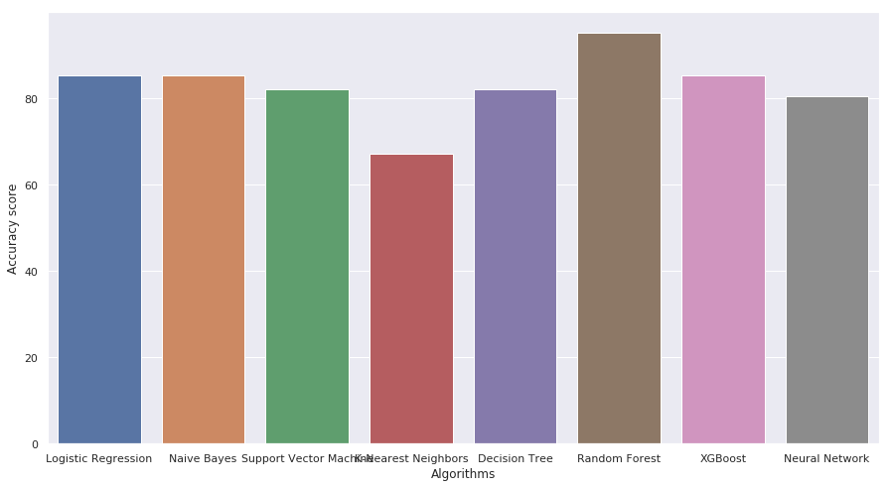
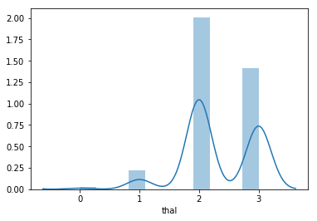
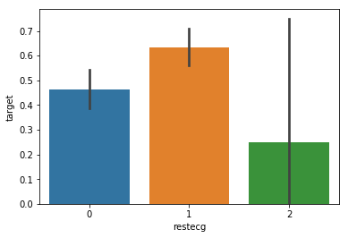
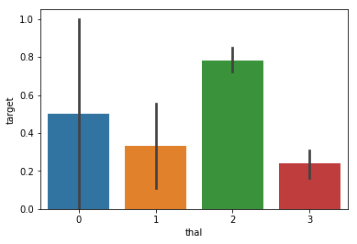
EXPECTED RESULTS
Thalassemia Results of the patient
ECG RESULTS OF OF PATIENT
ACCURACY RESULTS OF DIFFERENT ALGORITHMS

Slide 14
REFERENCES
Hastie, T., Tibshirani, R., & Friedman, J. (2009). The Elements of Statistical Learning: Data Mining, Inference, and Prediction. Springer.
Bishop, C. M. (2006). Pattern Recognition and Machine Learning. Springer.
Scikit-learn Documentation: https://scikit-learn.org/stable/documentation.html
Kaggle Kernels and Datasets: https://www.kaggle.com/
UCI Machine Learning Repository: https://archive.ics.uci.edu/ml/index.php

Slide 15
CONCLUSION_{(EXPECTED)}
The utilization of diverse machine learning algorithms, including Naive Bayes, Support Vector Machine (Linear), K-Nearest Neighbours, Decision Tree, and Random Forest, offers a comprehensive approach to heart disease prediction.
Each algorithm brings unique strengths to the prediction process, such as simplicity, robustness, and scalability, enhancing prediction accuracy, interpretability, and adaptability to changing data distributions.
Ensemble methods, particularly with Random Forest, hold promise in improving prediction accuracy while mitigating overfitting and handling noisy data effectively.
The transparency provided by Decision Tree models aids in understanding the underlying decision-making process, instilling trust in the predictions made by the system.
Continuous monitoring, model maintenance, and ethical considerations are essential to ensure the system's effectiveness and reliability in real-world healthcare applications.

Slide 16
QUERIES ??

Slide 17
THANK YOU

