Slide 1


P.E.S. COLLEGE OF ENGINEERING, MANDYA
DEPARTMENT OF INFORMATION SCIENCE & ENGINEERING
Team No: 1
"Deep Learning-Based Plant Health and Advisory Platform
for Angiosperm Plants"
Kisan Sahayak — AI-Powered Farmer Assistance Platform
TEAM MEMBERS
UNDER THE GUIDANCE OF
Ankith M – 4PS22IS006
Madan A – 4PS22IS033
Mohith M Y – 4PS23IS405
Hemanth C N – 4PS22IS022
Dr. Minavathi
Professor, ISE Department
P.E.S. College of Engineering, Mandya
Department of Information Science & Engineering | P.E.S. College of Engineering, Mandya – 571401

Slide 2
Agenda
1. Problem Identification & Motivation
8. User Dashboard & History
2. Objectives of the Project
9. Multilingual Support & AI Fallback Strategy
3. Phase-2 Recap
10. Database Design & Data Models
4. System Architecture & Tech Stack
11. Results & Outcomes
5. Plant Disease Detection – Methodology & Workflow
12. Limitations & Future Scope
6. Crop Recommendation – Methodology & Workflow
13. SDG Mapping
7. AI Farming Chatbot – Methodology & Workflow
14. References
Department of Information Science & Engineering
2

Slide 3
Problem Identification & Motivation
Problem Statement
The Gap
Agriculture is the livelihood of millions in India, yet farmers face:
Lack of real-time insights on crop health, soil, and weather.
Language barriers preventing access to digital farming tools.
Delayed disease detection causing significant yield loss.
Poor internet connectivity in rural and semi-urban areas.
No single integrated platform combining diagnosis, recommendation, and advisory support.
There exists no single, multilingual, and offline-capable AI platform that provides:
• Real-time agricultural support
• Crop advisory services
• Deep learning-based disease detection
...for Angiosperm plants in the farmer's native language.
Department of Information Science & Engineering
3

Slide 4
Objectives of the Project
01
Integrated AI Platform
02
Deep Learning Disease Detection
Develop a unified AI-powered farming assistant combining disease detection, crop advisory, chatbot support, and dashboard history into one full-stack SaaS web platform.
Design and deploy a CNN-based image classification model (my_cnn_model.h5, trained on PlantVillage ~87k images, 38 classes) for early and accurate Angiosperm plant disease detection.
03
Real-Time & Offline AI Support
04
Multilingual Accessibility
Implement a dual-mode AI pipeline: Gemini API for cloud intelligence and Ollama (LLaMA 3.2) as local fallback, ensuring continuous assistance even without internet.
Provide localized, AI-generated responses in 12 Indian languages (Hindi, Kannada, Tamil, Telugu, Malayalam, Marathi, Bengali, Punjabi, Gujarati, Oriya, Assamese, English).
Department of Information Science & Engineering
4

Slide 5
Technology Stack
Frontend & Framework
Backend & Database
AI / LLM Layer
ML / Python
Integrations
Next.js 15 (App Router)
Next.js API Route Handlers
Google Gemini API (primary)
TensorFlow + Keras
OpenWeatherMap API
React 19 + TypeScript
MongoDB + Mongoose
Ollama + LLaMA 3.2 (fallback)
CNN — my_cnn_model.h5
Twilio / WhatsApp API
Tailwind CSS
RESTful API design
OpenAI SDK (advisory)
Python predict.py script
Clerk (Auth + User Mgmt)
Clerk Authentication
Swagger / OpenAPI Docs
Prompt Engineering
PlantVillage dataset (87k)
Base64 Image Pipeline
Department of Information Science & Engineering
7

Slide 6
Feature 1: Plant Disease Detection — Methodology
CNN Architecture
Training & Methodology Details
Input: 224×224 RGB Leaf Image
Dataset: PlantVillage + New Plant Diseases (~87,000 images, 38 classes)
Preprocessing: Resize 224×224, normalize [0,1], augment (flip, rotation, zoom)
Model: Custom CNN in TensorFlow/Keras — supervised classification
Optimizer: Adam | Loss: Categorical Cross-entropy
Output: 38-class softmax prediction with confidence score
Inference: predict.py receives base64 image from API route, decodes, preprocesses, runs model.predict()
Post-process: Top class label + confidence returned to Next.js route handler
LLM Layer: Gemini/Ollama generates causes, symptoms, treatment, prevention in selected language
▼
Conv2D (32 filters, 3×3, ReLU) + MaxPool
▼
Conv2D (64 filters, 3×3, ReLU) + MaxPool
▼
Conv2D (128 filters, 3×3, ReLU) + MaxPool
▼
Flatten → Dropout (0.5)
▼
Dense (256, ReLU) → Dense (38, Softmax)
▼
Output: Disease Class + Confidence %
Department of Information Science & Engineering
8

Slide 7
Feature 1: Plant Disease Detection — Workflow
1
2
3
4
5
6
7
→
→
→
→
→
→
User Uploads
Plant Image
Frontend Sends
to API Route
Base64 → Python
predict.py
CNN Model
Predicts Disease
Disease Class
+ Confidence
Gemini/Ollama
Generates Treatment
Result Shown
+ Saved to DB
API Flow Detail
Step | API Route / Script | Action
Upload Image | app/api/analyze-plant/route.ts | Receive image, encode to Base64, spawn Python process
ML Inference | scripts/predict.py | Load my_cnn_model.h5, preprocess, model.predict(), return class+confidence
Treatment | app/api/analyze-plant/treatment/route.ts | Call generateTextWithFallback() → Gemini first, Ollama fallback, in selected language
Save Record | models/DiseaseDetection.ts | Persist detection result + treatment to MongoDB for dashboard
Department of Information Science & Engineering
9

Slide 8
Feature 2: Crop Recommendation — Methodology & Workflow
Rule-Assisted AI Methodology
Workflow
Input Factors Collected:
• State (→ climate region mapping) • Planting season selected by user • Soil type (clay, loam, sandy, black, red) • Desired harvest timeline • Language preference
Logic Pipeline:
• Derive current season from server timestamp • Map state → climate zone • Compute expected harvest season • Generate structured AI prompt • Gemini/Ollama returns crop list + rationale • Parse into: crop name + why suitable
Storage: Recommendation + reasoning saved to MongoDB CropRecommendation collection
1. User selects: State + Season + Soil + Timeline + Language
▼
2. System derives: climate zone, current season, harvest window
▼
3. Build AI Prompt → Send to Gemini / Ollama
▼
4. Parse AI response → Structured crop list with rationale
▼
5. Save to MongoDB + Render recommendations in UI
Department of Information Science & Engineering
10

Slide 9
Feature 3: AI Farming Chatbot — Methodology & Workflow
Chatbot Methodology
Request–Response Flow
System Prompt Design:
• Scoped strictly to agriculture and farming topics • Prevents off-topic or harmful responses • Encourages practical, actionable guidance
AI Backend:
• generateTextWithFallback() in utils/api-fallback.ts • Checks internet → tries Gemini → falls back to Ollama • Conversation history passed as context for coherent multi-turn dialogue
Persistence:
• Full conversation (user + assistant turns) stored in MongoDB ChatbotConversation model
• User can revisit, continue, or delete past conversations from dashboard
User: Types farming query in selected language
▼
Frontend: Sends message + conversation history to /api/chatbot
▼
API Route: Applies system prompt + calls generateTextWithFallback()
▼
AI Model: Gemini/Ollama returns contextual farming advice
▼
System: Response displayed + full conversation saved to MongoDB
Department of Information Science & Engineering
11

Slide 10
Feature 4: User Dashboard & History
Converts one-time AI outputs into a persistent, reviewable SaaS user record system.
Disease Detection History
Crop Recommendation History
Chatbot Conversation History
1. Lists all past disease detections per user
1. Lists all past crop recommendations per user
1. Lists all saved conversations with timestamps
2. Shows: plant image, detected disease, confidence, date
2. Shows: state, season, soil type, recommended crops
2. Full multi-turn dialogue preserved per session
3. Modal popup for full treatment + prevention details
3. Full rationale available in expandable modal
3. User can continue, export, or delete conversations
4. User can delete records from dashboard
4. Supports comparison across planting decisions
4. Enables ongoing, context-aware advisory sessions
Department of Information Science & Engineering
12

Slide 11
Feature 5 & 6: Multilingual Support & AI Fallback Strategy
Multilingual Support
Gemini + Ollama Fallback Strategy
Hindi
Bengali
1. Check internet connectivity
Kannada
Punjabi
2. Try Gemini API (cloud intelligence, rich responses)
Tamil
Gujarati
→ If OK: Use Gemini response directly
Telugu
Oriya
→ If FAIL: Switch to Ollama (local LLaMA 3.2 model)
Malayalam
Assamese
Marathi
English
3. Return result to API route handler
Language is passed as a parameter to disease treatment generation and crop recommendation flows.
Implementation: utils/api-fallback.ts → generateTextWithFallback()
Department of Information Science & Engineering
13

Slide 12
End-to-End System Workflow
Disease
Detection
Image Upload
CNN Inference
Disease Class
LLM Treatment
Save + Dashboard
→
→
→
→
Crop
Recommendation
State/Soil/Season
Climate Mapping
AI Prompt Build
Structured Crops
Save + Dashboard
→
→
→
→
AI
Chatbot
User Query
System Prompt
Gemini/Ollama
Multi-turn Context
Save + Dashboard
→
→
→
→
All flows protected by Clerk Authentication | Auth state checked before every API route
Department of Information Science & Engineering
15

Slide 13
Results & Outcomes
38
~87K
12
2
Disease Classes
Detected by CNN
Training Images
(PlantVillage dataset)
Indian Languages
Supported
AI Models
(Gemini + Ollama)
Achieved Features
✔ Plant disease detection from leaf images via CNN
✔ User dashboard with disease, crop & chat history management
✔ AI-generated treatment, prevention & advisory in 12 languages
✔ Dual-mode AI: Gemini (cloud) + Ollama (local offline fallback)
✔ Rule-assisted crop recommendation with seasonal & soil logic
✔ Full-stack SaaS with Clerk auth, MongoDB persistence, Next.js 15
✔ Multi-turn AI farming chatbot with full history persistence
✔ WhatsApp/Twilio extension module for rural accessibility
Department of Information Science & Engineering
16

Slide 14
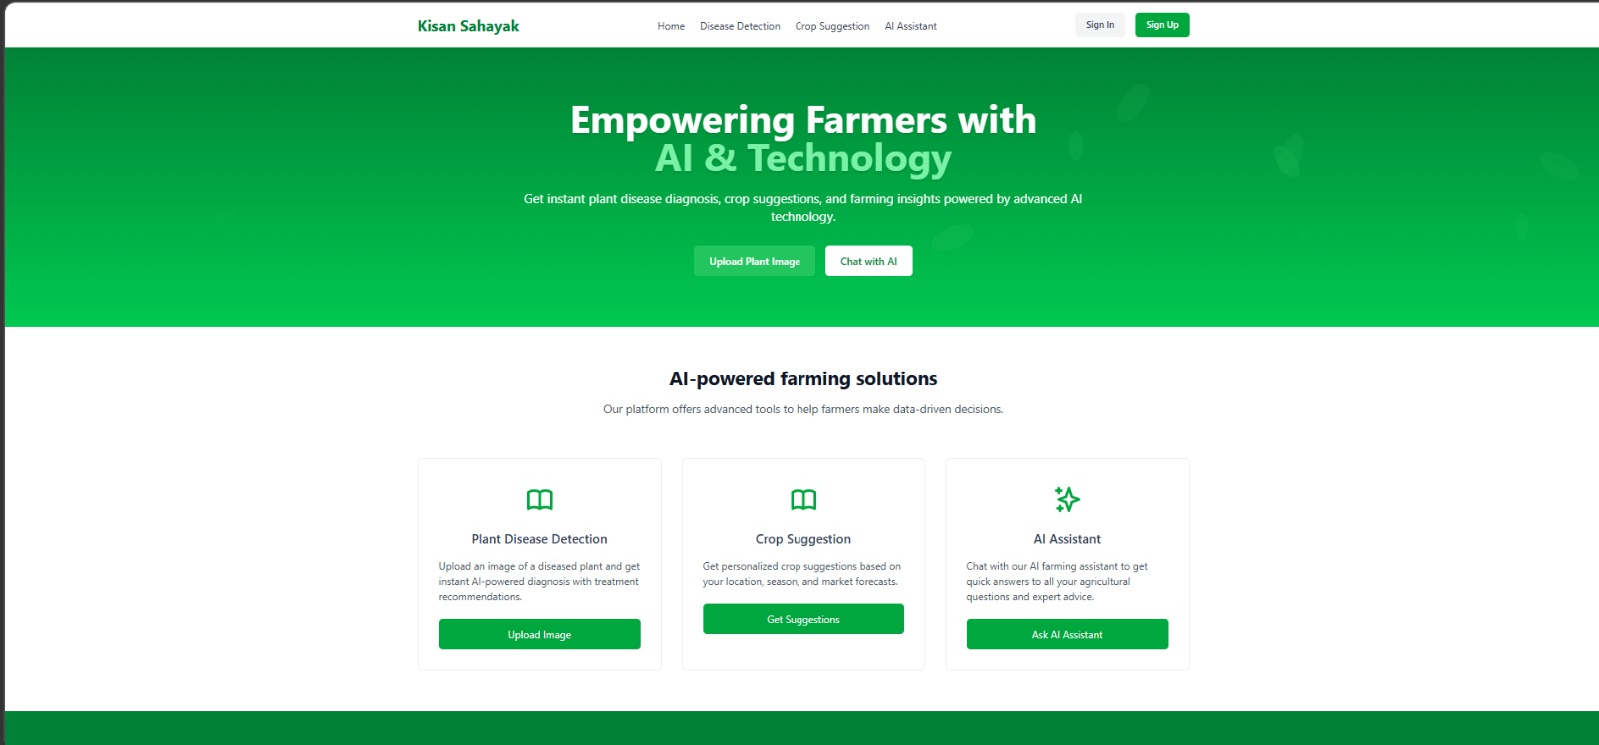
Home Page
Output Screen 1

Slide 15
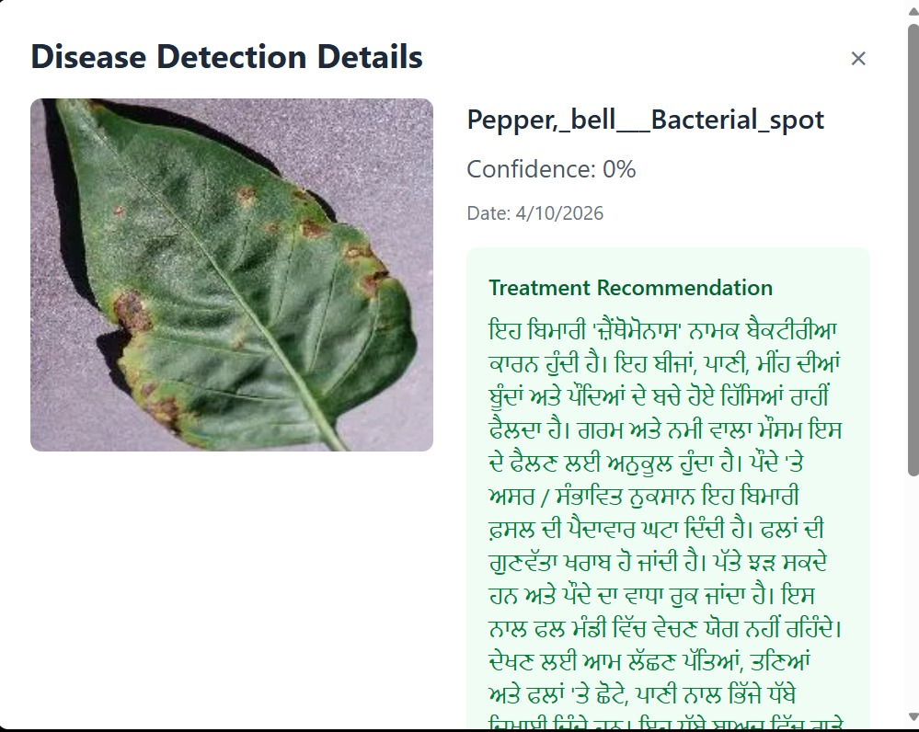
Output Screen 2

Slide 16
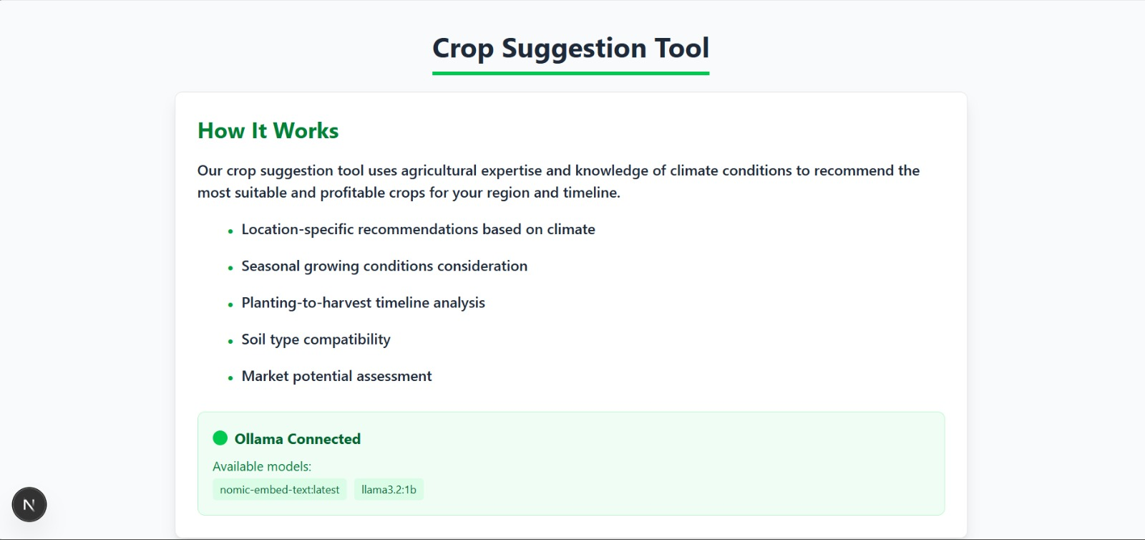
Output Screen 3

Slide 17
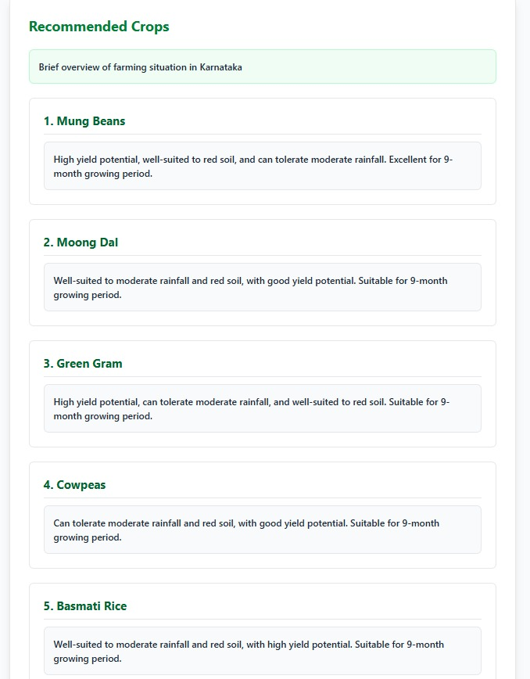
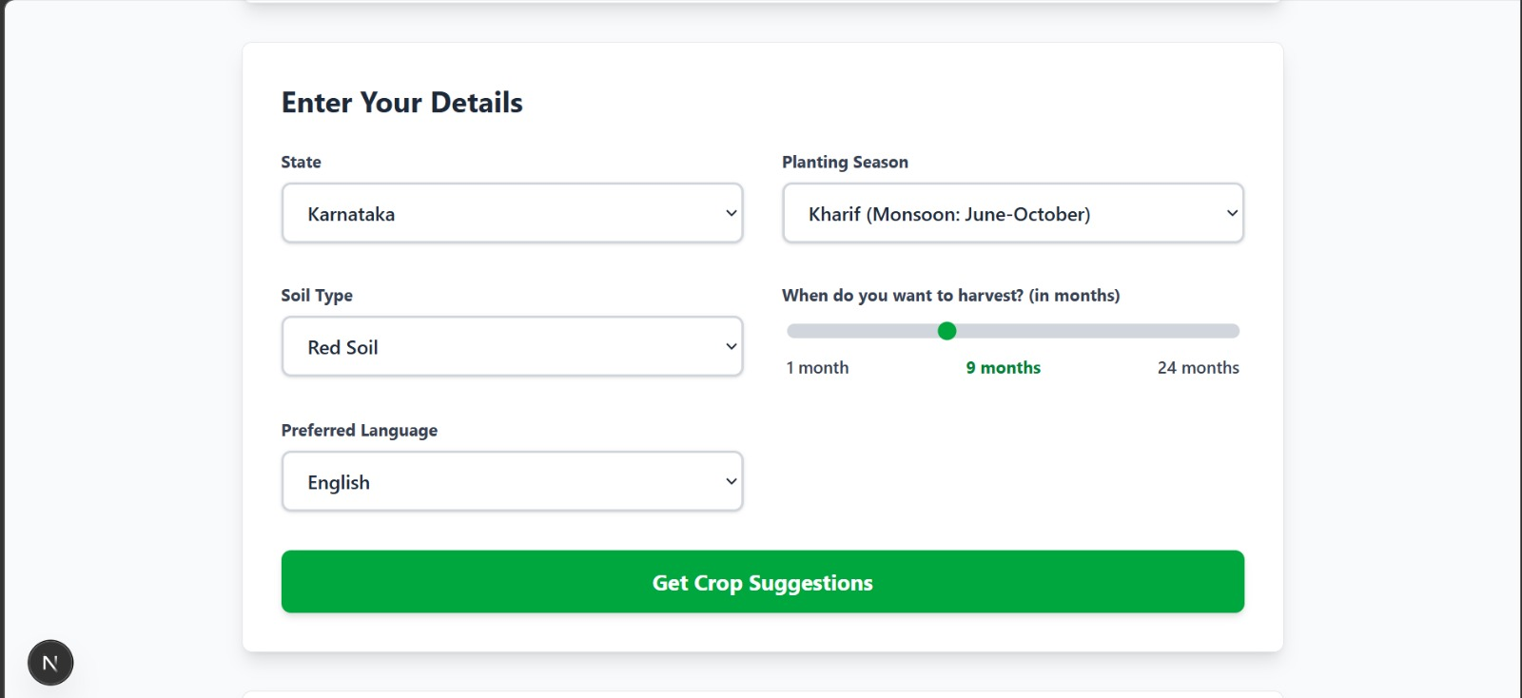
Output Screen 4

Slide 18
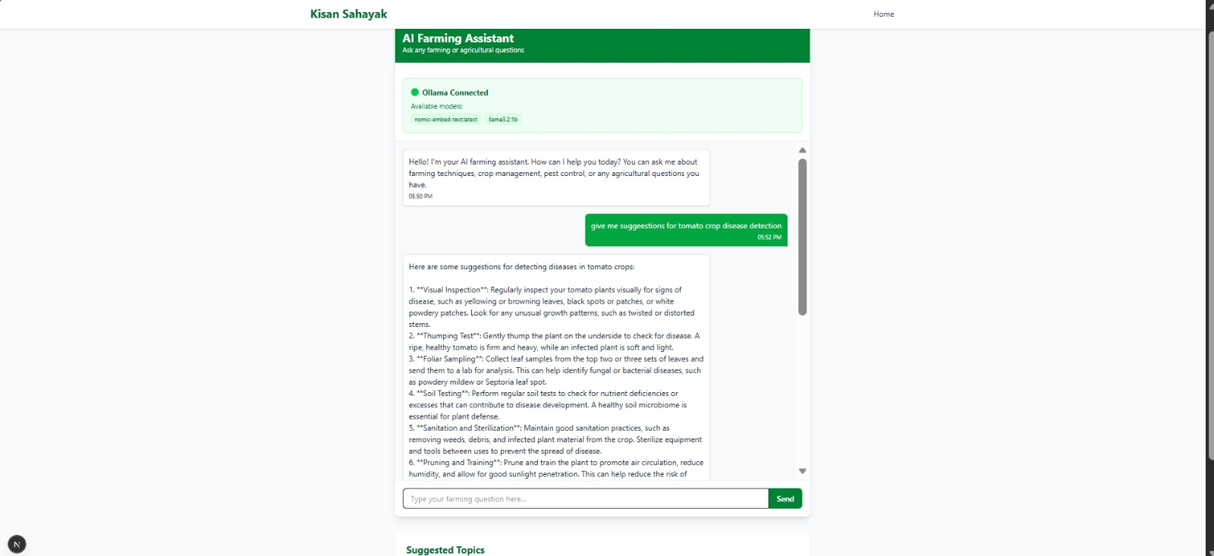
Output Screen 5

Slide 19
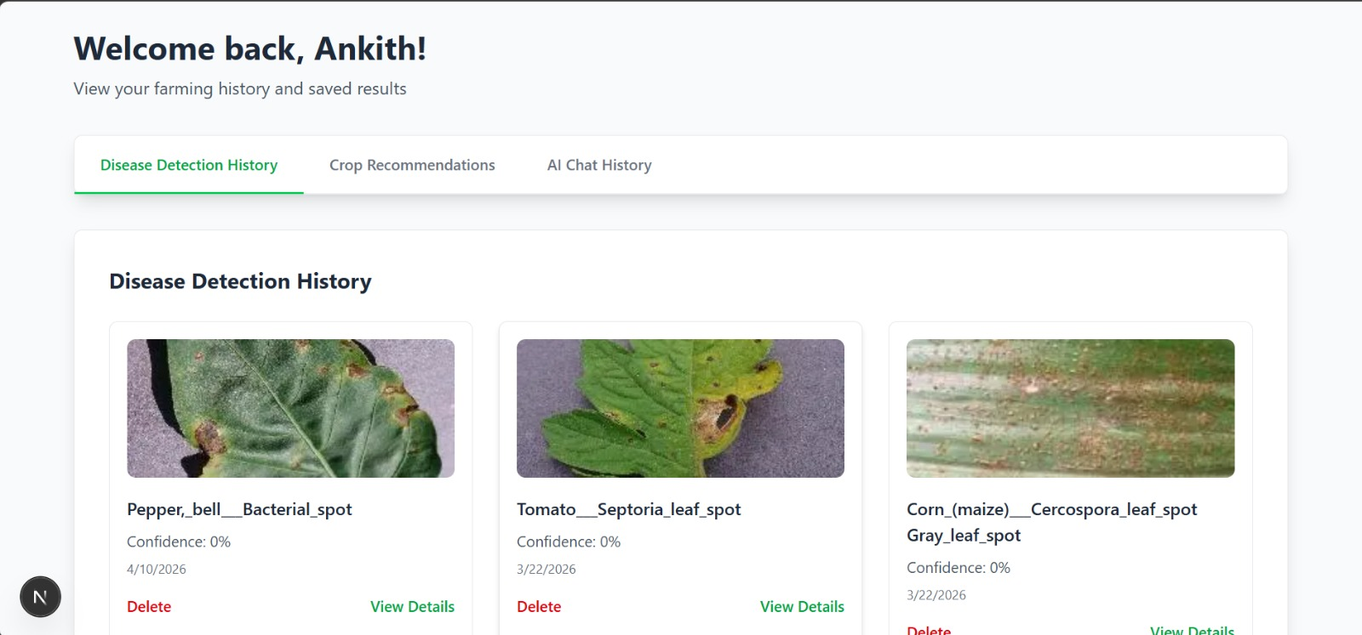
Output Screen 6

Slide 20
SDG Mapping
SDG 2 — Zero Hunger: Early disease detection and AI crop advisory reduce crop loss and promote sustainable farming, strengthening food security for millions of farmers.
SDG 9 — Industry, Innovation & Infrastructure: Integrates CNN, LLMs, and voice AI to build digital agricultural infrastructure in rural regions, driving innovation in precision farming.
SDG 12 — Responsible Consumption & Production: Data-driven crop recommendations optimize fertilizer, pesticide, and water use — reducing waste and enabling sustainable resource management.
SDG 13 — Climate Action: Real-time weather integration enables climate-resilient farming decisions — adjusting planting, irrigation, and pesticide cycles based on forecasted conditions.

Slide 21
Conclusion
"Kisan Sahayak successfully demonstrates how Deep Learning (CNN) and Large Language Models (Gemini/Ollama) can be combined into a practical, multilingual, full-stack agricultural SaaS platform that empowers Indian farmers with AI-driven disease diagnosis, crop planning, and advisory support."
✔ CNN-based deep learning model accurately classifies 38 plant diseases from leaf images, enabling early intervention.
✔ Multilingual AI responses (12 languages) break language barriers for farmers across India.
✔ Gemini + Ollama dual-AI architecture ensures the platform remains functional even in low-connectivity rural environments.
✔ Full-stack SaaS design with user authentication, history dashboard, and persistent MongoDB records — production-grade platform.
✔ Modular, extensible architecture supports future integration of IoT sensors, mobile apps, and government scheme advisories.
Department of Information Science & Engineering
19

Slide 22
References
[1] Hughes, D. P., & Salathé, M. (2015). An open access repository of images on plant health to enable the development of mobile disease diagnostics. arXiv:1511.08060. (PlantVillage Dataset)
[2] LeCun, Y., Bengio, Y., & Hinton, G. (2015). Deep learning. Nature, 521(7553), 436–444. (CNN Foundations)
[3] Chollet, F. et al. (2015). Keras: Deep Learning for humans. https://keras.io (TensorFlow/Keras Framework)
[4] Google DeepMind. (2024). Gemini: A Family of Highly Capable Multimodal Models. https://deepmind.google/technologies/gemini/ (Gemini API)
[5] Meta AI. (2024). LLaMA 3.2: Open Foundation and Fine-Tuned Chat Models. https://ai.meta.com/llama/ (LLaMA / Ollama backend)
[6] Vercel. (2024). Next.js 15 Documentation — App Router. https://nextjs.org/docs (Next.js Framework)
[7] MongoDB Inc. (2024). Mongoose ODM Documentation. https://mongoosejs.com/docs/ (Database Layer)
[8] Clerk Inc. (2024). Authentication and User Management. https://clerk.com/docs (Auth System)
[9] Kamilaris, A., & Prenafeta-Boldú, F. X. (2018). Deep learning in agriculture: A survey. Computers and Electronics in Agriculture, 147, 70–90.
[10] Mohanty, S. P., Hughes, D. P., & Salathé, M. (2016). Using deep learning for image-based plant disease detection. Frontiers in Plant Science, 7, 1419.
Department of Information Science & Engineering
20

