Slide 1

Department of CSE
(ARTIFICIAL INTELLIGENCE AND MACHINE LEARNING)
SENTIMENTAL ANALYSIS OF ONLINE PRODUCT REVIEWS
Under the Supervision
Prof . SRIRAM KUMAR
Presented By:
Ankita (ENG22AM0004)
Ankitha R (ENG22AM0005)
B H Pooja(ENG22AM0006)
M Nandini (ENG22AM0030)

Slide 2
Overview
Abstract
Problem Statement
Introduction
Methodology
State of the Art work(Literature Review)
Design
Working of flow diagram
Dataset
Code
Conclusion
References

Slide 3
Abstract
Sentimental analysis aims to tackle the problem of sentiment polarity categorization.
Sentiment analysis of the text which semantically classify the keywords into meaningful insights.
The results can help managers to develop the areas of a product where customers have expressed negative sentiments.
These results would help the manager to more effectively market the product.

Slide 4
Problem Statement
In an era where the E-commerce (online business) is booming, consumer reviews are very important.
The customers reviews will influence the other buyers of a product from a particular websites .
The negative sentimental orientation towards a product ,which significantly impact a product’s sales and make it challenging for a company to promote it.
The problem is that it’s hard for businesses to know how the customer feels about a product from online reviews .
So this is made easy by using a technique called Sentimental analysis.
Objectives : Understanding customer’s sentiment.
Understanding area of improvement in product.
Enhancing the customer’s experience by improving a
product.

Slide 5
Introduction
The proliferation and development of e-commerce technologies have led to a substantial increase in the number of consumers engaging in online shopping across many e-commerce platforms.
The virtual nature of e-commerce platforms often leads to issues with product sales.
There will be some discrepancies between product descriptions and goods received .The reviews from customers are analyzed through sentimental analysis
Sentimental analysis which is also called as the opinion mining / emotion detection/subjectivity analysis.
Sentimental analysis is extracting a customer’s feelings about a product from a data(reviews).
The process of analysing the unstructured digital text to determine if the emotional tone of text is positive , negative or neutral.

Slide 6
State of the Art-work
Paper Title and Author Name | Conference /Journal Name and year | Technology used | Results | What you infer
Sentimental analysis of online product review. Author Name: ;Hanan Alasmari | 2020 IEEE International Conference on Big Data. | NLP, Naive bayes , Lexicon based approach, Tableau. | Naive bayes gives above 70%-75% accuracy. | Naive bayes approach is better than lexicon.
SA on customers feed back data. Author Name : Pankaj,Nitasha Soni, Muskan. | 2019 International Conference &, Big Data, Cloud and Parallel Computing . | NLTK(Natural language tool kit) | NLTK is a tool for working with human language using python. | NLTK is a python library used for SA and helps in understanding of human language.
Sentimental analysis using machine learning Author name : Githanshu Chauhan ,Akash sharma | 2024 International Conference on Computing, Power, Communication Technologies . | Naive bayes ,lexicon(KDD) ,hybride method , support vector machine and random forest algorithm . | Naive bayes and random forest algorithms gives almost same accuracy . | Naive bayes is more simple and easy than the random forest even though it gets more accuracy .

Slide 7
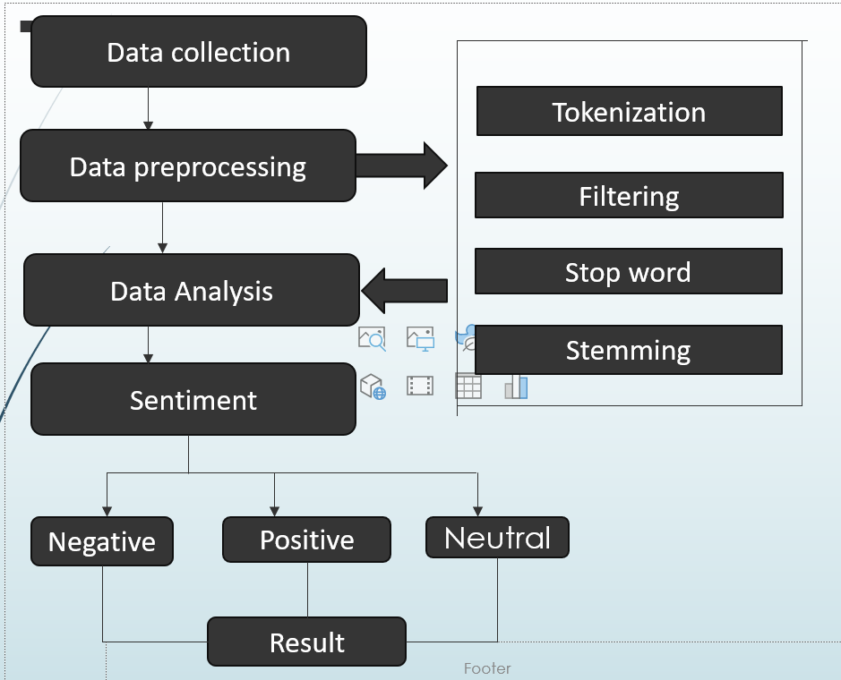
Design

Slide 8
Working of the flow Diagram
1 .Data collection : Collection of data set from e-coomerce website .the collected for the product which is having more number of reviews.
2.Data pre processing : Preparing data is the most important step when building any machine learning model.. Our dataset is unstructured, therefore it might have words that are repeated., and more words which are not at all needed in polarizing the reviews. Pre processing consists of various techniques for example –
Tokenization : It is defined as the process of extracting individual words from a document, such as a sentence or paragraph. These single terms are referred to as tokens. and tokens may consist of single words.

Slide 9
Working of flow Diagram
Stop words removal : It is defined as the process of removing common and non-meaningful words like “when” , “or” etc , from the textual data.
Stemming:-transforming a word to its root form.
Lemmatization:- Process of reducing the different forms of a word to one single form
4. Data analysis :- Analysing the data which is collected from the websites.
5.Sentiment Analysis :- Analysing the emotion tone behind the unstructured digital texts either it may be positive ,negative or neutral.

Slide 10
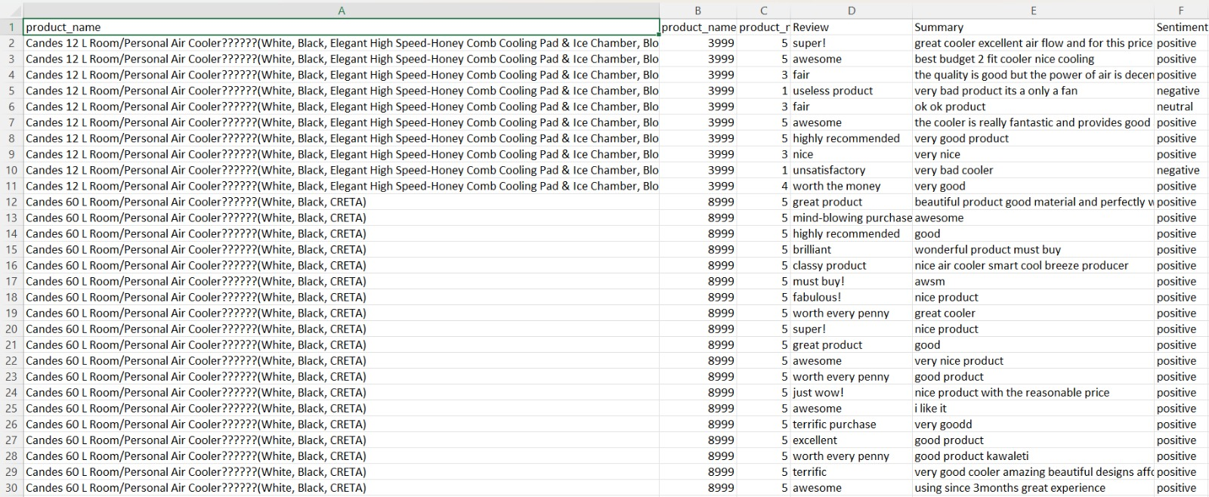
Dataset:

Slide 11
Code:
import os
import sys
from tempfile import NamedTemporaryFile
from urllib.request import urlopen
from urllib.parse import unquote, urlparse
from urllib.error import HTTPError
from zipfile import ZipFile
import tarfile
import shutil
try:
os.symlink(KAGGLE_INPUT_PATH, os.path.join("..", 'input'), target_is_directory=True)
except FileExistsError:
pass

Slide 12
try:
os.symlink(KAGGLE_WORKING_PATH, os.path.join("..", 'working'), target_is_directory=True)
except FileExistsError:
pass
for data_source_mapping in DATA_SOURCE_MAPPING.split(','):
directory, download_url_encoded = data_source_mapping.split(':')
download_url = unquote(download_url_encoded)
filename = urlparse(download_url).path
destination_path = os.path.join(KAGGLE_INPUT_PATH, directory)

Slide 13
try:
with urlopen(download_url) as fileres, NamedTemporaryFile() as tfile:
total_length = fileres.headers['content-length']
print(f'Downloading {directory}, {total_length} bytes compressed')
dl = 0
data = fileres.read(CHUNK_SIZE)
while len(data) > 0:
dl += len(data)
tfile.write(data)
done = int(50 * dl / int(total_length))
sys.stdout.write(f"\r[{'=' * done}{' ' * (50-done)}] {dl} bytes downloaded")
sys.stdout.flush()
data = fileres.read(CHUNK_SIZE)
if filename.endswith('.zip'):
with ZipFile(tfile) as zfile:
zfile.extractall(destination_path)
else:

Slide 14
with tarfile.open(tfile.name) as tarfile:
tarfile.extractall(destination_path)
print(f'\nDownloaded and uncompressed: {directory}')
except HTTPError as e:
print(f'Failed to load (likely expired) {download_url} to path {destination_path}')
continue
except OSError as e:
print(f'Failed to load {download_url} to path {destination_path}')
continue
print('Data source import complete.')

Slide 15
import numpy as np
import pandas as pd
import os
for dirname, _, filenames in os.walk('/kaggle/input'):
for filename in filenames:
print(os.path.join(dirname, filename))
import matplotlib.pyplot as plt
import numpy as np
import pandas as pd
import seaborn as sns
%matplotlib inline
from matplotlib import style
style.use('ggplot')
import csv

Slide 16
from google.colab import files
uploaded=files.upload()
df=pd.read_csv("archive (2).zip",encoding="unicode_escape")
df.head()
print(f'The dataset has {df.shape[0]} number of rows and {df.shape[1]} number of columns.')
df.columns
df['product_name'].nunique()
df.info()
df.isnull().sum()
df.dropna(inplace=True, axis=0)
for review in df['Review'][0:3]:
print(review,'\n')

Slide 17
from bs4 import BeautifulSoup
import nltk
import re
from nltk.corpus import stopwords
from nltk.stem.snowball import SnowballStemmer
# Download the stop words corpus
nltk.download('stopwords')
stops = set(stopwords.words('english')) #english stopwords
stemmer = SnowballStemmer('english') #SnowballStemmer
def review_to_words(raw_review):
# 1. Delete HTML
review_text = BeautifulSoup(raw_review, 'html.parser').get_text()
# 2. Make a space
letters_only = re.sub('[^a-zA-Z]', ' ', review_text)

Slide 18
# 3. lower letters
words = letters_only.lower().split()
# 5. Stopwords
meaningful_words = [w for w in words if not w in stops]
# 6. Stemming
stemming_words = [stemmer.stem(w) for w in meaningful_words]
# 7. space join words
return( ' '.join(stemming_words))
df['Review'] = df['Review'].apply(review_to_words)
from sklearn.preprocessing import LabelEncoder
encoder = LabelEncoder()
df['sentiment_encoded'] = encoder.fit_transform(df['sentiment’])
from sklearn.model_selection import train_test_split
from sklearn.feature_extraction.text import TfidfVectorizer
from sklearn.metrics import confusion_matrix
from sklearn.naive_bayes import MultinomialNB

Slide 19
vectorizer = TfidfVectorizer()
reviews_corpus = vectorizer.fit_transform(df.Review)
reviews_corpus.shape
sentiment = df['sentiment_encoded']
sentiment.shape
from sklearn.model_selection import train_test_split
X_train,X_test,Y_train,Y_test = train_test_split(reviews_corpus,sentiment,test_size=0.33,random_state=42)
print('Train data shape ',X_train.shape,Y_train.shape)
print('Test data shape ',X_test.shape,Y_test.shape)
clf = MultinomialNB().fit(X_train, Y_train)
pred = clf.predict(X_test)
print("Accuracy: %s" % str(clf.score(X_test, Y_test)))
print("Confusion Matrix")
print(confusion_matrix(pred, Y_test))

Slide 20
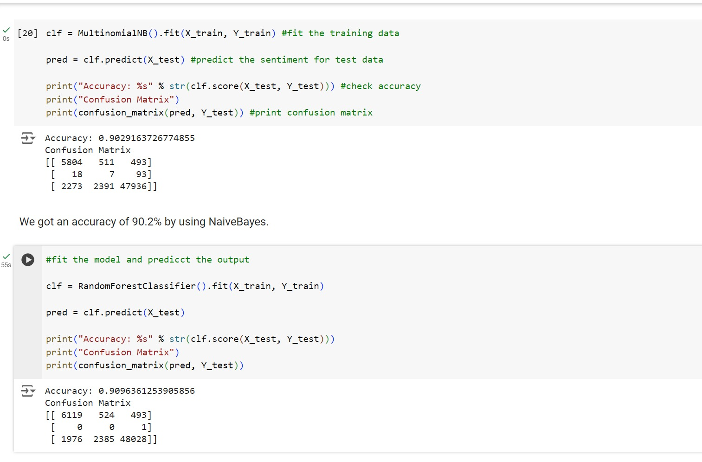

Slide 21
Conclusion:
In conclusion, the project "Flipkart Review Sentimental Analysis" utilizing Naive Bayes classification offers valuable insights into customer sentiments expressed through Flipkart reviews. By accurately predicting and identifying sentiments, it enables businesses to monitor customer satisfaction, evaluate product performance, and make data-driven decisions. Moving forward, the continuation of this research work holds promise in advancing sentiment analysis capabilities, enhancing predictive analytics, deepening competitive intelligence, and augmenting customer engagement strategies. With ongoing efforts, businesses can leverage sentiment analysis to stay responsive to customer needs, gain competitive advantage, and foster long-term customer relationships in the dynamic e-commerce landscape

Slide 22
Reference:
Githanshu Chauhan , Akash Sharma ,Nripendra Dwivedi “Amazon Product Reviews Sentimental Analysis Using machine learning ”.2024 IEEE International Conference on Computing, Power and Communication Technologies (IC2PCT) .
Hanan Alasmari “Sentimental Visualization: Semantic Analysis of Online Product Reviews Using Python and Tableau2020” IEEE International Conference on Big Data (Big Data) , DOI: 10.1109/BIGDATA50022.2020.9391769.
Pankaj, Prashant Pandey, Muskan, Nitasha Soni “Sentiment Analysis on Customer Feedback Data: Amazon Product Reviews ”2019 International Conference on Machine Learning, Big Data, Cloud and Parallel Computing (Com-IT-Con), India, 14th -16th Feb 2019.
Mrs Ritu Patidar,Dr Sachin Patel “Design & Implementation of Product Recommendation Solution using Sentiment Analysis ”2022 International Conference on Edge Computing and Applications (ICECAA) | DOI: 10.1109/ICECAA55415.2022.9936480.

