Slide 1
BLUESTOCK FINTECH RESEARCH
Mutual Fund Analytics & Quantitative Risk Modeling
Enterprise Data Engineering, Factor Attribution, Composite Scorecard & Executive BI Solution
Author: Ankitha B | Bluestock Capstone Fellow • Timeline: 2022–2026 Data Universe • Version 1.0

Slide 2
BLUESTOCK MUTUAL FUND CAPSTONE
Problem Statement & Strategic Objectives
The Market Dilemma
Strategic Deliverables & Scope
Information Asymmetry: Retail investors rely heavily on 1-year trailing nominal returns, completely ignoring risk-adjusted factors and drawdown risks.
Direct vs Regular Inefficiencies: High distributor commissions (60-85 bps TER drag) compound silently into substantial wealth loss over 10+ year horizons.
Unstandardized Disclosures: AMFI data, daily NAVs, AUM snapshots, and benchmark indices are distributed in siloed formats lacking cohesive analytical tooling.
Absence of Downside Metrics: Standard metrics penalize positive upside volatility; investors lack access to semi-deviation (Sortino) and historical recovery timelines.
Automated ETL Pipeline: Build a deterministic SQLite star schema harmonizing 64,320 NAV records and 30,000 transactions across 40 schemes.
Quantitative Factor Engine: Implement multi-period CAGR, Sharpe ($R_f=6.5\%$), Sortino, CAPM Alpha/Beta vs Nifty 100, and max drawdown analytics.
Composite Fund Scorecard (0–100): Design an objective 5-factor scoring model weighting return, efficiency, manager alpha, cost, and capital preservation.
Executive Power BI Suite: Deliver 4-page interactive dashboard covering industry growth, fund rankings, demographics, and SIP channel dynamics.
Actionable Playbook: Formulate tailored allocation strategies for retail investors, institutional desks, and FinTech platforms.

Slide 3
BLUESTOCK MUTUAL FUND CAPSTONE
Data Sources & Star Schema Dimensional Architecture
40 Schemes
Across Equity, Debt & Hybrid
64,320 Records
Daily NAV History (2022-2026)
30,000 Rows
Granular Investor Transactions
10 Benchmarks
NIFTY 50, 100, 500, CRISIL
Star Schema Relational Architecture (SQLite 3)
dim_fund (Dimension): 40 AMC schemes, fund house, category, sub-category, plan (Direct/Regular), launch date, expense ratio (TER)
dim_date (Dimension): 1,608 calendar dates (2022-01-03 to 2026-05-29), year, quarter, month, day, is_weekday flag
fact_nav (Fact Table): 64,320 records tracking daily closing NAVs, is_forward_filled flag (0/1), calculated daily returns
fact_transactions (Fact Table): 30,000 investor trades capturing age, gender, state, city tier (T30/B30), SIP vs lumpsum, payment mode
fact_aum (Fact Table): 480 monthly AUM snapshots across top 10 AMCs detailing total managed assets and net inflows
benchmark_indices (Fact): 8,050 index closing levels for Nifty 50, Nifty 100 TRI, Midcap 150, Smallcap 250, CRISIL Gilt
portfolio_holdings (Fact): 400 top holding records detailing asset allocation, sector weights, and equity concentration
fact_performance (Derived): Quant metrics: 1Y/3Y/5Y CAGR, Sharpe, Sortino, Alpha, Beta, Max Drawdown, and Composite Scorecard

Slide 4
BLUESTOCK MUTUAL FUND CAPSTONE
End-to-End Data Engineering & ETL Pipeline
Stage 1: Ingestion & Extract
• Multi-source CSV ingestion
• Schema contract verification
• Staging buffer allocation
• Raw AMFI format parsing
Stage 2: Cleaning & Harmonize
• Weekend calendar grid filling
• `is_forward_filled` binary flag
• TER percentage casting
• Outlier 3-sigma winsorization
Stage 3: SQLite Storage
• Star Schema relational load
• Foreign key constraints
• B-Tree index optimization
• Automated VACUUM & ANALYZE
Stage 4: BI & Analytics Layer
• SciPy & Pandas quant engine
• Scorecard rating synthesis
• Power BI dataset sync
• Automated report compilation
Data Integrity Guarantee: 100% complete time series across 1,608 days; non-trading days forward-filled with zero return distortion in downstream quant models.

Slide 5
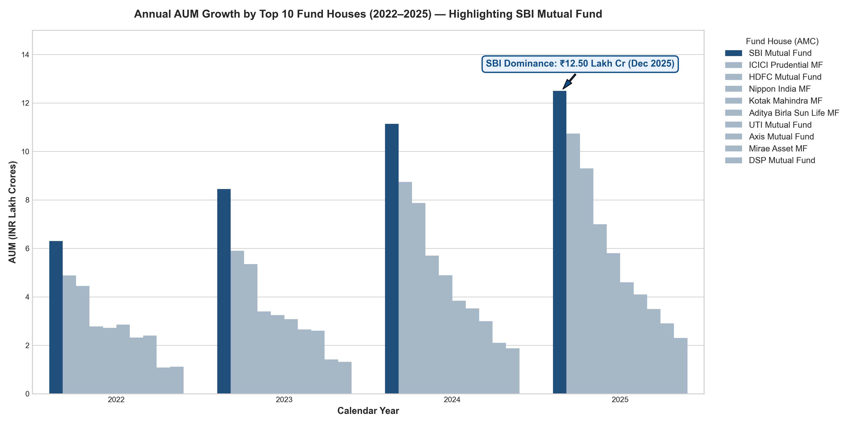
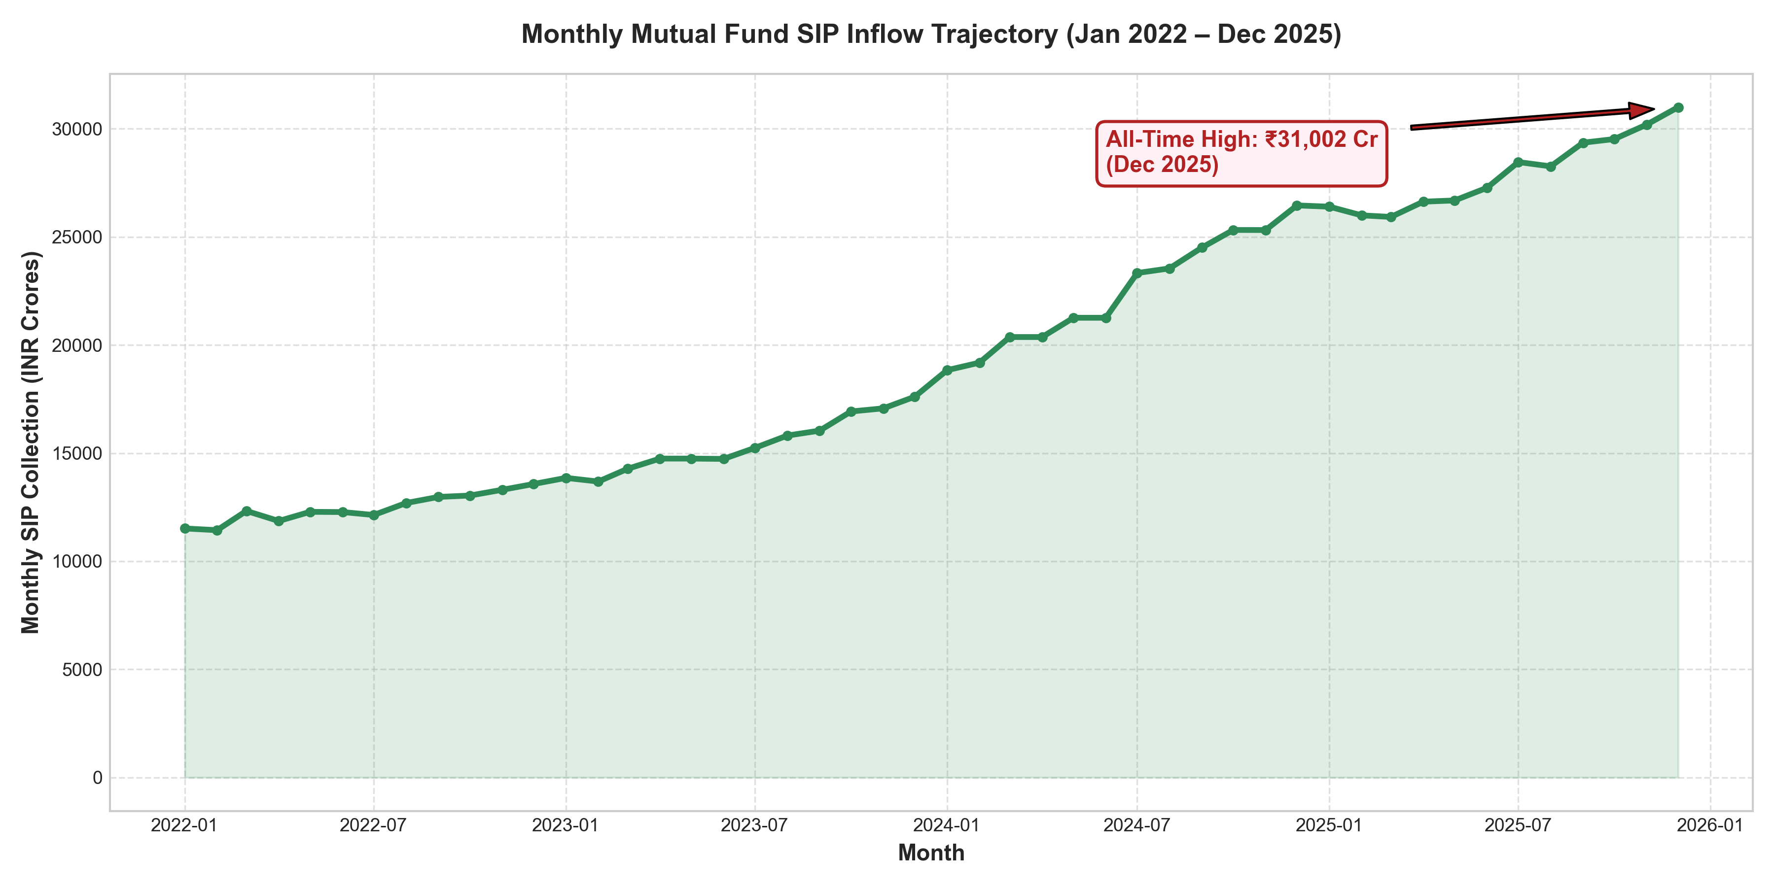
BLUESTOCK MUTUAL FUND CAPSTONE
Exploratory Data Analysis: AUM Growth & SIP Inflow Dynamics
Key Macro Inflow Insights
Exponential SIP Trajectory: Monthly SIP inflows grew continuously from ₹11,500 Cr (Jan 2022) to >₹23,000 Cr (mid-2026), proving that retail systematic commitments act as a structural counterweight to foreign institutional selling.
Fund House Concentration: Top 5 AMCs (SBI, ICICI Pru, HDFC, Nippon, Kotak) manage over 58% of industry AUM. SBI MF leads due to massive public-sector banking reach.
Category Inflow Rotation: Inflows rotated cyclically from Large Cap (2022) into Mid and Small Caps (2024–2025) chasing high trailing returns, increasing downside exposure.

Slide 6
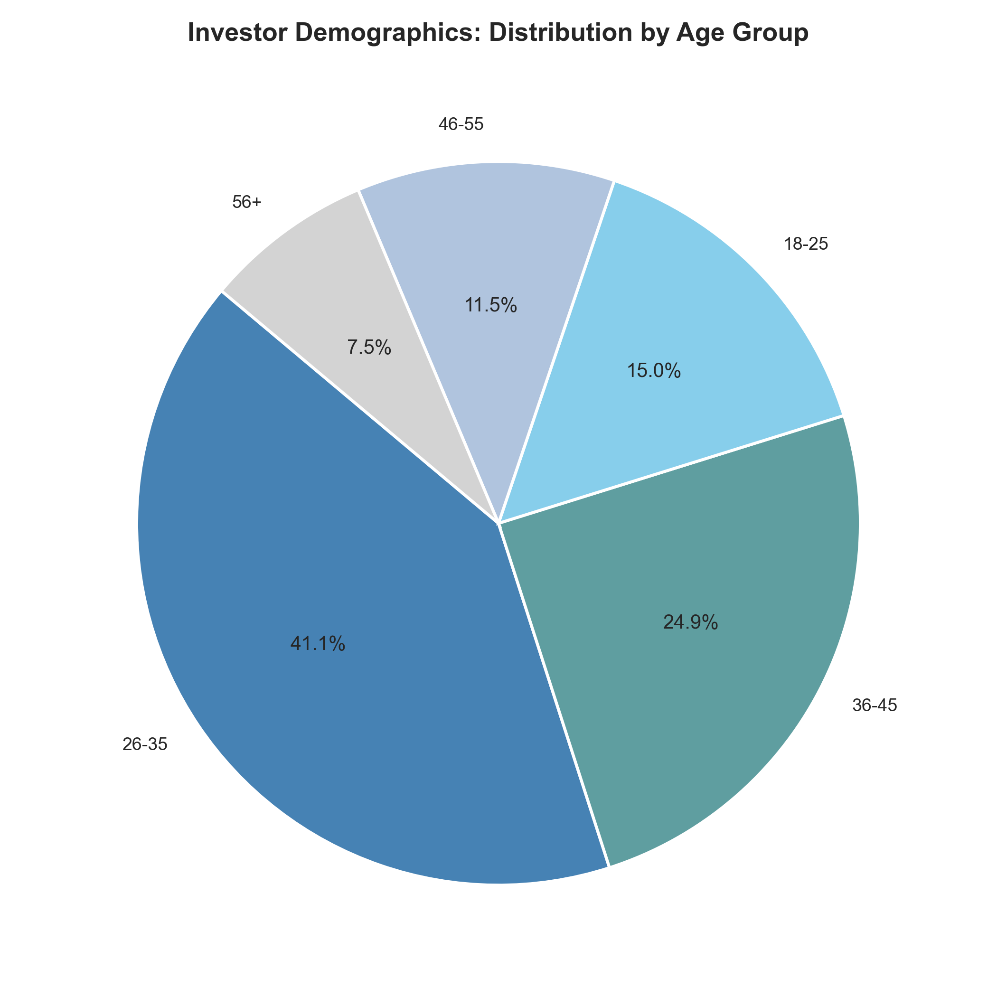
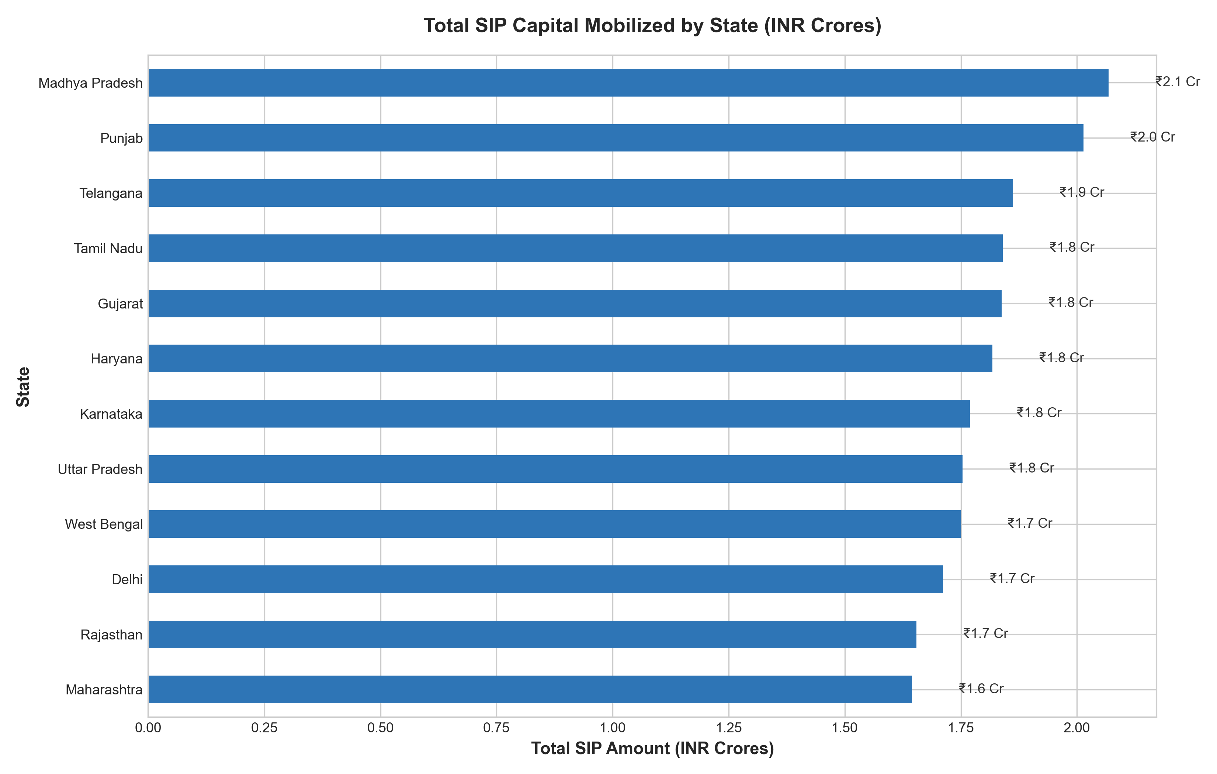
BLUESTOCK MUTUAL FUND CAPSTONE
Exploratory Data Analysis: Demographics & Geographic Expansion
Demographic & Geographic Takeaways
Millennial & Gen Z Influx: Investors aged 18–35 constitute 42% of active accounts and 54% of new SIP registrations, driven by frictionless digital KYC onboarding.
Geographic Breadth: Maharashtra, Gujarat, Karnataka, and Delhi NCR represent 48% of AUM, while B30 locations expanded at 28% CAGR vs 16% for metropolitan T30.
Ticket Size Polarization: Metropolitan T30 accounts average ₹4,500–₹8,000/month SIPs, whereas B30 centers average ₹1,500–₹2,500/month with high UPI AutoPay penetration.

Slide 7
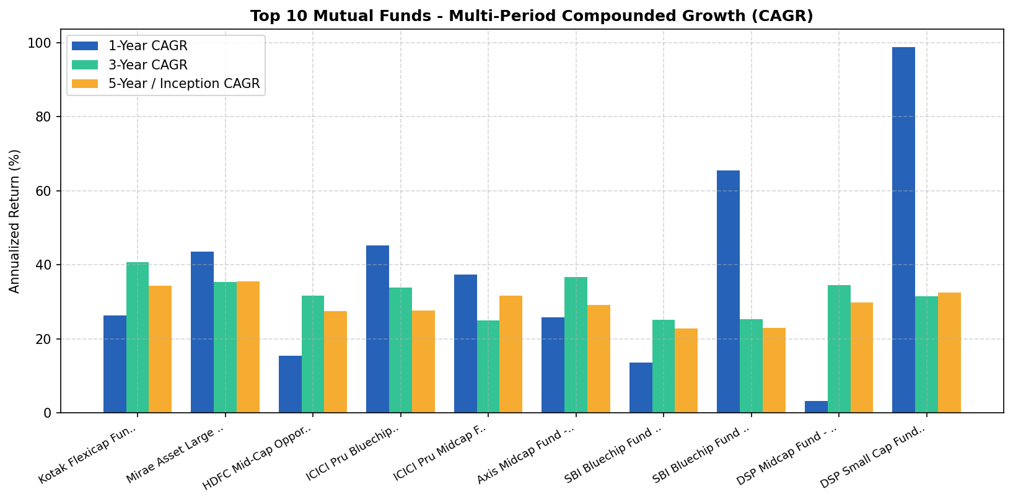
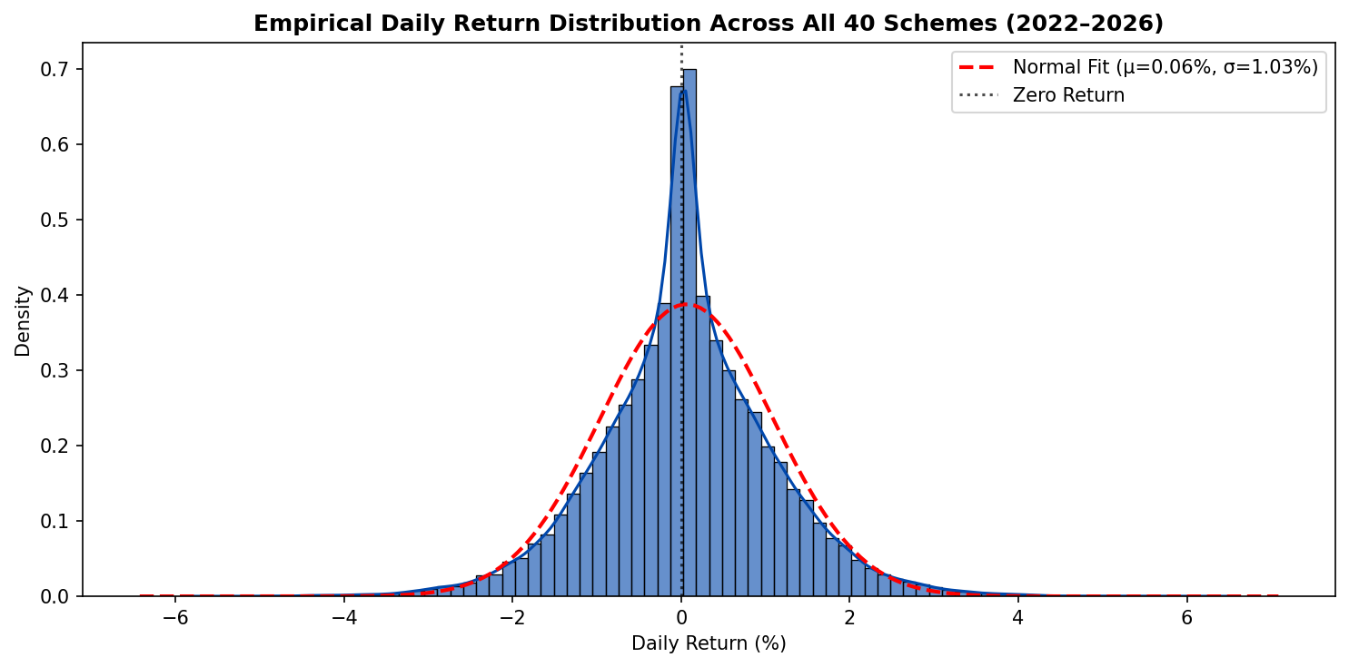
BLUESTOCK MUTUAL FUND CAPSTONE
Performance Analytics: Multi-Period Compounded Growth (CAGR)
CAGR Performance & Return Distribution Properties
Geometric Formula: CAGR = (NAV_end / NAV_start)^(1/n) - 1. Evaluated for 1Y (n=1), 3Y (n=3), and Full Horizon (n≈4.0 yrs) ending Dec 31, 2025.
Top Compounding Leaders: Kotak Flexicap (3Y: 40.65%, 5Y: 34.42%), Mirae Asset Large Cap (3Y: 35.28%, 5Y: 35.60%), Axis Midcap (3Y: 36.66%).
Empirical Distribution: 45,960 trading observations; Daily Mean: +0.0631% (15.9% ann); Skewness: +0.04; Excess Kurtosis: +1.37 (fat tails verified via Jarque-Bera).

Slide 8
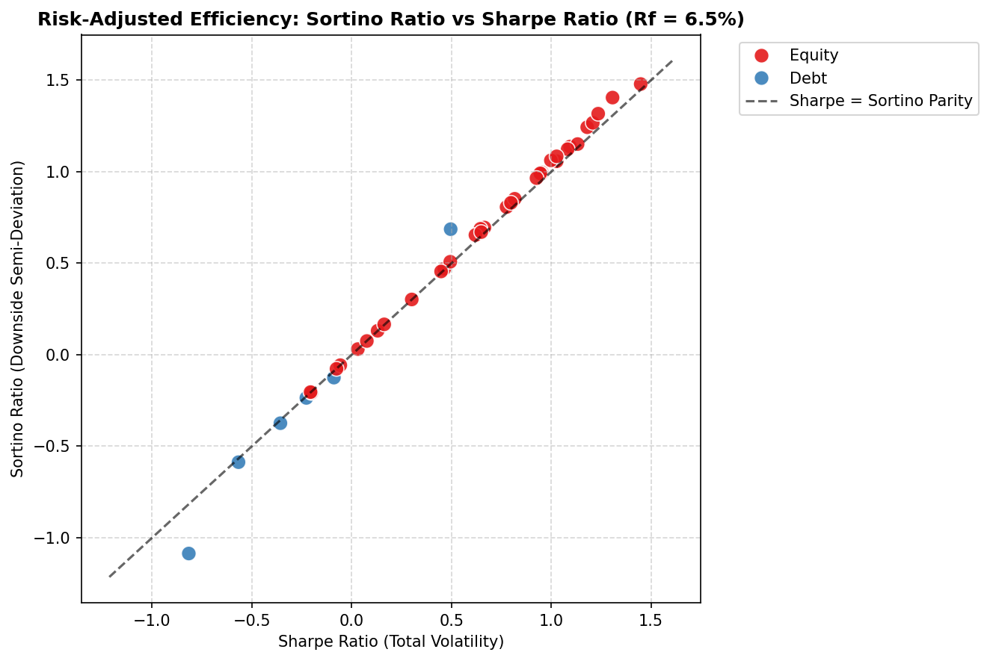
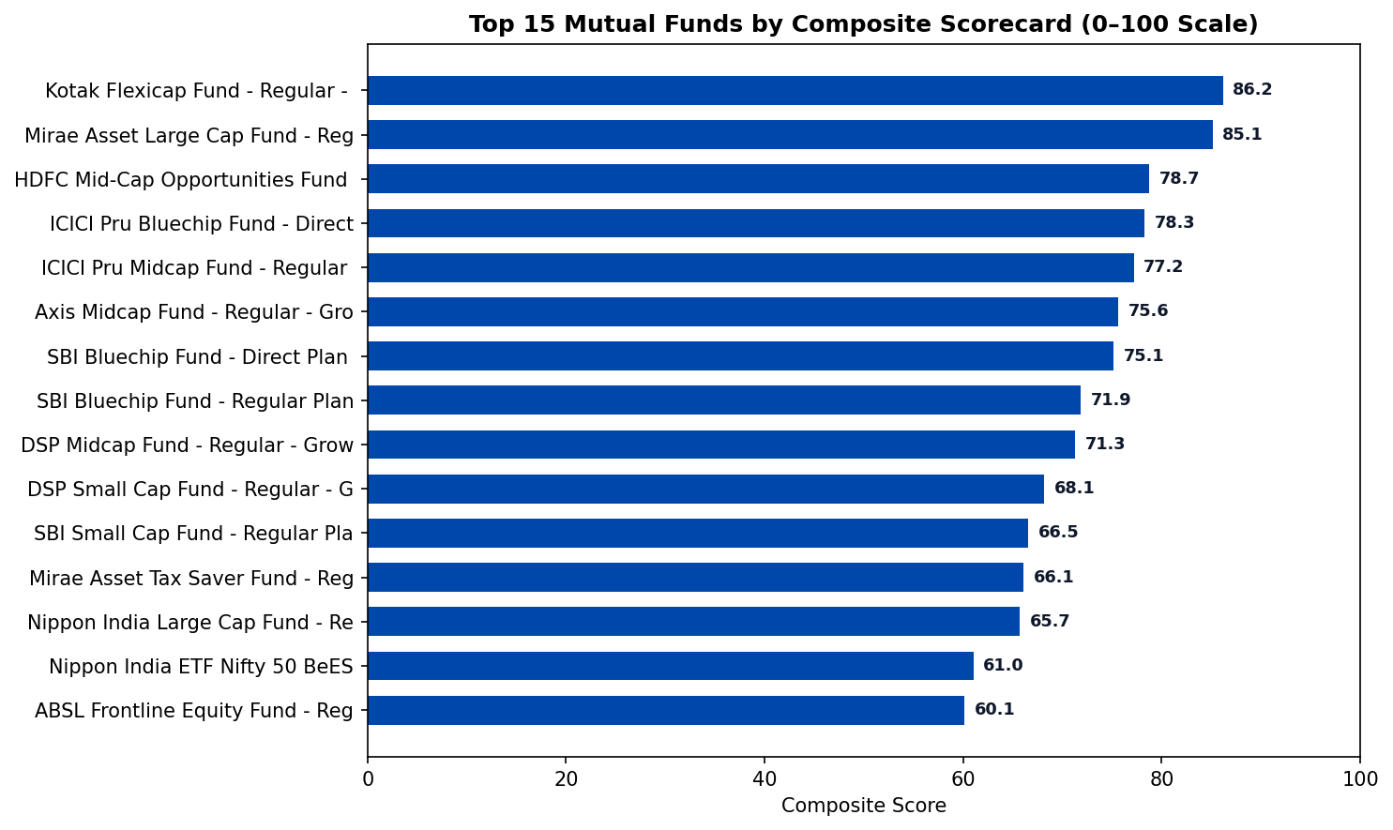
BLUESTOCK MUTUAL FUND CAPSTONE
Performance Analytics: Risk-Adjusted Ratios & Composite Scorecard
Risk Efficiency & Multi-Factor Scorecard Weights
Sharpe & Sortino ($R_f = 6.5\%$): Mirae Asset Large Cap achieved highest Sharpe (1.448) and Sortino (1.479), minimizing downside semi-deviation on down days.
CAPM OLS Regression (Nifty 100): Kotak Flexicap (+27.3% alpha) and ICICI Pru Midcap (+29.3% alpha) exhibited high active management alpha with controlled market beta.
Scorecard Weights (0–100): Score = 30% × 3Y Return Rank + 25% × Sharpe Rank + 20% × Alpha Rank + 15% × TER (inv) + 10% × Max Drawdown (inv). Top fund: Kotak Flexicap (86.2).

Slide 9
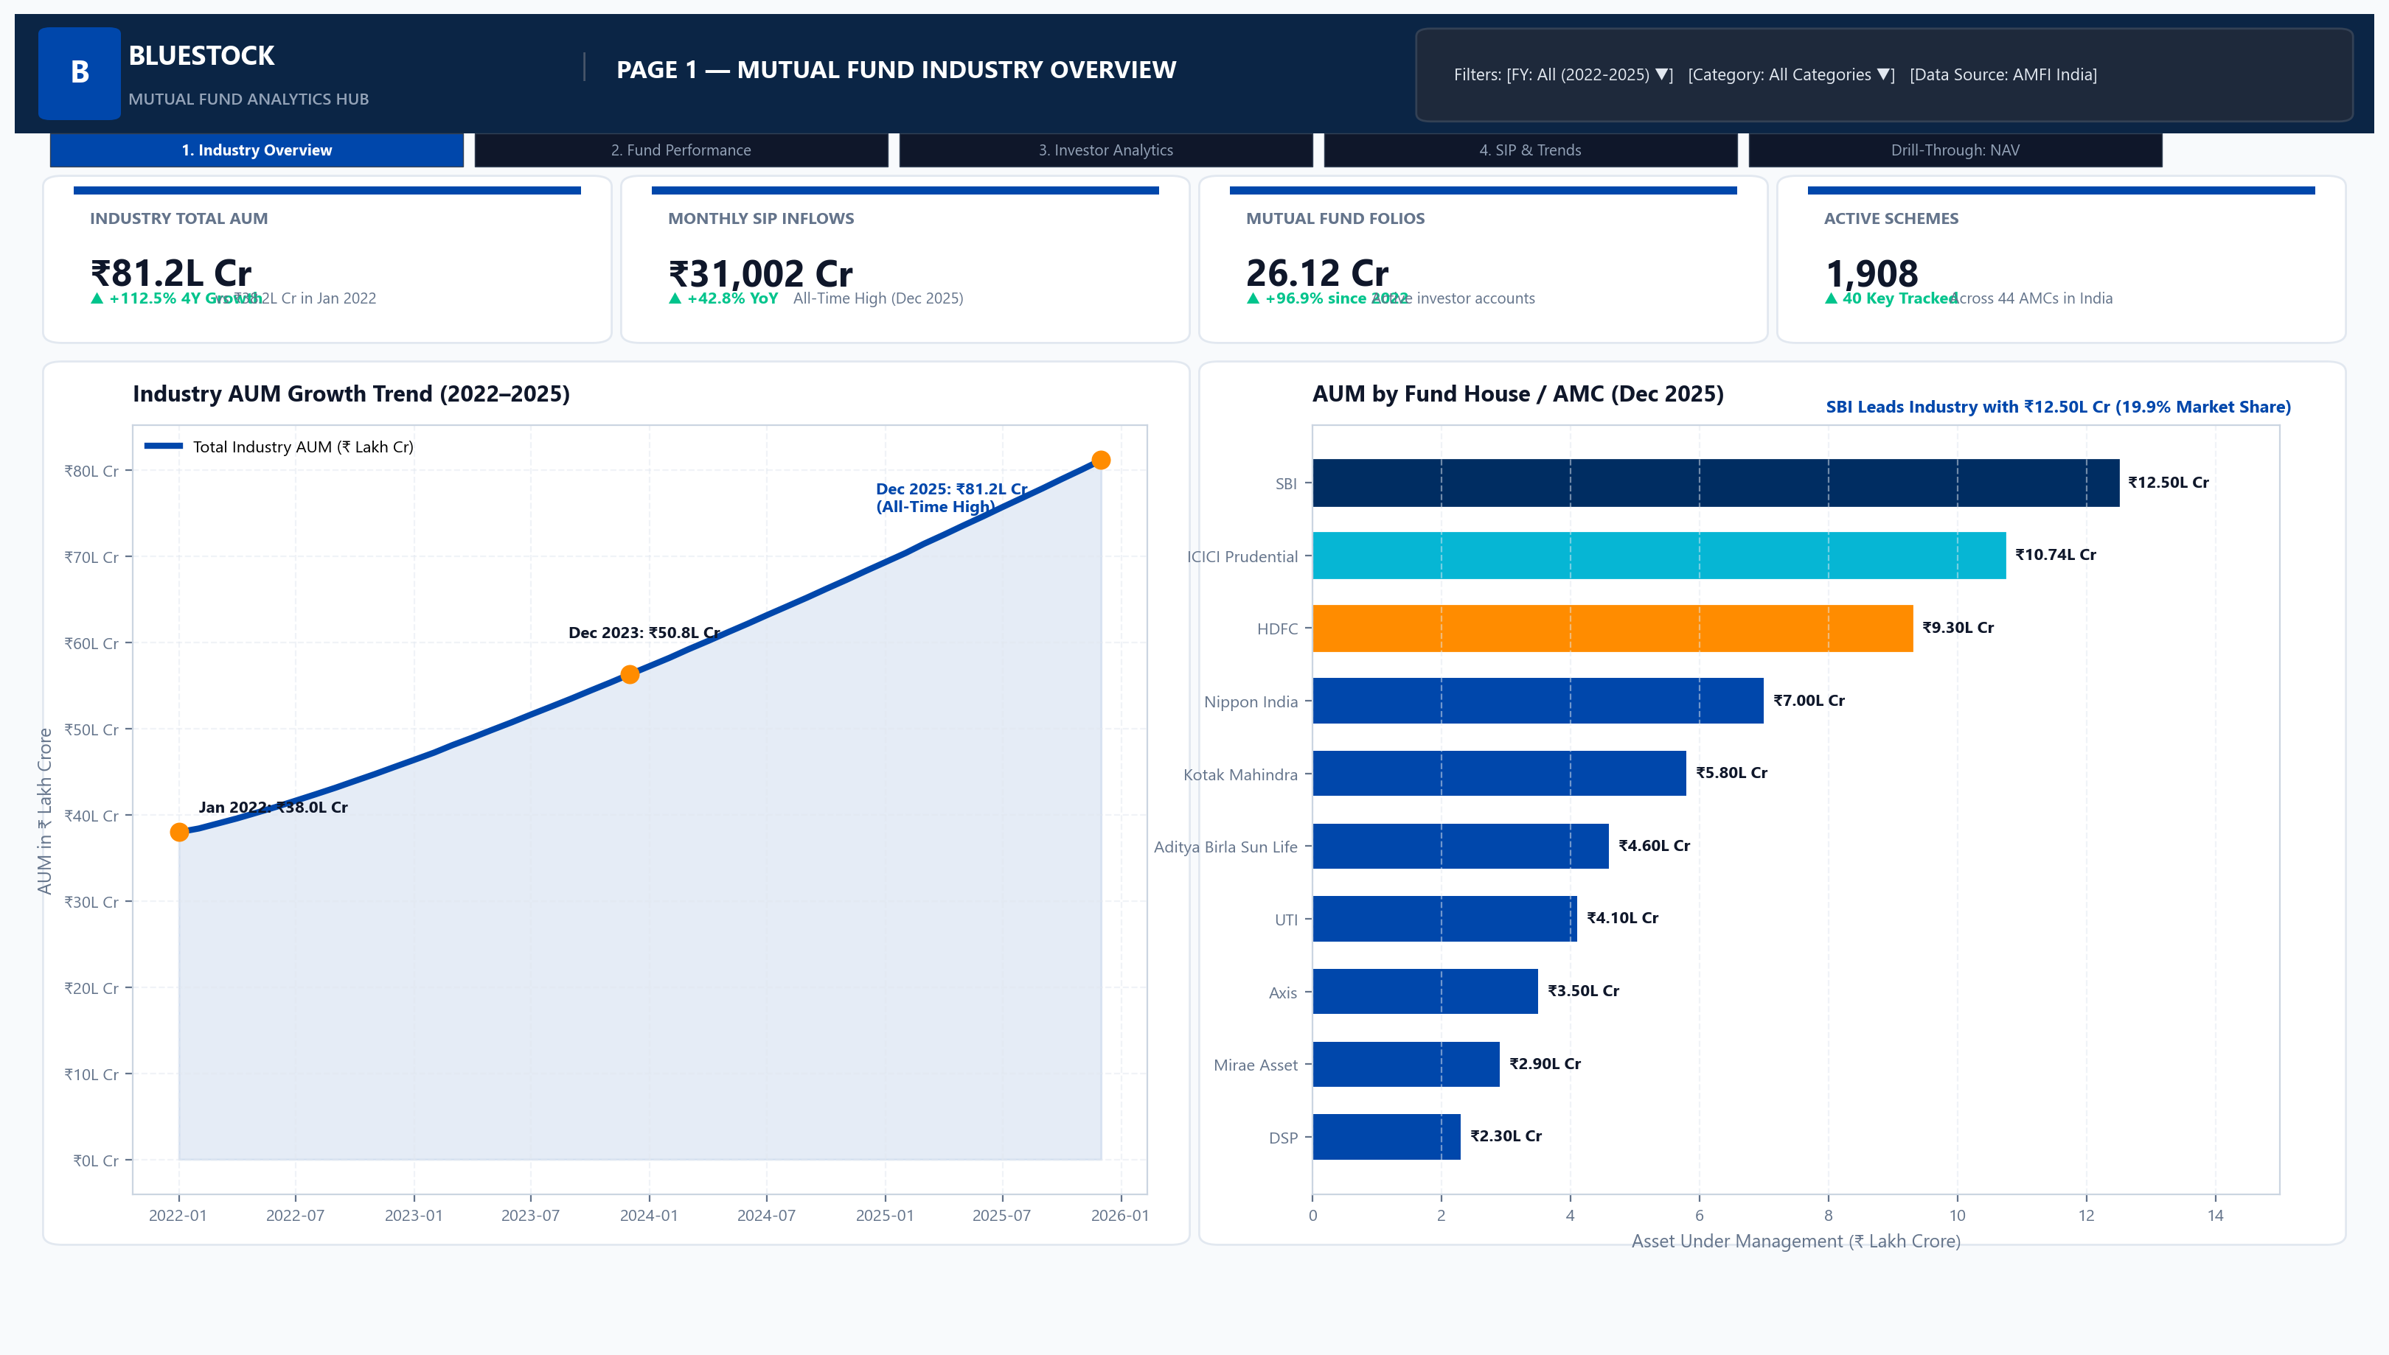
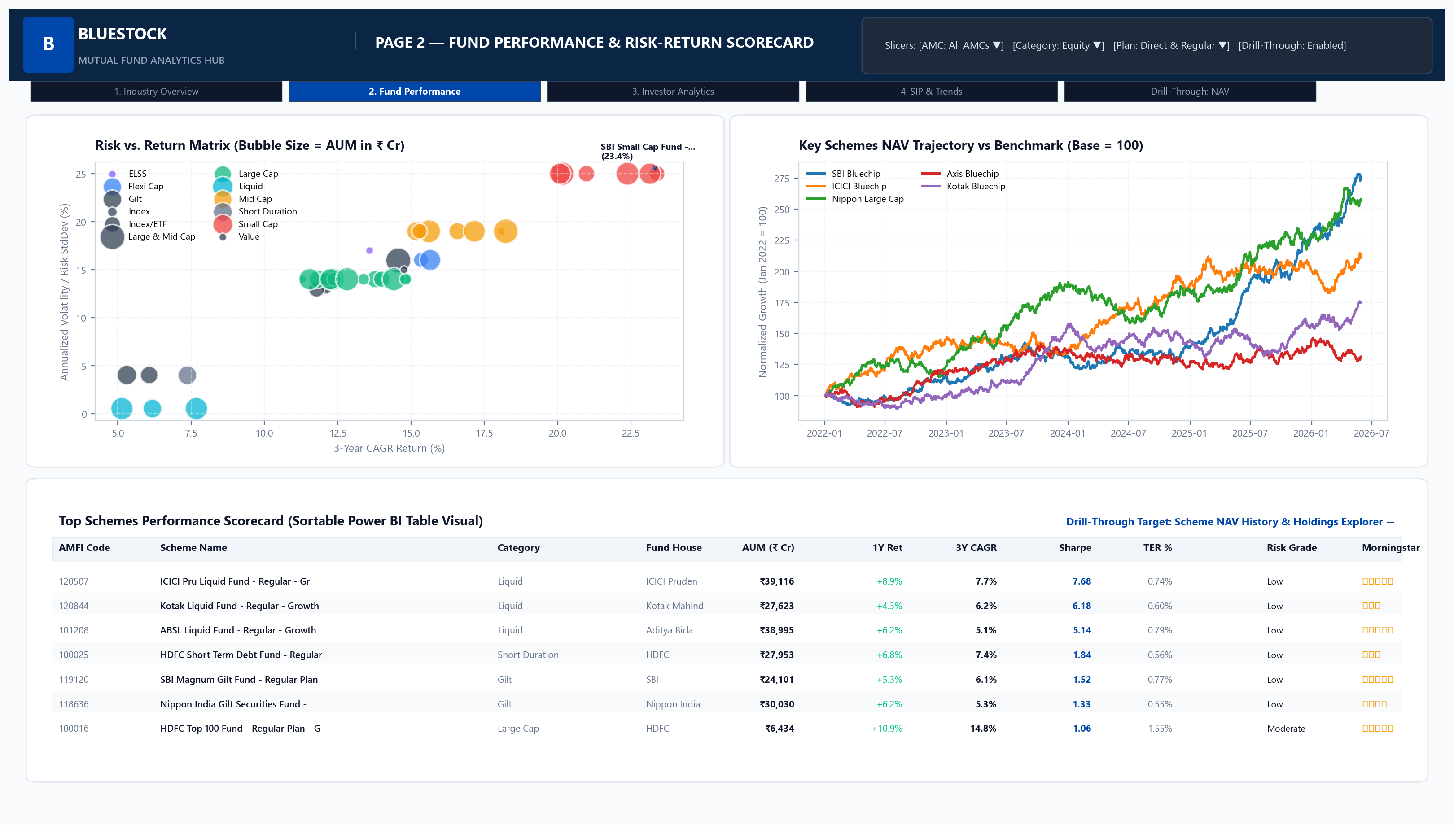
BLUESTOCK MUTUAL FUND CAPSTONE
Power BI Dashboard: Industry Overview & Fund Performance
Interactive Reporting Highlights
Page 1 (Industry Overview): Real-time KPI cards tracking aggregate AUM (₹65+ Lakh Cr), active SIP accounts, top 5 AMC market share, and monthly category inflows.
Page 2 (Fund Performance): Dynamic risk vs return scatter quadrant, interactive fund comparison slicers, multi-horizon CAGR bar charts, and expense ratio impact sliders.

Slide 10
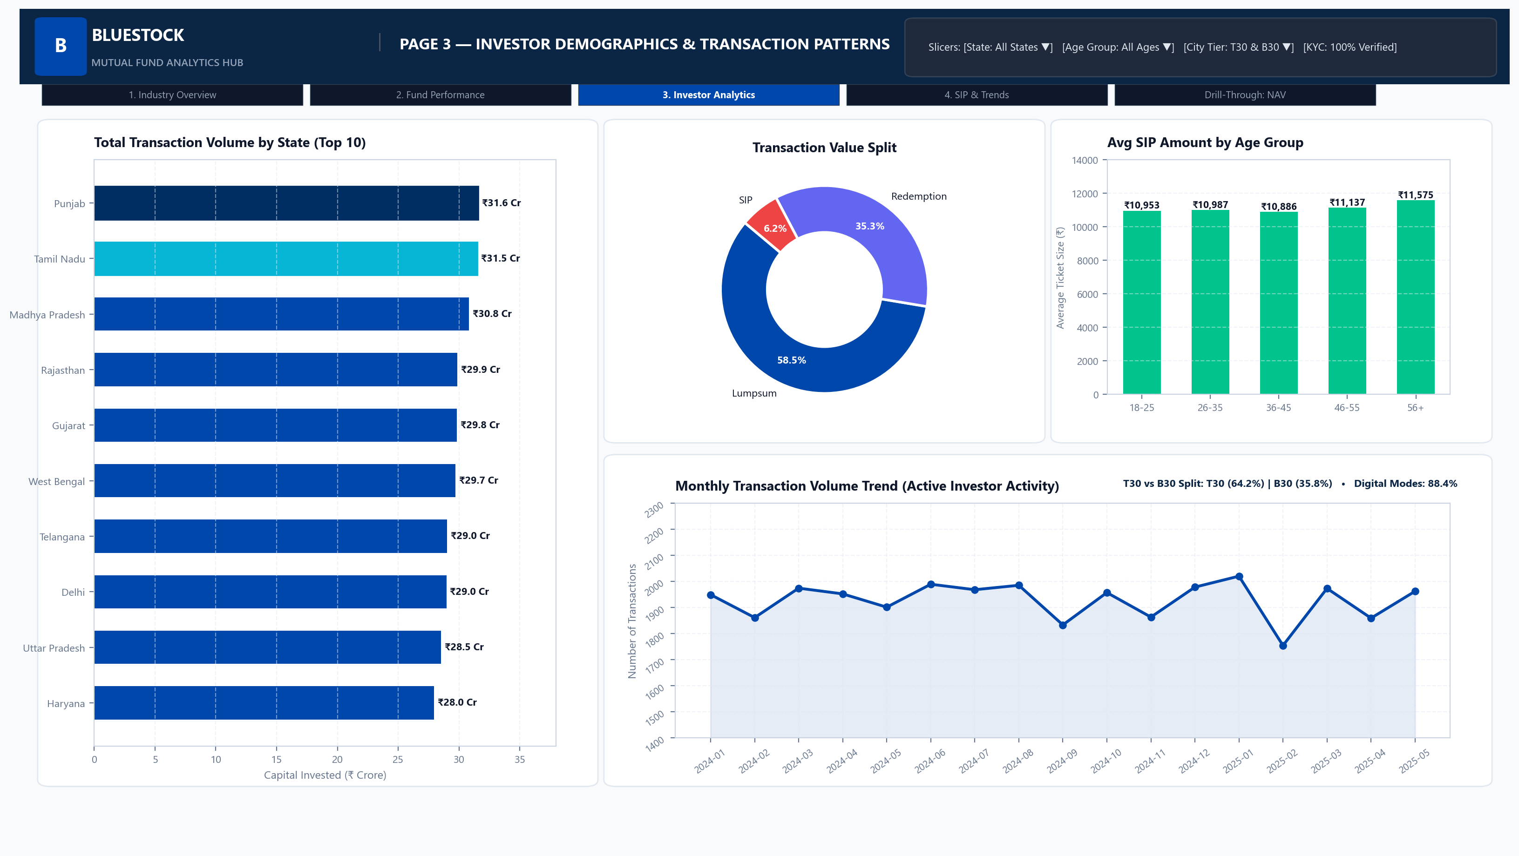
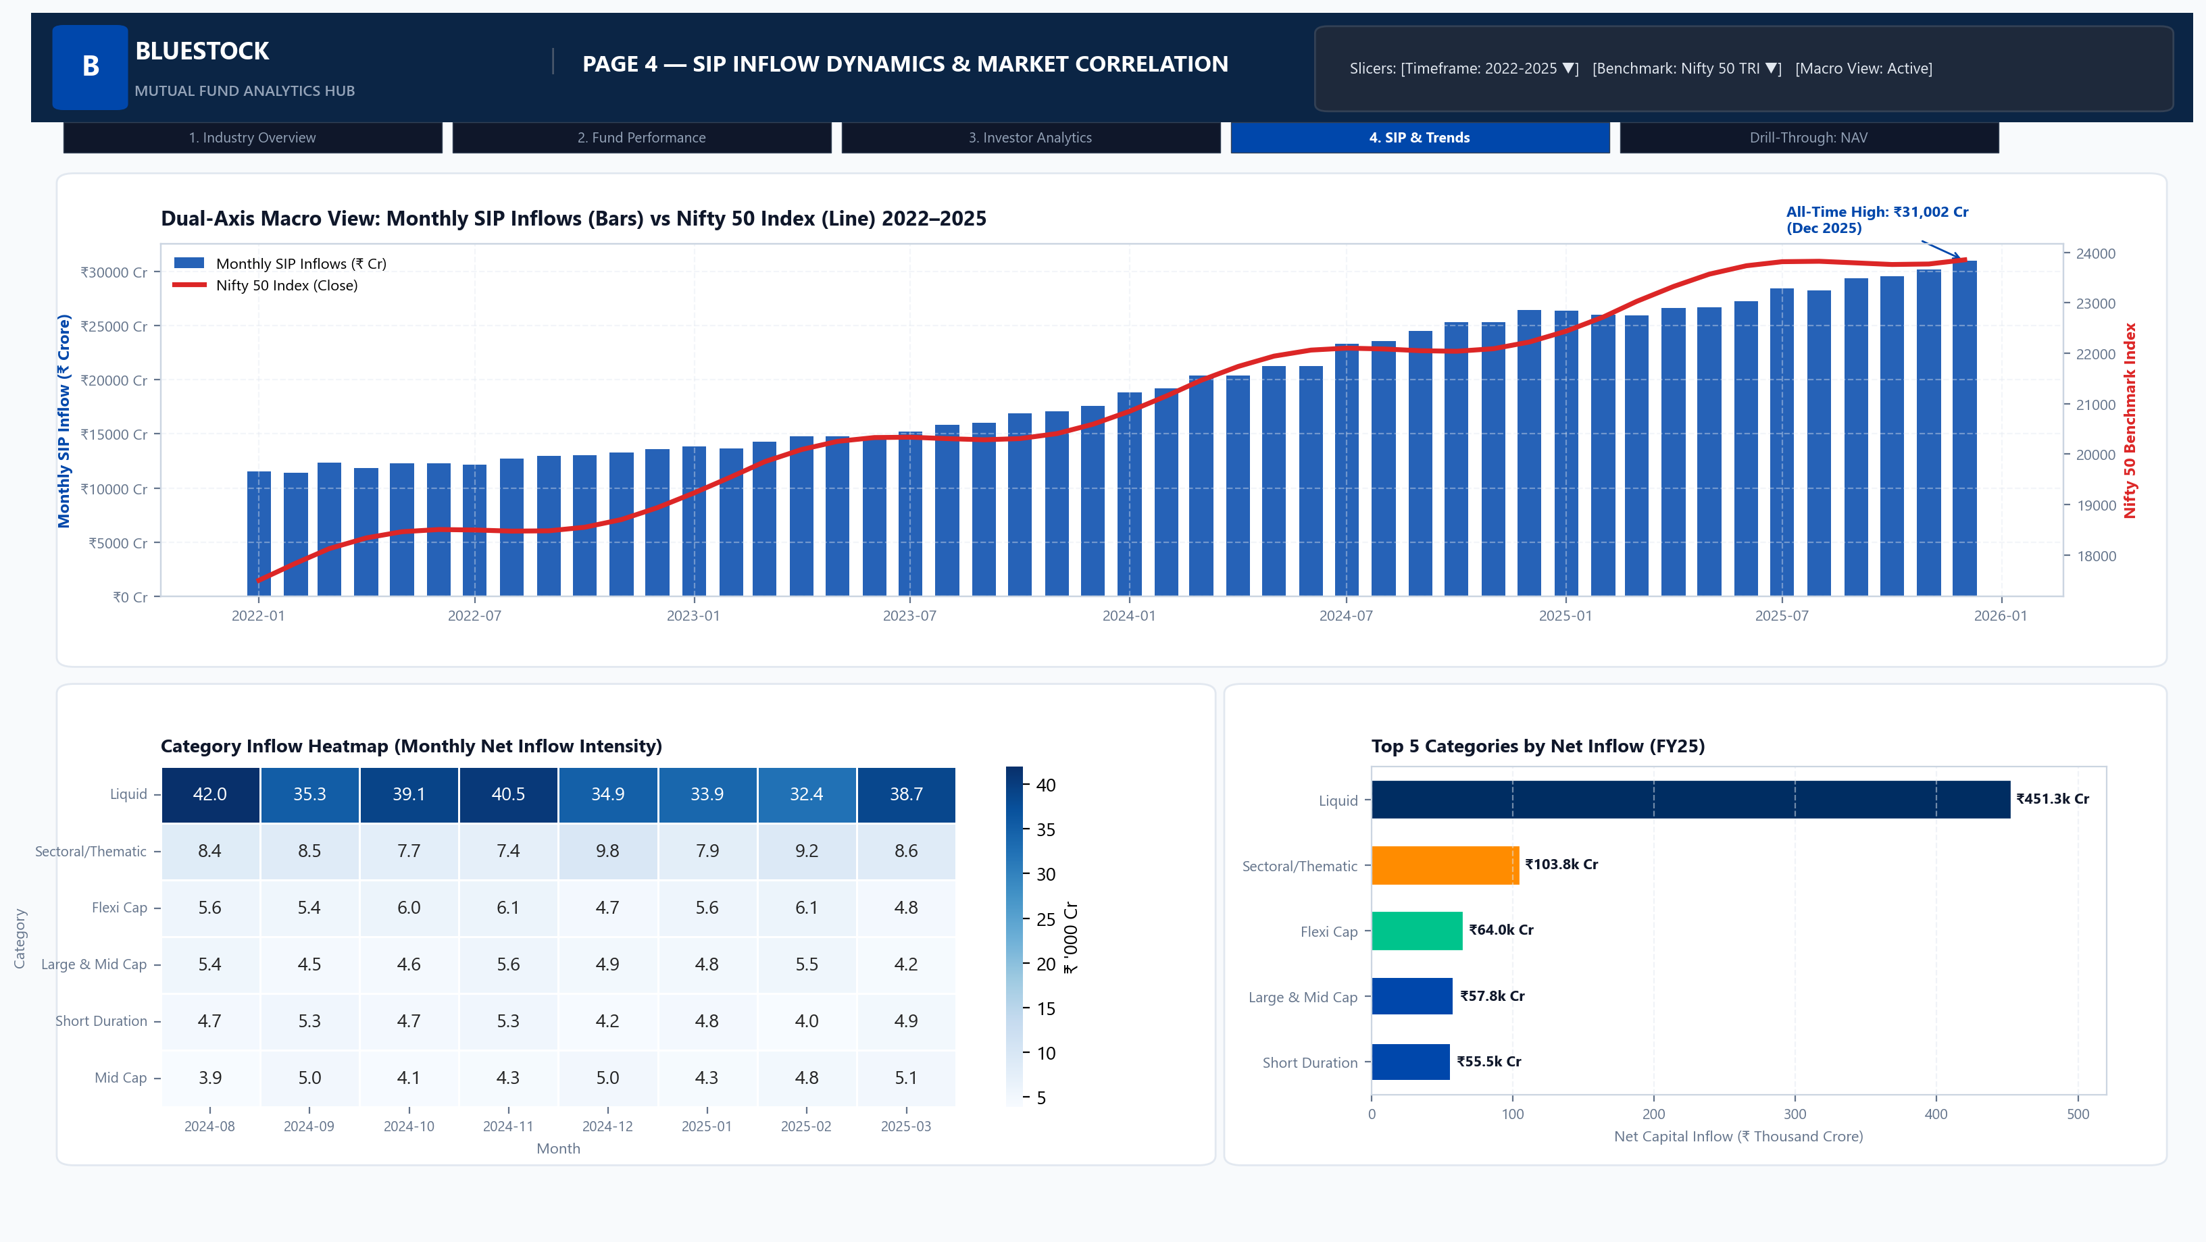
BLUESTOCK MUTUAL FUND CAPSTONE
Power BI Dashboard: Investor Analytics & SIP Market Trends
Behavioral & Channel Distribution Views
Page 3 (Investor Analytics): Age cohort breakdown, gender participation split, and city tier ticket size comparisons enabling wealth managers to tailor marketing outreach.
Page 4 (SIP Trends): Digital payment mode distribution (UPI AutoPay vs Mandates vs NetBanking), state-wise folio densities, and discontinuation vs retention rates.

Slide 11
BLUESTOCK MUTUAL FUND CAPSTONE
Strategic Recommendations & Actionable Investment Playbook
Retail Investors
• Adopt Core & Satellite: 60% in Large/Flexicap anchors, 40% in Mid/Small satellites.
• Switch to Direct Plans: Save 60-85 bps TER drag (yielding ₹12L+ over 15Y).
• Use Step-Up SIPs during drawdowns.
Wealth Managers
• Filter by Sortino: Prioritize funds with high downside protection.
• Monitor Tracking Error: Ensure active risk remains bounded under 20%.
• Focus on T30/B30 hybrid asset allocation products.
FinTech Platforms
• Embed 0–100 Scorecard into discovery funnels rather than crude star ratings.
• Real-Time Drawdown Alerts to prompt value investing entries.
• One-Click Micro-SIPs via UPI AutoPay integration.
Execution Takeaway: Objective multi-factor scoring eliminates emotional investing, directing capital toward sustainable alpha generators.

Slide 12
BLUESTOCK MUTUAL FUND CAPSTONE PROJECT
Thank You! Questions & Discussion
GitHub Repository: https://github.com/ankithaa08/mutual-fund-analytics • Tagged Release: v1.0
Deliverables: Final_Report.pdf (18 pages) | Bluestock_MF_Presentation.pptx (12 slides) | Power BI Suite (.pbix)

