Slide 1

DATA MINING • FINAL PROJECT ADVERTISEMENT
Who actually pays the airline-competition premium?
A data-mining investigation of US airfares • 1993 – 2024
“The textbook story is wrong. The real story is more interesting.”
Ankitha Prasad
Data Mining • 2026

Slide 2

THE TEXTBOOK STORY
Fewer airlines should mean higher prices.
Everyone believes it.
1 airline
Airlines price around it.
⇧
Regulators review mergers on it.
$ $ $
An intuition so strong it became policy.
higher fares
Data Mining Final Project • Ankitha Prasad • Who pays the airline premium?

Slide 3



THE EVIDENCE BASE
We tested the textbook at scale.
US DOT Consumer Airfare Report • cleaned + CPI-adjusted
237,985
212
64
32
OBSERVATIONS
AIRPORTS
CARRIERS
YEARS
route-quarters, cleaned
origin-destination pairs
legacy, low-cost, regional
1993 – 2024
Every route. Every quarter. Thirty-two years.
Data Mining Final Project • Ankitha Prasad • Who pays the airline premium?

Slide 4
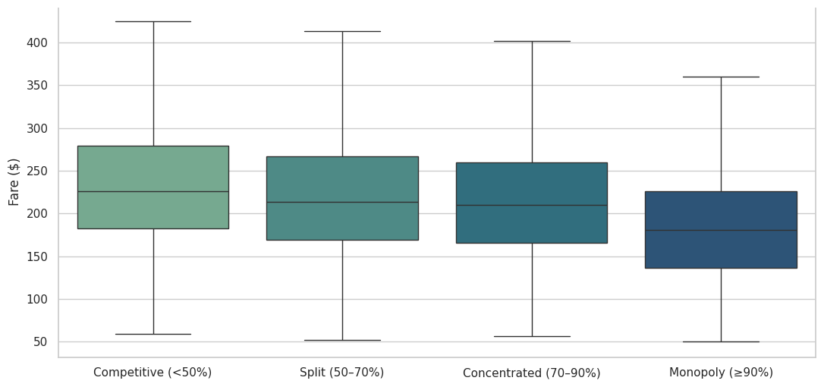
THE SURPRISE
Monopoly routes are … cheaper?
-$12.61
Fare distribution by market structure
PER TICKET • MONOPOLY vs. COMPETITIVE
After controlling for distance, demand, year.
Source: Checkpoint-3 notebook, cell 20
The opposite of the textbook prediction. So — why?

Slide 5
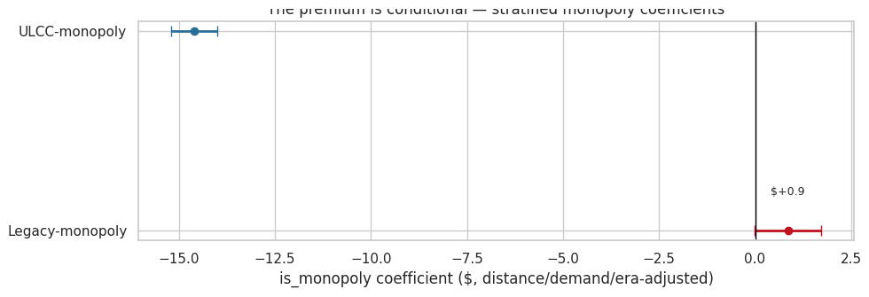
WHY — A COMPOSITION EFFECT
Who actually runs those monopoly routes?
Stratified monopoly effect — when you split by carrier type
THE MONOPOLY COLUMN
47.3%
of monopoly routes are
low-cost carriers.
They price cheap everywhere —
bags and seats, not fares.
Carrier identity,
not market power.
ULCC: -$14.60 (real discount) Legacy: +$0.86 (indistinguishable from zero)
Source: Checkpoint-3 notebook, cell 42 • OLS, 95% CI
Data Mining Final Project • Ankitha Prasad • Who pays the airline premium?

Slide 6

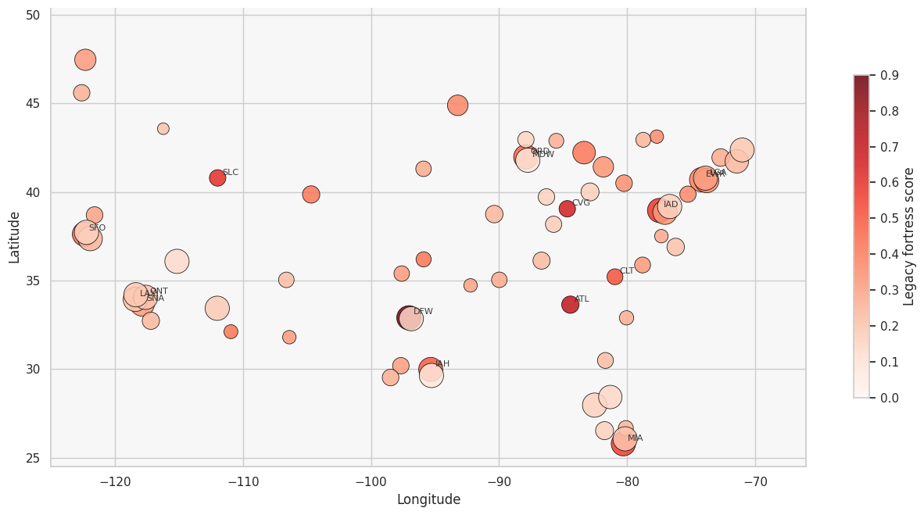


THE PIVOT
We were asking at the wrong level.
ROUTE LEVEL
US fortress hubs — single-carrier dominance
“One airline on one route”
Too narrow — a carrier can run an entire hub's banks without 90% on any one route.
AIRPORT LEVEL
“One airline dominates the hub”
Fortress hubs — one carrier, all the banks, all the gates, and the fare ladder.
Source: Checkpoint-3 notebook
Move the unit of analysis. Everything changes.

Slide 7
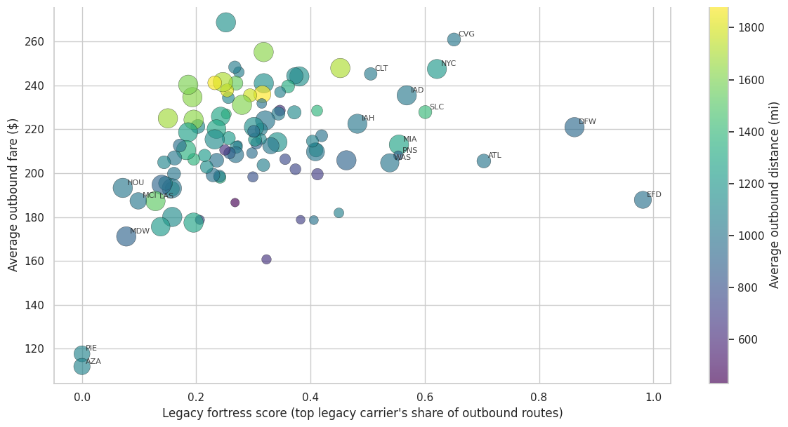
THE CASE STUDY
DFW vs. MDW — same destinations, different fare.
$56.71
Fortress score vs. airport fare — DFW and MDW, side by side
MEAN FARE GAP
per ticket, DFW − MDW
86.5%
OF SHARED DESTINATIONS
DFW is the pricier airport
89
SHARED DESTINATIONS
common city pairs
Source: Checkpoint-3 notebook · per-airport avg fare
Same plane. Same distance. Different airport.

Slide 8
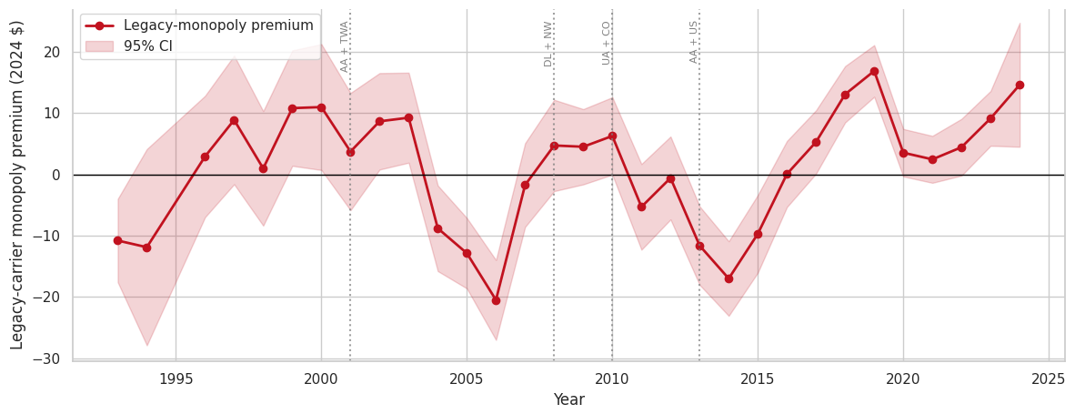
THE TIMING
This premium didn't exist 10 years ago.
Legacy carrier monopoly premium, 1993 – 2024 (CPI-adjusted)
FIRST SEEN
2016
the year AA finished absorbing US Airways.
NEW NORMAL
+$14.64
in 2024 — not an outlier.
A structural shift.
Source: Checkpoint-3 notebook · vertical lines mark AA+TWA, DL+NW, UA+CO, AA+US
The premium appeared only after consolidation had time to settle.

Slide 9

THE TAKEAWAY
Fortress hubs, not monopoly routes.
01 · ROUTE LEVEL
02 · AIRPORT LEVEL
03 · OVER TIME
−$12.61
$56.71
+$16.90
Composition effect,
not market power.
Fortress hubs charge
a measurable premium.
The premium emerged
after 2016 mergers.
The real premium isn't one airline on one route. It's one airline dominating the airport.
POLICY Antitrust review should track airport-level legacy concentration, not route-level market share.
Three findings · 32 years of data · one conclusion.

