Slide 1

Effects of Aviation on Environment
NAME : ANKITHA YAMINI BATHINOZU
BITS ID : 2022MT12088
SUPERVISOR : CHIRUVOLU KARTHIKEYA
COURSE : M.Tech. SOFTWARE SYSTEMS
BITS Pilani
Pilani Campus
BITS Pilani
Pilani Campus

Slide 2
Abstract
The exponential growth of the aviation industry has facilitated global connectivity and economic prosperity.
This expansion has brought forth environmental challenges, primarily in the form of air pollution, which poses significant threats to both human health and climate stability.
This dissertation explores the impacts of aviation on the environment, focusing on carbon dioxide (CO2) emissions as a significant contributor to air pollution.
Machine learning is used for sustainable aviation practices by utilizing daily CO2 emission data from various countries.

Slide 3
Dataset Overview
The dataset utilized in this study, originates from Carbon Monitor, a platform dedicated to tracking and analyzing carbon emissions globally
This dataset provides comprehensive insights into carbon dioxide (CO2) emissions attributed to aviation activities across various countries and sectors.
It includes information on the daily CO2 emissions recorded for each country, categorized by both Domestic aviation and International Aviation.

Slide 4
Data Pre-processing
Data transformation and cleaning
Dropped unused columns from the dataset.
The 'date' column in the dataset is converted to a datetime format to facilitate temporal analysis.
Log-transformed the CO2 emissions value to address potential skewness.
Feature engineering:
It aims to preprocess the dataset and extract meaningful information from the raw data, making it suitable for training machine learning models. By transforming and creating features appropriately, the feature engineering process enhances the predictive performance of the models and facilitates the interpretation of model outputs.
The month-year information is extracted from the 'date' column and stored as a separate column ('month_year').
This feature allows for the aggregation of CO2 emissions data at the monthly level, enabling the exploration of temporal patterns and trends.

Slide 5
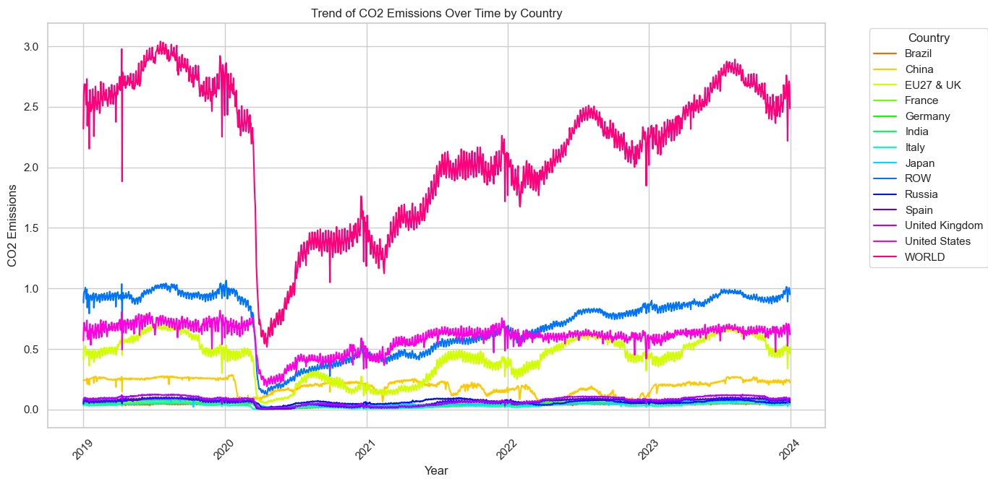
Exploratory Data Analysis
Trend of CO2 Emissions from Aviation by Country:

Slide 6
Contd..
Insights:
Distinct disparities in CO2 emissions across countries and aviation were apparent, making significant contributions to the total emissions.
A significant decrease in CO2 emissions was noted during the COVID-19 lockdown period.
Seasonal fluctuations in CO2 emissions were observable annually

Slide 7
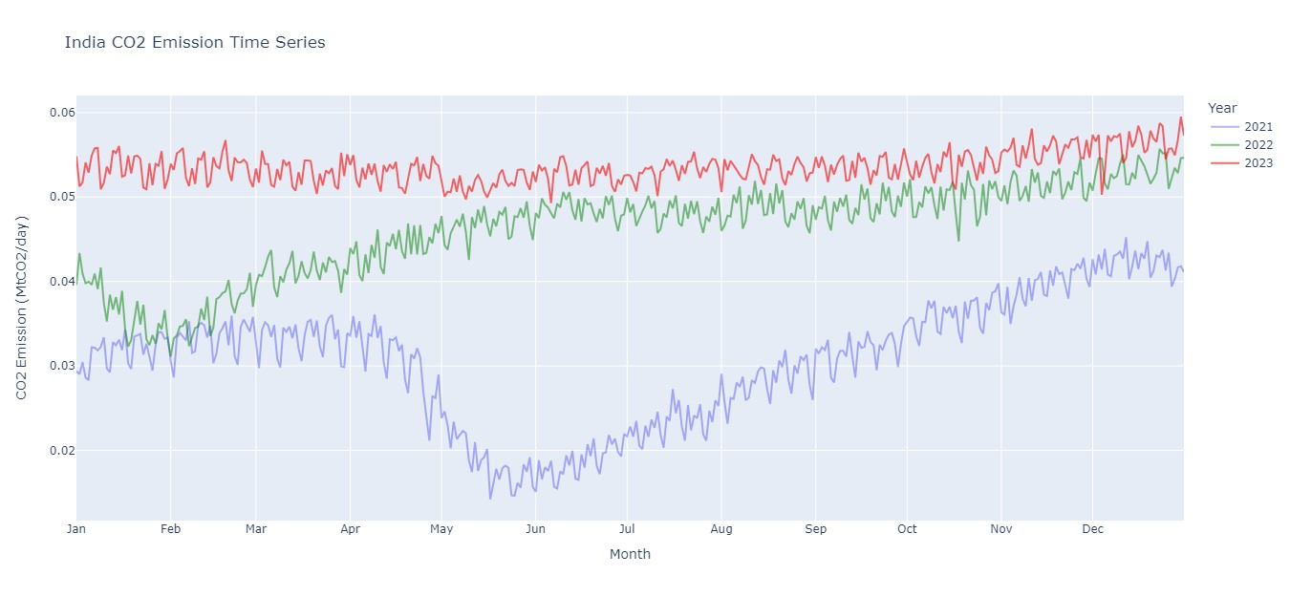
Contd..
Time Series Analysis of Country-wise CO2 Emissions by Aviation over a period of last 3 years:
Example: India’s CO2 emissions
Insight: A seasonal trend exists, with higher CO2 emissions in winter and lower emissions in summer. This likely reflects increased heating energy use in winter.

Slide 8
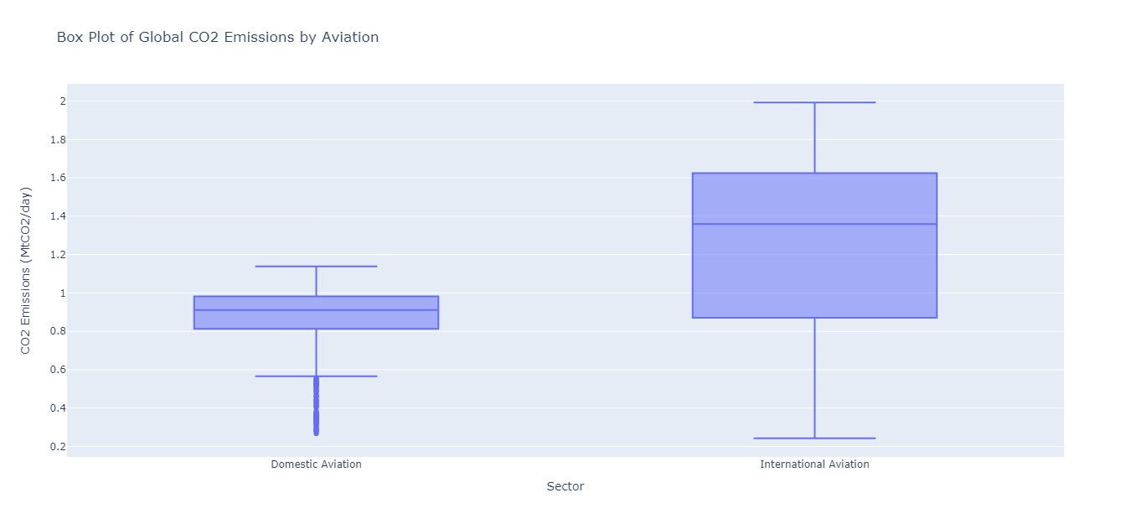
Contd..
Box Plot of Global CO2 Emissions by Aviation:

Slide 9
Contd..
Insights:
The box plot shows the spread of CO2 emissions for domestic aviation and international aviation.
Based on the position of the line in the middle of the box, it appears that CO2 emissions from domestic aviation tend to be lower than CO2 emissions from international aviation.
The box for domestic aviation is smaller than the box for international aviation. This suggests that CO2 emissions from domestic flights are more tightly clustered around the median than CO2 emissions from international flights. There is more variability in emissions from international flights.

Slide 10
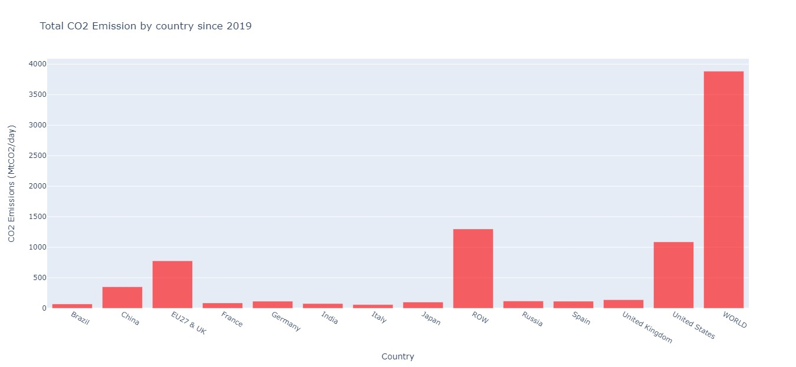
Contd..
Bar graph of CO2 emissions from aviation across countries:

Slide 11
Contd..
Insights:
The histogram shows the distribution of total CO2 emissions from aviation across different counties. The bars on the x-axis represent the range of CO2 emissions in MtCO2, while the height of each bar represents the number of countries that fall within that emissions range.
We can now say that some countries emit lower amounts of CO2 (left side of the histogram), while others emit higher amounts (right side).
By looking at the far right side of the histogram, we can see if there are any countries with a significant number of emissions compared to other countries. These countries could be potential high emitters of CO2 from aviation.

Slide 12
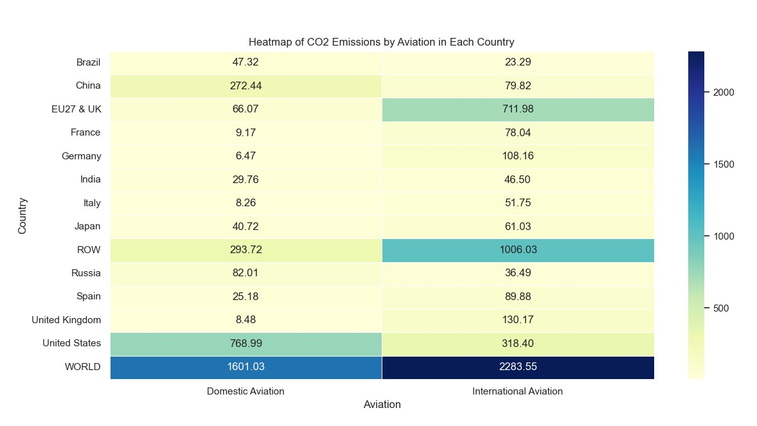
Contd..
Heatmap of CO2 Emissions by Aviation in Each Country:

Slide 13
Machine Learning Model
CatBoostRegressor model is used to predict CO2 emissions by aviation in a country.
It's a gradient boosting algorithm suitable for regression tasks.
This model is chosen due to its:
Scalability for adding more features (flight type, aircraft type, etc.)
Robustness to overfitting
Ability to handle categorical features
Splitting and Training
Splitting the Dataset:
The data is split into training and testing sets using scikit-learn's train_test_split function.
The training set (e.g., 80%) is used to train the model, and the testing set (e.g., 20%) is used to evaluate its performance.
Training the Model:
The model is trained using the training data to learn the relationship between the input features such as country, date, sector (domestic aviation and international aviation), month_year and the target variable is log-transformed CO2 emissions.
Predictions are made on both the training and testing sets.

Slide 14
Contd..
Evaluating the Model:
The trained model is assessed on both training and testing data using various metrics:
Root Mean Squared Error (RMSE): Measures the average deviation of predicted from actual values (lower is better).
R-squared: Represents the proportion of variance in CO2 emissions explained by the model (closer to 1 indicates a better fit).
Mean Absolute Error (MAE): Measures the average absolute difference between predicted and actual values (provides insight into prediction accuracy).
Baseline Model:
A simple baseline model is implemented for comparison.
It predicts the mean CO2 emissions for all data points regardless of features.

Slide 15
Results
Trained Model:
 | Train data | Test data
RMSE | 0.0756 | 0.0823
R-squared | 0.9891 | 0.9872
MAE | 0.0453 | 0.0468
Average predicted CO2 emissions is 0.043
Average actual CO2 emissions is 0.043
Baseline Model:
 | Train data | Test data
RMSE | 0.5290 | 0.5307
R-squared | 0.0 | 0.0
MAE | 0.5767 | 0.5765

Slide 16
Summary
Aviation significantly contributes to CO2 emissions, harming air quality and fueling climate change.
Machine learning was used to predict CO2 emissions
A CatBoostRegressor model outperformed a baseline model in accuracy.
The model considers factors like country, aviation sector, and time.
It achieved high accuracy with low error rates (RMSE) and explained most of the CO2 emission variations (R-squared).
This suggests the model can effectively predict CO2 emissions from aviation activities.

Slide 17
Recommendations
Adopting Sustainable Practices: Encourage the aviation industry to adopt sustainable practices, such as investing in fuel-efficient aircraft, optimizing flight routes, and implementing alternative propulsion technologies like electric or biofuel-powered planes.
Regulatory Measures: Implement stringent regulations and emission reduction targets for the aviation sector to curb CO2 emissions. This could include emissions trading schemes, carbon pricing mechanisms, and incentives for investing in green technologies.
Infrastructure Development: Invest in modernizing aviation infrastructure to enhance efficiency and reduce emissions. This includes upgrading air traffic management systems, developing eco-friendly airports, and promoting the use of renewable energy sources.
Public Awareness and Education: Raise public awareness about the environmental impact of aviation and encourage individuals to make environmentally conscious travel choices, such as opting for alternative modes of transportation or offsetting their carbon footprint.

Slide 18
Future Work
Refinement of Machine Learning Models: Continuously refine and improve machine learning models for predicting CO2 emissions from aviation activities. This involves incorporating additional features, refining algorithms, and validating model performance on real-world data.
Exploration of Alternative Fuels: Further research and development into alternative aviation fuels, such as sustainable biofuels or hydrogen, to reduce reliance on fossil fuels and mitigate CO2 emissions.
Impact of Technological Advances: Investigate the potential impact of emerging technologies, such as electric or hybrid-electric aircraft, on reducing aviation emissions and their feasibility for widespread adoption.
Policy Evaluation: Evaluate the effectiveness of existing environmental policies and regulations in mitigating aviation emissions and identify areas for improvement or expansion.
Global Data Collaboration: Foster collaboration among countries and international organizations to collect and share comprehensive data on aviation emissions, enabling more accurate modeling and analysis of environmental impacts on a global scale.

Slide 19
Questions ?

Slide 20
Thank You

