Slide 1

Inner Power – Unlock the Power within
Holiday Inn Resort Goa
Sept 27th -28th

Slide 2



Inner Power
Go Live Your Dreams
Goa – Sep 27th – 28th

Slide 3


Inner Power – Unlock the Power within
About
I believe there's an inner power that makes winners or losers, and the winner are the ones who really listen to the truth of their hearts. – Sylverster Stallone
Module
“Inner Power” is organizing a two-day event comprises of a series of theme based workshop sessions to strengthen the core beliefs of individuals to excel in every aspects of life (professional & personal). The event is an open event to passionate entrepreneurs, visionary and for those who looking forward to take charge of their lives. Where you will get to meet the passionate speaker, network with passionate minded group.
And in our pursuit of a truly transformational experience, we propose to bring renowned inspirational achievers, thought leaders, and industry stalwarts to deliver keynote addresses for the various themes lined up as part of the “Inner Power” event. Each keynote speech will set the ball rolling for the series of workshop learning activities and deliberations related to that particular theme.

Slide 4
Inner Power – Unlock the Power within
Take Away
The secret of outstanding achievement runs much more than knowing strategy or knowledge, it is born from within oneself, we call it "Inner Power". In Inner Power club, you will meet the highly successful speakers, and inspiring people as a invites and passionate participants, who will inspire you to take you to next level of personal achievement.
Meet Passion minds
Networks
Amazing Place
Tools for Inspiration
Fun / Activates
Adventure
You are much stronger than you think

Slide 5
Inner Power – Unlock the Power within
Tabs
Home
Program
Destination
sponsors
Free Stuffs
Speakers
Register Today
Forum
About
Place
Overview
PDF / Blog
Overview
competition
Discussion
Resort
Sponsor benefit
Videos
Forms
Transport
Forms
Pics

Slide 6
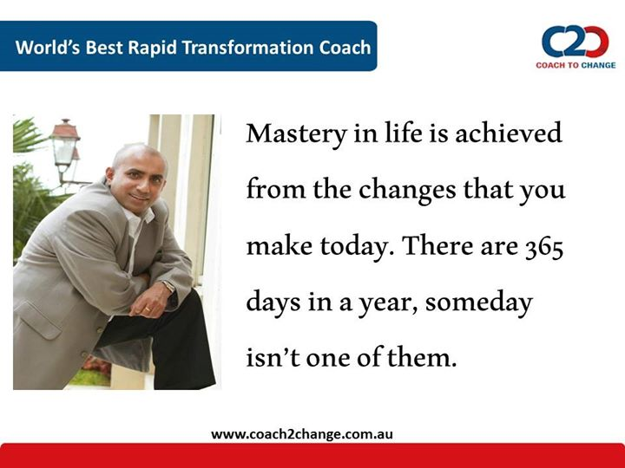
Inner Power – Go Live Your Dreams
Theme
INNER POWER
Self awareness
Inner Passion
energy
Self Care
Self Inspiration
Edge
Passion is energy. Feel the power that comes from focusing on what excites you.
Oprah Winfrey

Slide 7
Inner Power – Go Live Your Dreams
Destination / About
Goa is India's smallest state by area and the fourth smallest by population. Located in West India in the region known as the Konkan, it is bounded by the state of Maharashtra to the north, and by Karnataka to the east and south, while the Arabian Sea forms its western coast.
Mobor Beach is an ideal location for the adventure tourists. It is one of the most popular beaches in Goa, which enables the tourists to indulge in adventure sports such as water skiing, water surfing, jet ski, banana and bump rides and parasailing. The beach can be visited throughout the year; however, the best months to visit Mobor Beach of Goa is between the months of September and March. In fact, the Cavelossium-Mobor is famous for water sports. The water sports at Mobor beach at Goa include speed boat rides, jet ski, water skiing, banana and bump rides, wind surfing, parasailing and many others. These water sports takes place behind the Betty Palace.

Slide 8
Inner Power – Go Live Your Dreams
Sponsors
Sponsorship Opportunities
Make valuable connections within the Inner Power community by becoming a Conference Sponsor and promoting your products and services to the Passionate Group.
Download the Sponsorship Portfolio
Download the sponsor’s pledge form
The Inner Power along with Coach to Change – organizing a conference Go Live your Dream in Goa, sep 27th – 28th. This is a great oppituinity to get your product and your brand reached out to around 300 passionate minds. As the largest conference of its kind, this event offers a unique opportunity to gain high-value visibility with numerous chances to connect with Managers, entrepreneurs, and Academics while networking with influential thought-leaders in the industry.
Please contact Raphael Joseph today to inquire about sponsorship opportunities and select a package that best suits your needs. Sponsors@innerpowerclub.com

Slide 9
Inner Power – Go Live Your Dreams
Destination / Means
Travel plan
Basic city:
Connectivity: Air / Bus / Train
Pune
Mumbai
Bangalore
Mangalore
Chennai
Delhi
Hyderabad
Any others pls send your enquiry mail

Slide 10
Inner Power – Go Live Your Dreams
Organizers
Organizers : Inner Power / Coach to success
Co-orgainzers: Elan Tattva

Slide 11
Inner Power – Go Live Your Dreams
Registration Page - Take Away
Be a Part of INNER POWER and Begin Your Personal Success Journey
Immerse yourself in Motivational Talks and Workshops, plus Keynotes and Special Events -- It's ALL included with your Registration -- plus breakfast, lunch, reception and the evening party.
This is your best opportunity in 2014 to network with the most active and passionate minds.
Confer with leading coaches and experts, thought leaders, innovators, and sports genius as they share their experiences, expertise and enthusiasm with you. You'll take away the actionable knowledge, valuable contacts, and inspiration you need to achieve your objectives.
Get ready for a dynamic, stimulating weekend of focused learning, brainstorming, problem-solving, networking, and collaborating with life coaches, experts, colleagues and peers. If you can are passionate mind, looking to make your life a passionate one.. this workshop is for you.
Don't forget your peers and colleagues!
Make sure all your key players are attending this year.
Click to view conference rates and information, Member, Group and Academic discounts.
REGISTER TODAY

Slide 12
Inner Power – Go Live Your Dreams
Registration Page
All fees are in Indian rupees ** Super Early Bird and Early Bird registrations do not have a specified cut-off date. These registrations are based on a first-come / first-served basis and will be available until the maximum quantities have been met.
Groups of 20 or more should contact Gaurav Singh ( ) Registration Coordinator, for additional pricing.
PAYMENT METHODS:
Inner Power 2014 accepts Debit card, Visa, MasterCard, Cash transfer payments.
Please Make Check/Money Order Payable to: ----------------------------------------------------------
Please send a printed copy of your confirmation email along with your payment.

Slide 13
Inner Power – Go Live Your Dreams
Registration Page
Inner Power Registration
Attendee Information
Registration Type *
O Diamond O Golden O Silver O Student
From Goa
O Power O Student
Price
Register here.
First Name *
Last Name *
Company *
Job Title *
Email *
Phone Number *
Company Size *
Job Category *
State
Country *

Slide 14
Inner Power – Go Live Your Dreams
Registration Page
Inner Power Registration
Attendee Communication Preferences
Send this attendee conference-related emails.
Attendee Medical/Dietary/Accessibility Restrictions
In order for our event staff to better serve you, please indicate if you have any medical/dietary restrictions and/or accessibility requirements.
No, I do not have medical/dietary restrictions and/or accessibility requirements.
Yes, I have medical/dietary restrictions and/or accessibility requirements.
* Indicates a required.

Slide 15
Inner Power – Go Live Your Dreams
Need Assistance
Here for you
Contact the Sponsor Liaison
Registration Inquiries and Assistance
Contact Inner Power Membership
Contact for Press Inquiries
Contact Volunteer Coordinator
Conference Program
PROGRAM & SCHEDULE
Program Tracks
Keynote Speakers
Special Events
Conference Sponsorship Info
Download the Sponsorship Portfolio
Download the Sponsor's Pledge form
Inquire about Sponsorship
Planning Questions
Please contact us with any questions you might have about the planning process for Inner Power2014.
______________, Inner Power2014 Speaker Coordinator ______________, Inner Power 2014 Logistics

Slide 16
Inner Power – Go Live Your Dreams
Social Link
Facebook
Linkedin
Twitter
General Information
Sep Weather -
Local Area distance
Emergencies - Conference Links

