Slide 1
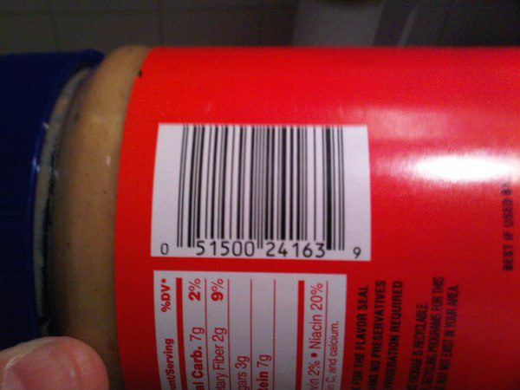
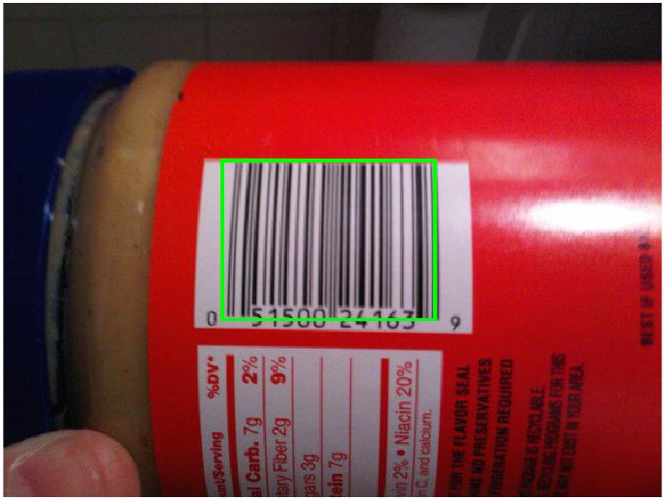
BAR CODE DETECTOR
Before :
2112001
2112088
2112100
After :

Slide 2
AIM :
The aim of this presentation is to demonstrate a MATLAB-based approach for barcode detection in images.
OVERVIEW :
We'll explore various image processing techniques including gradient computation, binarization, morphological operations, and connected component analysis to achieve accurate and robust barcode detection.

Slide 3
ABSTRACT :
This presentation showcases a MATLAB approach for detecting barcodes in images. We cover image preprocessing, gradient computation, binarization, morphological operations, and connected component analysis.
Through a series of MATLAB demonstrations, we illustrate each stage of the barcode detection pipeline, providing insights into the underlying algorithms and their implementation. Finally, we present the results of barcode detection, showcasing the effectiveness of the proposed approach in accurately localizing and identifying barcodes in diverse image scenarios.

Slide 4
Loading and Preprocessing the Image:
Load the original image and display it.
Convert the image to grayscale.
1.

Slide 5
Computing Gradients:
Compute gradients along the X and Y directions using Sobel operators.
Display the gradient images.
2.

Slide 6
Binarization:
Calculate the gradient magnitude.
Binarize the gradient image using a threshold.
3.

Slide 7
Morphological Operations:
Create a rectangular structuring element.
Perform morphological closing using the rectangular structuring element.
Erode the closed image using a disk-shaped structuring element.
Dilate the eroded image using the same structuring element.
4.

Slide 8
Connected Components:
Identify connected components in the dilated image.
Visualize the connected components on the image.
5.

Slide 9
Barcode Detection:
Extract regions of interest (ROI) based on the connected components.
Draw bounding boxes around the detected regions.
6.

Slide 12
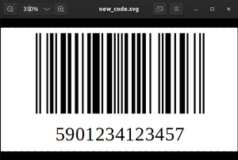

BAR CODE DETECTOR :

Slide 13
CONCLUSION :
Our MATLAB-based barcode detection solution combines gradient computation, binarization, morphological operations, and connected component analysis to accurately locate and identify barcodes in images.
This approach offers a versatile and powerful tool for real-world barcode recognition tasks, contributing to advancements in image processing applications.

Slide 14
Thank You !!!

