Slide 1
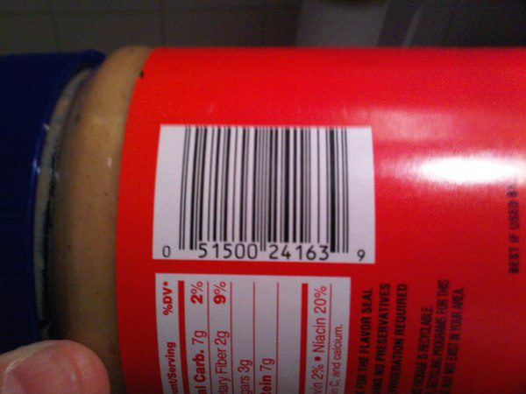
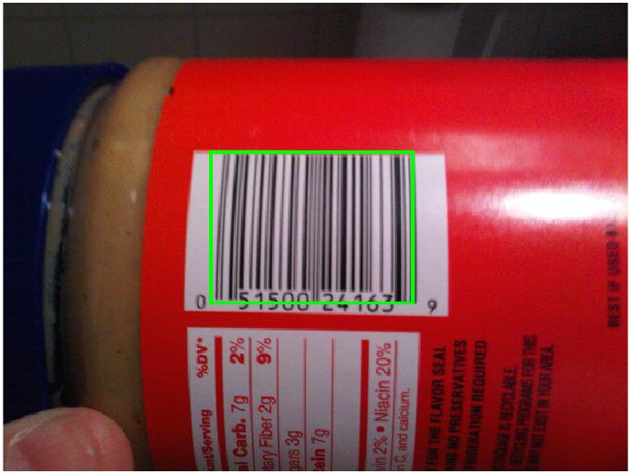
BAR CODE DETECTOR
2112001 - G Vinay
2112088 - G AnkithKumar
2112100 - Amisha Singh

Slide 2
AIM :
The aim of this presentation is to demonstrate a MATLAB-based approach for barcode detection in images.
OVERVIEW :
We'll explore various image processing techniques including gradient computation, binarization, morphological operations, and connected component analysis to achieve accurate and robust barcode detection.

Slide 3
ABSTRACT :
This presentation showcases a MATLAB approach for detecting barcodes in images. We cover image preprocessing, gradient computation, binarization, morphological operations, and connected component analysis.
Through a series of MATLAB demonstrations, we illustrate each stage of the barcode detection pipeline, providing insights into the underlying algorithms and their implementation. Finally, we present the results of barcode detection, showcasing the effectiveness of the proposed approach in accurately localizing and identifying barcodes in diverse image scenarios.

Slide 4
The Following Are the stages in Detecting of BAR CODE :
LET’S BEGIN -

Slide 5
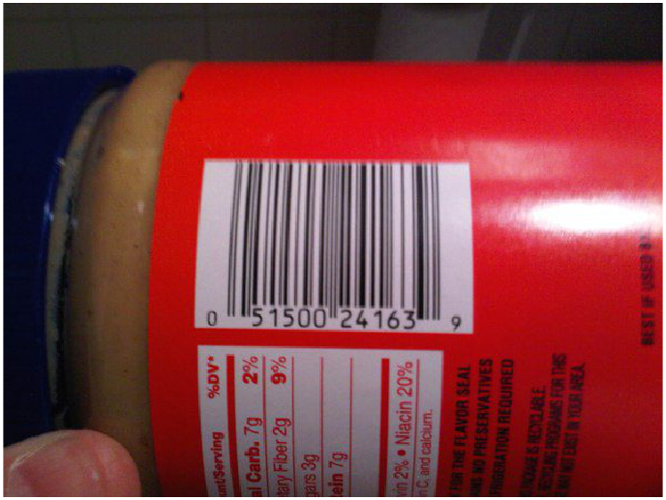
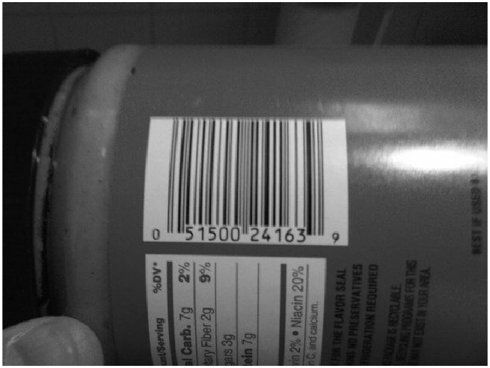
Loading and Preprocessing the Image:
Load the original image and display it.
Convert the image to grayscale.
1.
Original Image
Grayscale Image

Slide 6
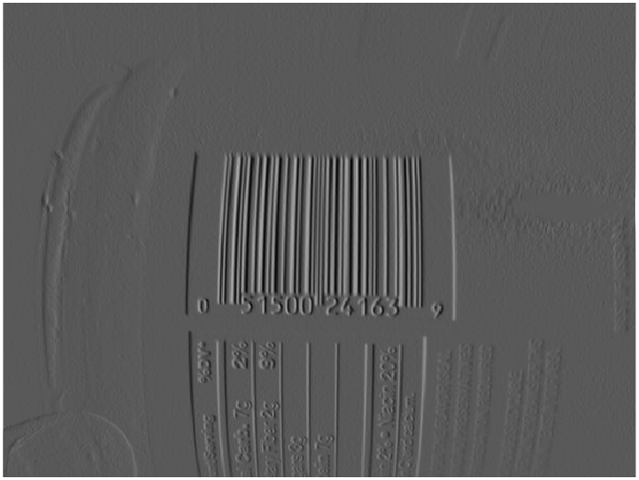
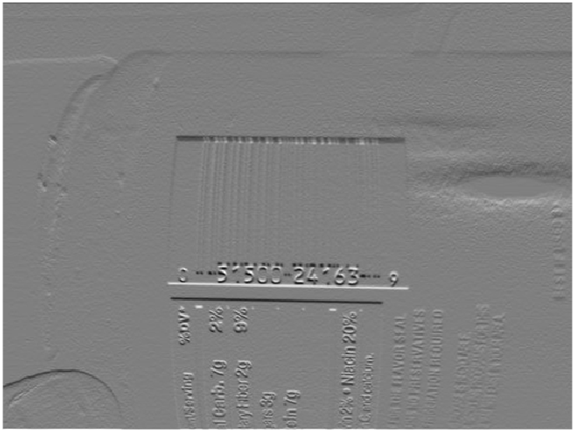
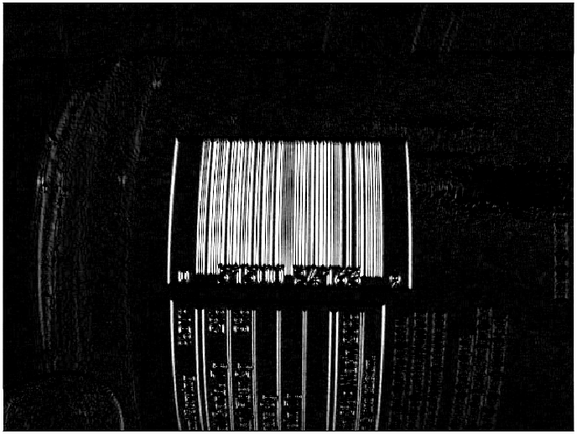
Computing Gradients:
Compute gradients along the X and Y directions using Sobel operators.
Display the gradient images.
Calculate the gradient magnitude.
2.
Gradient along X
Gradient along Y
Grad(X)-Grad(Y)

Slide 7
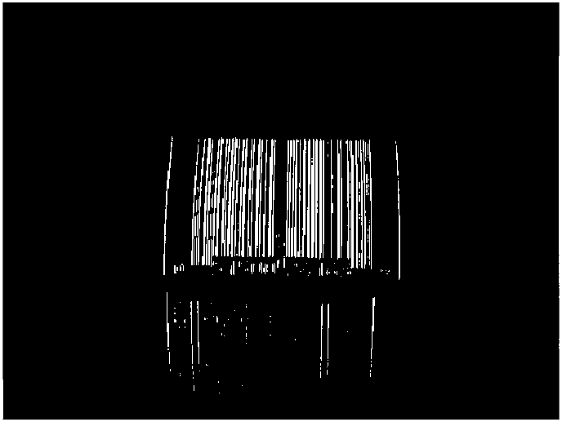
Binarization:
Binarize the gradient image using a threshold.
Display the Binary Image.
3.
Gradient
Binary Image

Slide 8
Morphological Operations:
Create a rectangular structuring element.
Perform morphological closing using the rectangular structuring element.
Erode the closed image using a disk-shaped structuring element.
Dilate the eroded image using the same structuring element.
4.

Slide 9

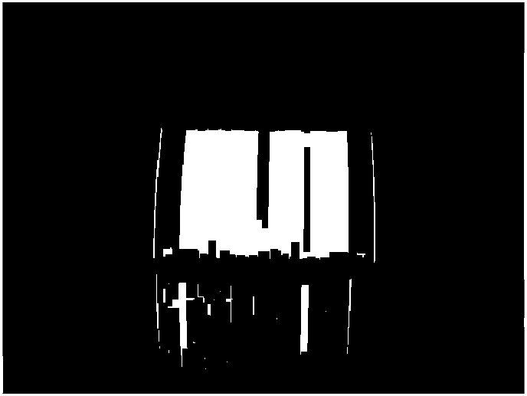

Morphological Operations:
Binary Image
Disk Dilated Image
Initial Closed Image
Disk Eroded Image

Slide 10
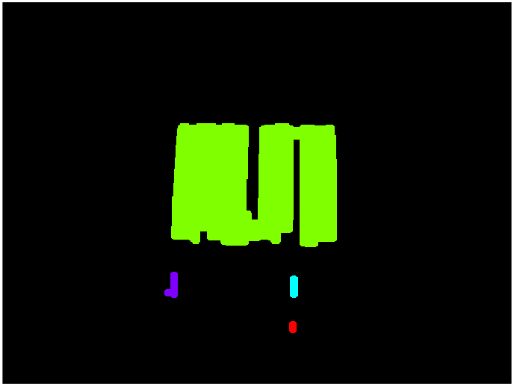
Connected Components:
Identify connected components in the dilated image.
Visualize the connected components on the image.
5.
Final Dilated Image
Connected Components

Slide 11

Barcode Detection:
Extract regions of interest (ROI) based on the connected components.(Largest Area)
Draw bounding boxes around the detected regions.
6.
Connected Components
Detected Barcode

Slide 12

BAR CODE DETECTOR :
Original Input Image
Output Image with
Barcode Detected

Slide 13
CONCLUSION :
Our MATLAB-based barcode detection solution combines gradient computation, binarization, morphological operations, and connected component analysis to accurately locate and identify barcodes in images.
This approach offers a versatile and powerful tool for real-world barcode recognition tasks, contributing to advancements in image processing applications.

Slide 14
Thank You !!!

