Slide 1
TASK 2

Slide 2
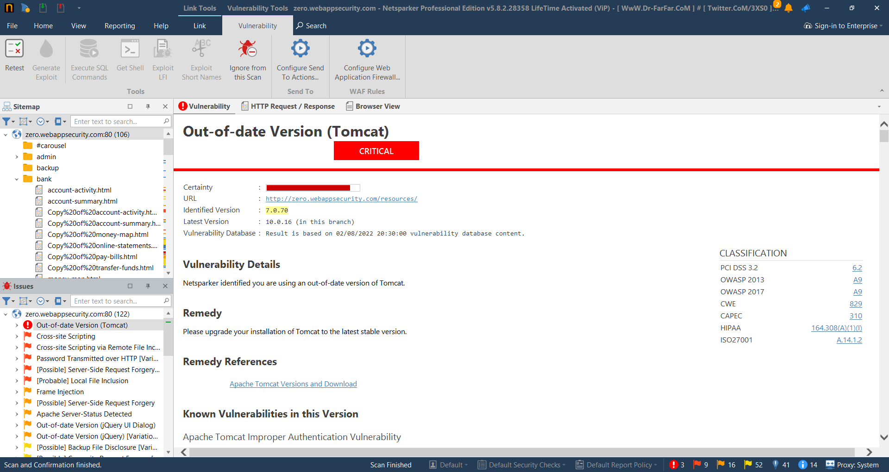
Out-of-date Version (Tomcat)

Slide 3
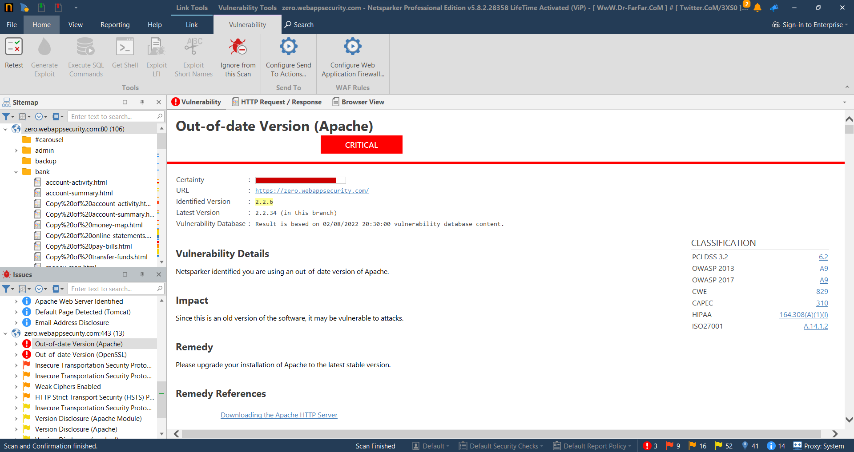
Out-of-date Version (Apache)

Slide 4

Out-of-date Version (OpenSSL)

Slide 5
REPORT On Out-of-date Version(OpenSSL)
URL : https://zero.webappsecurity.com/
Certainty : Critical
Identified Version : 0.9.8e
Vulnerability Details : Netsparker has found that https://zero.webappsecurity.com
is using an out of date version of OpenSSL which is used in
implementing the Transport Layer Security(TLS) .
Impact : As https://zero.webappsecurity.com/ was using the older version of OpenSSL hence it is vulnerable to attacks such as
FREAK attack.
Remedy : Remedy to this is to upgrade to the latest stable version of OpenSSL that is version 3.0.1.
Vulnerabilites of this version : OpenSSL Improper Authentication Vulnerability ,
OpenSSL Cryptographic Issues Vulnerability

