Slide 1



METHODS OF ADVANCED DATA ENGINEERING
Project:- Road Accident & Bicycle Traffic Trends in Cologne
Presented By:
Ankit Joshi
23123817
qa97lela

Slide 2

Introduction
Data Sources
Data Engineering Pipeline
Exploratory Data Analysis
Results & Future Work

Slide 3
Project 1:- Analysis of Road Accidents in Cologne
Project Scope
This project embarks on an extensive analysis of traffic-related incidents that occurred within the city of Cologne throughout the calendar years of 2017 and 2018. In unraveling the stories hidden within every accident, our project focuses on Cologne's streets in 2017 and 2018, seeking insights for a safer future
Focus of the Analysis
This study dives into three main aspects: understanding the types of accidents, how lighting conditions affect incident rates, and the impact of road conditions. Additionally, we'll closely examine the unique characteristics that set apart bicycle accidents from vehicular ones.
Project Goal
This project is driven by a dedication to urban safety and preventing accidents strategically. By breaking down statistical patterns systematically, we aim to provide stakeholders with evidence-based insights. The ultimate goal is to contribute to creating a city environment marked by careful planning and improved safety standards.

Slide 4
Project 2:- Bicycle Traffic in Cologne: An increase or decrease in the traffic
Project Scope
This project explores Cologne's cycling trends using data from 17 counting points, spanning 2020 to 2022. The online platform makes it easy to explore individual points, providing a detailed look at bicycle traffic dynamics in the city.
Focus of the Analysis
This analysis looks at how bicycle traffic has changed over the years, using data from 2020 and 2021. We're trying to find out if cycling has increased, decreased, or stayed about the same. The online mapping tool helps us understand these changes more thoroughly.
Project Goal
Our main goal is to provide useful information about how bicycle traffic is changing. This information can help with city planning and efforts to create more sustainable and cyclist-friendly environments in Cologne. I want to share data-driven insights with decision-makers, urban planners, and the community.

Slide 5
Methods
Data Source
Data Engineering (Cleaning and Pipeline Creation)
Exploratory Data Analysis
Results
We gathered crucial datasets from reputable sources, such as the accident atlas and police accident statistics for road accidents, and automatic counting points for cycling traffic. These sources provide comprehensive insights into accident locations, types, and conditions, as well as trends in bicycle traffic over the years. The selection of reliable and diverse data sources forms the cornerstone of our analysis.
This stage involves cleaning and transforming the raw data to make it suitable for exploration. Irrelevant columns are dropped, and necessary columns are renamed for clarity. Additionally, values are replaced with their actual meanings to enhance interpretability. The cleaned data is then structured into a systematic pipeline, streamlining the subsequent analysis.
With the cleaned dataset in place, the Exploratory Data Analysis (EDA) stage begins. Here, statistical and visual techniques are employed to unearth patterns, trends, and insights within the data. EDA allows us to understand the distribution of accidents, identify key factors influencing incidents, and make initial observations that will guide more in-depth analysis.
The final stage focuses on presenting the analyzed data in a fitting format without interpretation. This may include creating tables, diagrams, figures, or similar visual representations that effectively convey the findings. The results stage lays the groundwork for the subsequent interpretation and discussion of the project's outcomes.

Slide 6
Introduction
Data Sources
Data Engineering Pipeline
Exploratory Data Analysis
Results & Future Work

Slide 7
Data Sources
Data Sources and Dataset Description for Project 1:
For this analysis, two datasets were employed, accessible via the following URLs:
2018 Dataset - https://offenedaten-koeln.de/sites/default/files/Unfallstatistik%20K%C3%B6ln%202018.csv
2017 Dataset - https://offenedaten-koeln.de/sites/default/files/Unfallstatistik%20K%C3%B6ln%202017.csv
The datasets contain detailed information on traffic-related incidents in Cologne for the respective years, encompassing variables such as the year of occurrence, month, hour, weekday, accident category, accident type, lighting conditions, involvement of bicycles and cars, and road conditions.

Slide 8
Data Sources
Data Sources and Dataset Description for Project 2:
The primary data sources for this analysis include two datasets from bicycle counting points in Cologne. The datasets were obtained from the following URLs:
2022 Dataset - https://offenedaten-koeln.de/sites/default/files/Radverkehr%20f%C3%BCr%20Offene%20Daten%20K%C3%B6ln%202022.csv
2021 Dataset - https://offenedaten-koeln.de/sites/default/files/Radverkehr%20f%C3%BCr%20Offene%20Daten%20K%C3%B6ln%202021.csv
2020 Dataset - https://offenedaten-koeln.de/sites/default/files/Fahrrad_Zaehlstellen_Koeln_2020.csv
This dataset provides a rich temporal perspective on bicycle traffic dynamics within the city. The counting points offer a comprehensive view, capturing the ebb and flow of cycling activity over the years.

Slide 9
Introduction
Data Sources
Data Engineering Pipeline
Exploratory Data Analysis
Results & Future Work

Slide 10
Data Engineering Steps
01
Combining Datasets
Merged the datasets for 2017 and 2018 into a single dataframe for comprehensive analysis.
02
Dropping Irrelevant Columns and Renaming the Remaining Columns
Removed columns that were deemed irrelevant for the current analysis.
Standardized column names for clarity and consistency.
03
Removing Row and Column Errors and Handling Null Values
Character encoding errors were addressed in column names and rows by replacing characters like 'Ã¼' with 'ü', 'ÃŸ' with 'ß', and 'Ã¤' with 'ä'.
NaN values were replaced with relevant values to ensure consistency and facilitate downstream analysis.
04
Replacing Values with Actual Meaning
Substituted coded values with meaningful labels for better interpretation.
05
Database Connection and Storage
Established a SQLite database connection and stored the processed data frames ie. road_accidents as tables within the database for efficient retrieval and analysis.

Slide 11
Introduction
Data Sources
Data Engineering Pipeline
Exploratory Data Analysis
Results & Future Work

Slide 12
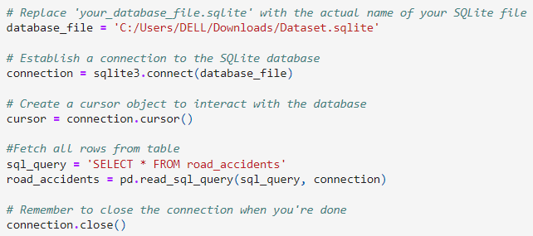
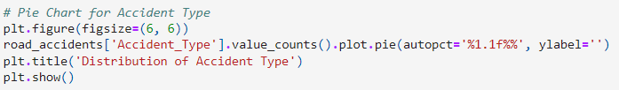
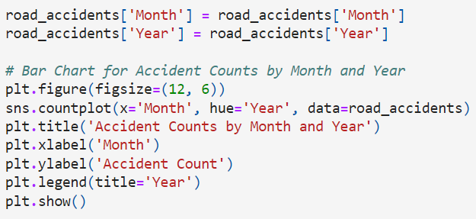
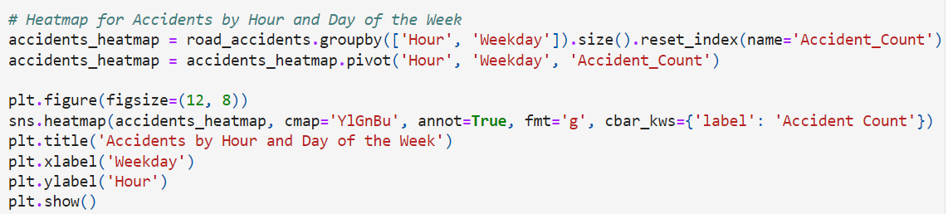
Exploratory Data Analysis for Project 1

Slide 13
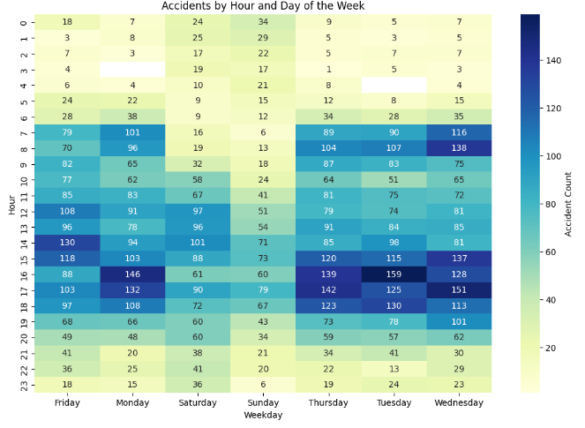
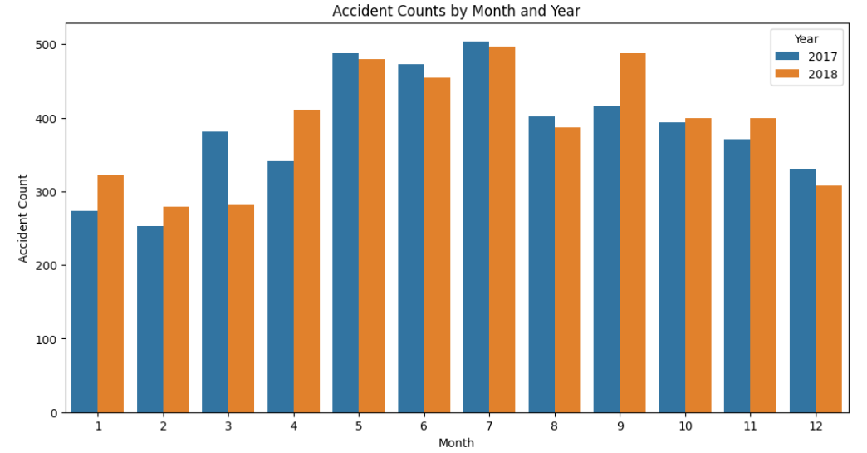
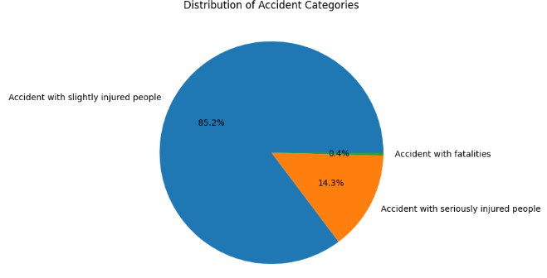
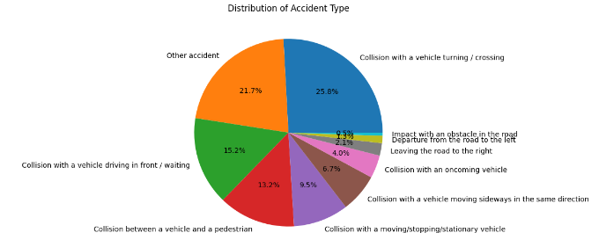
Exploratory Data Analysis

Slide 14
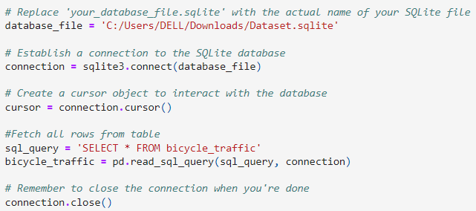
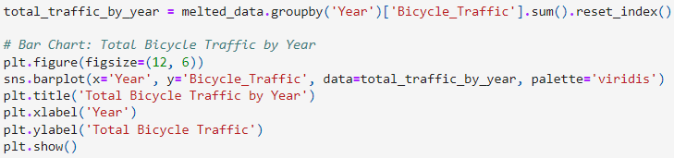
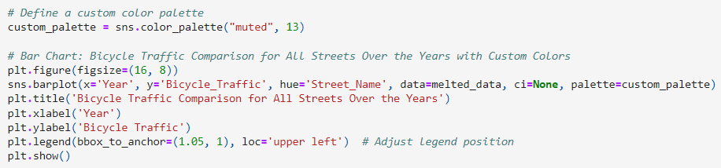
Exploratory Data Analysis for Project 2

Slide 15
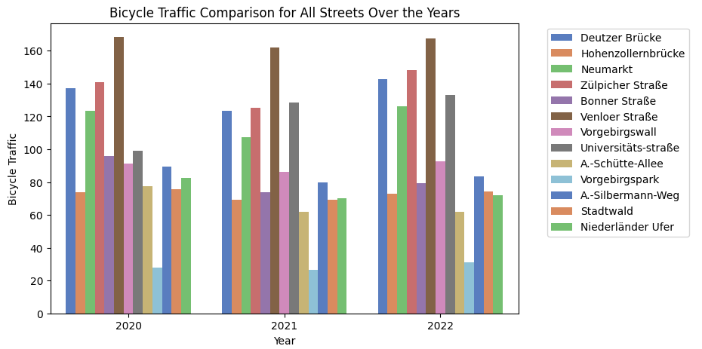
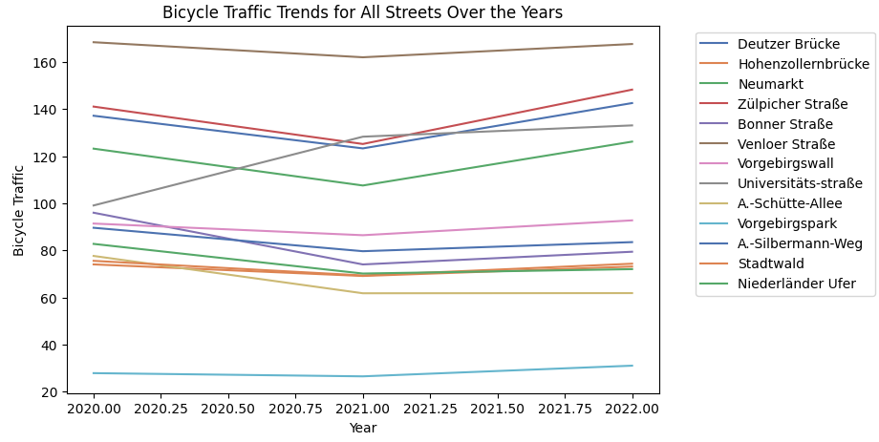
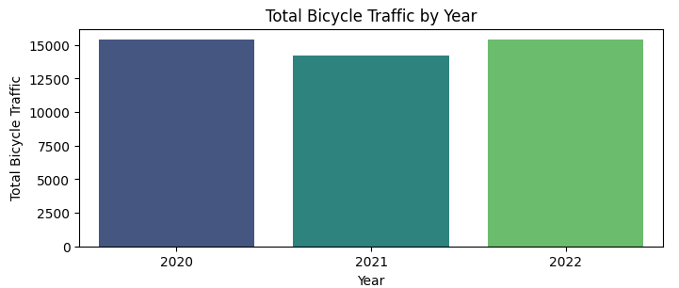
Exploratory Data Analysis

Slide 16
Introduction
Data Sources
Data Engineering Pipeline
Exploratory Data Analysis
Results & Future Work

Slide 17
Results & Future Work for Project 1
Insights
1) May, June and July has the highest number of accidents in both the year.
2) Maximum accidents take place between noon 12 till evening 7.
3) The majority of accidents in Cologne caused slight injuries (7,956), followed by 1,337 incidents resulting in serious injuries, and 41 accidents leading to fatalities.
4) Collisions with turning or crossing vehicles are the most common accidents in Cologne, with 2,412 cases, followed by other accident types at 2,024 cases.
5) Daylight conditions witnessed the highest number of accidents in Cologne, totaling 6,989 cases, significantly surpassing accidents during dark (1,883 cases) and dusk (462 cases).
Future Work
Incorporating weather data, urban development information, or even socio-economic factors may provide a more holistic understanding. Moreover, expanding the dataset to include a more extended time frame or incorporating real-time data could capture dynamic changes in accident trends and contribute to more robust conclusions.

Slide 18
Results & Future Work for Project 2
Insights
1) In all the years the street with most bikers has been : Venloer Straße
2) And the street with the least bikers has been : Vorgebirgspark
3) The bicycle traffic has remained constant over these years
Future Work
In the future, this project aims to analyze recent data, uncover seasonal patterns, explore demographic influences, and correlate trends with infrastructure changes. Machine learning models and user surveys will enhance predictive insights and qualitative understanding. Integrating real-time data and enhancing public engagement ensure a comprehensive approach, while ongoing efforts in data quality improvement maintain accuracy and reliability.

Slide 19
Thank You

