Slide 1

MONGO DB
PART – 1 MONGO DB USING SHELL
AUTHOR: ANKIT JAIN

Slide 2
CONTENT
PART-1
PART-2
EVOLUTION
WHY USE MONGO DB
RDBMS VS NO-SQL
CRUD QUERIES
AGGREGATION QUERIES
MONGO IN JAVA
JONGO
NEW-SQL

Slide 3
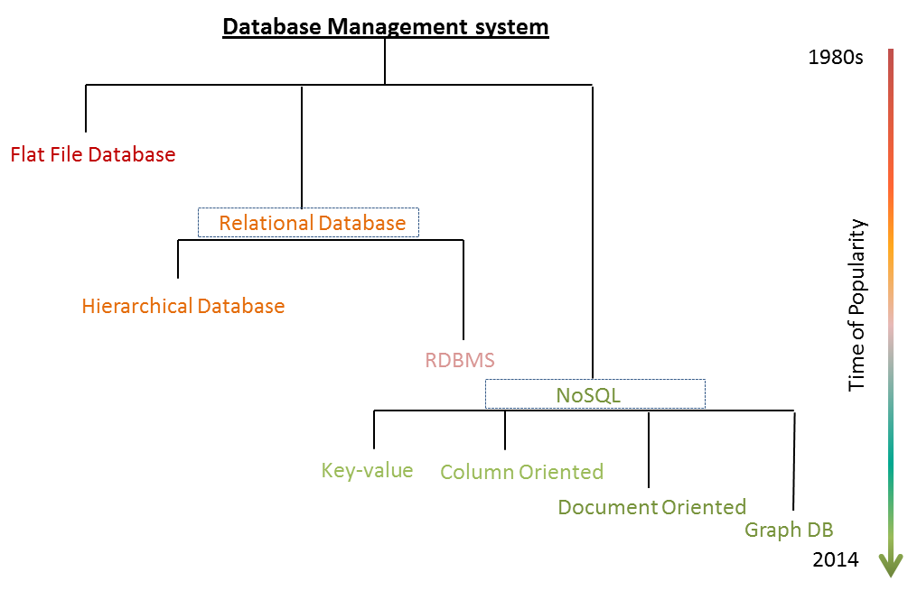
History and Evolution

Slide 4
Why use Mongo DB instead of MySQL?
Enables them to build applications faster,
Handle highly diverse data types,
Manage applications more efficiently at scale.
Development is simplified
Using Mongo DB removes the complex object-relational mapping (ORM) layer that translates objects in code to relational tables.
Mongo DB's flexible data model
Mongo DB scales easily with no downtime, and without changing your application.

Slide 5
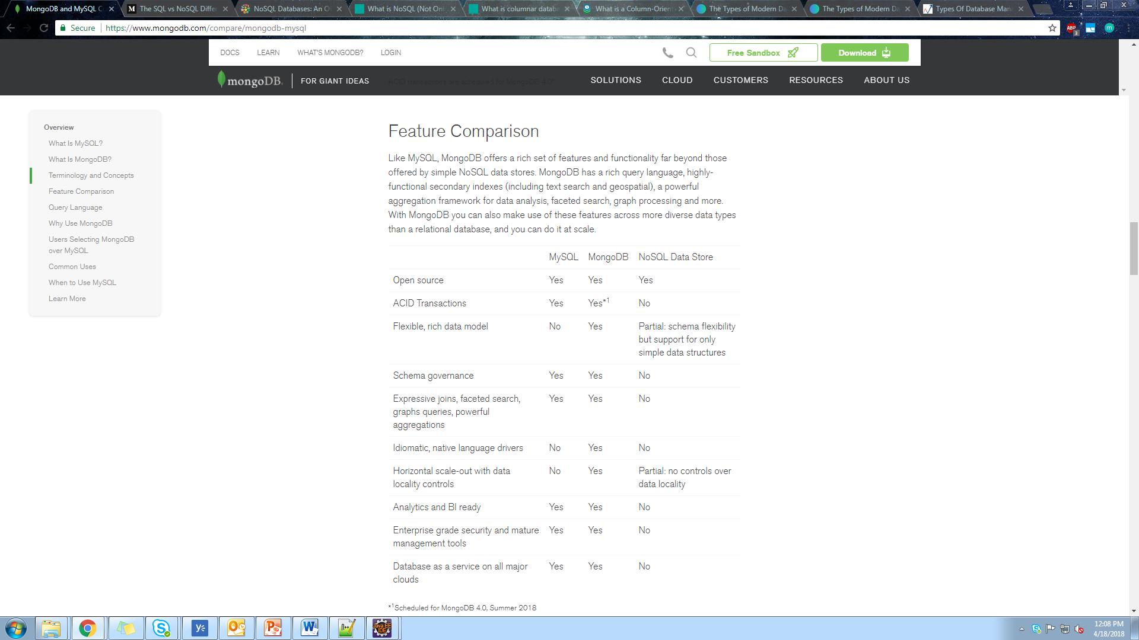
RDBMS VS NO-SQL
Understand the Difference
Understanding the no-sql databases

Slide 6
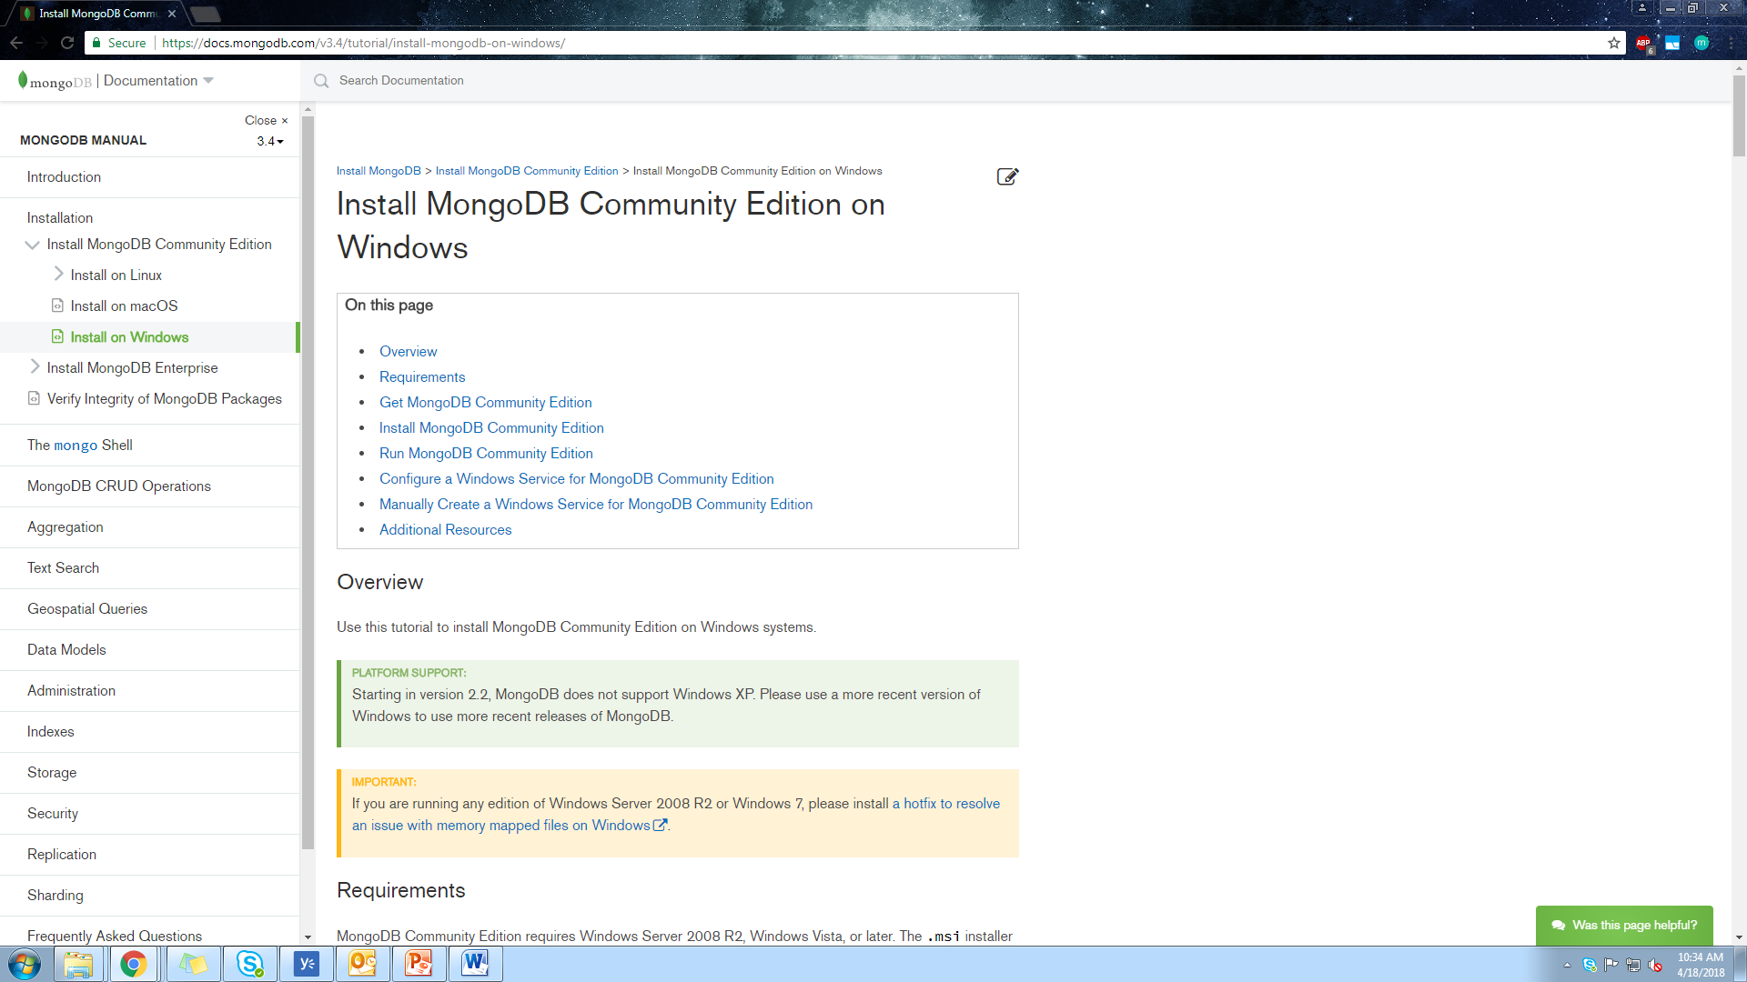
INSTALLATION GUIDE
Installing Mongo DB

Slide 7
C.R.U.D
CREATE
READ
UPDATE
DELETE

Slide 8
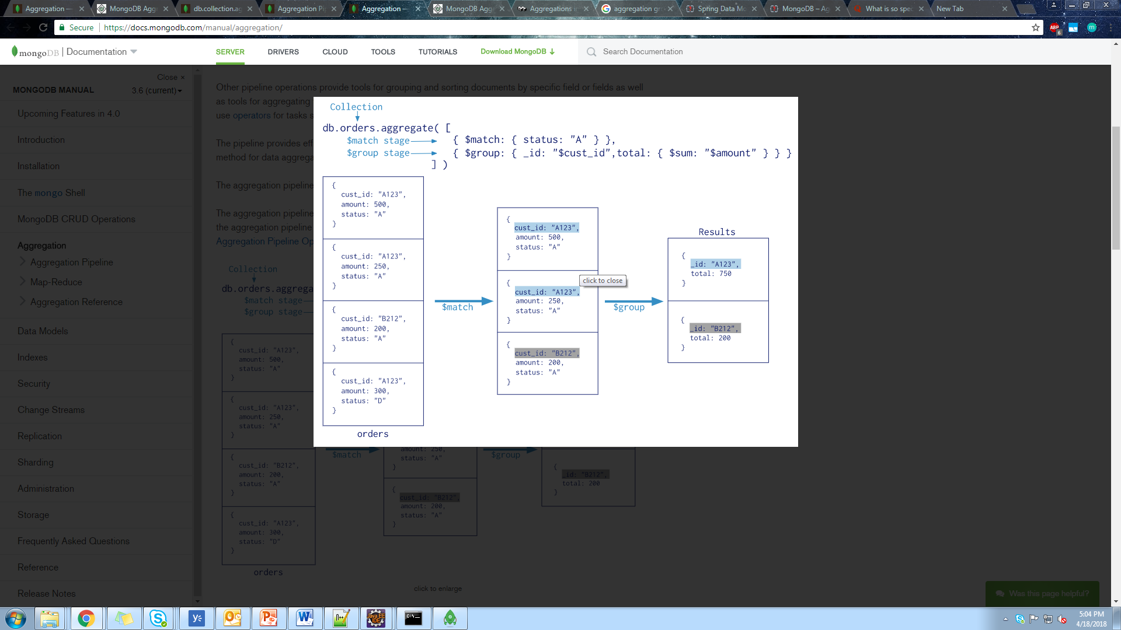
Aggregation in Mongo DB
Aggregation Pipeline Stages
Aggregation Pipeline Operators
Example

Slide 9
MONGO DB
PART – 2 MONGO DB USING JAVA

Slide 10
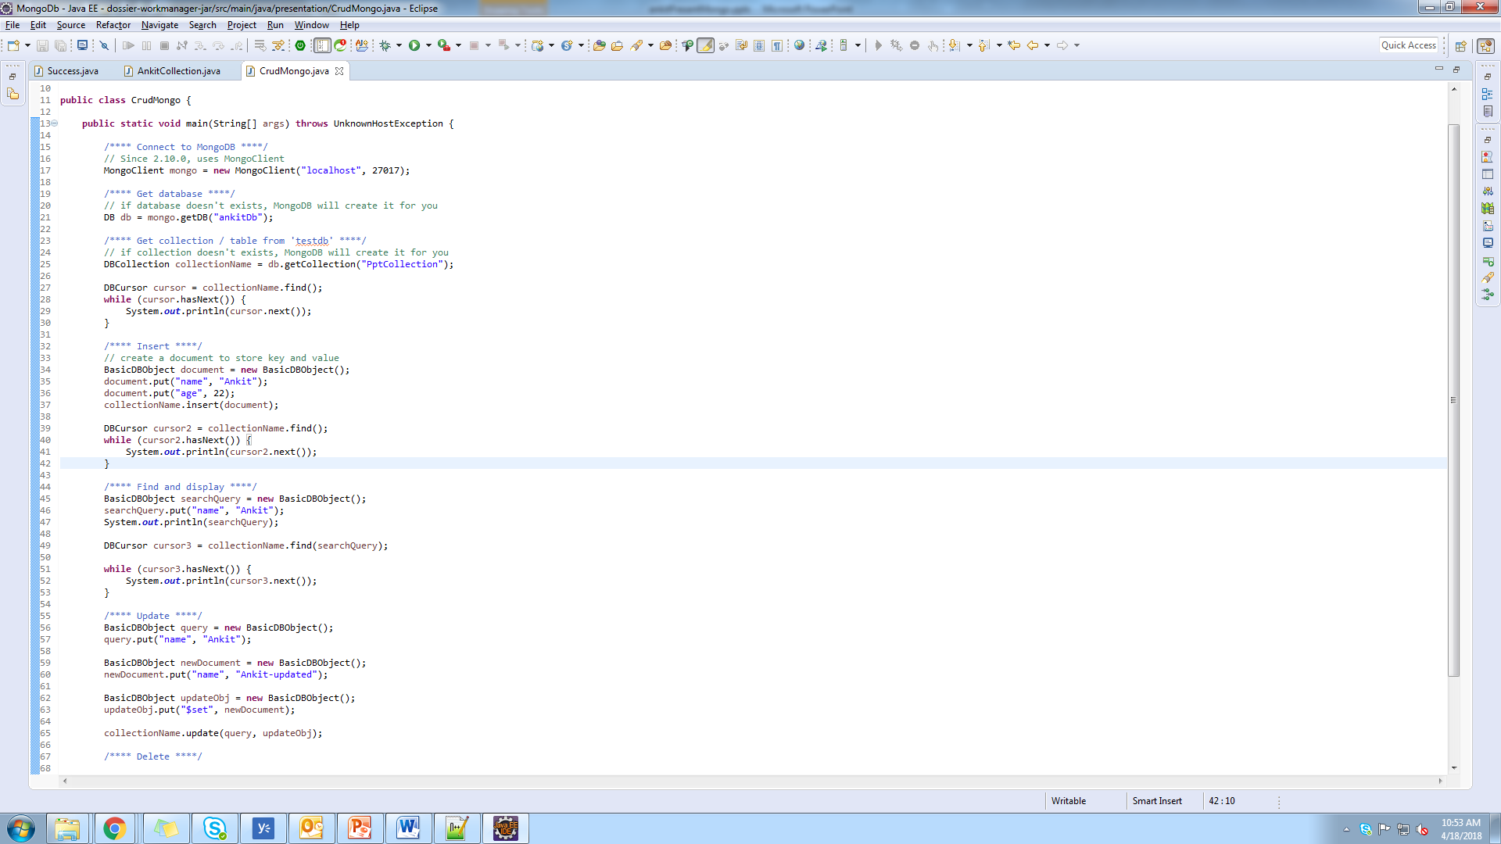
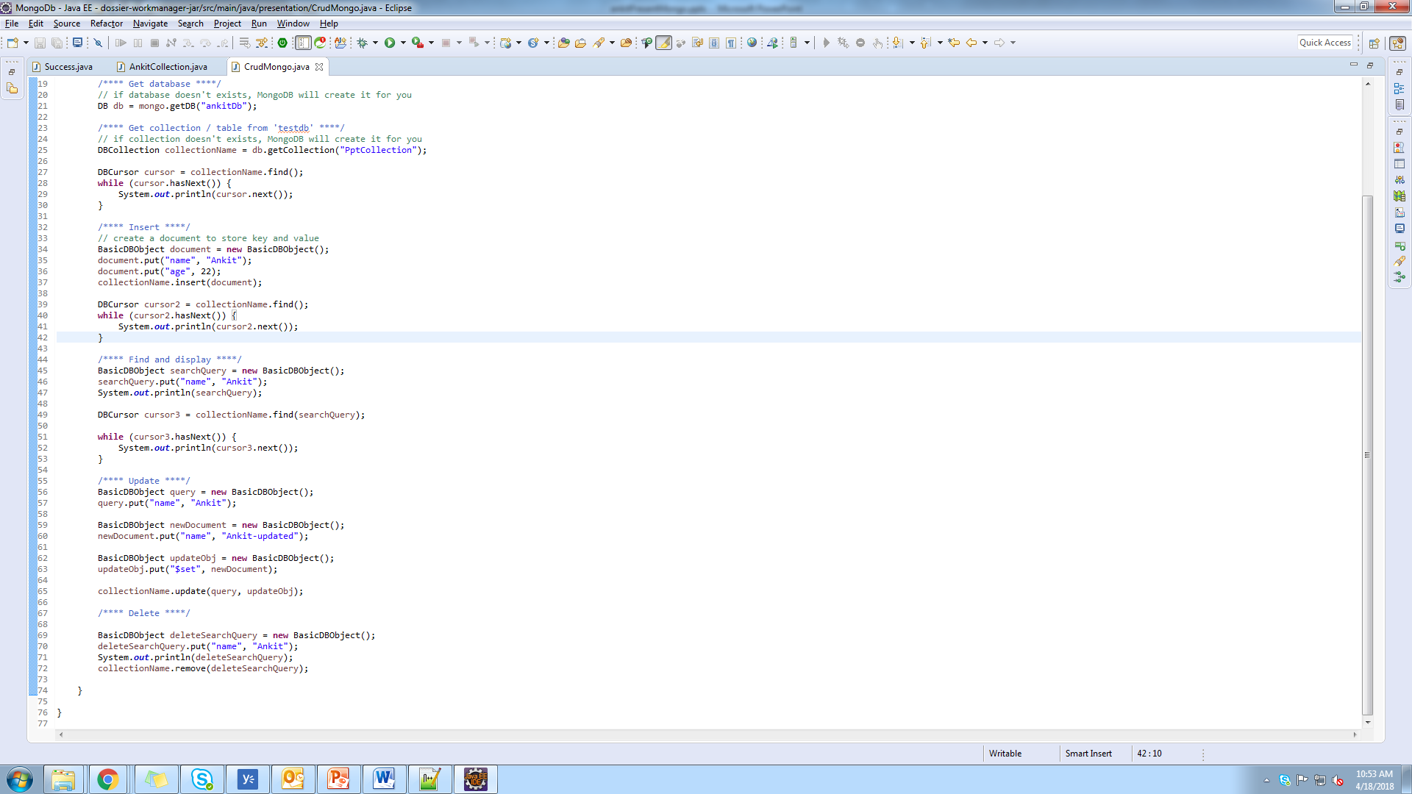
Mongo with Java

Slide 11
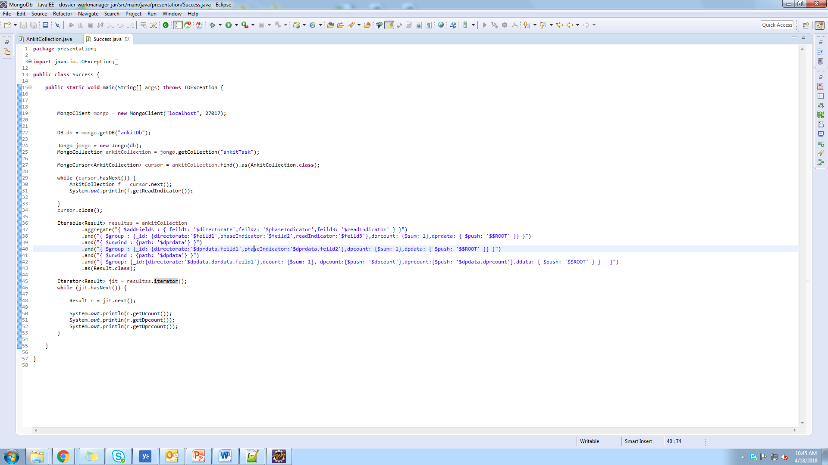
JONGO
Java + Mongo = Jongo

Slide 12
“NEW SQL”
SQL IS BACK

Slide 13
THANK YOU ANKIT JAIN

