Slide 1
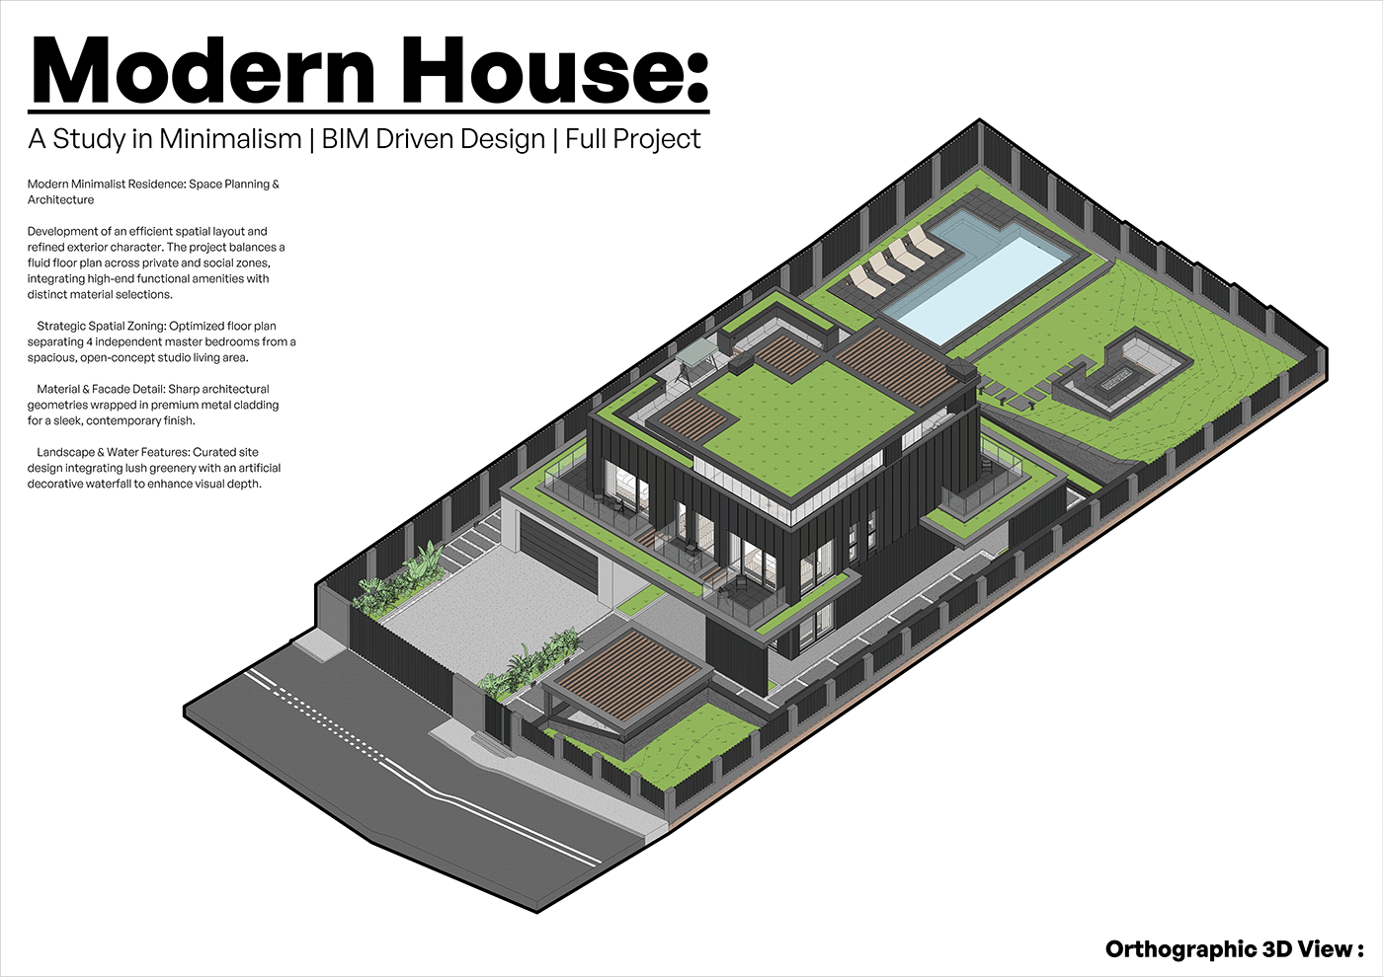
THE RIBHUS · BIM ARCHITECTURAL ATELIER · theribhus.com
Modern House:
A Study in Minimalism
BIM-Driven Design · Full Project
PLATFORM
Autodesk Revit 2024
STANDARD
LOD 300 · DIN EN 12831
DELIVERY
24 – 48 h · No MEP
European BIM production studio converting scanned paper drawings, PDF blueprints & 2D CAD surveys into production-ready Revit (.rvt) and ArchiCAD (.pln) architectural models for architects, real-estate planners, and Energieberater across the EU.
THE RIBHUS · theribhus.com
Revit 2024 · ArchiCAD · IFC4 · LOD 300

Slide 2
02 · PROJECT BRIEF · A-000
KEY PROJECT QUANTITIES · BIM TAKEOFF
Executive Brief &
Spatial Zoning Strategy
Plot / Site Area
840.0 m²
Gross Floor Area (BGF)
342.5 m²
Development of an efficient spatial layout and refined exterior character. The project balances a fluid floor plan across private and social zones, integrating high-end amenities with distinct material selections.
Net Usable Area (NRF)
278.4 m²
01
Strategic Spatial Zoning
Heated Gross Volume (Ve)
965.0 m³
Optimized floor plan separating 4 master bedrooms from a spacious open-concept studio living area with double-height volume.
Envelope Surface Area (A)
612.0 m²
02
Material & Facade Detail
Anthracite metal cladding, natural cedar timber battens, triple-pane structural curtain walls — precisely modeled in BIM.
Compactness Ratio (A/Ve)
0.63 m⁻¹
Exterior Glazing Area
118.4 m² (WWR 32%)
03
Landscape & Water Features
Curated site with infinity pool, sunken fire pit lounge, decorative water features — all included in the 3D model scope.
Energy Standard
Passivhaus / KfW 40
Regulated Standard
DIN EN 12831, DIN 277, GEG 2024
THE RIBHUS · theribhus.com
Revit 2024 · ArchiCAD · IFC4 · LOD 300

Slide 3
03 · 3D ARCHITECTURAL VIEW · A-001
Orthographic
3D Axonometric
Model View
VIEW
Orthographic Axon (30°/60°)
PLATFORM
Autodesk Revit 2024
LOD
LOD 300 Design Dev.
ENVELOPE
Watertight Thermal Shell
SITE
Pool, Hardscape, Greenroof
OUTPUT
.rvt + .pln + IFC4
Modern House: A Study in Minimalism · Autodesk Revit 2024 · THE RIBHUS
THE RIBHUS · theribhus.com
Revit 2024 · ArchiCAD · IFC4 · LOD 300

Slide 4
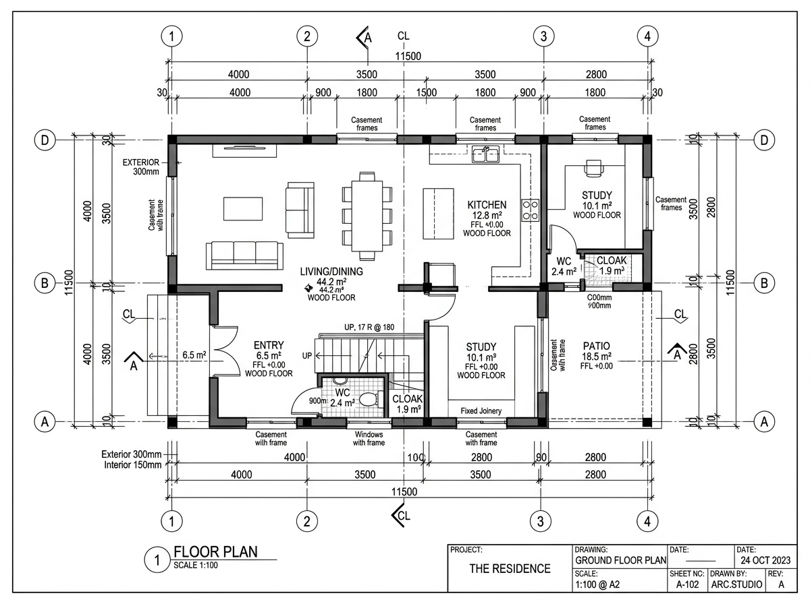
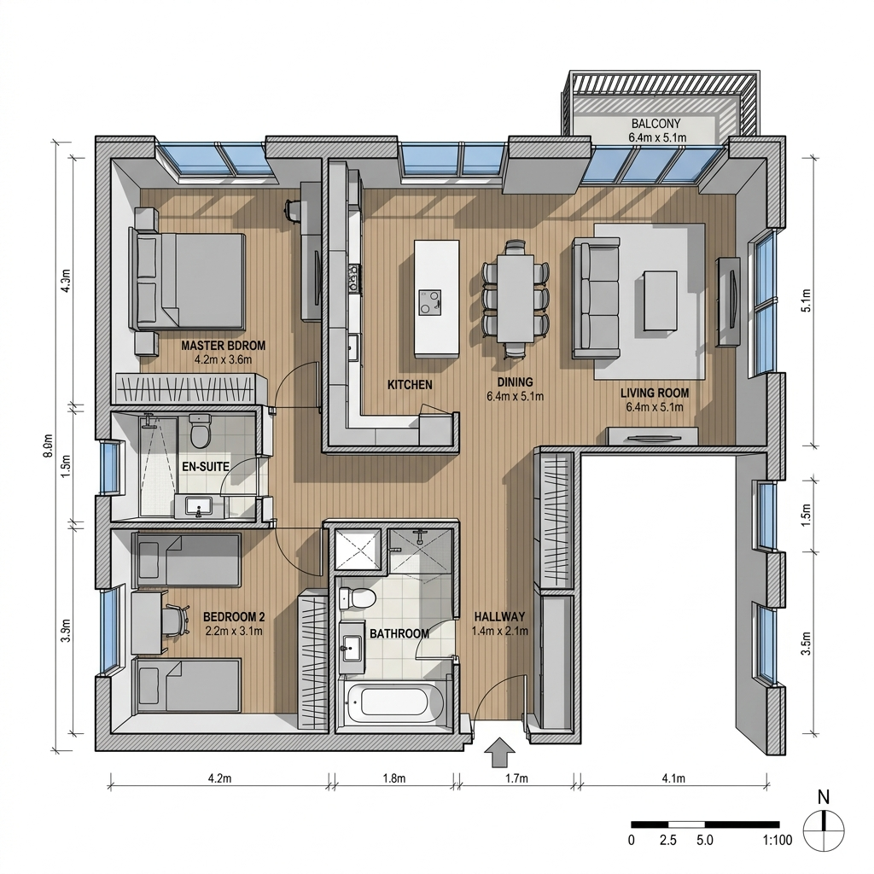
04 · FLOOR PLANS · A-101 / A-102
Ground Floor + Upper Level Plans · Scale 1:100
GROUND BGF
DOUBLE-HEIGHT LIVING
UPPER BGF
MASTER BEDROOM 01
GREEN ROOF TERRACE
DIN STANDARD
185.2 m²
64.8 m² (5.8m)
157.3 m²
28.5 m² + ensuite
88.0 m²
DIN 1356 / DIN 277
THE RIBHUS · theribhus.com
Revit 2024 · ArchiCAD · IFC4 · LOD 300

Slide 5
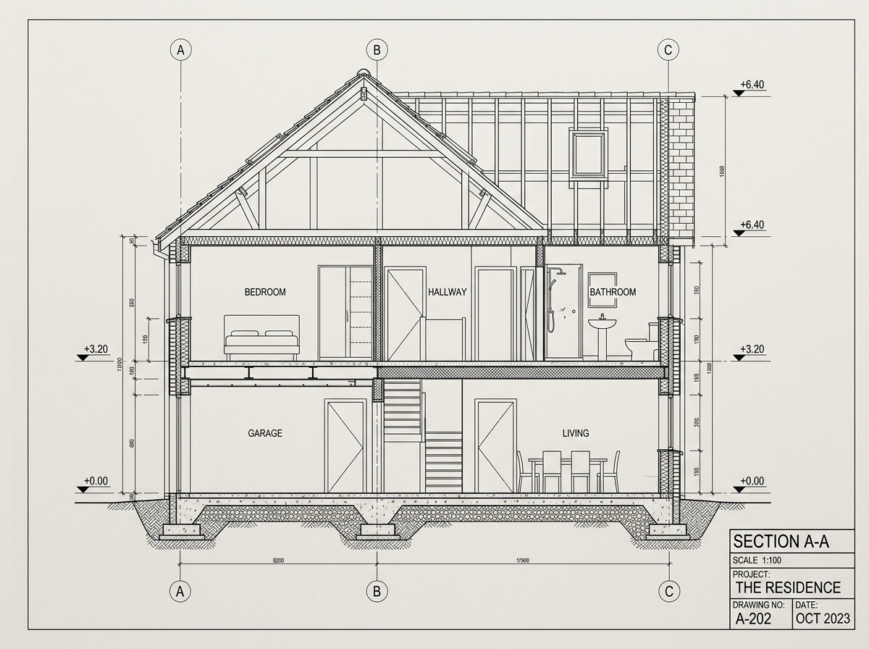
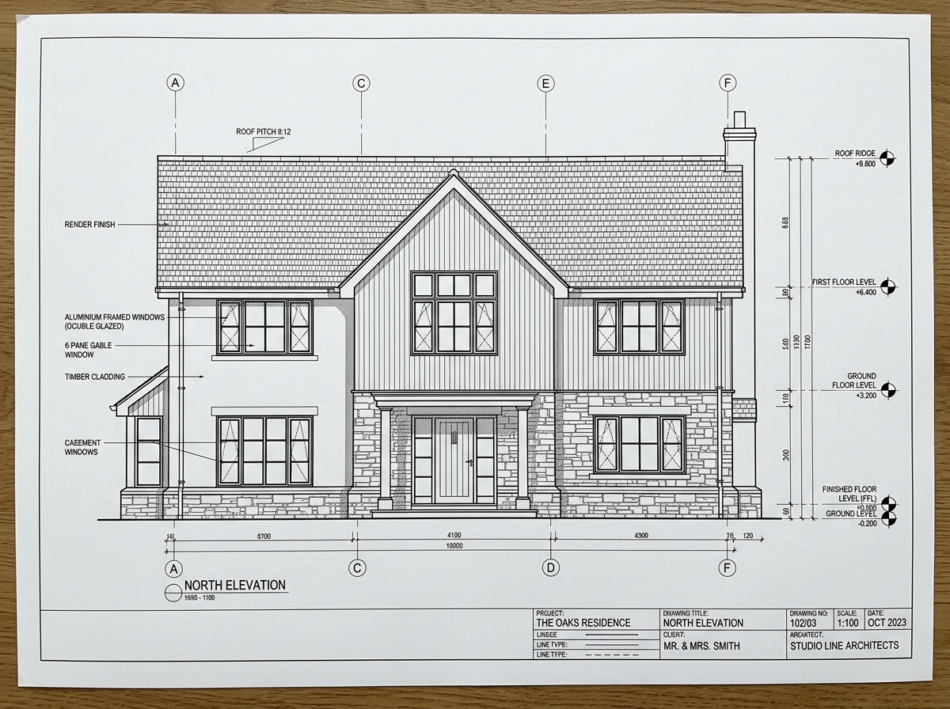
05 · SECTIONS & ELEVATIONS · A-201 / A-301
Building Sections & Facade Elevations
SECTION A-201
ELEVATION A-301
FLOOR-TO-FLOOR
GROUND CEILING
LEVEL 1 CEILING
FACADE
GLAZING UW
SCALE
3.30 m
2.85 m
2.70 m
Zinc RAL 7016 + Cedar
0.78 W/m²K (Triple)
1:100
THE RIBHUS · theribhus.com
Revit 2024 · ArchiCAD · IFC4 · LOD 300

Slide 6
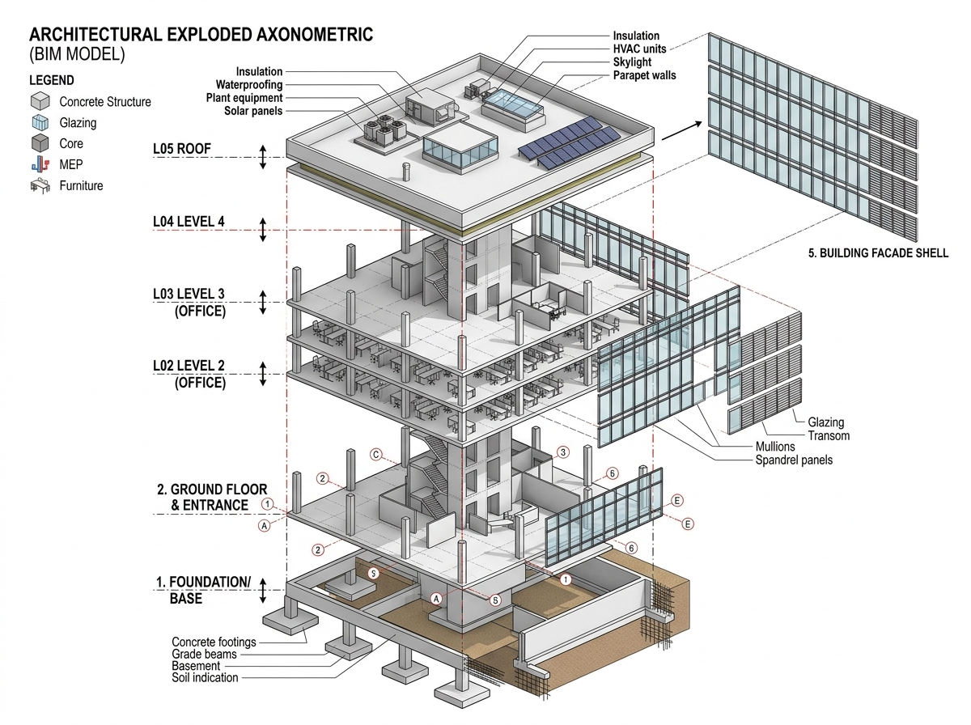
06 · BIM HIERARCHY · A-401
3D Exploded
Axonometric
4-Tier BIM Assembly
T4 · Roof Deck
Sedum greenroof, drainage mat, parapet.
T3 · Upper Level
4 master suites, cantilevered balconies.
T2 · Ground Floor
RC columns, curtain glass, double garage.
T1 · Sub-Structure
Foundation slab, pool basin, topography.
THE RIBHUS · theribhus.com
Revit 2024 · ArchiCAD · IFC4 · LOD 300

Slide 7
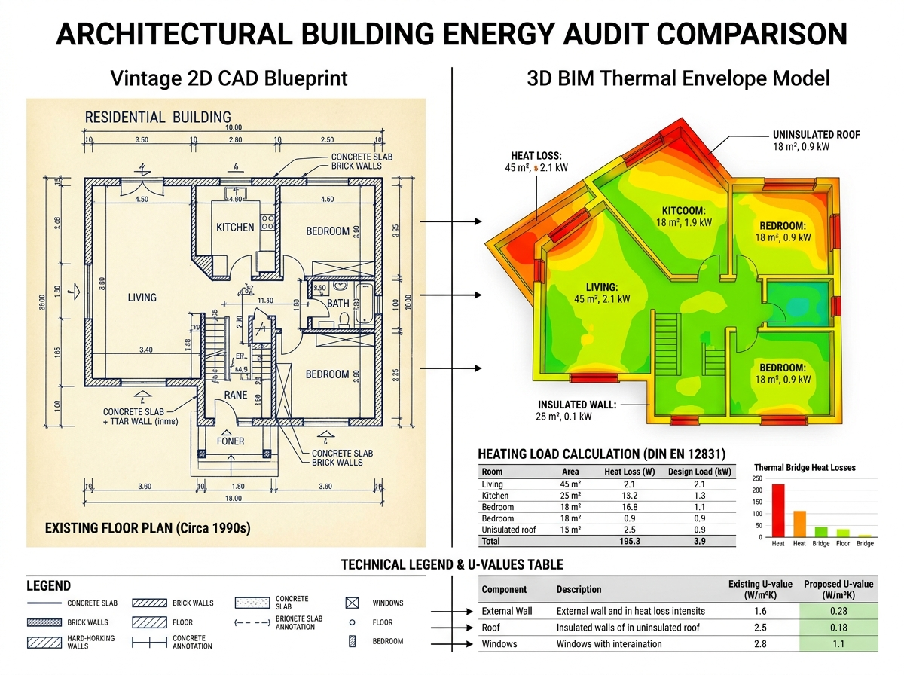
07 · BUILDING PHYSICS · A-501 · DIN EN 12831
Thermal Envelope & Energy Audit Calculation
EXTERIOR WALL U-VALUE
0.16 W/m²K
Passivhaus standard — triple mineral wool
ROOF DECK U-VALUE
0.12 W/m²K
PIR rigid foam — 220mm
GROUND SLAB U-VALUE
0.18 W/m²K
EPS perimeter insulation
WINDOW ASSEMBLY (UW)
0.78 W/m²K
Triple-pane Argon glass
ENVELOPE AREA (A)
612.0 m²
Watertight thermal boundary
HEATED VOLUME (VE)
965.0 m³
Per DIN EN 12831
ENERGY STANDARD
KfW 40
Passivhaus level performance
THE RIBHUS · theribhus.com
Revit 2024 · ArchiCAD · IFC4 · LOD 300

Slide 8
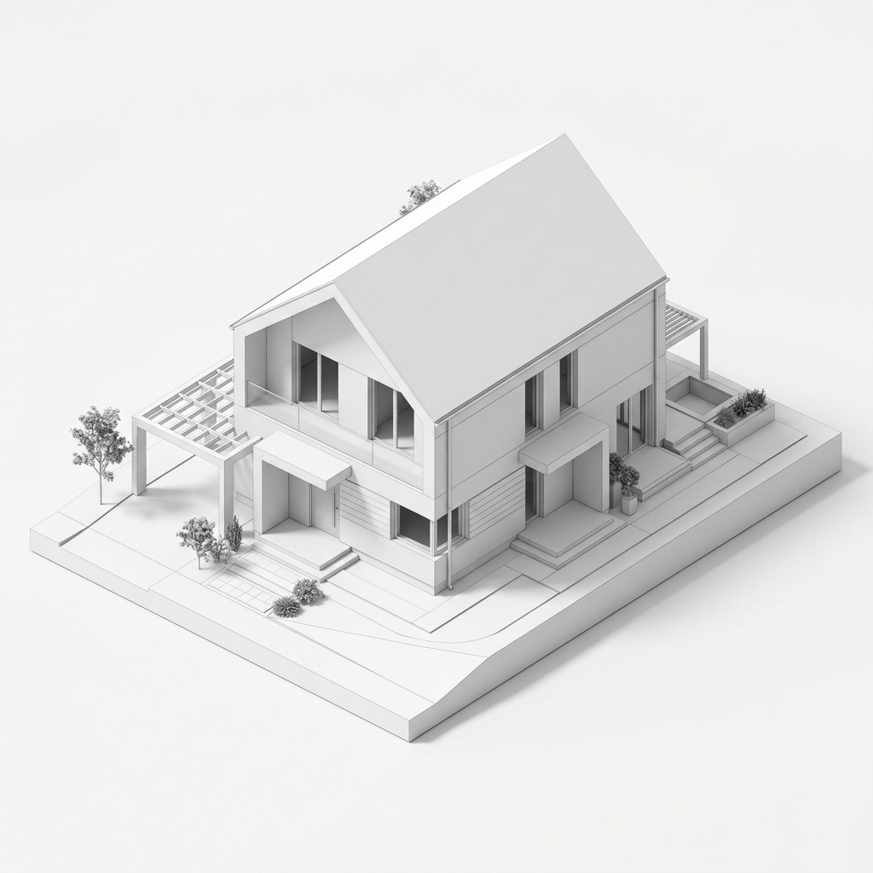
08 · BIM QTO · A-601 · MASSENERMITTLUNG
Revit Quantities Takeoff & Material Schedules
COMPONENT / MATERIAL
QUANTITY
SCOPE NOTE
Concrete C30/37 Volume
142.6 m³
Foundation, RC cols & slabs
Exterior Wall Surface
372.0 m²
Gross thermal boundary
Glazing & Curtain Walls
118.4 m²
WWR: 32% high solar gain
Mineral Wool Insulation
372.0 m²
160mm rigid (λ = 0.032)
Roof Waterproofing
176.0 m²
2-layer bituminous
Scheduled Openings
28 items
Full door & window schedule
Interior Drywall
485.0 m²
Non-bearing acoustic walls
Steel Framing
12.4 t
Cantilevered balcony frames
THE RIBHUS · theribhus.com
Revit 2024 · ArchiCAD · IFC4 · LOD 300

Slide 9
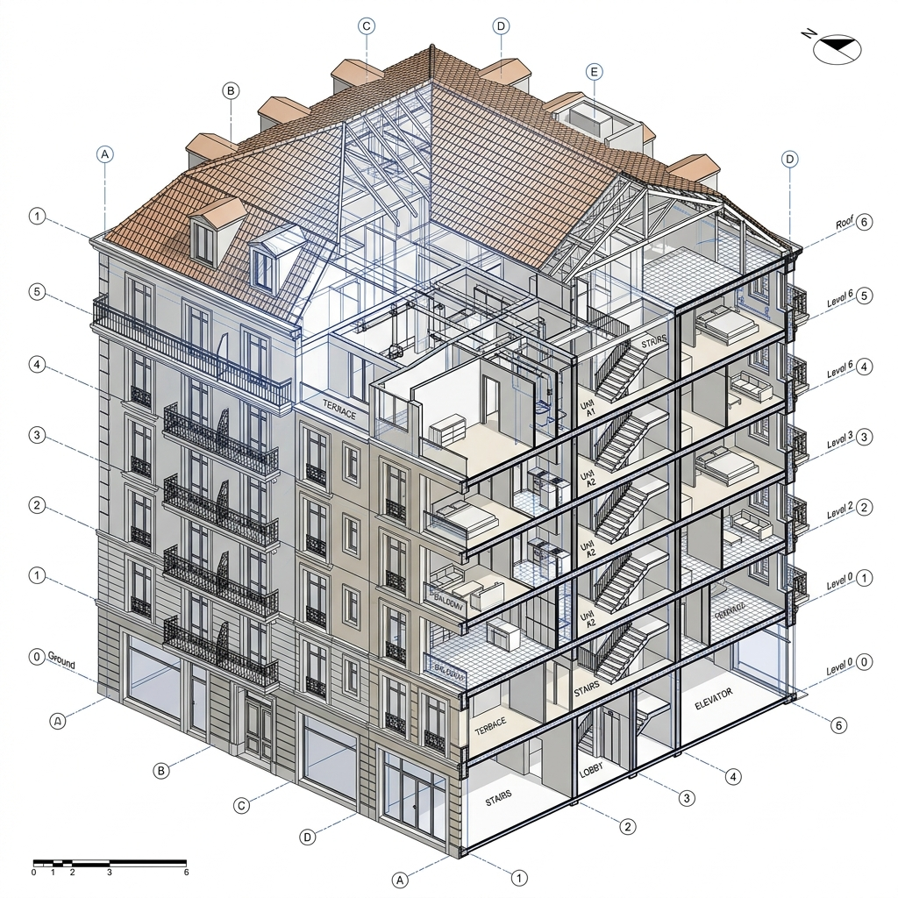
09 · MULTI-FAMILY REFERENCE · A-701
Urban Multi-Story
Residential Reference
European Multi-Family BIM
TYPOLOGY
Urban Multi-Story Residential
STOREYS
4 Floors + Underground Parking
TOTAL GFA
1,120 m²
UNITS
12 Residential Apartments
ZONES
12 DIN EN 12831 Thermal Zones
PLATFORM
Revit 2024 / OpenBIM IFC4
DELIVERY
48 Hours
MEP SCOPE
Pure Architectural — No MEP
THE RIBHUS · theribhus.com
Revit 2024 · ArchiCAD · IFC4 · LOD 300

Slide 10
10 · COMMERCIAL SCOPE · FEES-01
Transparent, Complexity-Based Pricing
Every model priced according to GFA, geometry & LOD — no bundles, no surprises.
★ Most Requested by Energieberater
Single-Family
Residential
Multi-Story
& Complex
Dedicated
Studio Retainer
€180
– €290
€450
– €950+
€1,500
/month
⏱ Turnaround: 24 – 48 Hours
⏱ Turnaround: 48 – 72 Hours
⏱ Turnaround: Guaranteed 24h
✓ Up to 250 m² BGF
✓ 250 m² – 1,200+ m² BGF
✓ External BIM production pod
✓ LOD 200/300 Arch. Shell
✓ Multi-family, mixed-use
✓ 8–15 models/month
✓ Watertight energy envelope
✓ Thermal zone per DIN EN 12831
✓ Priority 24h queue
✓ Revit (.rvt) or ArchiCAD (.pln)
✓ Revit system families / GDL
✓ Shared templates & standards
✓ OpenBIM (.ifc) + 2D PDF
✓ QTO schedules included
✓ Direct Slack/Teams channel
✓ 1 revision included
✓ 2 revisions included
✓ Ideal for Energieberater
THE RIBHUS · theribhus.com
Revit 2024 · ArchiCAD · IFC4 · LOD 300
All models: watertight IFC · native Revit/ArchiCAD · DIN EN 12831 / GEG 2024 / DIN 277 compliant

Slide 11
11 · HOW TO ORDER · PROCESS
3-Step Production Process
From scanned blueprints to a production-ready BIM model in 24–48 hours.
01
SEND YOUR DRAWINGS
Upload scanned blueprints, PDF plans, 2D DWG files, or hand-survey sketches to contact@theribhus.com. Any format accepted — we handle the cleanup.
02
RECEIVE FIXED-PRICE QUOTE
Within 2–4 hours, we review your drawings and send a detailed fixed-fee quote based on GFA, geometry complexity, and required LOD. No hourly billing.
03
GET YOUR BIM MODEL (24–48h)
Your production-ready Revit (.rvt), ArchiCAD (.pln), and OpenBIM (.ifc) files are delivered via secure transfer link within 24–48 hours. DIN EN 12831 compliant.
THE RIBHUS · theribhus.com
Revit 2024 · ArchiCAD · IFC4 · LOD 300

Slide 12
12 · CONTACT · THE RIBHUS
THE RIBHUS
Ready to convert your
2D plans into 3D BIM?
Send your scanned blueprints, PDF drawings, or DWG surveys. We deliver production-ready ArchiCAD (.pln) and Revit (.rvt) models in 24–48 hours. Strictly architectural — no MEP overhead.
EMAIL
WEBSITE
PORTFOLIO
contact@theribhus.com
theribhus.com
ankitk-glitch.github.io/3d-portfolio
REGION
FORMATS
Germany · Austria · Switzerland · EU
Revit (.rvt) · ArchiCAD (.pln) · IFC4 · DWG
THE RIBHUS · theribhus.com
Revit 2024 · ArchiCAD · IFC4 · LOD 300

