Slide 1
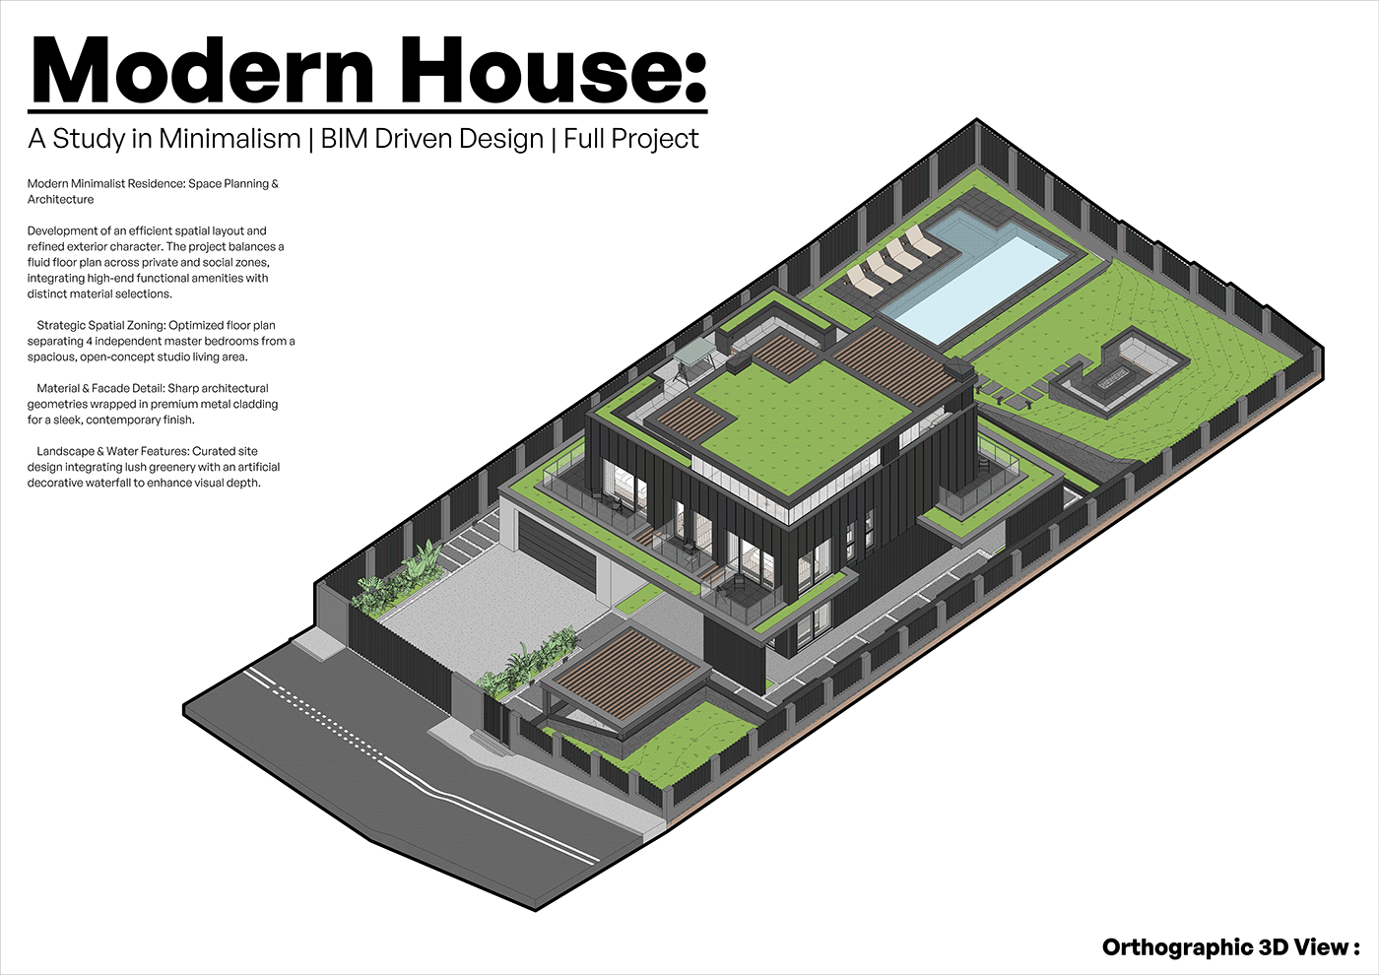
THE RIBHUS • theribhus.com
Modern House:
A Study in Minimalism | BIM Driven Design
Full Project Documentation Set
Complete architectural BIM modeling portfolio. Converts 2D scans, sketches, and CAD files into production-ready Autodesk Revit (.rvt) and ArchiCAD (.pln) models with watertight thermal envelopes for European architects and Energieberater.
• Authoring Platform: Autodesk Revit 2024 + OpenBIM IFC4
• Specification Level: LOD 300 (Strictly No MEP Overhead)
• Compliance: DIN EN 12831, DIN 277, GEG 2024
• Turnaround: 24 – 48 Hours
Confidential Portfolio Presentation • The Ribhus • info@theribhus.com • https://ankitk-glitch.github.io/3d-portfolio/

Slide 2
THE RIBHUS BIM STUDIO • PROJECT BRIEF • DWG NO: A-000
Executive Brief & Spatial Zoning Strategy
theribhus.com
Revit 2024 • LOD 300
Modern Minimalist Residence: Space Planning & Architecture
Development of an efficient spatial layout and refined exterior character. The project balances a fluid floor plan across private and social zones, integrating high-end functional amenities with distinct material selections.
■ Strategic Spatial Zoning
Optimized floor plan separating 4 independent master bedrooms from a spacious, open-concept studio living area with double-height volume.
■ Material & Facade Detail
Sharp architectural geometries wrapped in premium charcoal metal cladding, natural cedar timber battens, and triple-pane structural curtain walls.
■ Landscape & Water Features
Curated site design integrating lush greenery with an infinity swimming pool, sunken fire pit lounge, and decorative water features.
Key Project Quantities (BIM Takeoff)
Plot / Site Area: 840.0 m²
Gross Floor Area (BGF): 342.5 m²
Net Usable Area (NRF): 278.4 m²
Heated Gross Volume (Ve): 965.0 m³
Envelope Surface Area (A): 612.0 m²
Compactness Ratio (A/Ve): 0.63 m⁻¹
Exterior Glazing Area: 118.4 m² (WWR: 32%)
Energy Standard: Passivhaus / KfW 40
Modern House: A Study in Minimalism | Autodesk Revit BIM Model | Page 02 of 12

Slide 3
THE RIBHUS BIM STUDIO • ARCHITECTURAL 3D • DWG NO: A-001
Orthographic 3D Axonometric Model View
theribhus.com
Revit 2024 • LOD 300
Sheet Specification
Camera Type:
Orthographic Axonometric (30°/60°)
BIM Authoring:
Autodesk Revit 2024
Model LOD:
LOD 300 (Design Development)
Site Hardscape:
Driveway, Pergola, Pool Deck
Landscape Detail:
Intensive Sedum Green Roof
Thermal Perimeter:
Watertight Envelope Shell
Modern House: A Study in Minimalism | Autodesk Revit BIM Model | Page 03 of 12

Slide 4
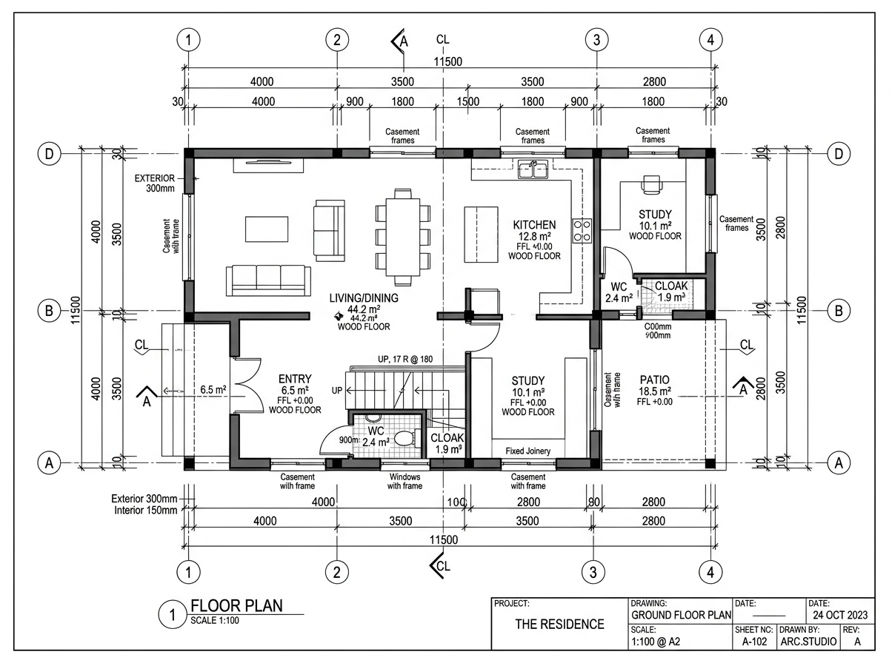
THE RIBHUS BIM STUDIO • FLOOR PLANS • DWG NO: A-101
Ground Floor & Master Site Plan (Scale 1:100)
theribhus.com
Revit 2024 • LOD 300
Ground Floor Programming
• Gross Floor Area (BGF): 185.2 m²
• Double-Height Living: 64.8 m² (5.8m ceiling)
• Dining & Kitchen Island: 38.2 m²
• Guest Bedroom Suite: 22.4 m² (with ensuite)
• Double Garage: 38.0 m²
• Terrace & Pool Deck: 92.5 m²
• DIN Compliance: DIN 1356 & DIN 277
Modern House: A Study in Minimalism | Autodesk Revit BIM Model | Page 04 of 12

Slide 5
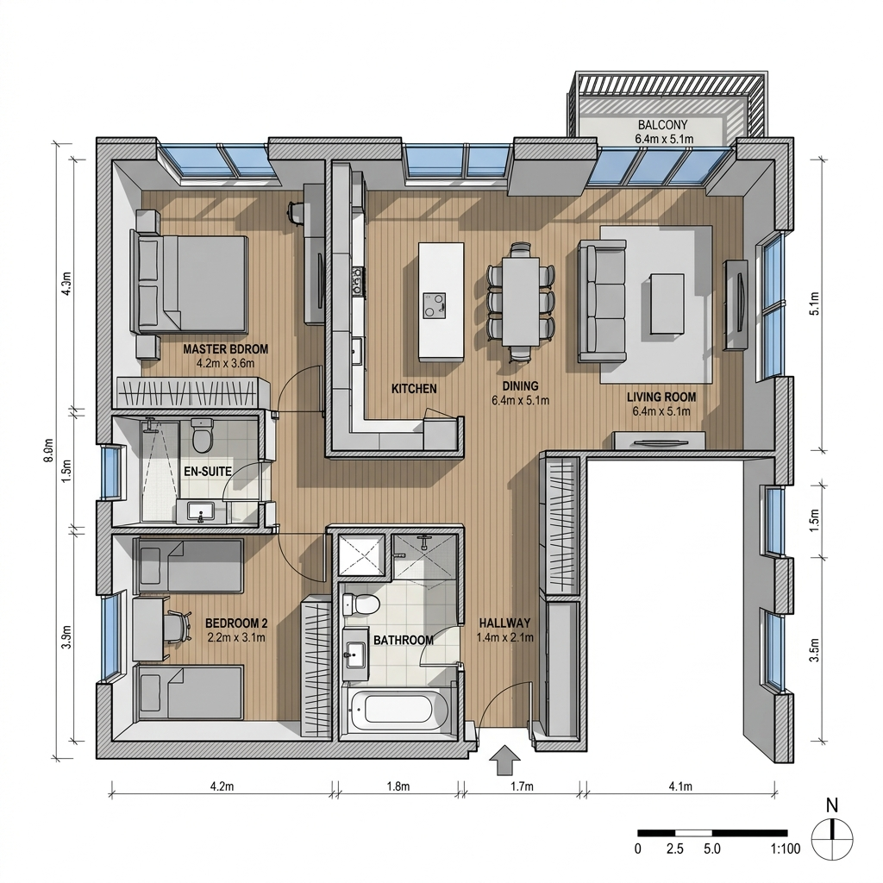
THE RIBHUS BIM STUDIO • FLOOR PLANS • DWG NO: A-102
Upper Floor & Intensive Green Roof Terrace (Scale 1:100)
theribhus.com
Revit 2024 • LOD 300
Upper Level Programming
• Gross Floor Area (BGF): 157.3 m²
• Master Bedroom 01: 28.5 m² (Ensuite + Walk-in)
• Bedroom Suites 02, 03, 04: 18.2 m² each (Independent)
• Central Gallery Lounge: 24.0 m² overlooking foyer
• Green Roof Terrace: 88.0 m² (Sedum roof)
• Clear Ceiling Height: 2.70 m finished
Modern House: A Study in Minimalism | Autodesk Revit BIM Model | Page 05 of 12

Slide 6
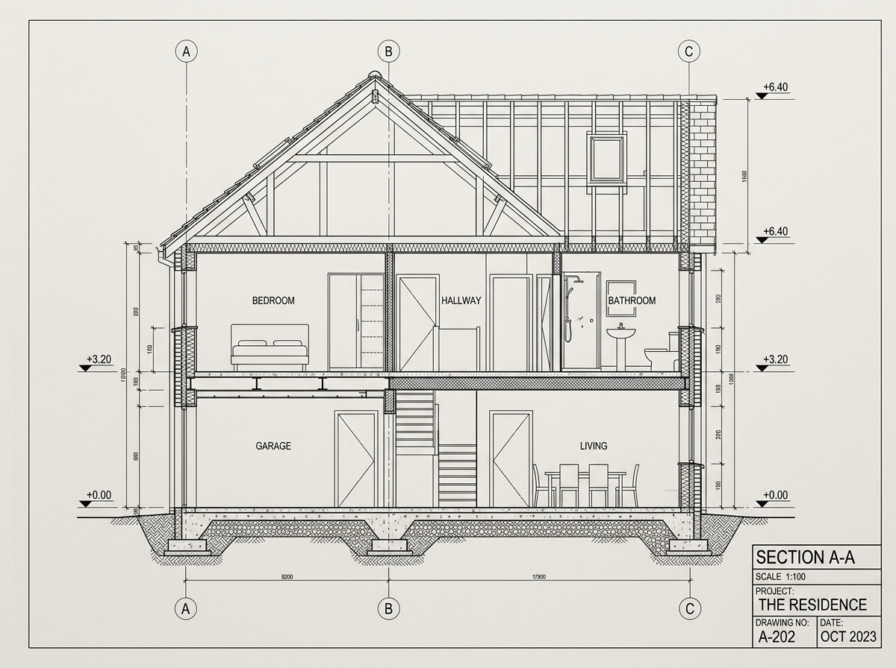
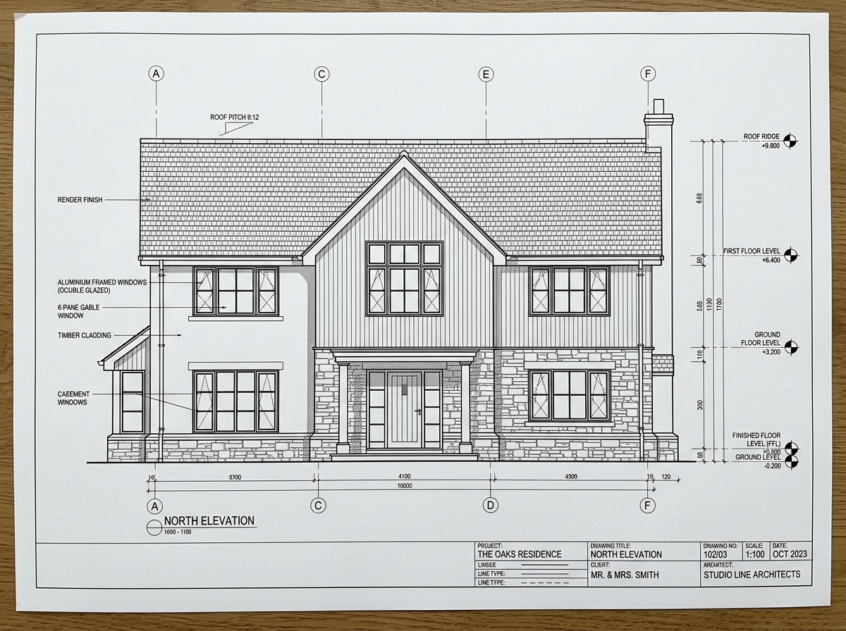
THE RIBHUS BIM STUDIO • SECTIONS & ELEVATIONS • DWG NO: A-201 / A-301
Architectural Building Sections & Exterior Facade Elevations
theribhus.com
Revit 2024 • LOD 300
Technical Datum: Floor-to-Floor 3.30m | Clear Heights: 2.85m Ground, 2.70m Level 1 | Facade: Anthracite Zinc Standing-Seam Cladding (RAL 7016) + Cedar Siding | Glazing: Triple Insulated Argon (Ug = 0.5 W/m²K, Uw = 0.78 W/m²K)
Modern House: A Study in Minimalism | Autodesk Revit BIM Model | Page 06 of 12

Slide 7
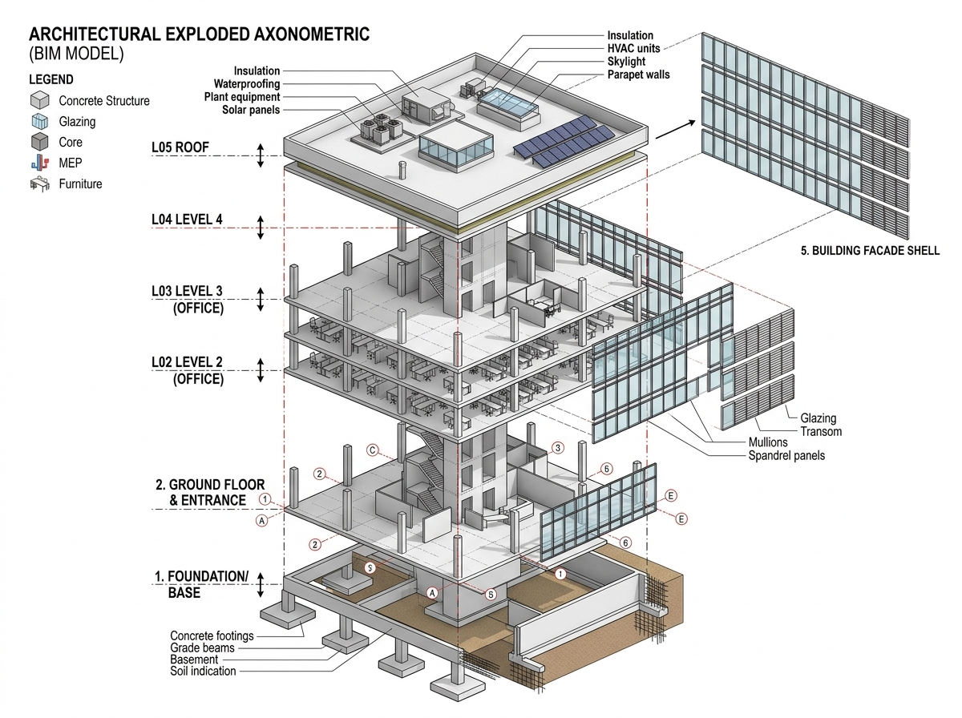
THE RIBHUS BIM STUDIO • BIM HIERARCHY • DWG NO: A-401
3D Exploded Axonometric & Model Assembly Hierarchy
theribhus.com
Revit 2024 • LOD 300
4-Tier BIM Hierarchy
▲ Tier 4: Roof Deck
Extensive green roof garden, sedum layer, drainage mat, parapet capping.
▲ Tier 3: Upper Level
4 master suites, lightweight drywall partitions, cantilevered balconies.
▲ Tier 2: Ground Floor
Reinforced concrete columns, floor-to-ceiling glass curtain walls, double garage.
▲ Tier 1: Sub-Structure
Frost-protected foundation slab, site topography, swimming pool basin.
Modern House: A Study in Minimalism | Autodesk Revit BIM Model | Page 07 of 12

Slide 8
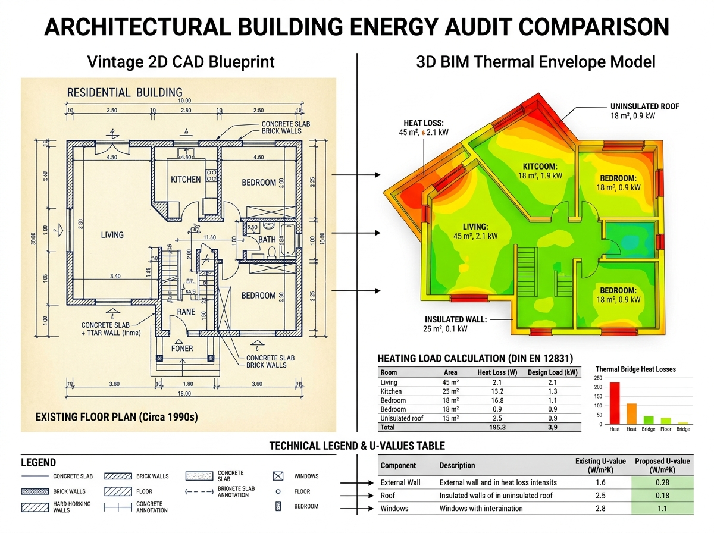
THE RIBHUS BIM STUDIO • BUILDING PHYSICS • DWG NO: A-501
Building Physics & Thermal Envelope Calculation (DIN EN 12831)
theribhus.com
Revit 2024 • LOD 300
Thermal Envelope Metrics
Exterior Wall U-Value:
0.16 W/m²K (Passiv standard)
Roof Deck U-Value:
0.12 W/m²K (PIR rigid foam)
Ground Slab U-Value:
0.18 W/m²K (EPS perimeter)
Window Assembly Uw:
0.78 W/m²K (Triple glazed)
Envelope Area (A):
612.0 m² watertight shell
Gross Heated Volume:
965.0 m³
Simulation Software:
Solar-Computer / Hottgenroth
Modern House: A Study in Minimalism | Autodesk Revit BIM Model | Page 08 of 12

Slide 9
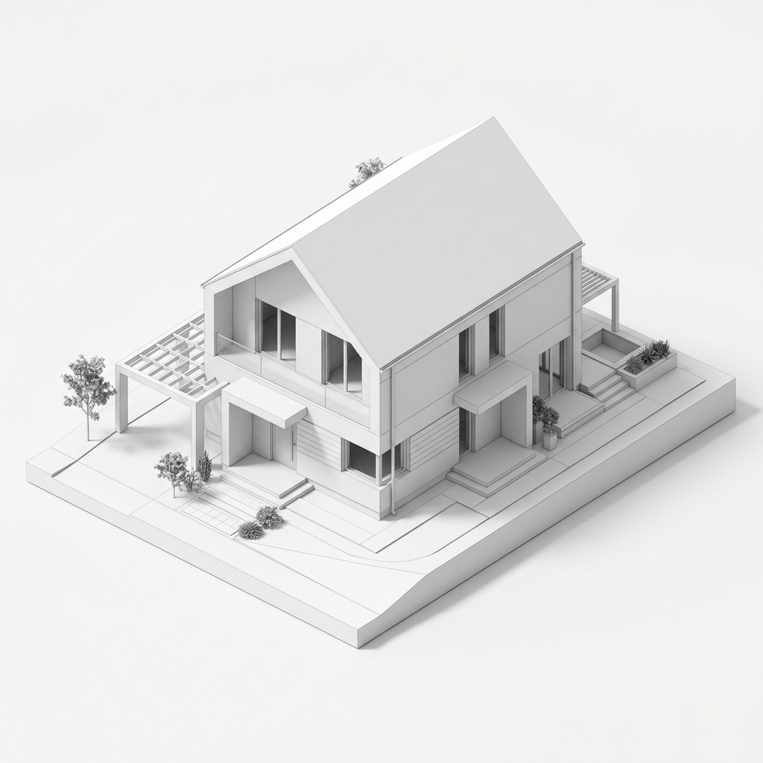
THE RIBHUS BIM STUDIO • BIM QTO • DWG NO: A-601
Revit BIM Quantities Takeoff & Component Schedules
theribhus.com
Revit 2024 • LOD 300
Automated Material Schedules (Massenermittlung)
■ Concrete C30/37 Volume: 142.6 m³
Scope: Foundation, RC columns & slabs
■ Exterior Wall Surface: 372.0 m²
Scope: Gross exterior thermal boundary
■ Glazing & Curtain Walls: 118.4 m²
Scope: WWR: 32% high solar gain glass
■ Mineral Wool Insulation: 372.0 m²
Scope: 160mm rigid insulation (λ = 0.032)
■ Roof Waterproofing: 176.0 m²
Scope: 2-layer bituminous waterproofing
■ Scheduled Openings: 28 Items
Scope: Full Revit door & window schedule
■ Interior Drywall Slabs: 485.0 m²
Scope: Non-bearing acoustic partition walls
Modern House: A Study in Minimalism | Autodesk Revit BIM Model | Page 09 of 12

Slide 10
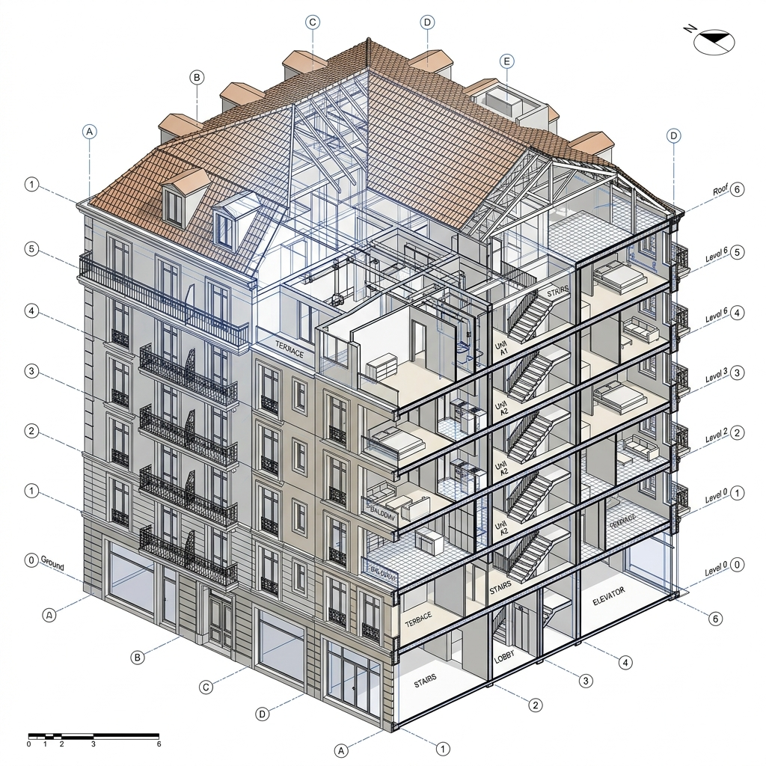
THE RIBHUS BIM STUDIO • MULTI-FAMILY BIM • DWG NO: A-701
Urban Multi-Story Residential Portfolio Reference
theribhus.com
Revit 2024 • LOD 300
Multi-Family Residential Scope
• Typology: Urban Multi-Story Residential Building
• Storeys Count: 4 Storeys + Subterranean Parking
• Total GFA (BGF): 1,120.0 m²
• Units Count: 12 Residential Apartments
• Thermal Zones: 12 Separate DIN EN 12831 Zones
• BIM Authoring: Revit 2024 / OpenBIM IFC4
• Turnaround Time: 48 Hours Delivery
• MEP Scope: Strictly Pure Architectural (No MEP)
Modern House: A Study in Minimalism | Autodesk Revit BIM Model | Page 10 of 12

Slide 11
THE RIBHUS BIM STUDIO • COMMERCIAL SCOPE • DWG NO: FEES-01
Transparent, Complexity-Based Production Pricing
theribhus.com
Revit 2024 • LOD 300
Single-Family & Small Residential
€180 – €290
Turnaround: 24 – 48 Hours
✓ Up to 250 m² Gross Floor Area (BGF)
✓ LOD 200 / 300 Architectural Shell
✓ Watertight envelope for energy audit
✓ Native ArchiCAD (.pln) or Revit (.rvt)
✓ OpenBIM (.ifc) + 2D PDF Drawing Output
✓ 1 revision round included
Multi-Story & Complex Residential
€450 – €950+
Turnaround: 48 – 72 Hours
✓ 250 m² to 1,200+ m² Gross Floor Area
✓ Multi-family, mixed-use, commercial
✓ Full thermal zone separation per DIN EN 12831
✓ Detailed Revit system families / ArchiCAD GDL
✓ QTO component schedules included
✓ 2 revision rounds included
Dedicated Studio Retainer
From €1,500 / mo
Turnaround: Guaranteed 24h
✓ Continuous external BIM production pod
✓ 8–15 models per month included
✓ Priority queue with guaranteed 24h delivery
✓ Shared templates, titleblocks & layer standards
✓ Direct Slack / Teams communication channel
✓ Ideal for high-volume Energieberater
Modern House: A Study in Minimalism | Autodesk Revit BIM Model | Page 11 of 12

Slide 12
THE RIBHUS • BIM ARCHITECTURAL POD
Ready to convert your 2D plans into 3D BIM models?
Send your scanned blueprints, PDF drawings, or DWG surveys. We deliver production-ready ArchiCAD (.pln) and Revit (.rvt) models in 24–48 hours.
✉️ Email: contact@theribhus.com | info@theribhus.com
🌐 Website: https://theribhus.com
📂 Live Portfolio: https://ankitk-glitch.github.io/3d-portfolio/
📍 Production Pods: Germany, Austria, Switzerland, European Union
⚡ Deliverables: Autodesk Revit (.rvt), ArchiCAD (.pln), OpenBIM (.ifc), AutoCAD (.dwg)

