Slide 1
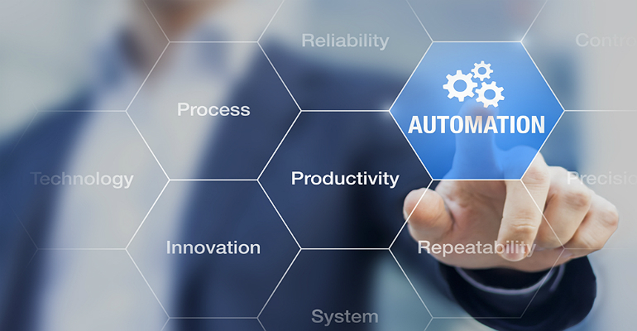
Automation Exercise
Introduction:
This application demonstrates Network Automation scenario using Rest APIs and communicates with the Devices using NETCONF protocol.

Slide 2
Tools/Libraries Used
Flask & Flask Restful
ODL
Robot Framework
REST
NETCONF
SQLite
Ncclient
YANG
Docker
Jenkins

Slide 3
Flow Diagram
ODL NETCONF Nettool’s Simulator Device
Flask Application
Postman
NETCONF edit-config
HTTP Get Call
GET:
Interface State
Get DB Data
GET:
DB Records
Robot Automation Tests
SQLite Database
HTTP Post Call
POST:
Interface Data
NETCONF Get
Save records to DB

Slide 4
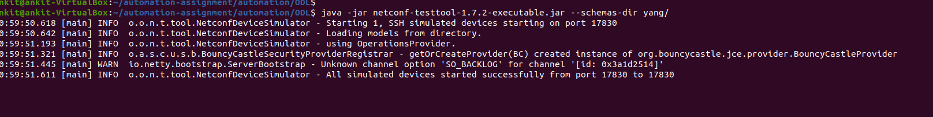
ODL Simulator Device
ODL's Netconf-testtool simulates NETCONF devices. To simulate a device, testtool jar is needed to be run with appropriate flags.
In our application, we will simulate 1 NETCONF device, with a specific small dummy yang file associated to it.
Device runs on 17830 port of local machine and supports basic NETCONF operations like get, edit-config, get-config etc.

Slide 5
Why Flask for this App?
Flask is a micro web framework written in Python. A micro web framework is a web development framework with an easy setup and can be used in developing minimalistic web applications.
It is designed to be easy, fast, and to scale up complex applications and microservices (which is a lightweight application that provides a narrowed list of features with a well-defined contract).
Django is an incredibly robust web application solution that isn’t suited to building REST APIs alone as it needs complex settings and configurations.
Flask is a powerful tool that offers just enough structure to move quickly, while at the same time offering the right amount of stability for developers to build anything they want without having to make design or implementation compromises.

Slide 6
App Architecture Brief
In this app, total 3 REST endpoints have been exposed, 2 for GET and 1 for POST method.
GET: http://localhost:5000/automation/ethernet-1
This returns the current admin and oper status of the respective interface by calling the GET operation of NETCONF to the device via Ncclient library.
200 OK
{
"admin-state": "up",
"oper-status": "up"
}

Slide 7
App Architecture Brief
POST: http://localhost:5000/automation/
This accepts payload with interface details and posts the data to the device via edit-config operation.
{
"device-name": "test-1",
"ip-address": "1.2.3.4",
"interface-name": "ethernet-1",
"shutdown": "yes"
}
Output: It returns whether the operations succeeds, and the data is pushed to the device.
{
"info": "request processed successfully"
}

Slide 8
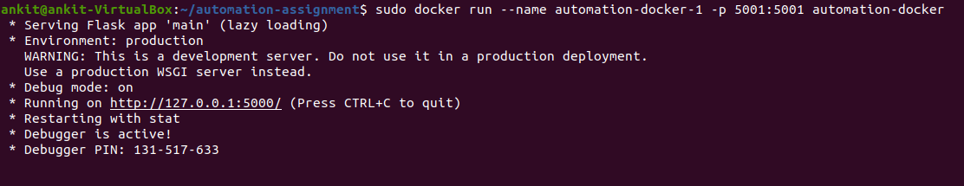
App as a Docker container
The Flask app has been Dockerised with a custom Dockerfile written.
This Dockerfile creates a python image with all necessary requirements needed to run the Flask app.
Container can be created by this Docker image to give a separate environment for the app to run inside it.

Slide 9
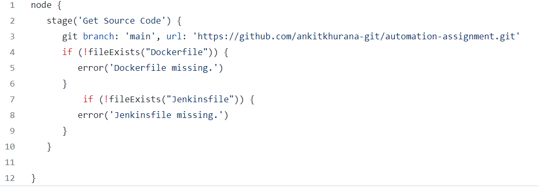
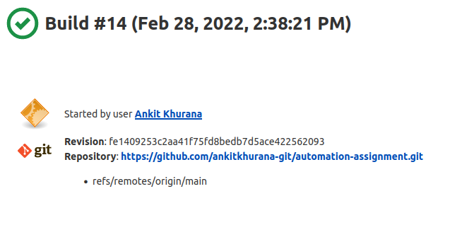
Basic Jenkins Pipeline
A very Jenkins Pipeline has been created.
It fetches the source code from the Github repo and check for the existence of Dockerfile and Jenkinsfile inside it.
A Jenkins file has been added to GIT repo.

Slide 10
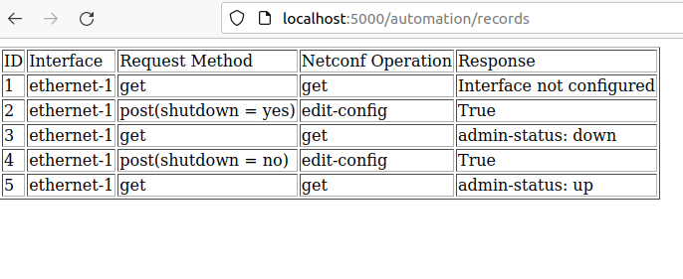
SQLite
SQLite will store device interactions which app does through NETCONF.
Currently, we store ID, REST Request Method, NETCONF Operation, Interface Name and NETCONF response in DB.
After every successful transaction to the device, a call is made to the DB to store these details in Records table.
At any given point, a special GET call can be made to Flask rest app to fetch the current data in the table.
The Output for this has been rendered in HTML format and is easily readable.

Slide 11
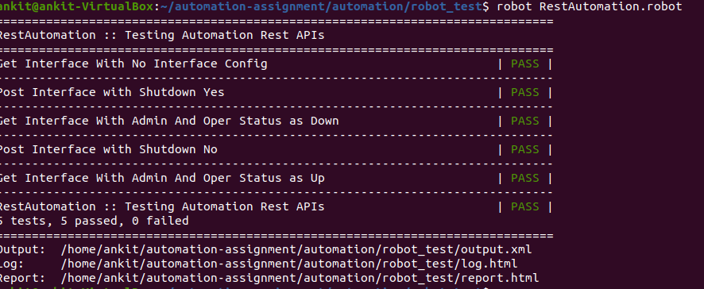
Robot Test Cases
Robot Framework Automation test cases have been written for complete end to end automation.
Total 5 positive scenarios have been automated
These tests not even just sends the request to the Flask rest app but even checks for the JSON response and REST response code.
Based on these checks, test is declared Pass/Fail.
Complete test report, logs are generated in HTML formal which are easily readable.
These tests takes very minimal time to execute and generate report.

Slide 12
DEMO TIME

