Slide 1
Word Sense Disambiguation
In Crowd Sourcing Mode
Team 39
Abhinav Pandey
Anubhav Srivastava
Ankit Kotak
Nazrul Haque Athar
Jayanth Katuri

Slide 2
Word Sense Disambiguation (WSD)
Process of identifying which sense of a word is used in a sentence when the word has multiple meanings
A word has multiple meanings based on its context in the sentence
When translating a word from one language to another, its context determines its exact meaning

Slide 3
Crowd Sourcing
Crowd sourcing is the practise of obtaining information from a large group of people, especially form an online community.
We address the problem of WSD using crowd sourcing where we collect information from the user regarding translation from English to Hindi.
Based on the context given by user, we further encourage the users to provide us with appropriate reasons for their choices.

Slide 4
Project Overview
Our first task was to build a rich interface to collect the Hindi translation of a random word from a given English sentence containing that word.
After this we will build an interface to form rules from the reasons given by the user.
To provide ease of usage,we will be building a web based application and a platform independent desktop application (Windows and Linux).

Slide 5
Technologies Used
Web2py
Python-GTK
HTML
CSS
JavaScript

Slide 6
Functionalities Implemented
Obtaining Hindi Translation of a word in a given English sentence.
Obtaining reasons for a given translation.
  The user can formulate rules on the sentences in the database which have already been translated.
  The information obtained from the rules generated by the user can then be viewed by the administrator.

Slide 7
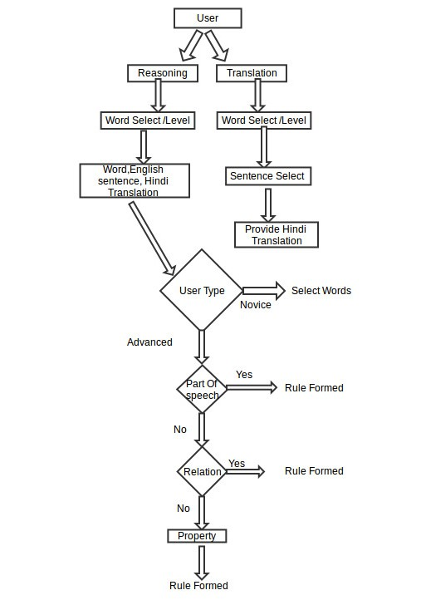
Basic User Work-Flow

Slide 8
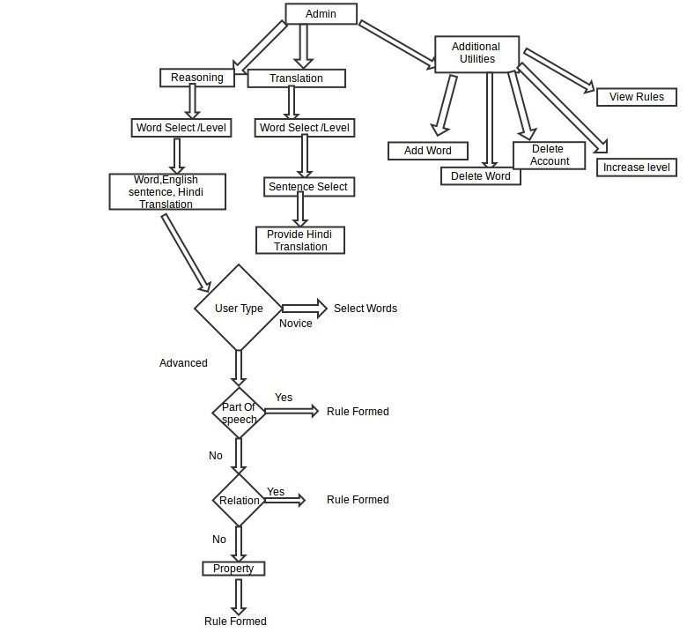
Basic Admin Work-Flow

Slide 9
The End

