Slide 1


Slide 3

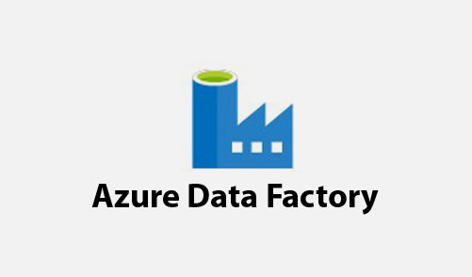
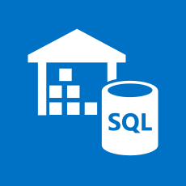
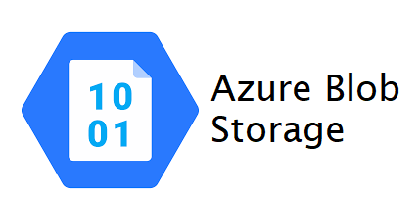
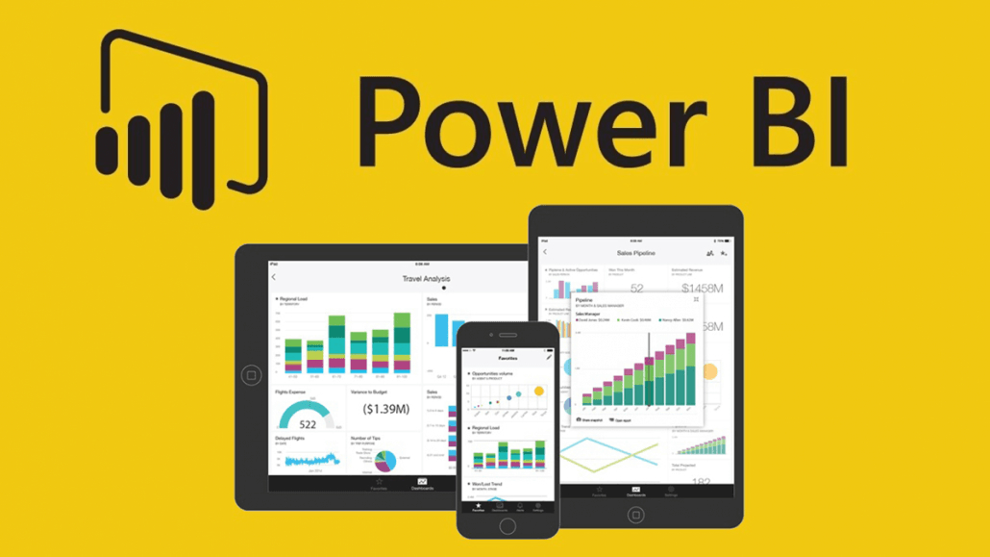
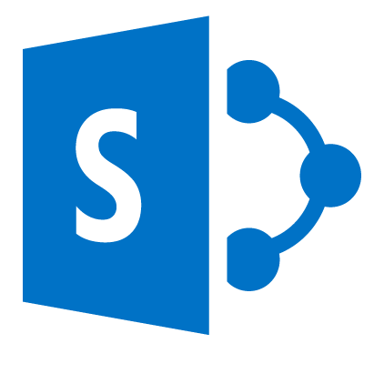
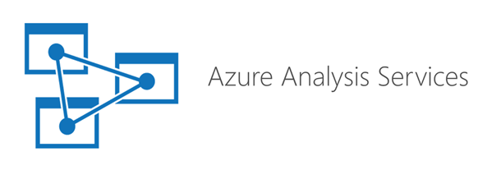
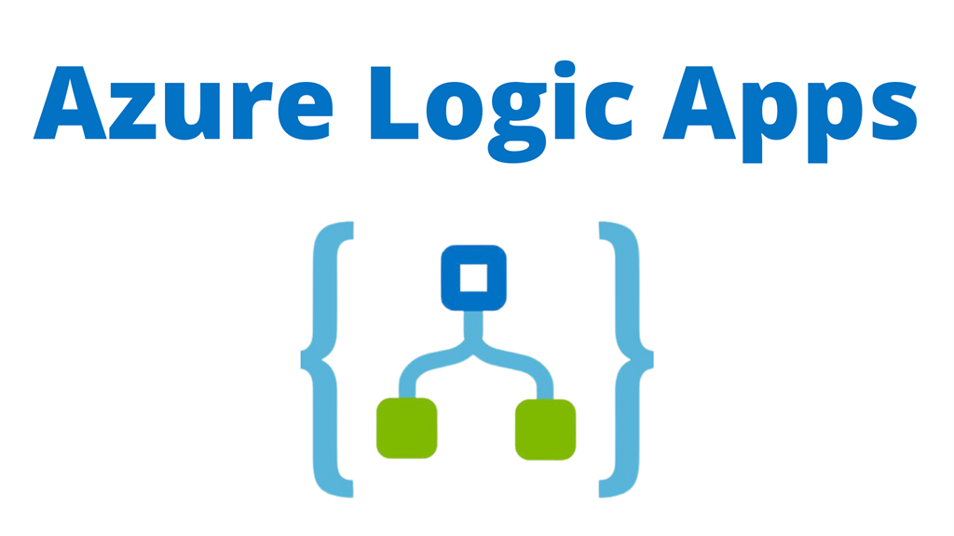
Finance Architecture
Data Sources
Data Ingestion
Data Storage
Data Transformation
Visualization
BW
Live Connection
DWH
Scheduled Batch Job
[5th to 15th every month]
Live Connection
Import Mode
Direct Query
SharePoint
Data Model
Data From Source:
Trial Balance – SAP BW
Hierarchies – SAP BW
Budget Data for P&L – SAP BW
PARN Data – Share Point
Master Data - SAP BW
Uses:
Refresh Data models
Pause Analysis service
Resume Analysis service
How Data is Stored
Master Data – Full Load
Budget Data – Full Load
Trial Balance – Incremental

Slide 4
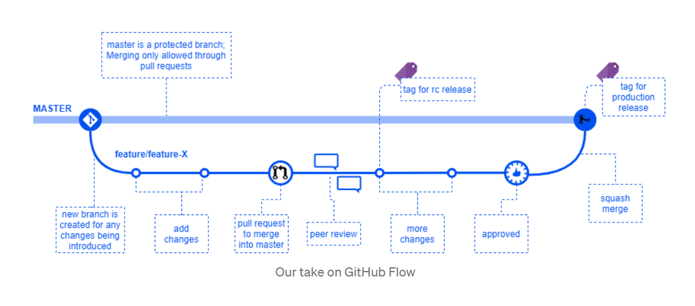
Continuous Integration & Delivery(CI/CD)
CI/CD mean moving Data Factory pipelines, Datasets, Linked Services, and Triggers from one environment (development, test, production) to another.
Azure Data Factory utilizes Azure Resource Manager (ARM) Templates to store the configuration of the various ADF entities (pipelines, datasets, data flows, and so on).

Slide 5
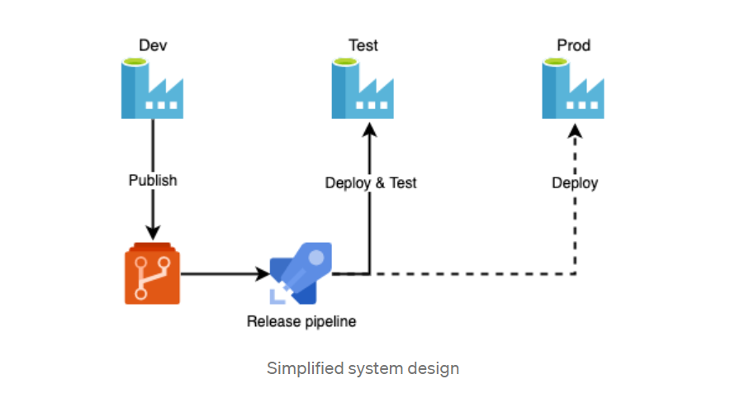
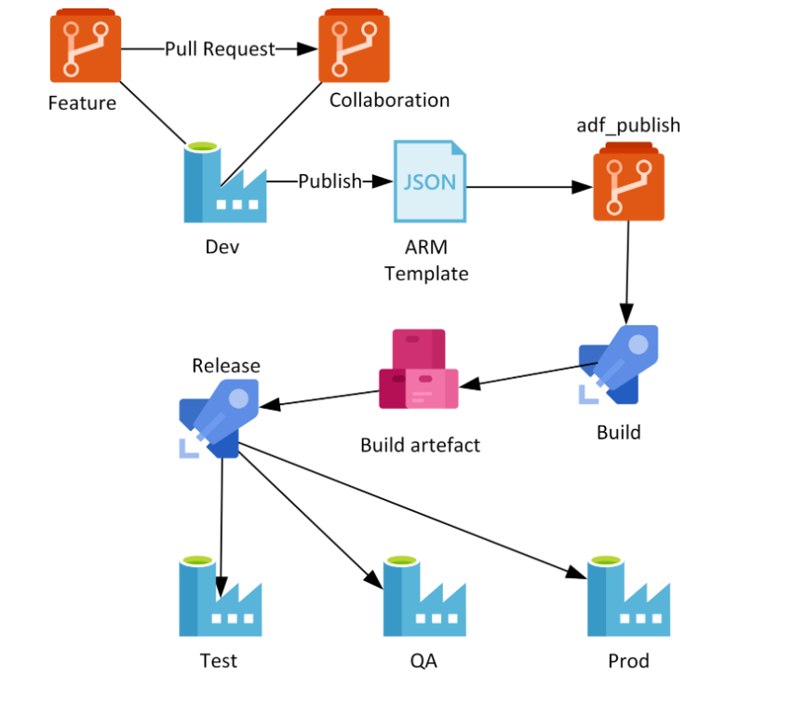
Continuous Integration & Delivery(CI/CD)
What we can improve….?
Restriction to update directly on the Master Branch.
Approval for Pull request by another Senior developer on the team.
Use of Release pipeline for Prod Release.

Slide 6
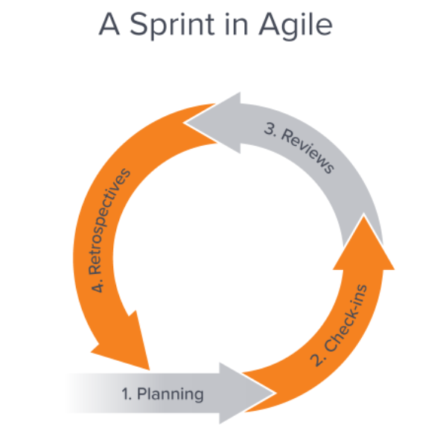
Best Practices Across Organization
Separate Development and Production environment.
Use of Release Pipelines to deploy changes from DEV to PROD.
Fix Data at Source system.
Agile Approach for development (Bi-Weekly Sprint and Production deployment).
Dedicated team to monitor the pipeline runs.

Slide 7


