Slide 1

LEARNING A BLACK-BOX FUNCTION
Periodic function learning with extrapolation beyond the training range
ML ENGINEERING take-home
ANKIT KUMAR $∙$OCTOBER 2026

Slide 2
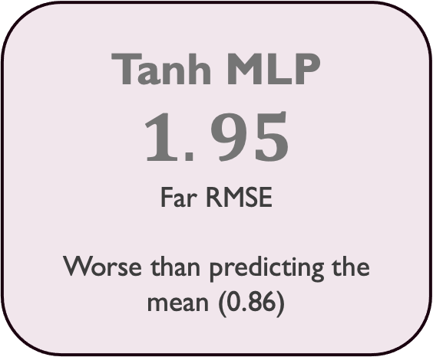
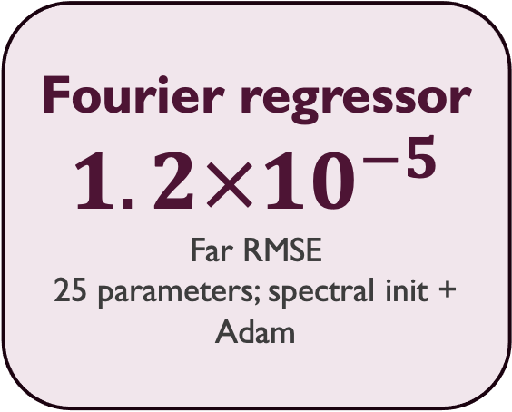
Result at a glance
Learn a periodic black-box function on $\left[−10π, 10π\right];$evaluate at $[50π, 60π]$ far outside the training range.
Tanh MLP
$$1.95$$
Far RMSE
Worse than predicting the mean (0.86)
Snake MLP
0.39
Far RMSE
Keeps the oscillation, but error increases farther from the training window.
Fourier regressor
$$1.2×{10}^{−5}$$
Far RMSE
25 parameters; spectral init + Adam
Message: Matching the model structure to the signal, with a data-driven frequency estimate, is what makes extrapolation work
Separately tuned configurations; seed 42

Slide 3
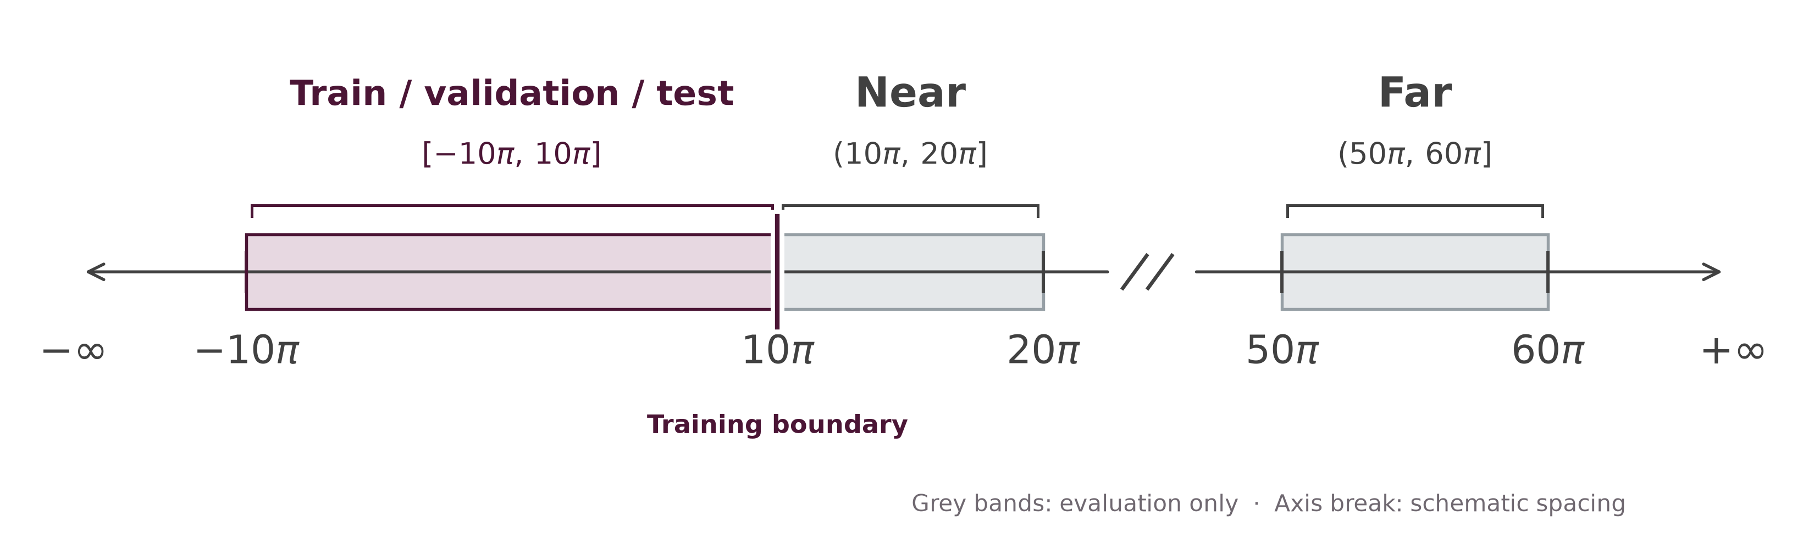
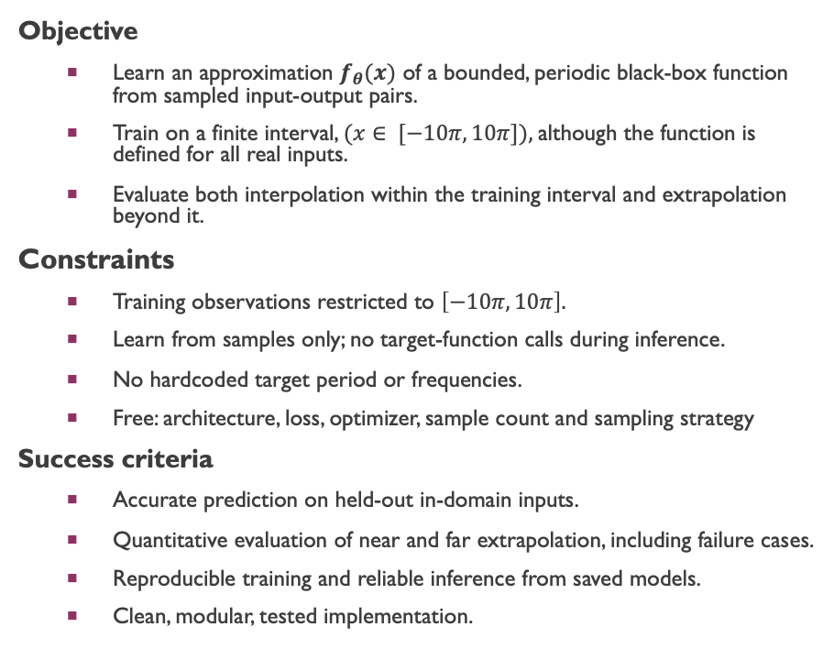
Problem statement & success criteria
Objective
  Learn an approximation $f_{θ}(x)$ of a bounded, periodic black-box function from sampled input-output pairs.
  Train on a finite interval, $(x∈ [−10π, 10π]),$although the function is defined for all real inputs.
  Evaluate both interpolation within the training interval and extrapolation beyond it.
Constraints
  Training observations restricted to $\left[−10π, 10π\right].$
  Learn from samples only; no target-function calls during inference.
  No hardcoded target period or frequencies.
  Free: architecture, loss, optimizer, sample count and sampling strategy
Success criteria
  Accurate prediction on held-out in-domain inputs.
  Quantitative evaluation of near and far extrapolation, including failure cases.
  Reproducible training and reliable inference from saved models.
  Clean, modular, tested implementation.

Slide 4
Why this problem matters in surgical robotics
Real-world data constraints
Limited data: expert surgical demonstrations and instrument telemetry are costly to collect.
High variability: anatomy, instruments, surgeon behavior and operating conditions differ between procedures.
Safety constraints: low average error is not enough; failures and uncertainty must be understood.
Connection to the take-home
Sample efficiency: how much can we learn from a limited number of observations?
Generalization: what happens when inputs fall outside the training distribution?
Model assumption: can the right mathematical structure make learning more reliable from limited data?
Core question: How do we build models that generalize reliably when data is scarce and mistakes are costly?

Slide 5
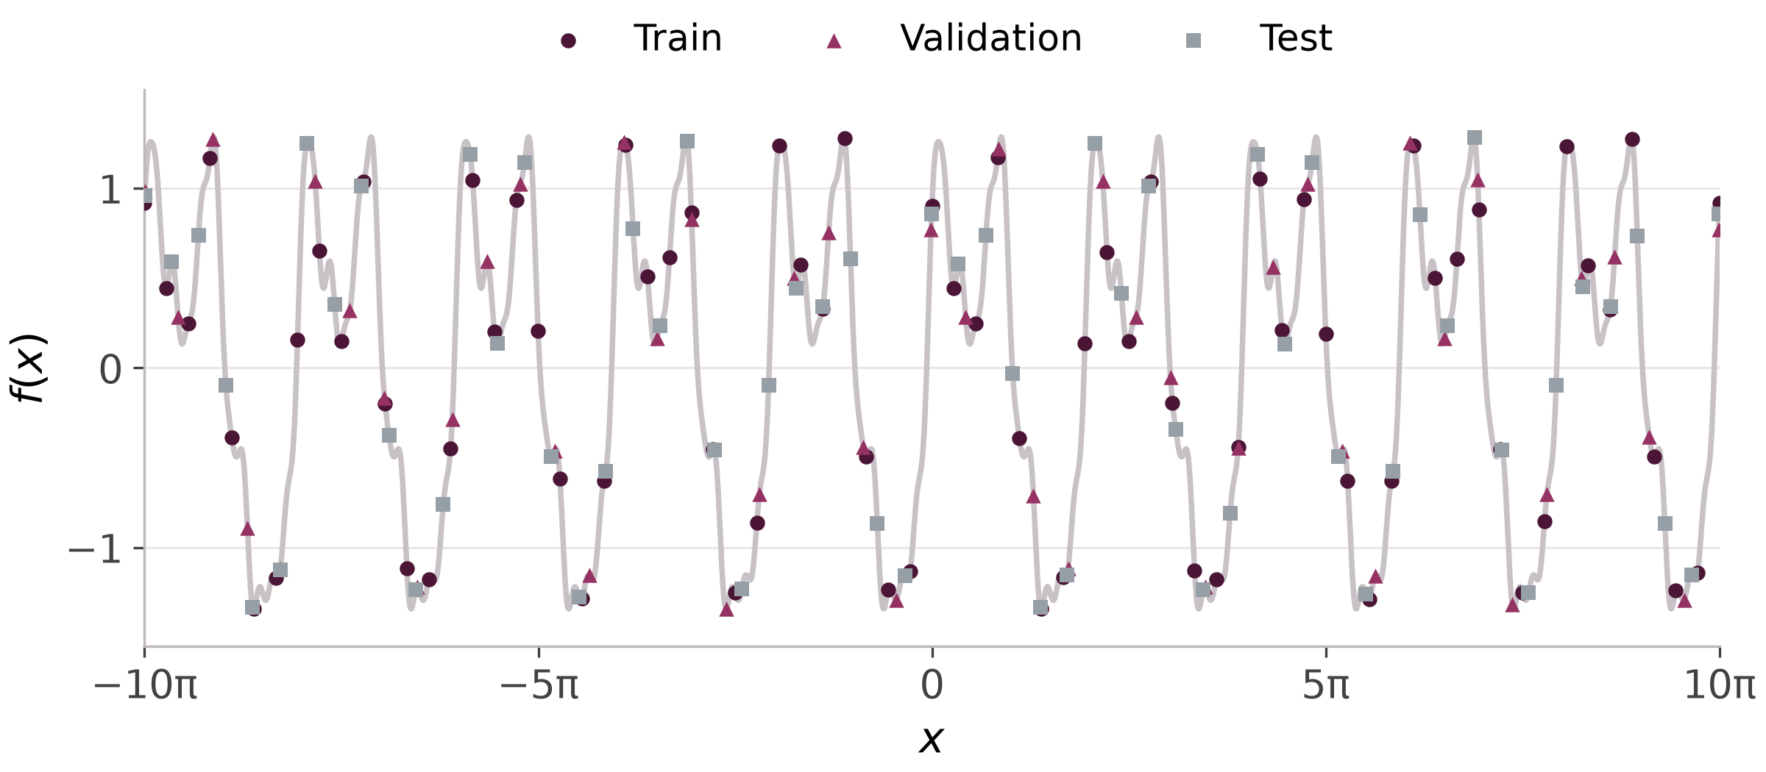
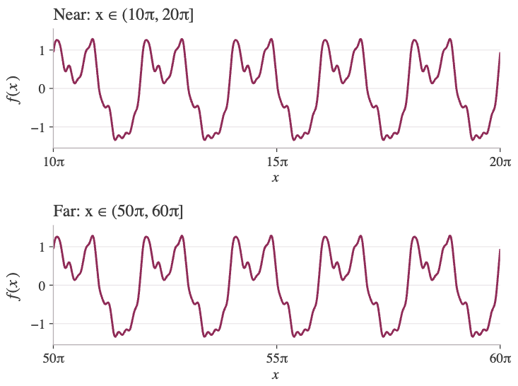

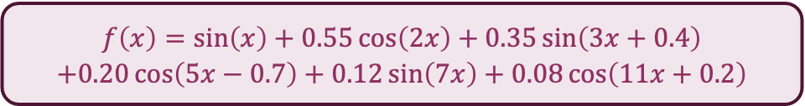

Data & evaluation design
In-domain (interpolation)
$$7,000 train, 1,000 validation, 2,000 test$$
Out-of-domain (extrapolation)
$$2,000 additional samples per band$$
Subset of the 10,000 samples shown.
Ground truth function:
$$\begin{aligned}f\left(x\right)=\sin\left(x\right)+0.55\cos\left(2x\right)+0.35\sin\left(3x+0.4\right) \\ +0.20\cos\left(5x−0.7\right)+0.12\sin\left(7x\right)+0.08\cos\left(11x+0.2\right)\end{aligned}$$
Known to the evaluator only; never for fitting or model selection
Period $2π$ · six frequencies · $σ ≈ 0.86$, so predicting the mean gives RMSE ≈ 0.86, the reference for all results.
Extrapolation samples are used only for evaluation – Not fitting or model selection

Slide 6
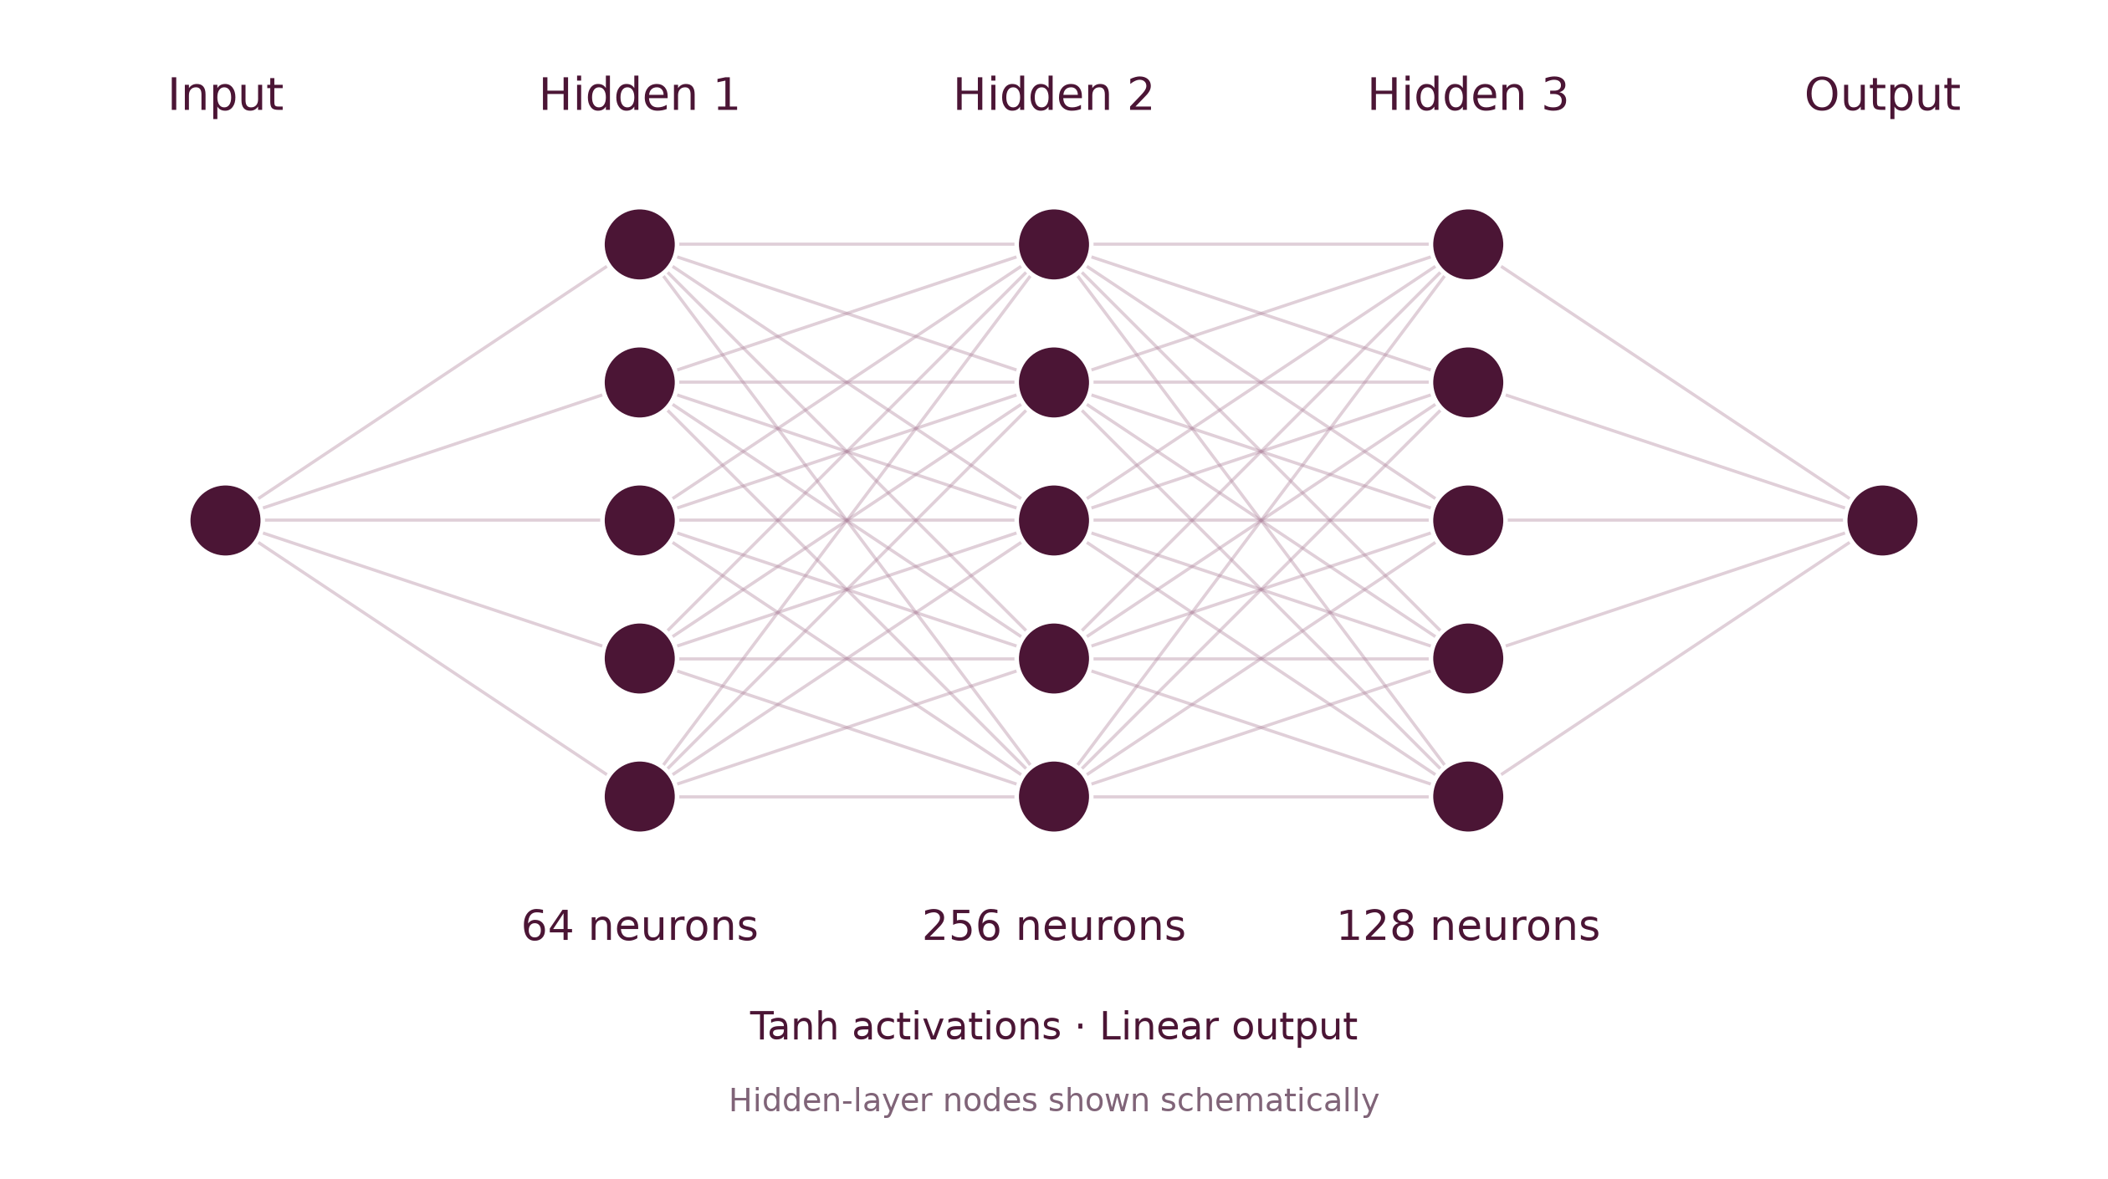
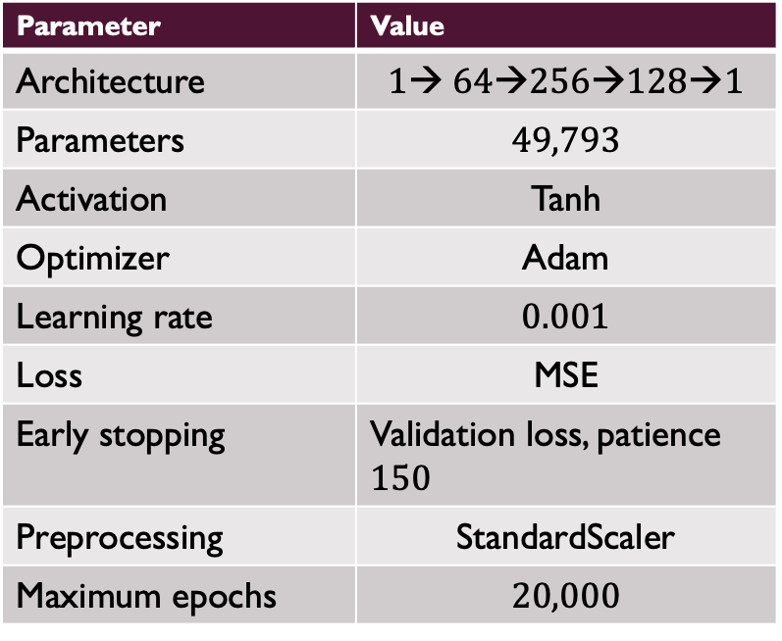
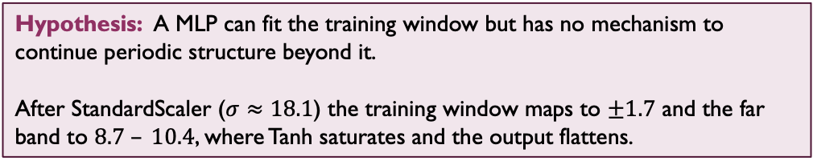
MLP Base configuration
Architecture
Base model training configuration
Parameter | Value
Architecture | $$1→ 64→256→128→1$$
Parameters | $$49,793$$
Activation | Tanh
Optimizer | Adam
Learning rate | $$0.001$$
Loss | MSE
Early stopping | Validation loss, patience $150$
Preprocessing | StandardScaler
Maximum epochs | $$20,000$$
Hypothesis: A MLP can fit the training window but has no mechanism to continue periodic structure beyond it.
After StandardScaler ($σ≈18.1$) the training window maps to $±1.7$ and the far band to $8.7 – 10.4$, where Tanh saturates and the output flattens.
This is the ablation reference; the next slide varies one factor at a time
Notes:
I started with a simple multilayer perceptron using two hidden layers of 64 neurons each and Tanh activations. My goal wasn't to maximize model complexity, but to establish a general-purpose baseline. I used Adam optimization, MSE loss, and validation-based early stopping. I also fitted the input scaler only on the training split to prevent information leakage.

Slide 7
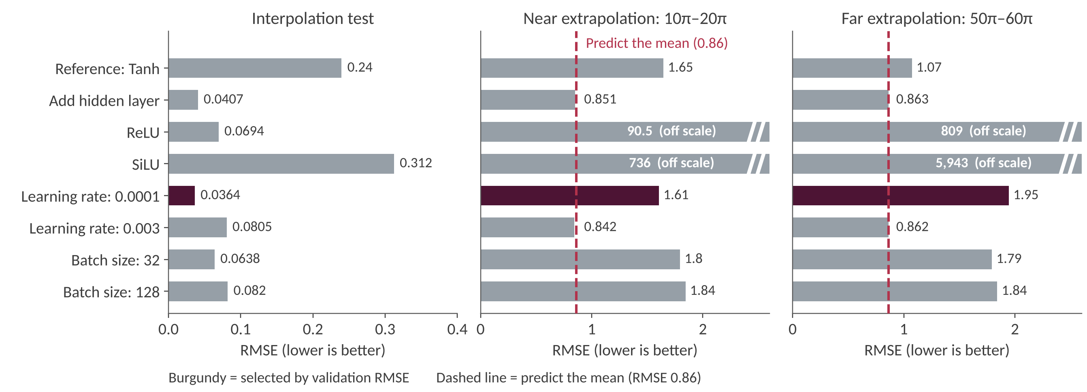
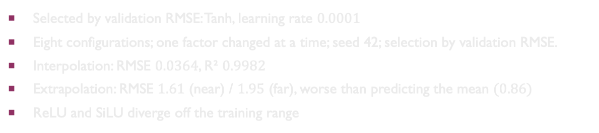
Periodic target: Ablation results
Base MLP
Selected by validation RMSE: Tanh, learning rate $0.0001$
Eight configurations; one factor changed at a time; seed 42; selection by validation RMSE.
Interpolation: RMSE $0.0364$, R² $0.9982$
Extrapolation: RMSE $1.61$ (near) / $1.95$ (far), worse than predicting the mean $(0.86)$
ReLU and SiLU diverge off the training range

Slide 8
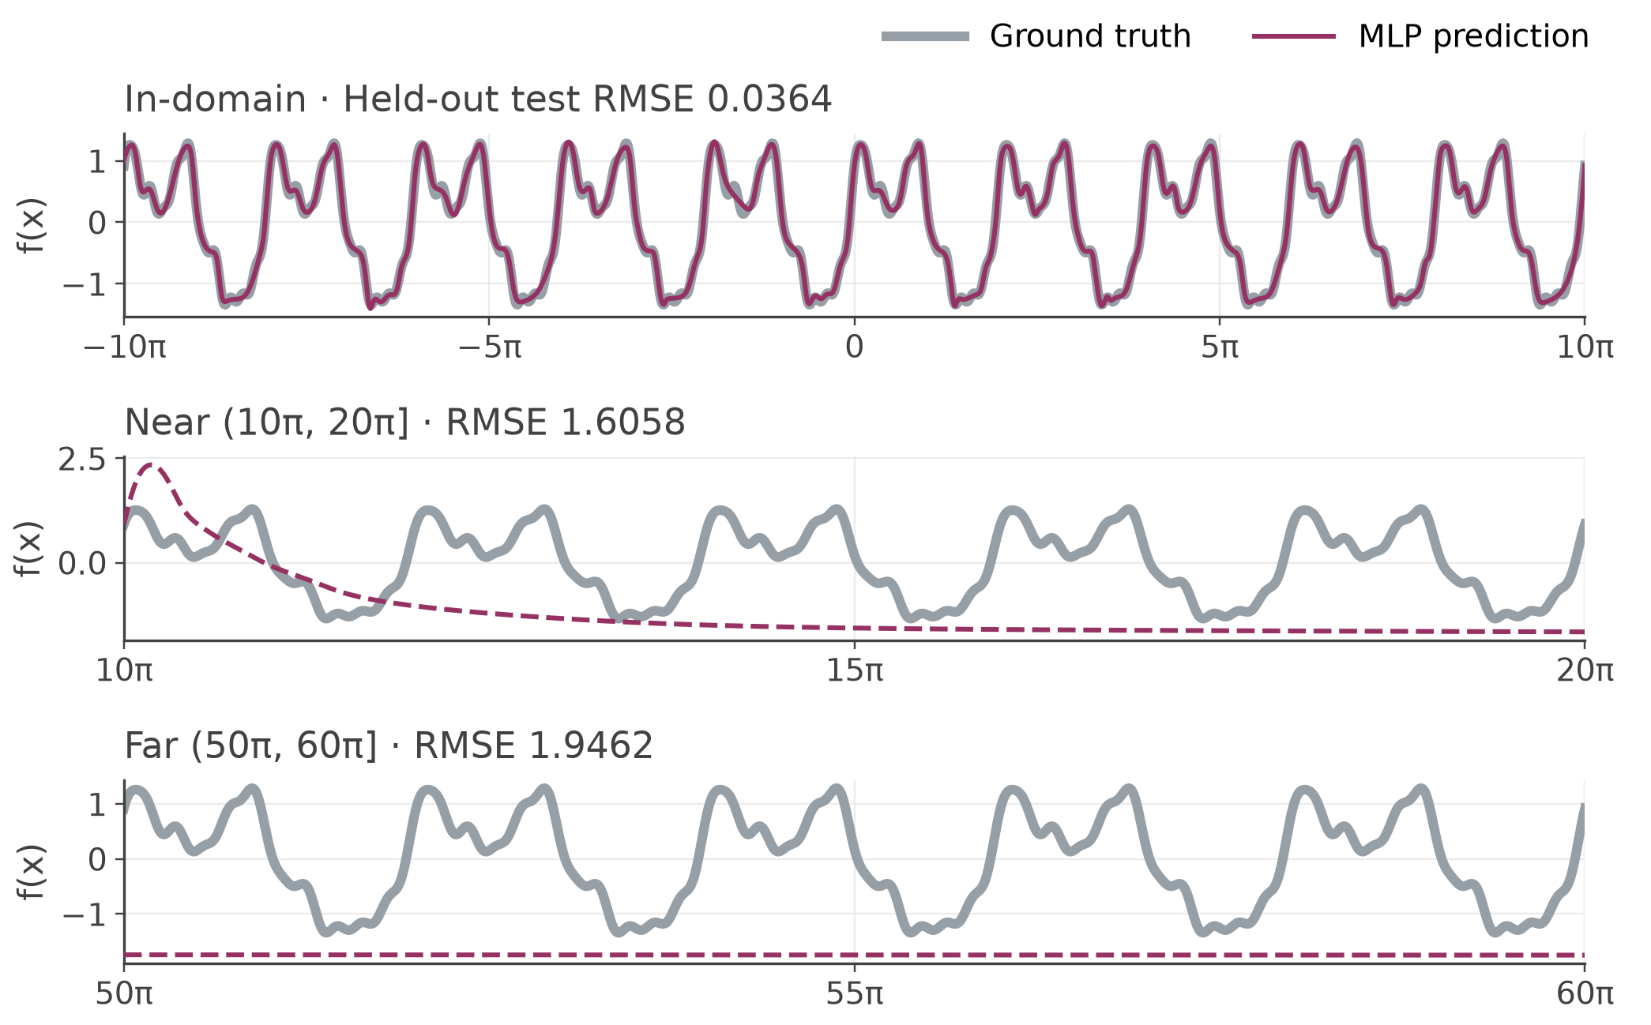
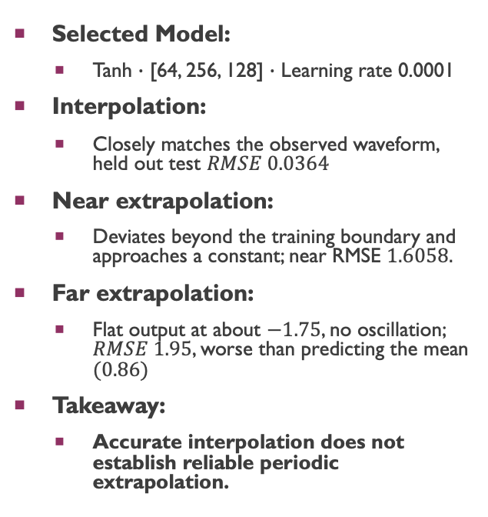
SELECTED MODEL: INTERPOLATION VS EXTRAPOLATION
Selected Model:
  Tanh $∙$ [64, 256, 128] $∙$ Learning rate 0.0001
Interpolation:
  Closely matches the observed waveform, held out test $RMSE 0.0364$
Near extrapolation:
  Deviates beyond the training boundary and approaches a constant; near RMSE $1.6058.$
Far extrapolation:
  Flat output at about $−1.75$, no oscillation; $RMSE 1.95$, worse than predicting the mean $(0.86)$
Takeaway:
  Accurate interpolation does not establish reliable periodic extrapolation.

Slide 9
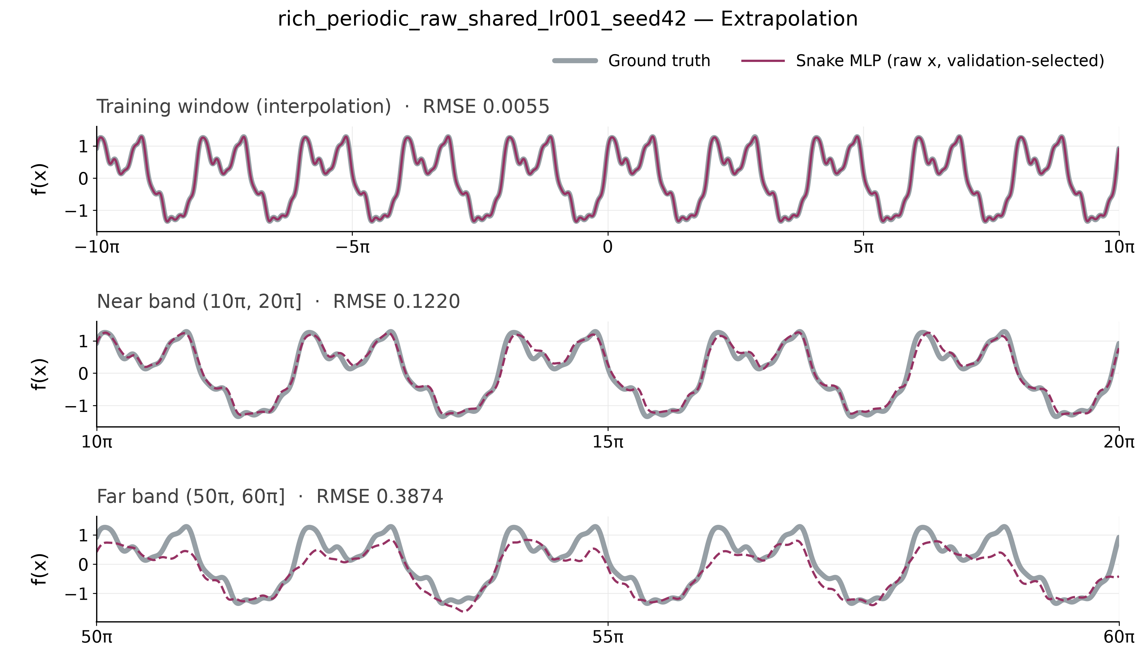
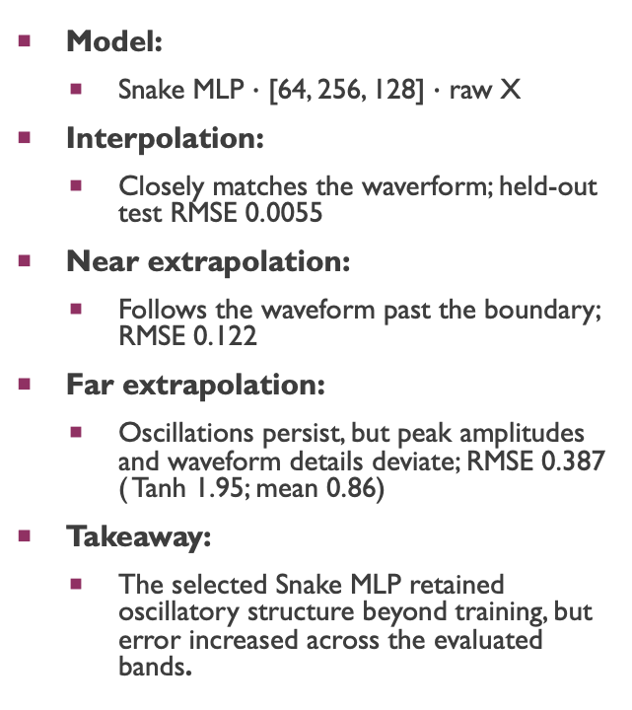
Snake Activation MLP
Model:
  Snake MLP $∙$ [64, 256, 128] $∙$ raw X
Interpolation:
  Closely matches the waverform; held-out test RMSE 0.0055
Near extrapolation:
  Follows the waveform past the boundary; RMSE 0.122
Far extrapolation:
  Oscillations persist, but peak amplitudes and waveform details deviate; RMSE 0.387 ( Tanh 1.95; mean 0.86)
Takeaway:
  The selected Snake MLP retained oscillatory structure beyond training, but error increased across the evaluated bands.
Snake: $x+\sin^{2}\left(a∙x\right)/a$, Trainable $a$ per neuron · Adam LR $0.001$ for weights and $a$· Batch 128 · Maximum 8,000 epochs · Patience $1,500$ · Seed $42$

Slide 10
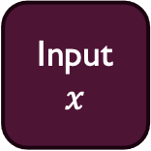
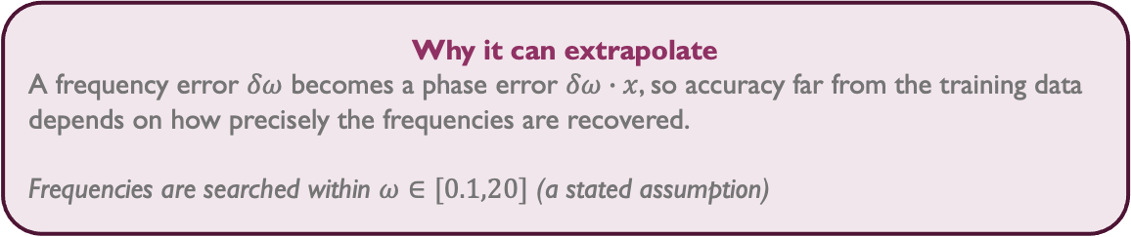
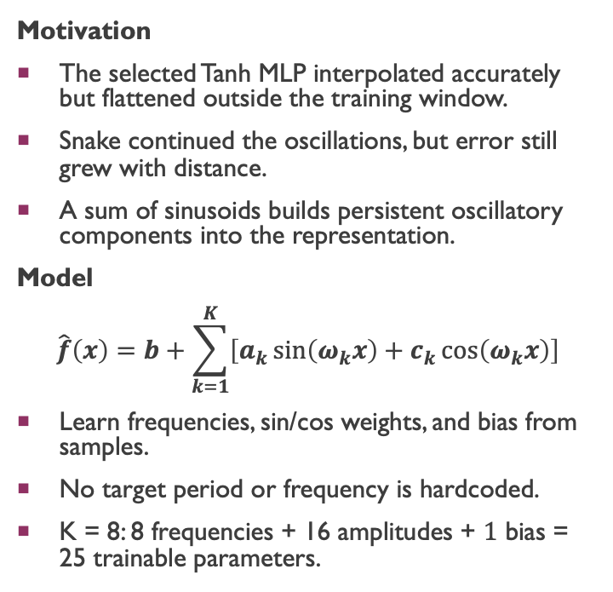

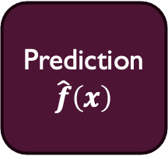
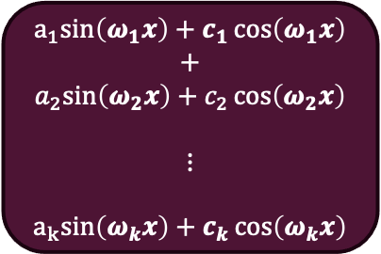
Why a fourier regressor?
Motivation
The selected Tanh MLP interpolated accurately but flattened outside the training window.
Snake continued the oscillations, but error still grew with distance.
A sum of sinusoids builds persistent oscillatory components into the representation.
Model
$$\hat{f}\left(x\right)=b+\sum_{k=1}^{K}{\left[a_{k}\sin\left(ω_{k}x\right)+c_{k}\cos\left(ω_{k}x\right)\right]}$$
Learn frequencies, sin/cos weights, and bias from samples.
No target period or frequency is hardcoded.
K = 8: 8 frequencies + 16 amplitudes + $1$ bias = 25 trainable parameters.
learned terms $ω_{k}, a_{k}, c_{k}$, b
$$a_{1}sin\left(ω_{1}x\right)+c_{1}\cos\left(ω_{1}x\right)$$
$$+$$
$$a_{2}sin\left(ω_{2}x\right)+c_{2}\cos\left(ω_{2}x\right)$$
$⋮$
$$a_{k}sin\left(ω_{k}x\right)+c_{k}\cos\left(ω_{k}x\right)$$
Sum + Bias
Input
$$x$$
Prediction
$$\hat{f}\left(x\right)$$
Why it can extrapolate
A frequency error $δω$ becomes a phase error $δω∙x$, so accuracy far from the training data depends on how precisely the frequencies are recovered.
Frequencies are searched within $ω∈[0.1,20]$ (a stated assumption)
Note: 20 is an assumed search bandwidth.

Slide 11
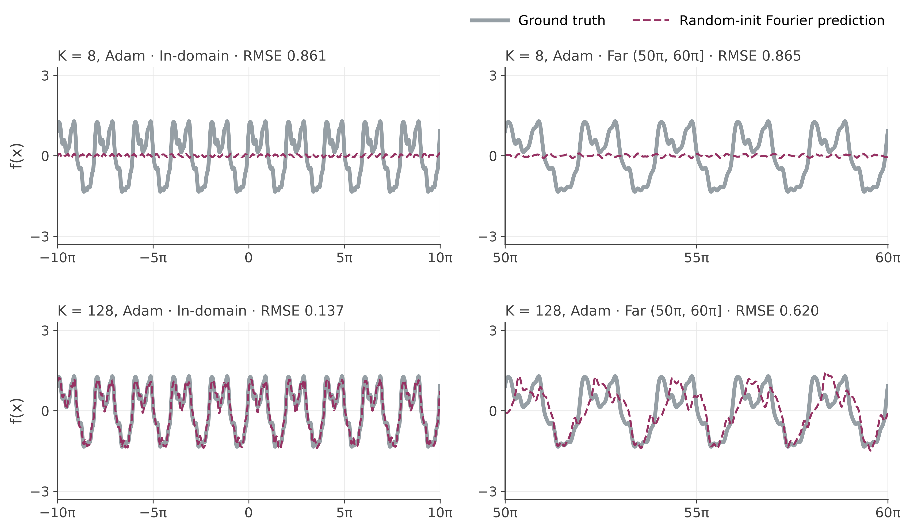
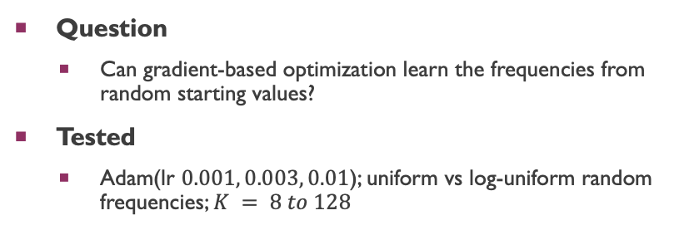
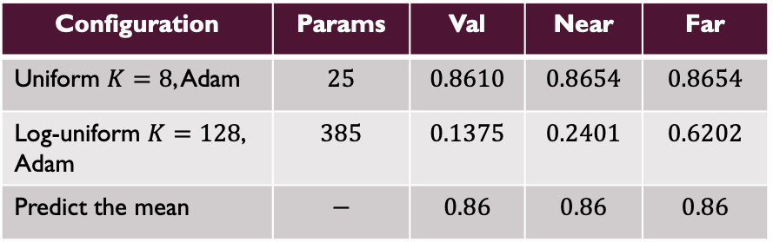
Random initialization – Experiments & findings
Question
  Can gradient-based optimization learn the frequencies from random starting values?
Tested
  Adam(lr $0.001, 0.003, 0.01$); uniform vs log-uniform random frequencies; $K = 8 to 128$
Configuration | Params | Val | Near | Far
Uniform $K=8$, Adam | $$25$$ | $$0.8610$$ | $$0.8654$$ | $$0.8654$$
Log-uniform $K=128$, Adam | $$385$$ | $$0.1375$$ | $$0.2401$$ | $$0.6202$$
Predict the mean | $$−$$ | $$0.86$$ | $$0.86$$ | $$0.86$$
Takeaway: The tested random-initialization configurations did not achieve the spectral model’s accuracy: the same-size model $(K=8)$ collapses to the mean, and a $15×$ larger one $(K=128)$fit the window but its phase error grows with distance.
Notes:
The sinusoidal representation was suitable, but finding accurate frequencies remained difficult. I next tested spectral initialization using training samples only.

Slide 12
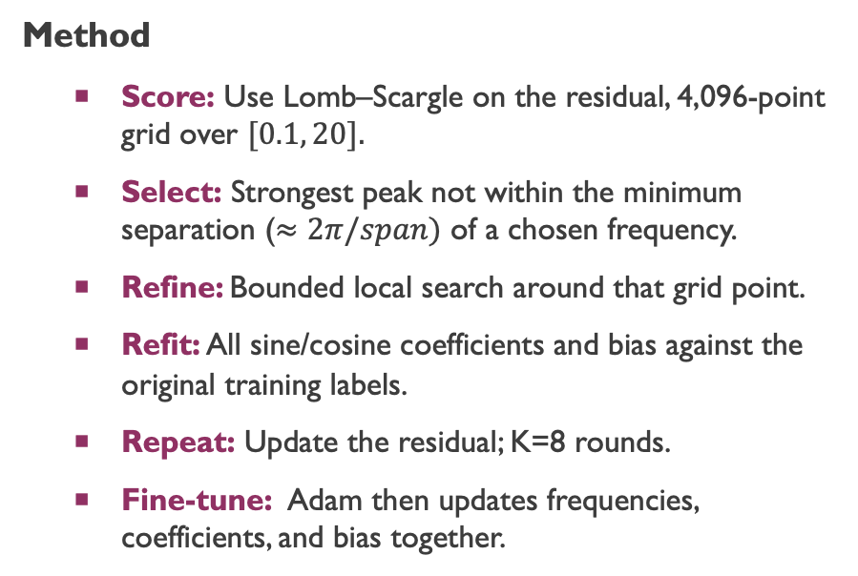
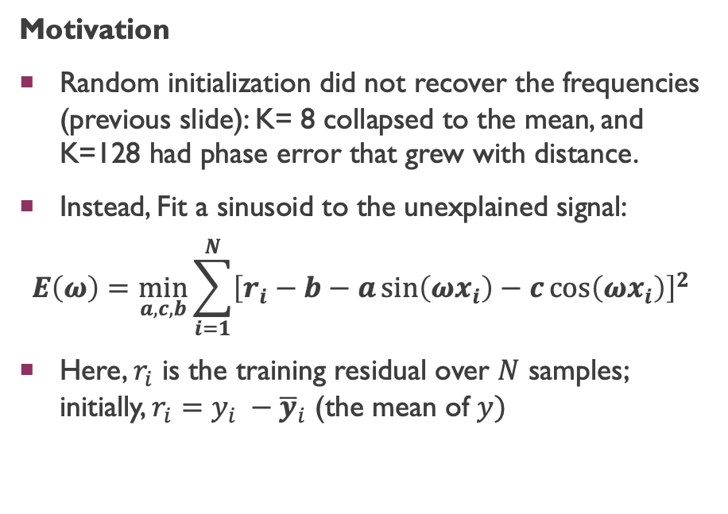
Spectral initialization – Estimating frequencies
Motivation
Random initialization did not recover the frequencies (previous slide): K= 8 collapsed to the mean, and K=128 had phase error that grew with distance.
Instead, Fit a sinusoid to the unexplained signal:
$$E\left(ω\right)=\min_{a,c,b}{\sum_{i=1}^{N}{{\left[r_{i}−b−a\sin\left(ωx_{i}\right)−c\cos\left(ωx_{i}\right)\right]}^{2}}}$$
Here, $r_{i}$ is the training residual over $N$ samples; initially, $r_{i}=y_{i} −{\overline{y}}_{i}$ (the mean of $y)$
Method
  Score: Use Lomb–Scargle on the residual, 4,096-point grid over $[0.1, 20].$
  Select: Strongest peak not within the minimum separation ($≈2π/span)$ of a chosen frequency.
  Refine: Bounded local search around that grid point.
  Refit: All sine/cosine coefficients and bias against the original training labels.
  Repeat: Update the residual; K=8 rounds.
  Fine-tune: Adam then updates frequencies, coefficients, and bias together.
Takeaway: Starting frequencies are learned from training samples, no target period or frequencies are supplied.

Slide 13
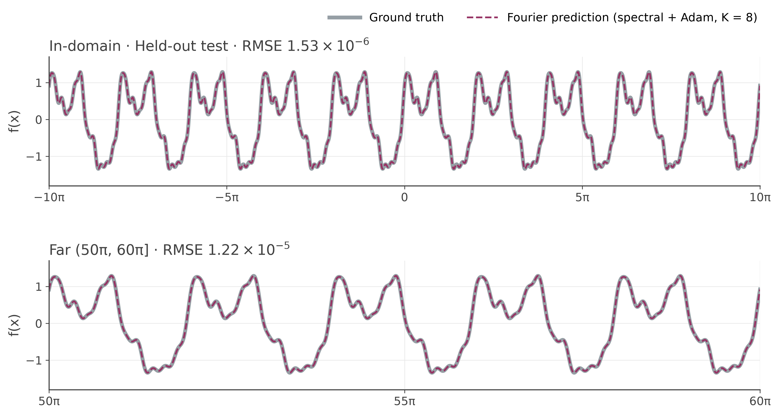
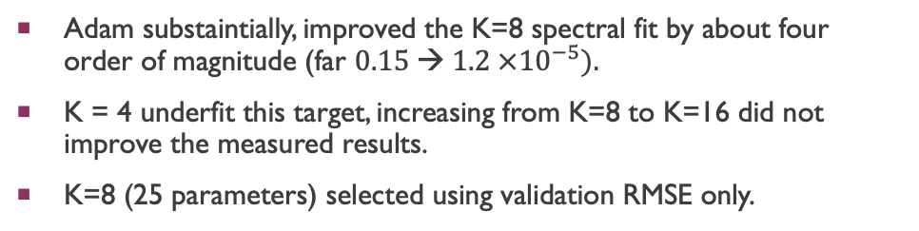
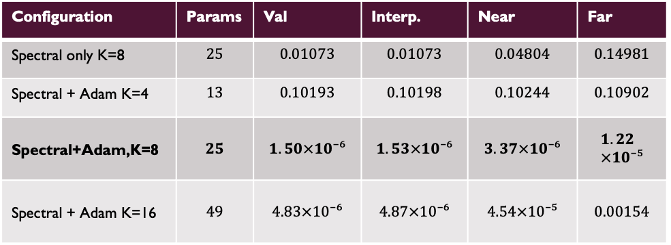
Fourier regressor: Results
Configuration | Params | Val | Interp. | Near | Far
Spectral only K=8 | $$25$$ | $$0.01073$$ | $$0.01073$$ | $$0.04804$$ | $$0.14981$$
Spectral + Adam K=4 | $$13$$ | $$0.10193$$ | $$0.10198$$ | $$0.10244$$ | $$0.10902$$
Spectral+Adam,K=8 | $$25$$ | $$1.50×10⁻⁶$$ | $$1.53×10⁻⁶$$ | $$3.37×10⁻⁶$$ | $$1.22×10⁻⁵$$
Spectral + Adam K=16 | $$49$$ | $$4.83×10⁻⁶$$ | $$4.87×10⁻⁶$$ | $$4.54×10⁻⁵$$ | $$0.00154$$
Adam substaintially, improved the K=8 spectral fit by about four order of magnitude (far $0.15 → 1.2 ×{10}^{−5}).$
K = 4 underfit this target, increasing from K=8 to K=16 did not improve the measured results.
K=8 (25 parameters) selected using validation RMSE only.
Takeaway: Spectral initialization plus Adam accurately reproduced the waveform inside training and across both evaluated extrapolated bands.
Note: Seed 42 · Adam learning rate $0.001$ · Maximum 30,000 epochs · Patience 3,000 · One noise-free target

Slide 14
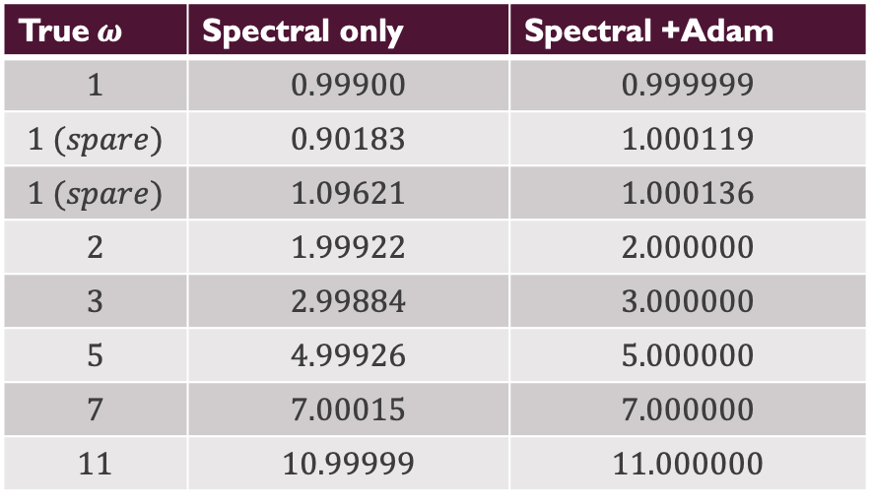
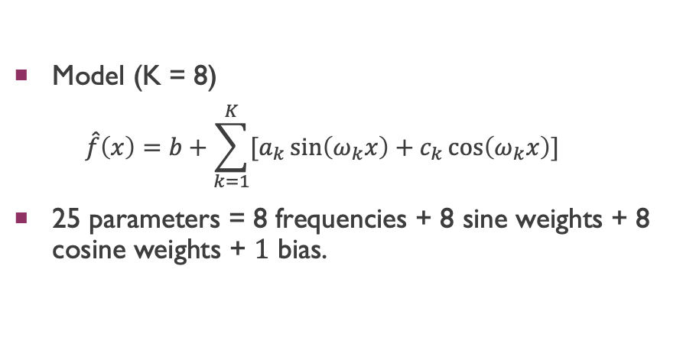


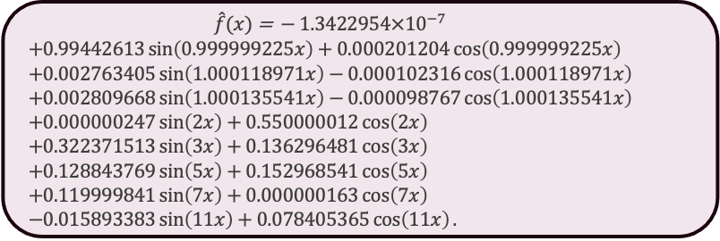
Fitted model: 25 parameters and the effect of adam
Fitted frequencies $ω_{k}$
Model (K = 8)
  $$\hat{f}\left(x\right)=b+\sum_{k=1}^{K}{[a_{k}\sin\left(ω_{k}x\right)+c_{k}\cos\left(ω_{k}x\right)]}$$
25 parameters = 8 frequencies + 8 sine weights + 8 cosine weights + $1$ bias.
True$ω$ | Spectral only | Spectral +Adam
$$1$$ | $$0.99900$$ | $$0.999999$$
$$1 (spare)$$ | $$0.90183$$ | $$1.000119$$
$$1 (spare)$$ | $$1.09621$$ | $$1.000136$$
$$2$$ | $$1.99922$$ | $$2.000000$$
$$3$$ | $$2.99884$$ | $$3.000000$$
$$5$$ | $$4.99926$$ | $$5.000000$$
$$7$$ | $$7.00015$$ | $$7.000000$$
$$11$$ | $$10.99999$$ | $$11.000000$$
Fitted function
$$\begin{aligned}\hat{f}(x) \text{=} −1.3422954×{10}^{−7} \\ &+0.99442613\sin\left(0.999999225x\right)+0.000201204\cos\left(0.999999225x\right) \\ &+0.002763405\sin\left(1.000118971x\right)−0.000102316\cos\left(1.000118971x\right) \\ &+0.002809668\sin\left(1.000135541x\right)−0.000098767\cos\left(1.000135541x\right) \\ &+0.000000247\sin\left(2x\right)+0.550000012\cos\left(2x\right) \\ &+0.322371513\sin\left(3x\right)+0.136296481\cos\left(3x\right) \\ &+0.128843769\sin\left(5x\right)+0.152968541\cos\left(5x\right) \\ &+0.119999841\sin\left(7x\right)+0.000000163\cos\left(7x\right) \\ &−0.015893383\sin\left(11x\right)+0.078405365\cos\left(11x\right).\end{aligned}$$
Adam closely aligns the six principal frequencies with the target frequencies; two small additional components remain near $ω = 1$.
Takeaways: Adam refines the frequency by four orders of magnitude, and that is what makes the far band accurate (RMSE $0.150→1.2×10^{−5}$).

Slide 15
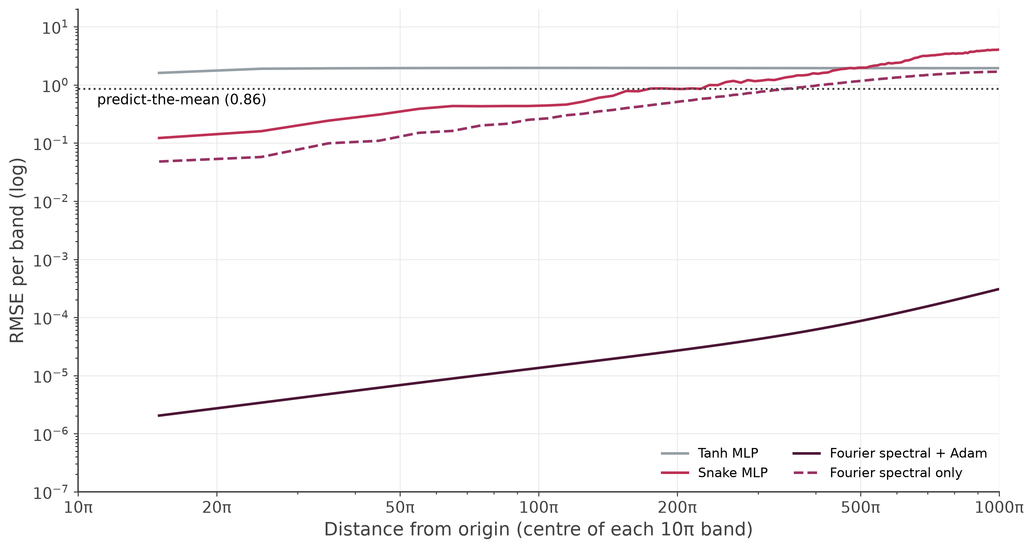
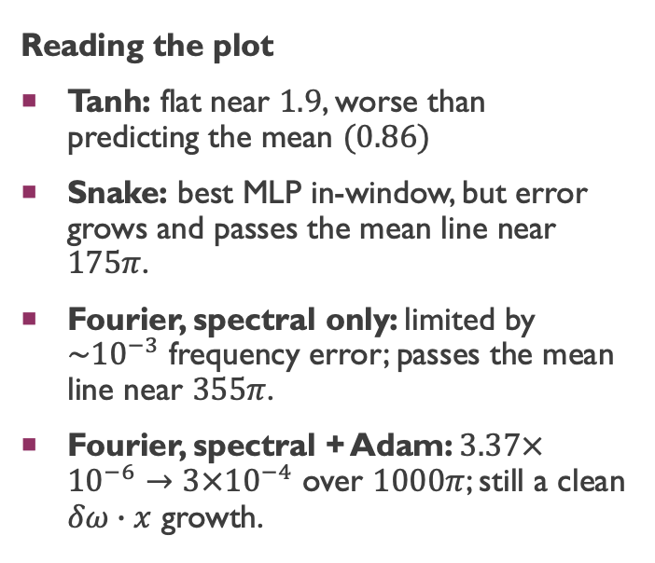
Error versus distance
Reading the plot
Tanh: flat near $1.9$, worse than predicting the mean $(0.86)$
Snake: best MLP in-window, but error grows and passes the mean line near $175π$.
Fourier, spectral only: limited by $\sim {10}^{−3}$ frequency error; passes the mean line near $355π$.
Fourier, spectral + Adam: $3.37×{10}^{−6}→3×{10}^{−4}$ over $1000π$; still a clean $δω∙x$ growth.
Note: the log axis; each gridline is a factor of ten.
Takeaway: In the final band, $(990π, 1000π],$spectral + Adam achieves approximately $2,400×$ lower RMSE than predicting the training mean.

Slide 16
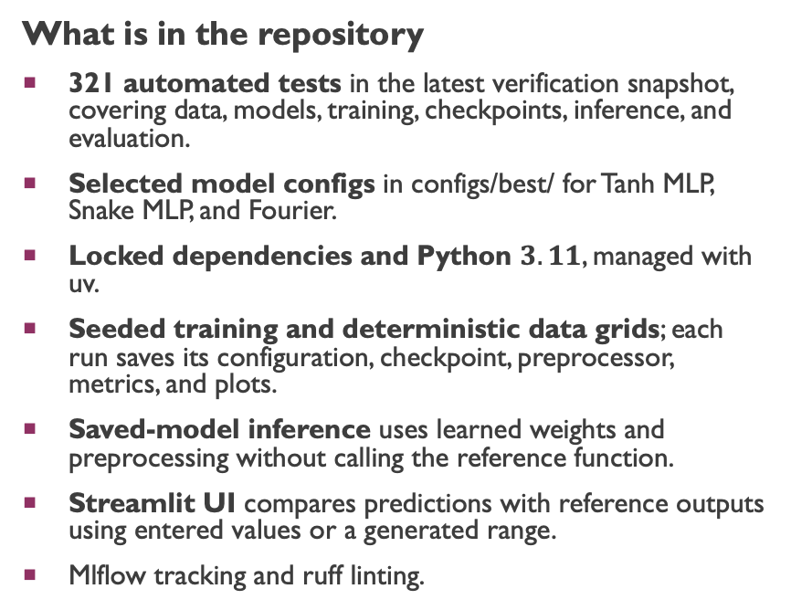
Engineering: tests, reproducibility and commands
What is in the repository
321 automated tests in the latest verification snapshot, covering data, models, training, checkpoints, inference, and evaluation.
Selected model configs in configs/best/ for Tanh MLP, Snake MLP, and Fourier.
Locked dependencies and Python $3.11$, managed with uv.
Seeded training and deterministic data grids; each run saves its configuration, checkpoint, preprocessor, metrics, and plots.
Saved-model inference uses learned weights and preprocessing without calling the reference function.
Streamlit UI compares predictions with reference outputs using entered values or a generated range.
Mlflow tracking and ruff linting.
Start here: Setup instructions in the README
Clone the repository, create the Python environment, and install dependencies before running the commands below.
# Install dependencies and run tests
uv sync --locked
uv run python -m pytest -q
# Train the selected Fourier recipe
uv run python -m scripts.run_experiments --config configs/best/fourier_rich_periodic.yaml
# Launch the comparison UI
uv sync --locked --group ui
uv run --group ui streamlit run streamlit_app.py
# Check code quality
uv run ruff check function_approximation scripts tests streamlit_app.py
Takeaways: Config-driven training and saved artifacts make experiments reproducible and predictions easy to inspect.

Slide 17
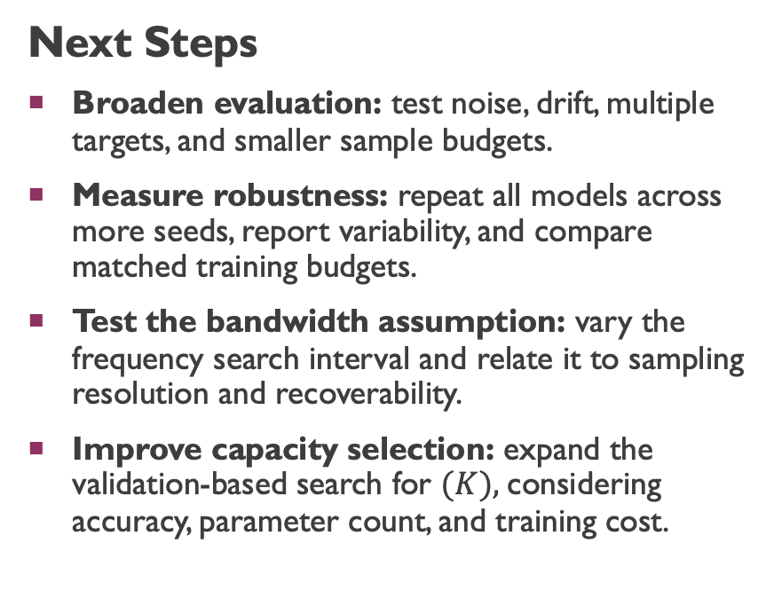
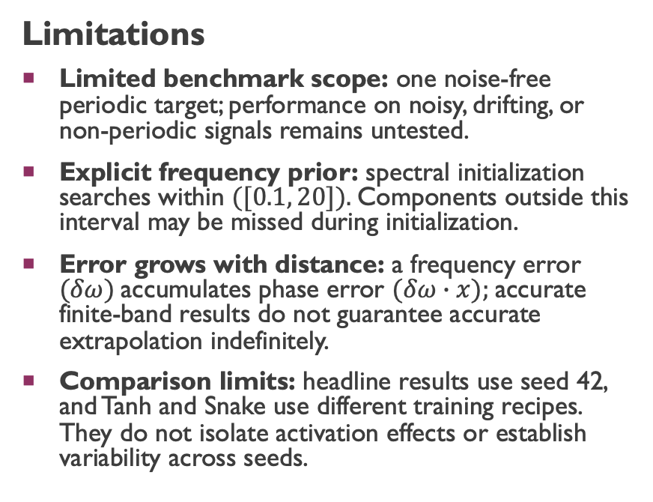
Limitation & next steps
Limitations
Limited benchmark scope: one noise-free periodic target; performance on noisy, drifting, or non-periodic signals remains untested.
Explicit frequency prior: spectral initialization searches within $([0.1, 20]).$Components outside this interval may be missed during initialization.
Error grows with distance: a frequency error $(δω)$accumulates phase error $(δω∙x);$accurate finite-band results do not guarantee accurate extrapolation indefinitely.
Comparison limits: headline results use seed 42, and Tanh and Snake use different training recipes. They do not isolate activation effects or establish variability across seeds.
Next Steps
Broaden evaluation: test noise, drift, multiple targets, and smaller sample budgets.
Measure robustness: repeat all models across more seeds, report variability, and compare matched training budgets.
Test the bandwidth assumption: vary the frequency search interval and relate it to sampling resolution and recoverability.
Improve capacity selection: expand the validation-based search for $(K),$considering accuracy, parameter count, and training cost.
Takeaways: Fourier achieved the lowest error on the tested periodic function. Further experiments would assess its robustness to noise and other signals.

Slide 18
Appendix

Slide 19
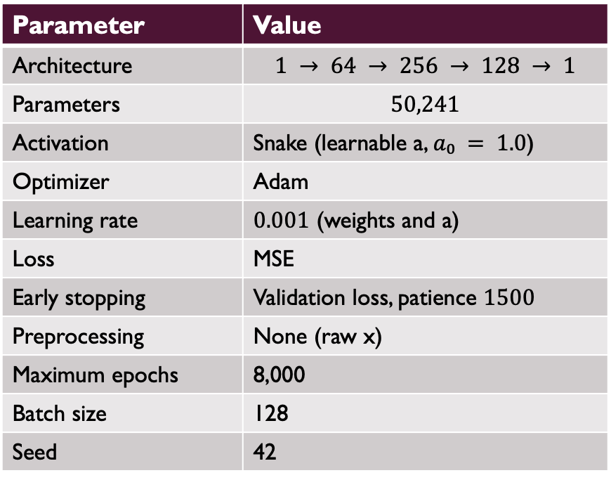
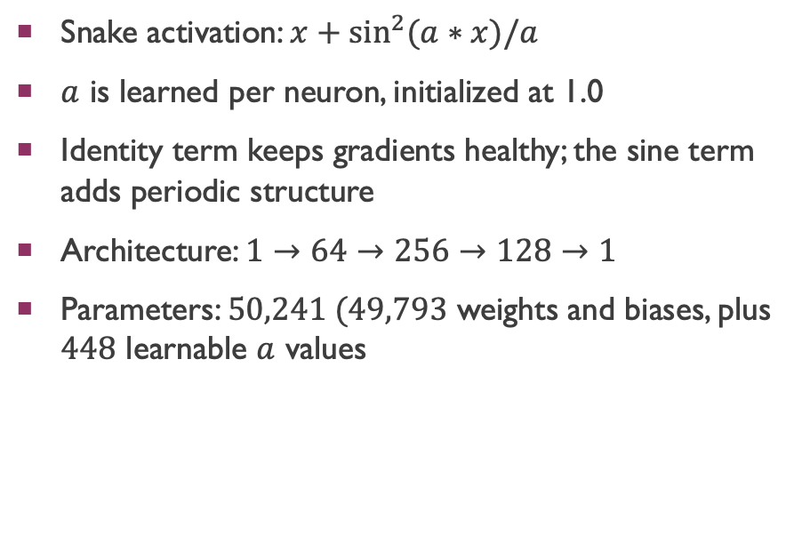
Snake MLP configuration
Parameter | Value
Architecture | $$1 → 64 → 256 → 128 → 1$$
Parameters | $$50,241$$
Activation | Snake (learnable a, $a₀ = 1.0$)
Optimizer | Adam
Learning rate | $0.001$ (weights and a)
Loss | MSE
Early stopping | Validation loss, patience $1500$
Preprocessing | None (raw x)
Maximum epochs | 8,000
Batch size | 128
Seed | 42
Snake activation: $x+\sin^{2}{(a∗x)/a}$
$a$ is learned per neuron, initialized at 1.0
Identity term keeps gradients healthy; the sine term adds periodic structure
Architecture: $1→64→256→128→1$
Parameters: $50,241 (49,793$ weights and biases, plus $448$ learnable $a$ values
Differences from the Tanh reference: raw x instead of StandardScaler, batch 128 instead of 64, patience 1500 instead of 150. Snake’s validation curve is noisy and plateau-prone, so patience 150 stops too early.
Ziyin, Hartwig, Ueda, “Neural Networks Fail to Learn Periodic Functions and How to Fix It”, NeurIPS 2020. paper

