Slide 1
SWE 681 Secure Password Manager
Antara Tewary (G01413546)
Ankit Kumar (G01436204)
Lingyun Dai (G01464288)

Slide 2
Project Overview
Purpose A secure password management system that implements modern cryptographic techniques
Key Features
PBKDF2 implementation with configurable iterations
Multiple hash function options (SHA-256, SHA-384, SHA-512)
Configurable key length (128-512 bits) for derived keys
Adjustable salt length (16, 24, or 32 bytes)
Web-based interface with local storage

Slide 3
Motivation & Problem Statement
Breach Statistics: In 2023 alone, over 15 billion records were exposed in data breaches, with password theft involved in 81% of hacking-related breaches
Real-world Consequences: Average cost of a data breach involving passwords reached $4.35 million in 2024, with small businesses being disproportionately affected
Technical Challenge: Computing power increases follow Moore's Law, making yesterday's secure hashing algorithms vulnerable to today's hardware
User Experience Impact: Security measures that create noticeable delays (>300ms) significantly increase user abandonment rates
Regulatory Pressure: New regulations like GDPR and CCPA impose severe penalties for inadequate security measures, including weak password storage
Attack Sophistication: Modern attackers use specialized hardware (GPUs, ASICs) that can test billions of password hashes per second
These highlight the urgency and business impact of proper password security, which makes investing in advanced password management solutions crucial in modern software development landscape.

Slide 4
Problem
Problem
How to balance security strength with performance in password management systems?

Slide 5
Solution: Adaptive Security Approach for Password Management
User-Configurable Security Parameters
Performance Tracking and Transparency
Modern Cryptographic Practices
allows users to select their desired security level via:
Configurable PBKDF2 iteration counts (10,000 to 500,000)
Visualization of the performance impact in real-time
Clear feedback on encoding/verification time
Records and displays hash generation time
Shows verification time during login
Presents comparative performance data when updating passwords
The implementation uses:
PBKDF2 with SHA-256 for key derivation
Unique salt per password to prevent rainbow table attacks
Secure Web Crypto API for standardized implementation

Slide 6
System Architecture
User Interface Layer
Password Manager Core
Cryptographic Module
Storage Layer
Performance Tracking System

Slide 7
User Interface Layer
Purpose: Provides interactive controls and displays for all user operations
Key Components:
Registration, login, and management forms
Security parameter configuration controls
Status message system
User database display
Technologies: HTML5, CSS3, JavaScript event handling
Features:
Interactive sliders and dropdowns for security configuration
Real-time feedback on operations

Slide 8
Password Manager Core
Purpose: Central coordination system for all operations
Key Components:
PasswordManager class with user management function
Form handling logic and event integration
Features:
User operation coordination (register, login, change, delete)
Input validation and error handling
UI update management based on operation results
Design Pattern: Object-oriented with promise-based async operations

Slide 9
Cryptographic Module
Purpose: Implements all security and cryptographic operations
Key Components:
PBKDF2 implementation with Web Crypto API
Salt generation and binary data utilities
Security Features:
Configurable hash functions (SHA-256/384/512)
Adjustable key length (128-512 bits)
Variable iteration count (10,000-500,000)
Cryptographically secure salt generation(16/24/32 bytes)
Implementation: Browser's native Web Crypto API for optimal performance

Slide 10
Storage Layer
Purpose: Manages persistent data storage across sessions
Key Components:
localStorage integration
Features:
JSON serialization for browser storage
Automatic data loading on startup
Secure credential storage format
Data clearing functionality for demonstrations

Slide 11
Performance Tracking System
Purpose: Measures and displays cryptographic operation performance
Key Components:
Timing functions using Performance API
Performance history storage
Features:
Millisecond-precision timing for all operations
Comparative analytics between security configurations
Historical performance tracking for verification

Slide 12
Authentication & Authorization Flow
Login Authentication: [Include workflow diagram]

Slide 13
Authentication & Authorization Flow
Security Criteria:
Unique salt per password
PBKDF2 with different Hashing function
Configurable iterations ranging from 10,000 to 500,000
derived key ranging from 128 to 512

Slide 14
Core Cryptographic Implementation
PBKDF2 Implementation

Slide 15
Core Cryptographic Implementation Slow Hashing Implementation
Purpose: Increasing computational cost for attackers
Implementation: User-configurable PBKDF2 iterations

Slide 16
User Registration Implementation Process:
Username/password collection
Iteration selection
Salt generation
Key derivation using PBKDF2
Performance measurement
Storage of credentials

Slide 17
User Authentication Implementation Process:
Username/password collection
Retrieval of stored salt and iterations
Key derivation using same parameters
Hash comparison
Performance measurement

Slide 18
Performance Results Graph: Relationship between iterations and processing time
Key Findings:
Linear relationship between iterations and time
Encoding time vs. verification time comparison
Performance impact on user experience

Slide 19
Experiment overview
We tested various password security configurations with the following parameters:
Different hashing algorithms (SHA-256, SHA-384, SHA-512)
Variable salt lengths (16, 24, 32 bytes)
Different iterations (10,000 vs 500,000)
Key length variations (128 vs 512 bits)
All tests were performed using the same test password "12345" to ensure consistency in measurements.

Slide 20
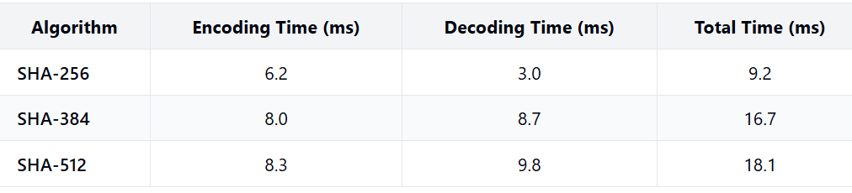
Comparison of Hashing Algorithms
Key Observations:
SHA-256 is the fastest algorithm, completing operations in 9.2ms total
SHA-512 is approximately 2x slower than SHA-256
Higher security comes with performance trade-offs

Slide 21
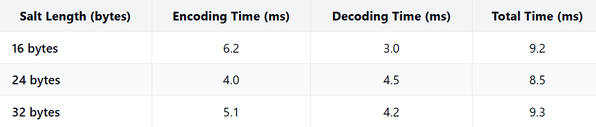
Impact of Salt Length
Key Observations:
Surprisingly, increasing salt length doesn't significantly impact performance
24-byte salt provided the best overall performance in our tests
Security benefit of longer salt comes with minimal performance cost

Slide 22
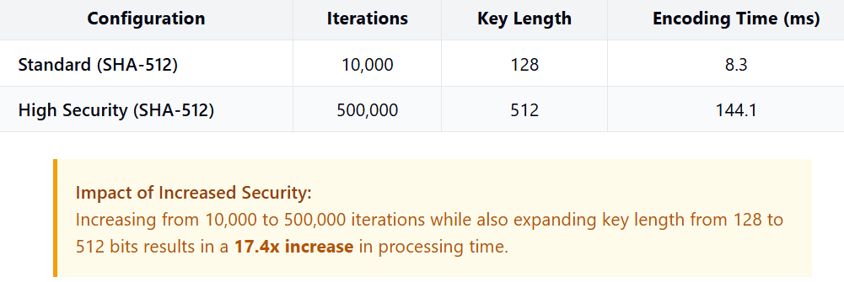
Impact of Iterations and Key Length
Key Observations:
Iterations have the most significant impact on processing time
High security configuration creates substantial delay, enhancing resistance to brute force attacks
The performance impact is approximately linear with iteration count

Slide 23
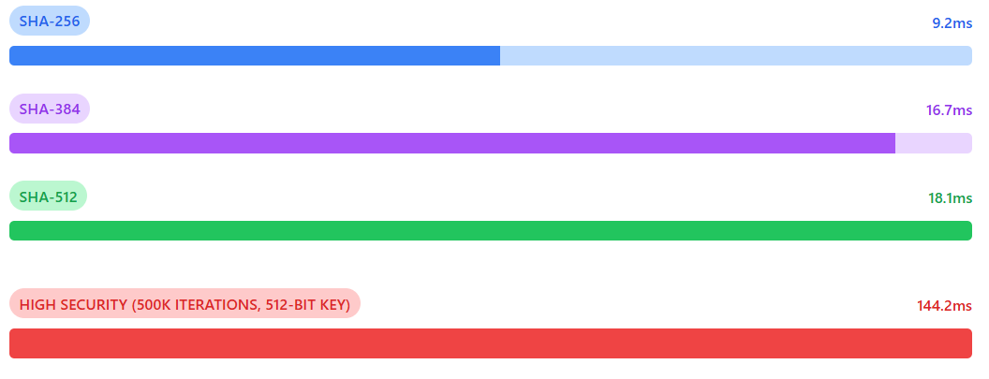
Visual Comparison: Algorithm Performance
Comparison of password hashing performance across configurations. SHA-256 processes fastest (9.2ms), with SHA-384 (16.7ms) and SHA-512 (18.1ms) offering progressively stronger security at moderate time costs. The high-security configuration with 500,000 iterations and 512-bit key (144.2ms) demonstrates the significant performance impact of maximum security settings – approximately 16x slower than the baseline SHA-256 option.

Slide 24
Recommendations
For most web applications
For High-Security Applications
General Best Practices
Use SHA-256 with at least 10,000 iterations
Implement 24-byte salt (good balance of security vs. performance)
128-bit key length is sufficient for most applications
Use SHA-512 with 100,000+ iterations
Implement 32-byte salt or larger
Consider 256-bit or 512-bit key length
Be prepared for 10-15x performance impact
Always use unique salt per password
Consider adaptive hashing functions like Argon2 or bcrypt
Implement rate limiting and account lockouts
Balance security needs with user experience

Slide 25
Technical Challenges
Challenge 1: Browser crypto API limitations
Solution: Strategic use of SubtleCrypto API
Challenge 2: Performance vs security trade-offs
Solution: User-configurable iterations with visual feedback
Challenge 3: Local storage security concerns
Solution: Storing only derived keys, never raw passwords

Slide 26
Live Demonstration
Demo Plan:
Register new user with different iteration counts
Show performance measurements
Login with created user
Change password with different iteration count
Compare old vs new performance

Slide 27
System Limitations
Current Limitations:
Browser-based crypto performance variation
Local storage security constraints
Single-factor authentication only
Edge Cases:
Very long passwords
High iteration counts on low-power devices
Browser compatibility considerations

Slide 28
Conclusion
Summary of Achievements
Security Assessment
Performance Findings
Key Takeaways

Slide 29
Future Improvements
Multi-factor authentication
Advanced password strength requirements
Adaptive iteration counts based on device capability
Server-side implementation option

Slide 30
Thank You
Questions?

