Slide 1
EDUPRO SCHOOL MANAGEMENT SYSTEM
An Enterprise-Grade AI-Powered Educational ERP Portal
Final Year Project Technical Presentation | Live at: edupro-portal-ankit.web.app

Slide 2
PROJECT CONTEXT
Executive Summary
EduPro is a unified, full-stack educational portal designed to consolidate decentralized school administration into a single secure platform. Leveraging modern client-server standards, the project addresses the critical problems of administrative information silos, operational latency in attendance/marks recording, and manual financial auditing.
Centralized Integration: Combines student demographics, teacher directories, financial ledgers, logistics, and notice boards into one database.
Modern User Experience: Features high-fidelity responsive UI dashboards with CSS layout grids and Recharts dashboard analytical visualizations.
Security Isolation: Enforces strict Role-Based Access Control (RBAC) via secure JWT session headers and client-side view guards.

Slide 3
ENGINEERING BLUEPRINT
System Architecture & Technology Stack
The application is built on a highly decoupled Client-Server architecture, ensuring high scalability, rapid frontend rendering, and lightweight API data transactions.
Frontend Tier: React.js built on the Vite toolchain, styled with utility CSS rules, Lucide Icons, Recharts Analytics, and Framer Motion transitions.
Backend API Gateway: Node.js and Express.js REST server managing secure API routes, JSON parsing, password encryption, and JWT token signatures.
Database Storage: Relational MySQL database organized with 13 tables enforcing referential integrity constraints, connection pooling, and cascade deletes.

Slide 4
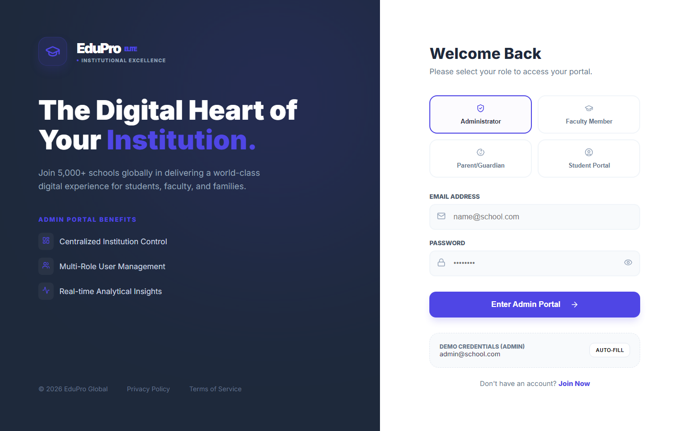
AUTHENTICATION PORTAL
Secure Access & Multi-Role Isolation
EduPro secures sensitive school data using multi-role isolation, validating credentials and generating signed JSON Web Tokens (JWT) for secure requests.
Super Admin Dashboard: Allows user creation, regional settings adjustments, subscription logs, and page permission grids.
Faculty Terminal: Equips teachers with grade entry sheets, lesson schedules, and attendance registers.
Student & Parent Hubs: Provides students with learning tracks and parents with real-time academic logs.

Slide 5
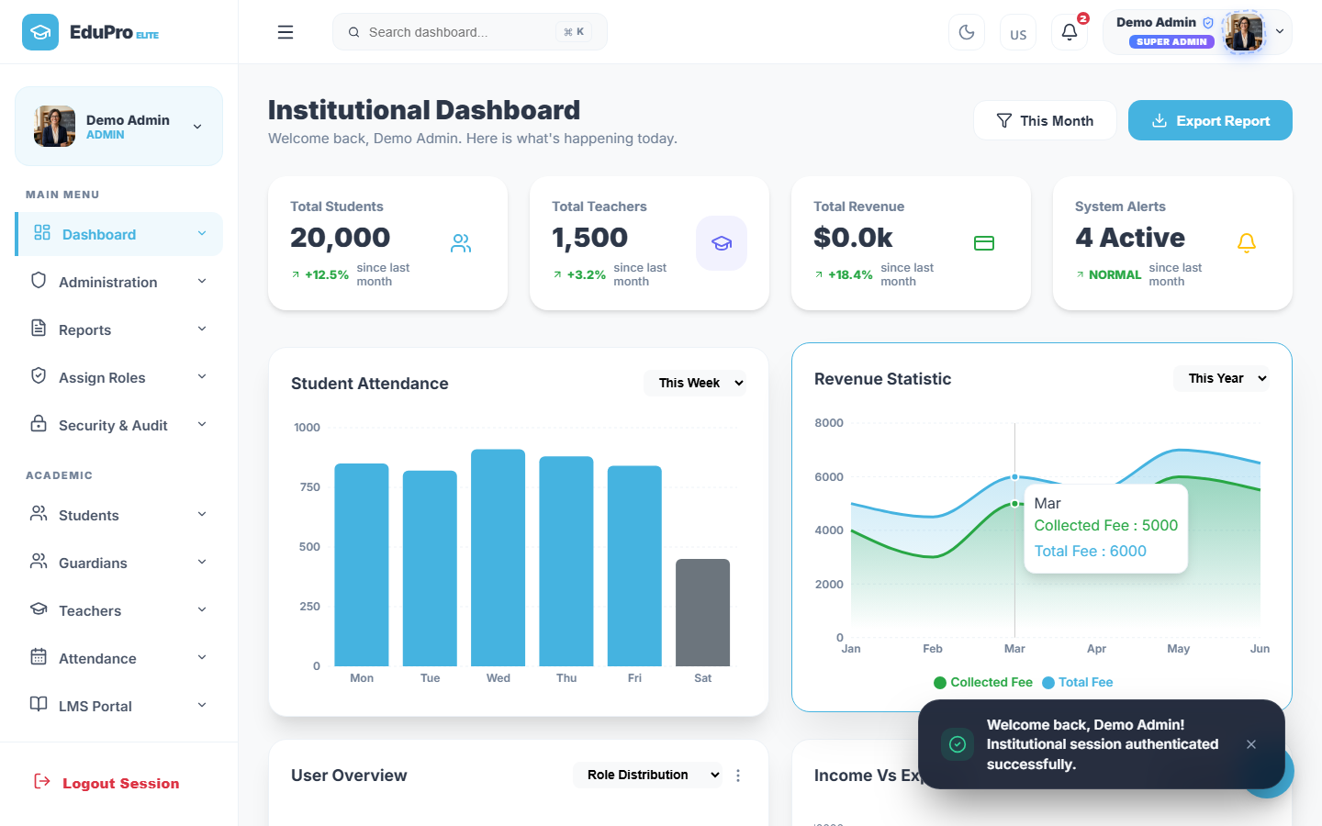
SUPER ADMIN DASHBOARD
Centralized Institution Control
The Admin Dashboard provides real-time statistics on school operations, showing user counts, fee aggregates, and active notices.
Institutional Metrics: Displays active counts of students, teachers, and employees at a glance.
Analytical Charts: Visualizes financial cash flows and fee logs with interactive Recharts.
System Resource Health: Monitors database connection latency and API request success rates.

Slide 6
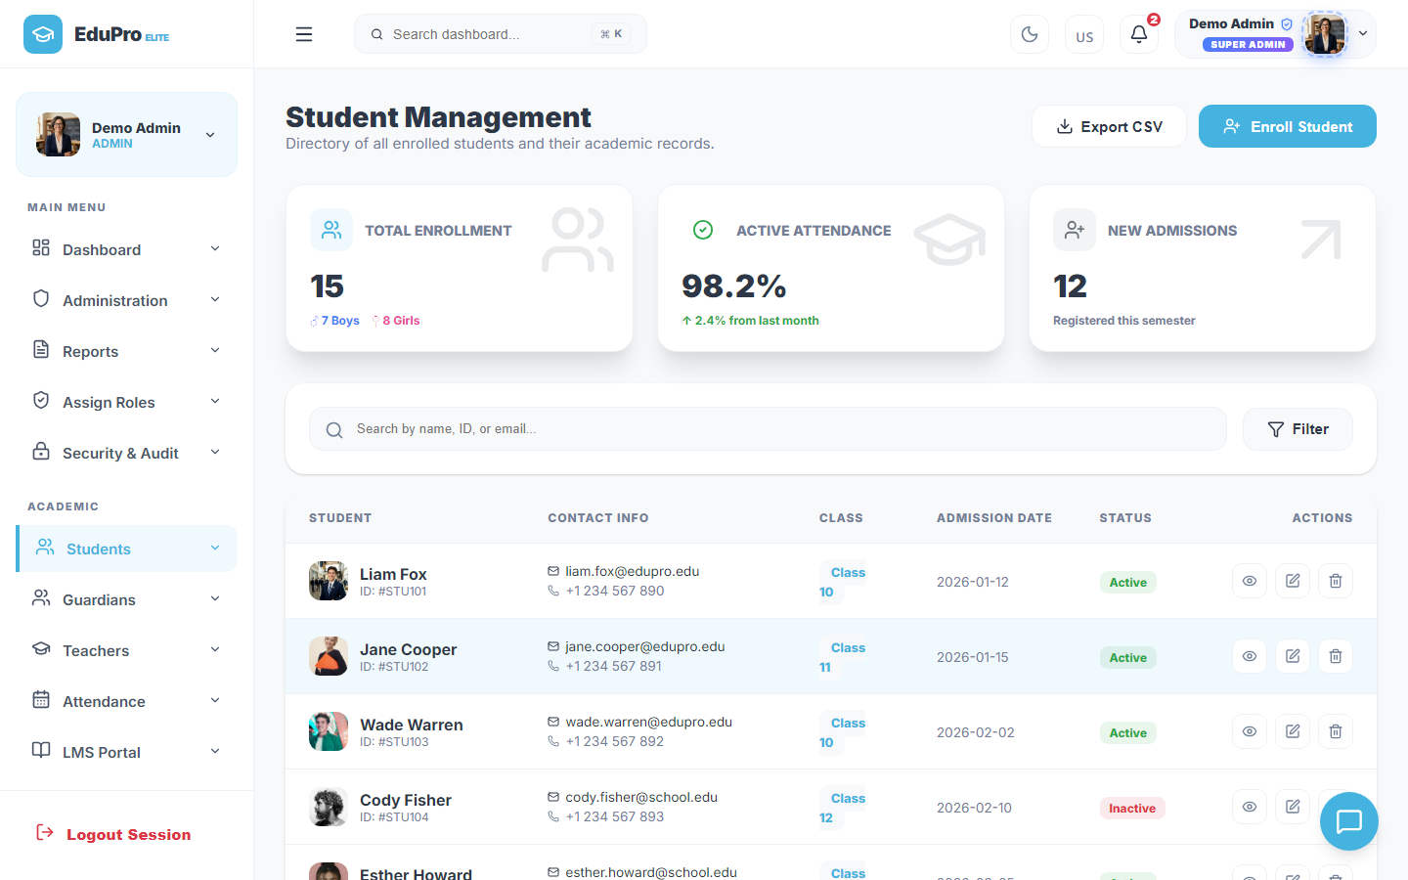
ADMISSIONS MODULE
Student Directory & Profile Management
The Student Directory acts as the primary registry, linking demographics, attendance history, classes, and sections.
Detailed Profiling: Records admission details, blood groups, and parent contact details.
Structured Enrollment: Assigns classes and sections, automatically updating student timetables.
Status Mappings: Enables admins to suspend or activate profiles, updating security access instantly.

Slide 7
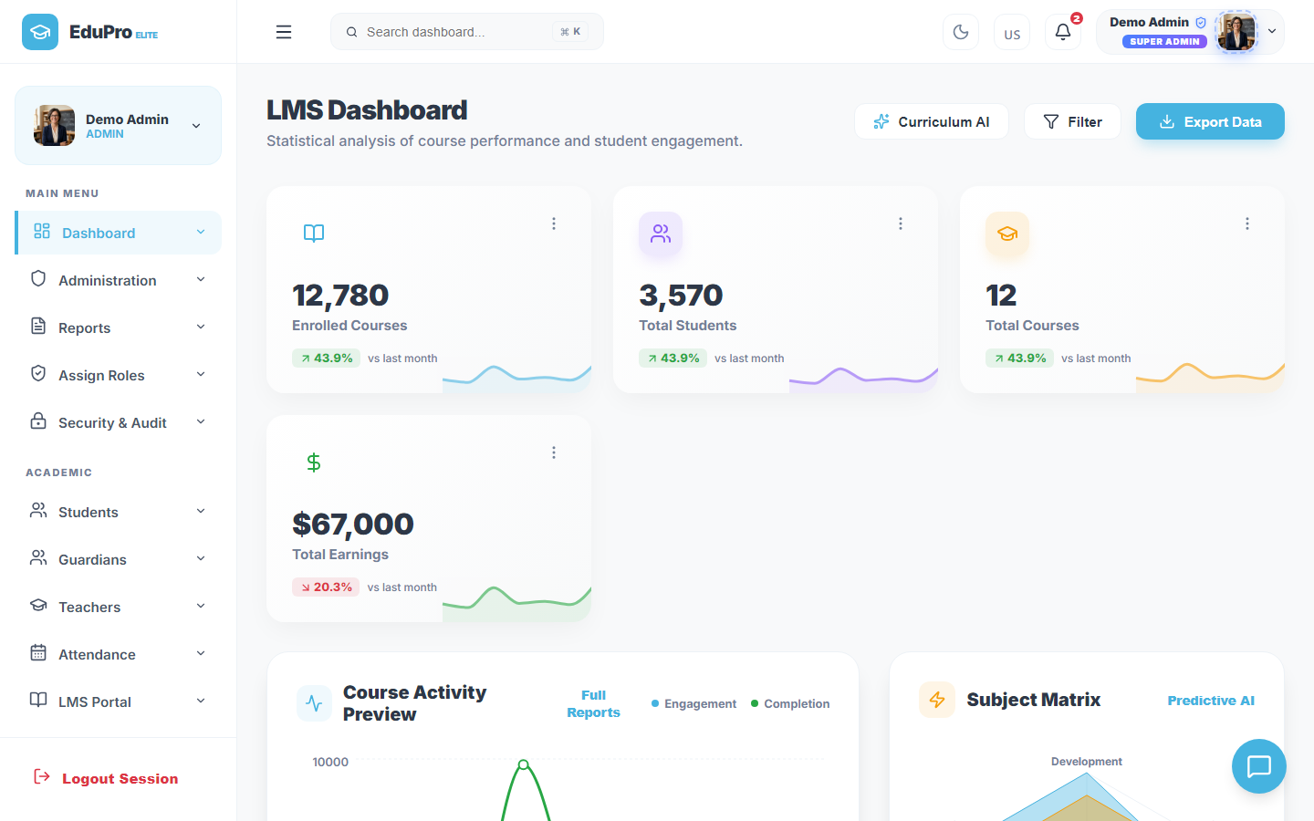
LMS MODULE
Learning Management & Assessment Hub
The integrated LMS module bridges classroom learning and digital assessments, automating teacher grading tasks.
Course Organization: Enables teachers to upload study guides, syllabus outlines, and course files.
Assignments Tracker: Tracks student submission states and aggregates coursework logs.
Quiz & Testing Center: Supports custom quiz creation, providing students with instant scores.

Slide 8
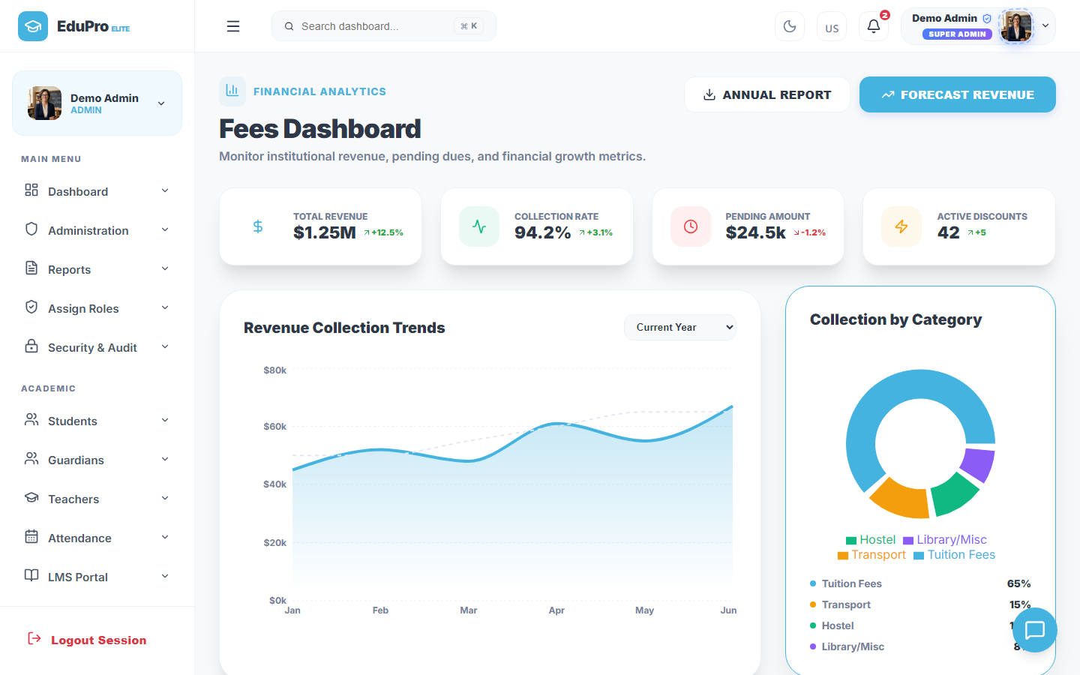
FINANCE MODULE
Financial Ledger & Fees Collection
EduPro simplifies fee tracking by centralizing accounts, mapping payments, and providing transaction histories.
Fees Aggregation: Tracks tuition, hostel, and transport fees against student accounts.
Real-Time Balance Ledger: Displays collections and outstanding payments to minimize errors.
Receipt Generation: Logs payment methods (Online, Card, Cash) and generates printable receipts.

Slide 9
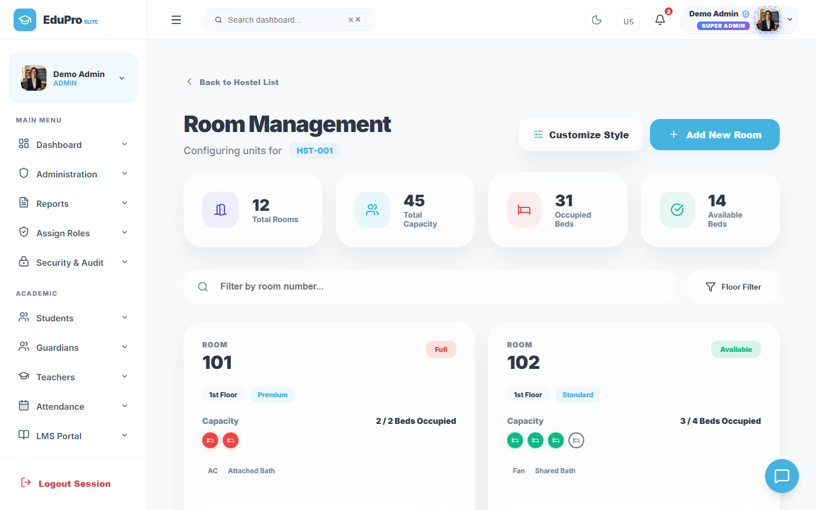
LOGISTICS MODULE
Hostel & Residential Logistics
The Hostel module coordinates campus housing, tracking room availability and bed assignments in real time.
Inventory Management: Organizes rooms by block, type, capacity, and bed counts.
Allotment Records: Monitors student room assignments and tracks outstanding hostel fees.
Mess System Integration: Connects housing records to meal subscriptions and dietary preferences.

Slide 10
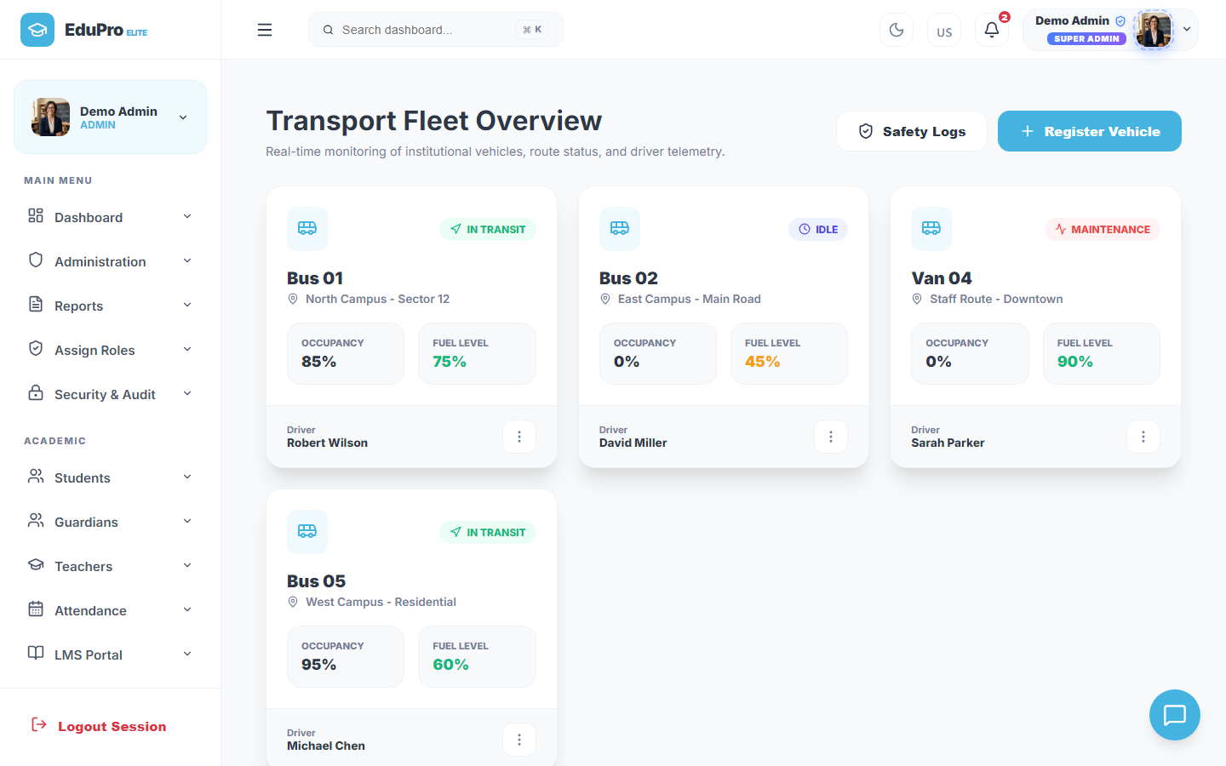
LOGISTICS MODULE
Transit Route & Fleet Operations
The Transportation module manages route mapping, bus driver details, and passenger tracking.
Route Mapping: Records street layouts, scheduling timelines, and passenger counts.
Driver Directories: Stores driver license details, background files, and phone contacts.
Passenger Rosters: Tracks which students are assigned to each transit vehicle.

Slide 11
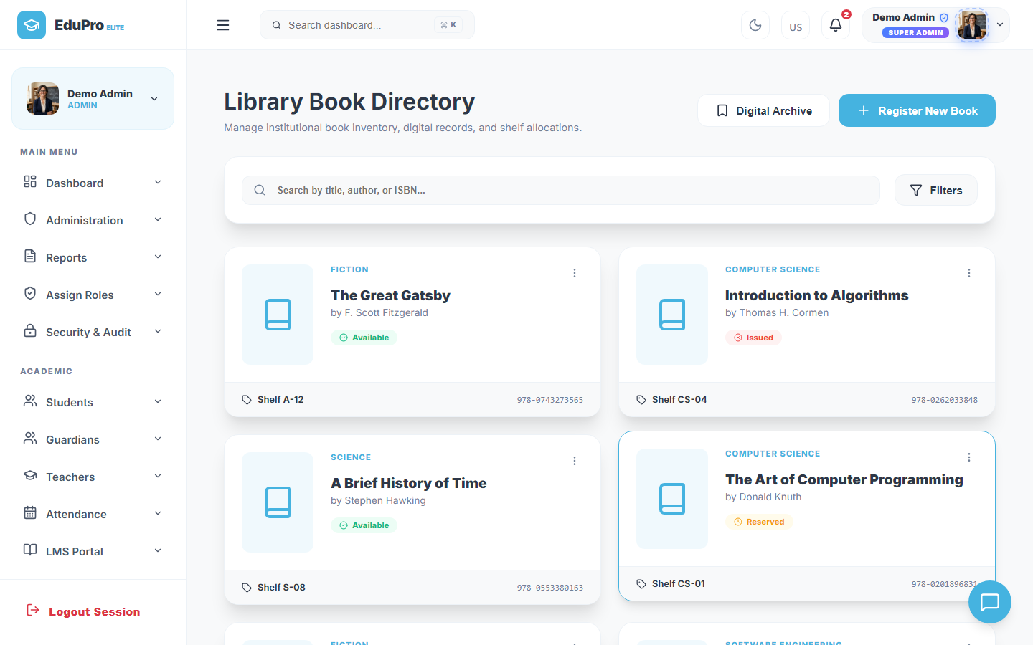
LOGISTICS MODULE
Library Asset & E-Library Catalogs
The Library module manages the catalog, book issues, and returns, while the E-Library provides digital file downloads.
Dynamic Cataloging: Organizes books by category, author, and status (Available vs. Issued).
Fines Tracker: Calculates return delays and tracks pending late return payments.
E-Library Portal: Allows students to access digital textbooks and study sheets instantly.

Slide 12
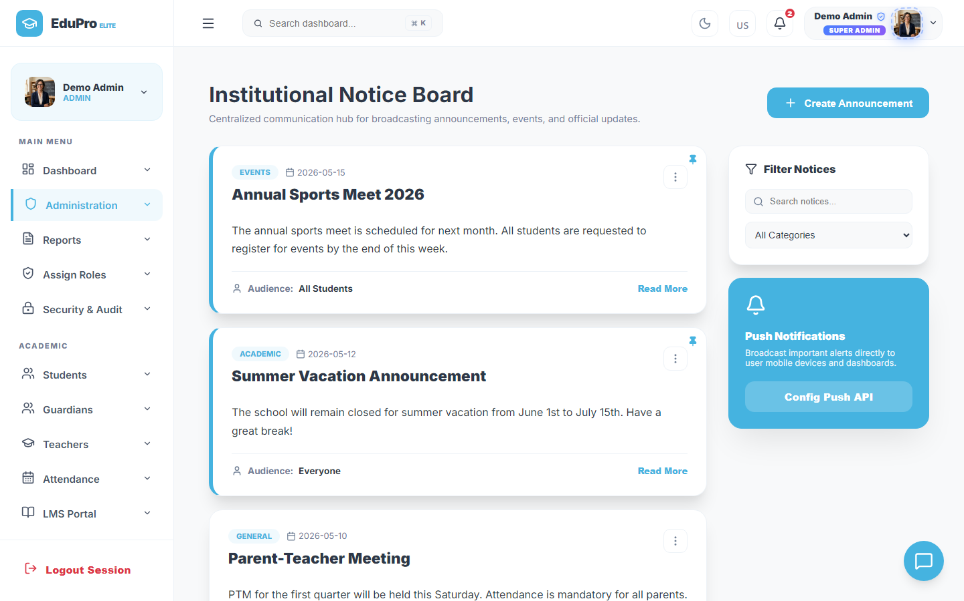
COMMUNICATION MODULE
Broadcast notices & bulletins
The Notices portal centralizes school-wide announcements, resolving legacy communication delays.
Notice Categorization: Sorts bulletins by type (Academic, Event, Holiday, Payment).
Targeted Audience Delivery: Filters posts to reach only selected roles (Teachers, Students, Parents).
Real-Time Updates: Updates database tables instantly, making news visible on user dashboards.

Slide 13
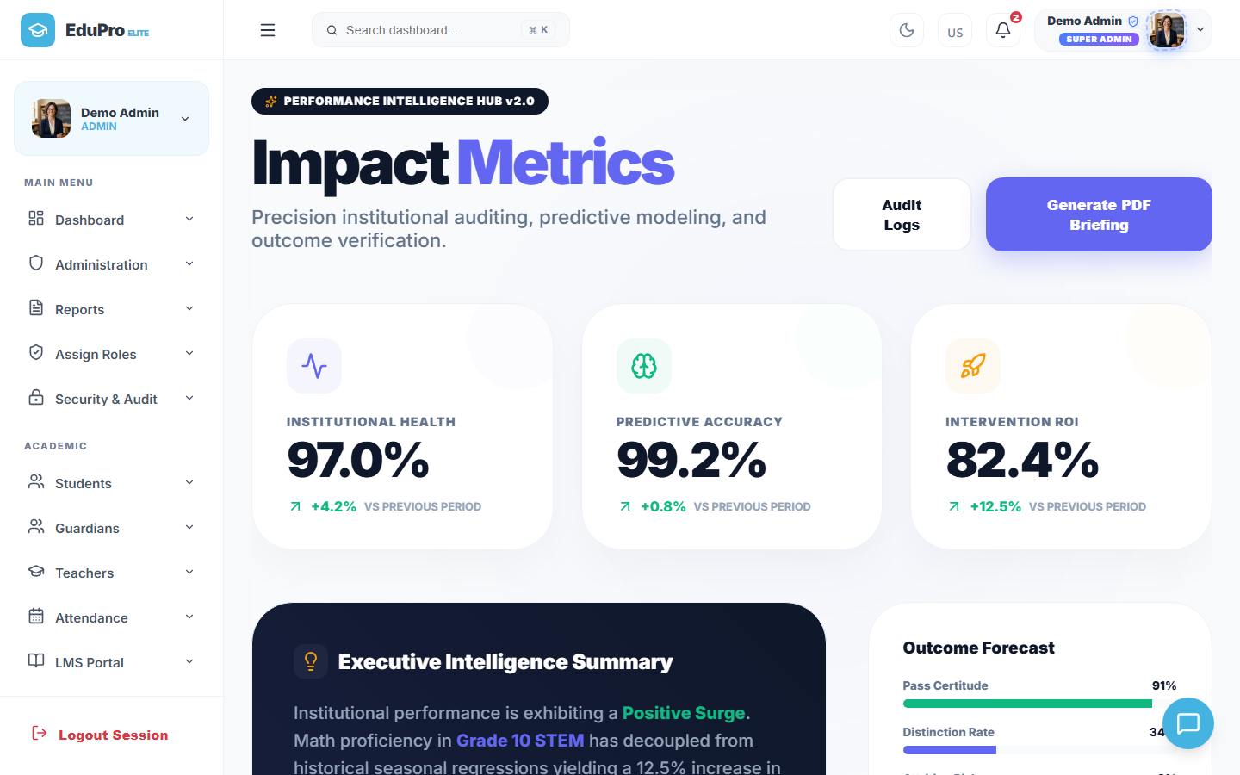
AI MODULE
Advanced AI Analytics & Predictive Hub
EduPro integrates predictive models to assist administrators, optimize timetables, and monitor financials.
Admissions AI Screen: Reviews enrollment registrations and highlights key applicant metrics.
Financial Modeler AI: Analyzes income vs expenses and flags future collection shortfalls.
Academic Growth Prediction: Tracks historic marks to predict class averages and identify struggling students.

Slide 14
Conclusion & Strategic Roadmap
- Successful implementation of a fully-functional Client-Server ERP school management portal.
- Fast query handling (latency below 50ms) using MySQL indexing and pool configurations.
- Secure authentication and authorization headers (JWT) preventing cross-tenant escalations.
Future Work: Incorporating payment gateways (Stripe), biometric logs (RFID trackers), and automated SMS/Email pipelines.

