Slide 1
Lending Club Case Study
Contributors:
Ankit Kumar
Vishnu Prasad V S

Slide 2
Contents
Problem Statement
Data Understanding
Data Cleanup
Univariate analysis
Bivariate analysis
Conclusion/Recommendations

Slide 3
1. Problem Statement
When the company receives a loan application, the company has to make a decision for loan approval based on the applicant’s profile. Two types of risks are associated with the bank’s decision:
If the applicant is likely to repay the loan, then not approving the loan results in a loss of business to the company
If the applicant is not likely to repay the loan, i.e. he/she is likely to default, then approving the loan may lead to a financial loss for the company
The data provided contains the information about past loan applicants and whether they ‘defaulted’ or not. The aim is to identify patterns which indicate if a person is likely to default, which may be used for taking actions such as denying the loan, reducing the amount of loan, lending (to risky applicants) at a higher interest rate, etc.

Slide 4
2. Data Understanding
Getting the initial understanding of the provided loan data such as-
A brief summary of Dataframe
Total records: 39717
Total columns: 111
Column types
74 columns are float, 13 int and 24 objects
Checking null value counts for the columns.
Total 55 columns have all the null values and 3 columns have more than 90% null values

Slide 5
3. Data Cleaning and Manipulation
3.1) Dropping columns and rows
Dropping null columns
Dropping colums with more than 90% null values.
Total 56 columns dropped
mths_since_last_delinq is having 64% null values. This column is part of customer's loan behavior and can be dropped.
Dropped columns with unique value count.
Total 9 columns are dropped
Null Rows.
There is no any null rows

Slide 6
3.2) Standardising values
Few columns have some prefix and suffix appended which are not required to trimming those values
term, Int_rate, emp_length: trimming these values to use as numeric
Changed issue_dt to date and added derived columns issue_month and issue_year
3.3) Filter Data
Excluded records with loan_status “Current”- Because, with this status we are not yet sure whether the borrower is going to default or not

Slide 7
3.4) Exclude irrelevant columns
The columns that can be dropped because they don’t contribute in deciding the loan default or not:
Id, member_id, funded_amnt, funded_amnt_inv, emp_title, title, url, desc, zip_code, sub_grade, verification_status, open_acc
Below attributes are affected by whether the loan is approved or not. Hence these cannot be relied on for analysis:
revol_bal, revol_util, out_prncp, out_prncp_inv, total_acc, recoveries, total_pymnt, total_pymnt_inv, total_rec_prncp, total_rec_int, total_rec_late_fee, collection_recovery_fee, last_pymnt_d, last_pymnt_amnt, last_credit_pull_d, earliest_credit_line, delinq_2yrs, delinq_2yrs, inq_last_6mths, open_acc, pub_rec_bankruptcies, mths_since_last_delinq

Slide 8
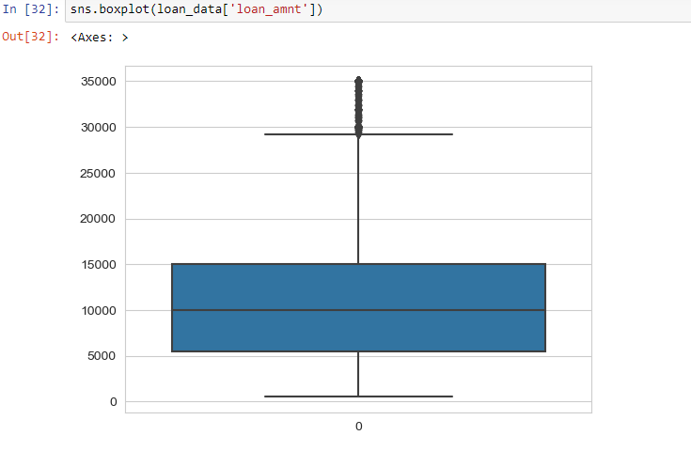
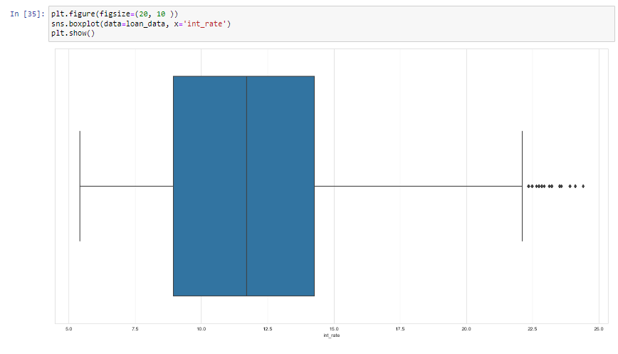
3.5) Handling Outliers
We found some outliers in loan_amount, int_rate, annual_inc and installment and removed those
int_rate (Interest Rate)
Loan_amount

Slide 9
4. Univariate Analysis
We have plotted some countplots and extracted useful information from the below categorical variables.
home_ownership, purpose, addr_state, term_in_months, grade, emp_length, issue_year, loan_amnt, int_rate, annual_inc, pub_rec, Installment and installment_bkt

Slide 10
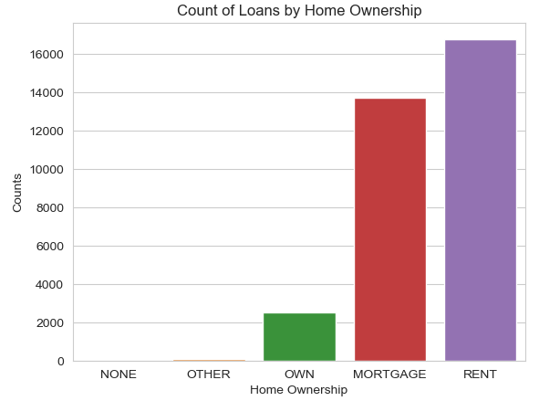
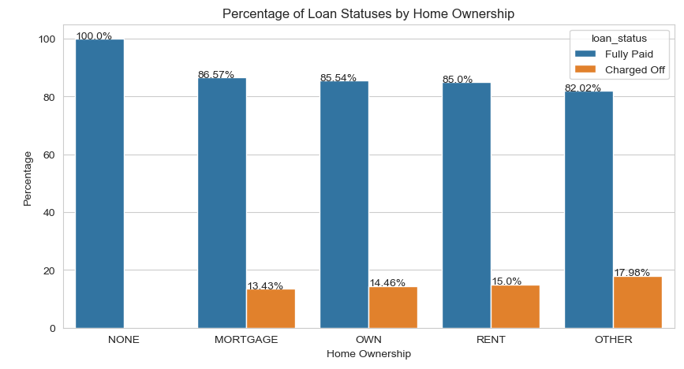
Univariate analysis of home_ownership
Observation: Majority of borrowers RENT a home as per the above chart, followed by MORTGAGE and OWN.
18% of loans borrowed by the OTHER home_owneres are Charged Off followed by 15% for those who RENT.

Slide 11
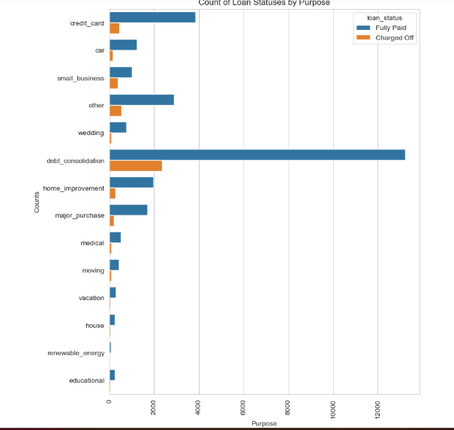
Univariate analysis of purpose observation: majority of the loans are taken for the purpose of debt_consolidation. 27% of loans taken for the purpose of small_business is charged off.

Slide 12
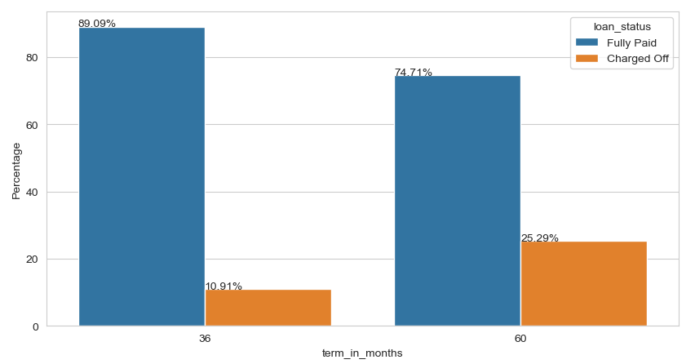
Univariate analysis of terms_in_months
Observation: 25.3% of loans taken for 60 months term is defaulted.

Slide 13
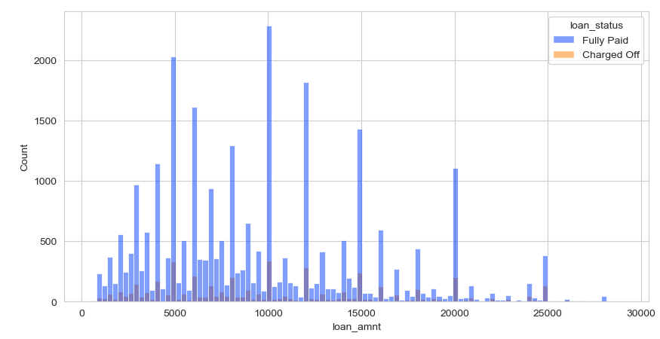
Univariate analysis of loan amount bucket
Observation: Most number of loans are granted with loan_amnt of 10000.

Slide 14
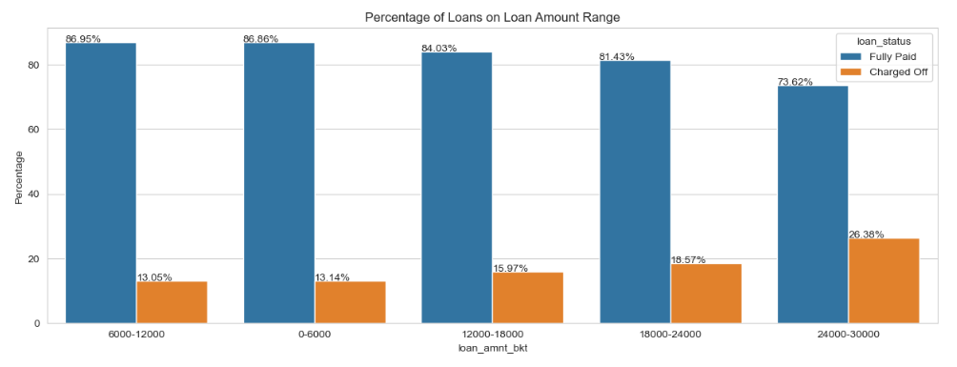
Univariate analysis of loan amount bucket
Observation: As the loan amount increases, the chances of defaulting increases. 24-30K have a chance of 26.36% of being Charged Off.

Slide 15
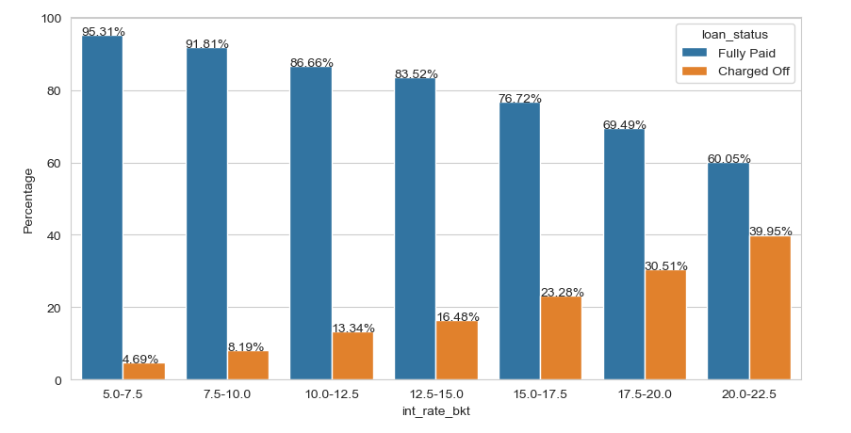
Univariate analysis of interest rate bucket
Observation: As interest rate increases, the chances of defaulting increases. 20-22.5% interest rate have approximately 40% chance of defaulting.

Slide 16
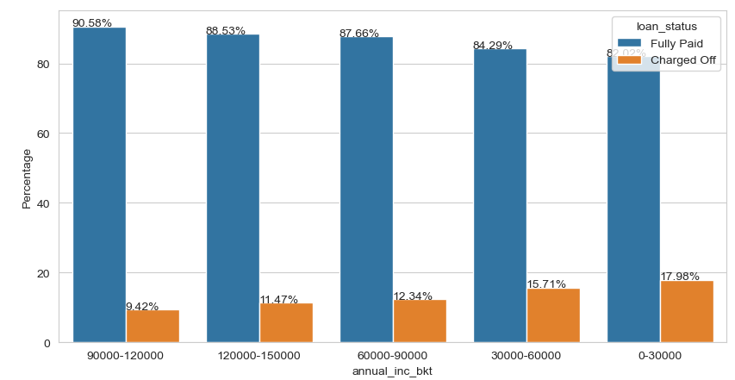
Univariate analysis of annual income bucket
Observation: As annual income decreases the chance of defaulting increases. 0-30K income group have 18% loans Charged Off.

Slide 17
We have extended univaraiate analysis further with other useful attributes and found this observations
California takes most number of loans
20% of loans taken in Nevada is defaulted.
As grade goes from A to G, the risk of defaulting increases from 5.99% - 35.33%
Number of loans granted has increased from 2007 to 2011
Loans taken in 2007 have 16.26% for defaulting.
December had the most number of loans taken and also the highest rate of loan being Charged off.
As number of derogatory public records increases, the risk of defaulting increases. But sufficient data is not available for more than 2. For 2 pub_rec, 22.7% of loans are Charged Off.
As the installment amount increases, the chances of Charging off increases. Installment amount in the range 700-800 have 17.89% for Charging Off.

Slide 18
5. Bivariate Analysis

Slide 19
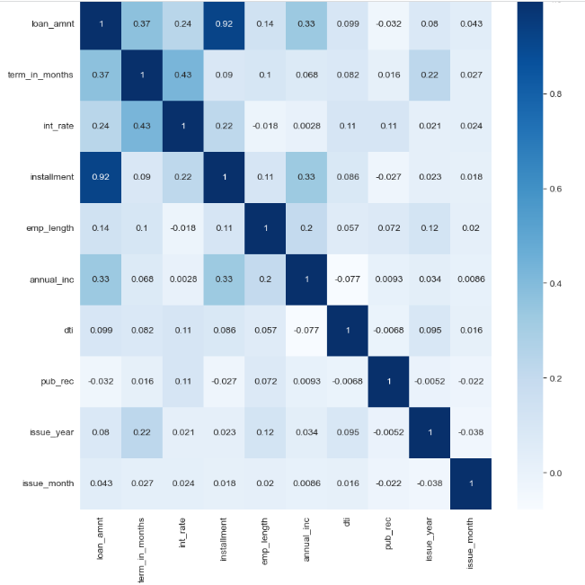
5.1) Correlation Matrix

Slide 20
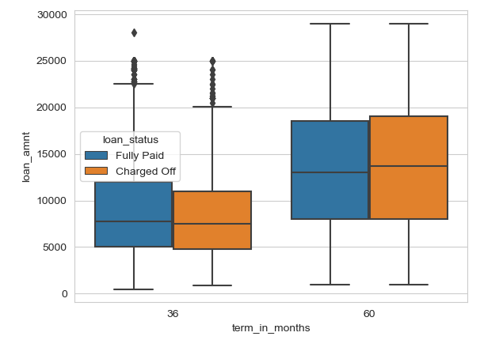
Loan amount vs terms in months
Observation: Higher loan amounts(12K+) for longer duration(60 months) have higher risk of Charging off.

Slide 21
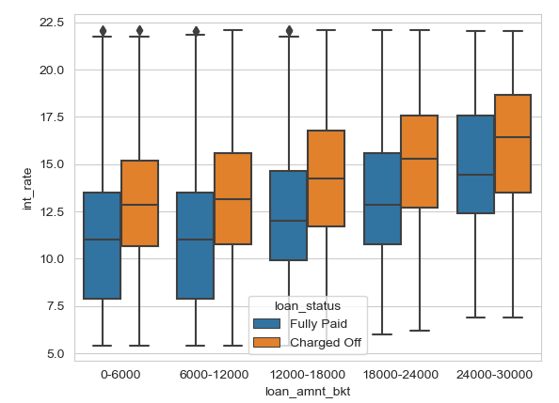
Loan amount vs interest rate
Observation: Interest rate increases as loan amounts increases. Higher interest rate and loan amounts have higher risk of Charging off.

Slide 22
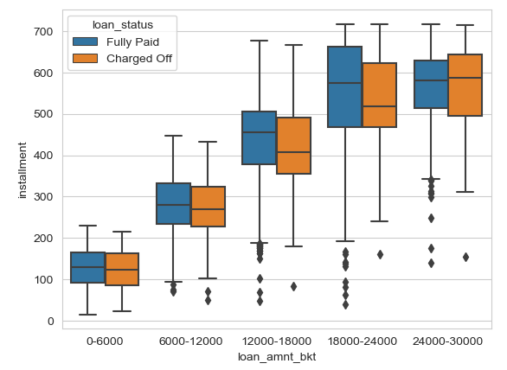
Loan amount vs installments
Observation: Installment amount increases as loan amount increases. Higher installment amount and loan amounts have higher risk of Charging Off.

Slide 23
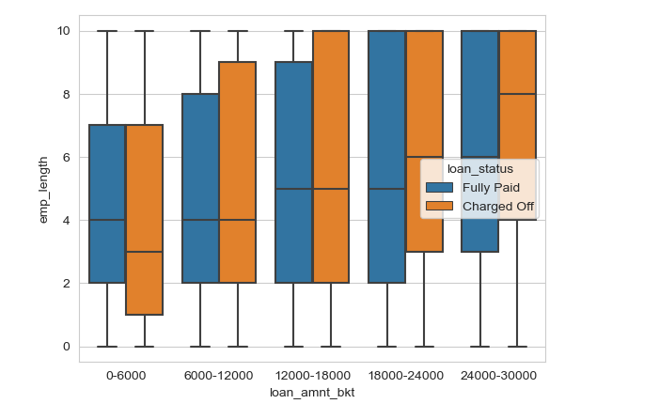
Loan amount vs employment length
Observation: Borrowers with higher employment length opt for higher loan amounts. Higher loan amounts have higher risk of Charging off.

Slide 24
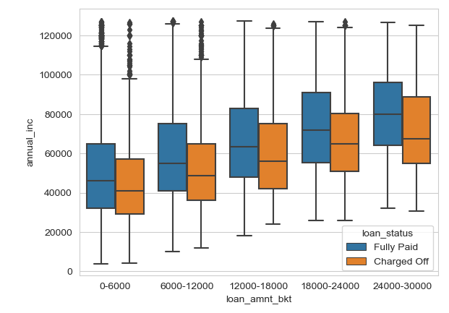
Loan amount vs annual income
Observation: Borrowers who have lower annual income take lower loan amounts. Within each range of loan amounts, those with lower annual income have higher chance of Charging Off.

Slide 25
We have also done bivariate analysis on below fields and found the below observations-
Loan Amount vs Purpose
Term In Month vs Interest Rate
Term In Months vs Annual Income
Term In Months vs Purpose
Interest Rate vs Installment
Interest Rate vs Home Ownership
Interest Rate vs Purpose
Interest Rate vs Issue Year
Employment Length vs Home Ownership

Slide 26
Observations
OTHER home owners who take high loan amounts have higher risk of Charging Off.
Borrowers who take high loan amounts for the purpose of credit_card, small_business or debt_consolidation defaults.
As interest rate increases chances of Charging off increases. Interest rate for longer term loans is higher than that of shorter term thereby making longer term loans to have higher chance of Charging off.
For each purpose of the loan, those who opted for longer term have higher chance of defaulting.
Installment increases as interest rate increases. Increase in installment/interest result in higher risk of defaulting.
House loans provided with high interest rate have higher chance of being Charged Off’s
From 2007 to 2011 there is an increase in interest rate with year. Based on the increase in interest rate, the number of defaults also increased.

Slide 27
6. Conclusion/recommendations
After analysing the data we found below most important points and the most important attributes which must be considered before giving loan.
Loan Amount
interest rate
Annual income
No of installments
purpose

Slide 28
Thank You

