Slide 1

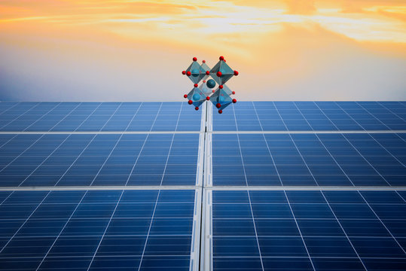
INDIAN INSTITUTE OF ENGINEERING SCIENCE AND TECHNOLOGY, SHIBPUR
PEROVSKITE
PRESENTED BY
GUIDED BY
ANKIT KUMAR [2021MMB013]
2ND YEAR [3RD SEMESTER]
DR. AVISHEK KUMAR
METALLURGY AND MATERIALS ENGINEERING

Slide 2
Content
Introduction
Chemical Formula
Origin
Structure
Manufacturing
Energy Band Gap Diagram
Why Semiconductor
Applications
Properties
Compare with Silicon
Disadvantages
Future
Conclusion
PEROVSKITE
2

Slide 3
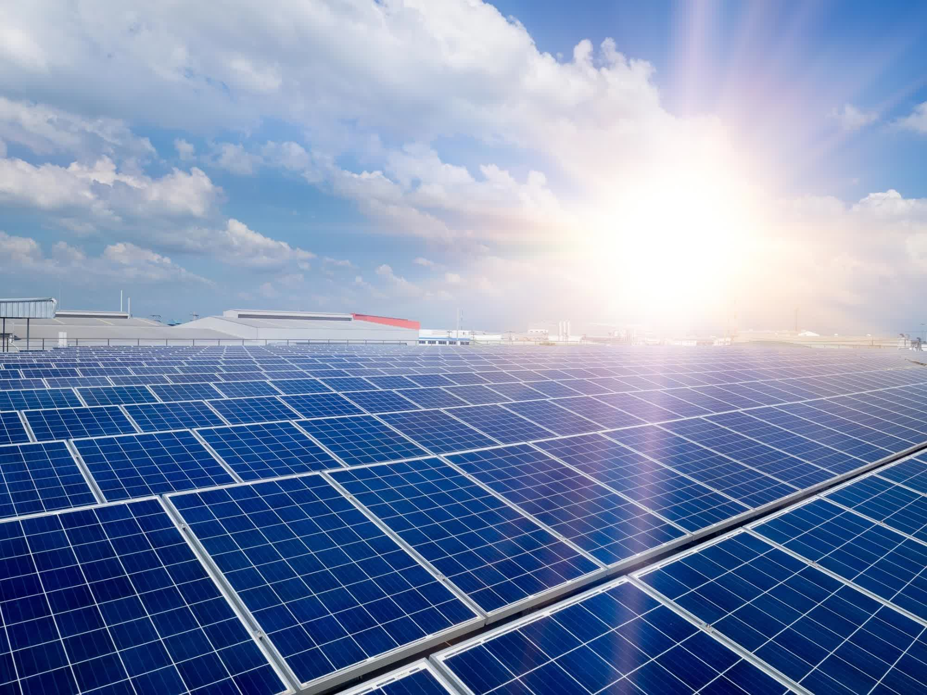
INTRODUCTION
Perovskite is a solar cell. Solar cells capture the energy from the sun and then convert it to electricity. It is used to transport the electric charge whenever the light hits the material. Perovskite also absorbs high-energy blue photons from sunlight. It is the material that has the same crystal structure as calcium titanium oxide and calcium titanate was the 1st mineral with a perovskite structure. A large number of different elements can be together to form perovskite structures.
PEROVSKITE
3

Slide 4
CHEMICAL FORMULA
Chemical Formula: ABX₃
Where: A and B are Cations and X are Anion.
Cation A is located at the 8 corners of the cube. Cation B is located at the Centre of the cube i.e., in octahedral position and Anion X is located at every 6 faces of the cube.
Examples: Calcium Titanate [CaTiO₃], Barium Titanate [BaTiO₃], and Calcium Silicate [CaSiO₃].
PEROVSKITE
4

Slide 5
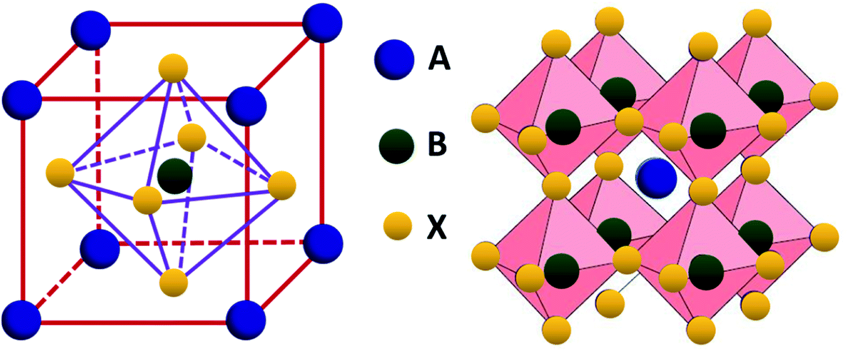
STRUCTURE
PEROVSKITE
5

Slide 6
ORIGIN
It was discovered by German Mineralogist Gustav Rose in 1839 and Named after Russian Mineralogist Lev Perovski, hence Perovskite.
PEROVSKITE
6

Slide 7
MANUFACTURING
Perovskite is manufactured by two-step processing.
First Step Processing: A perovskite solution is prepared by mixing lead halide and organic halide through various coating methods such as spin coating, spraying, and blade coating to form perovskite film. This is simple and fast but it is more challenging to control the perovskite film uniformly and with quality.
Two-Step Processing: In this method, first deposit the lead halide film and then reacts with organic halide to form perovskite film. In this method, Perovskite film is better film quality because of volume expansion during the convention of lead halide.
PEROVSKITE
7

Slide 8
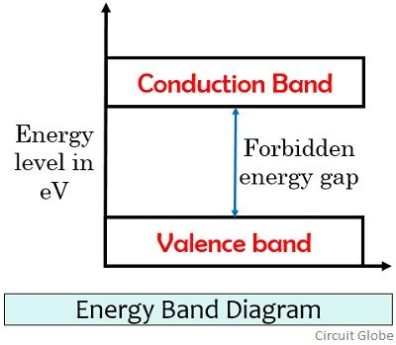
ENERGY BAND GAP DIAGRAM
PEROVSKITE
8

Slide 9
WHY SEMICONDUCTOR
In a Conductor, the energy band gap between the valence bond and conduction bond is negligible, so electrons can be ejected very easily. And In Insulator, the energy band gap between the valence bond and conduction bond is very large. So, more energy is required to eject out the electrons.
The Semiconductor lies between the conductor and the insulator. The energy band gap between the valence bond and conduction bond of the semiconductor is less. So, Photons can easily eject electrons. Due to the presence of PN Junction, there is an electric field present in the semiconductor because without it the solar cells won’t work. The electrons and holes try to mix but they are not able to mix completely, otherwise, the junction will become neutral and will be of no use. When a few holes and electrons are combined and go toward the opposite charge, repulsive force comes into play because of heavy rush of like charges. That’s why semiconductor is used in solar cells.
PEROVSKITE
9

Slide 10


APPLICATIONS
1. LED
Light Emitting Diode (LED): Light Colour depends on the band gap. As the band gap increases frequency increases. The Band gap of the visible region is 2 to 3 electron volts. If the band gap is more than 3 electron volts, then light is emitted in the ultraviolet region and less than 2 electron volts then light emits in the infrared region.
Example: The Band gap of Gallium Nitride (GaN) is 3.4 electron volts, and we see the blue colour.
LED has low energy consumption.
Impact Resistant
Long Lifespan
PEROVSKITE
10

Slide 11

2. PHOTOVOLTAICS
Photovoltaics (PV): Photo means visible light and voltaic means electricity. Photovoltaic Produces electricity from visible light. PV is made up of several panels, with each generating around 200-350 watts of energy in strong sunlight. PV cells need an electric field.
Limitation: It generates only a small amount of current. Therefore, we need a complete solar PV system rather than just PV cells.
PEROVSKITE
11

Slide 12
PROPERTIES
Ferroelectric Perovskite Oxides [BaTiO3]→ Exhibit large non-linear optical coefficients.
Large Dielectric constant.
Strong e⁻-e⁻ interaction.
Because strong e⁻-e⁻ interaction are dependent on structure and finite size.
PEROVSKITE
12

Slide 13
COMPARE WITH SILICON
Manufacturing of perovskite at a cost of around $0.25 per square foot. And for silicon around $2.5 per square foot is needed to produce a crystalline silicon panel. So, Perovskite is much cheaper than Silicon.
Silicon required more heat but Perovskite doesn’t require heat and can be manufactured with much thinner layers. They can also work with almost all visible wavelengths, resulting in more efficient transport, recombination, and extraction of charges than Silicon cells.
The Perovskite layer is only 0.5 microns thick while the Silicon layer is approximately 200 microns.
Perovskite cells are small, fragile, and degrade much faster than Silicon crystal panels.
PEROVSKITE
13

Slide 14
The increased efficiency and decreased manufacturing costs of Perovskite solar cells decrease the price of solar panels [by approximately $4.22 per kilowatt-hour per Silicon].
The Band gap of Perovskite [1.5-1.7 electron volt] is high as compared to Silicon [1.1 electron volt]. Silicon captures more energy from the sun than Perovskite. A Higher band gap will provide a higher operating voltage.
Silicon solar cell is heaviness than Perovskite.
Perovskite is lightweight, has flexibility, low fabrication costs, and higher tolerance to radiation than Silicon.
PEROVSKITE
14

Slide 15
DISADVANTAGES
Perovskite material breaks down quickly due to exposure to heat, moisture, and snow.
Degradation issue of Methyl Ammonium Lead trihalide.
The main issue of Perovskite solar cells are film quality and thickness.
PEROVSKITE
15

Slide 16
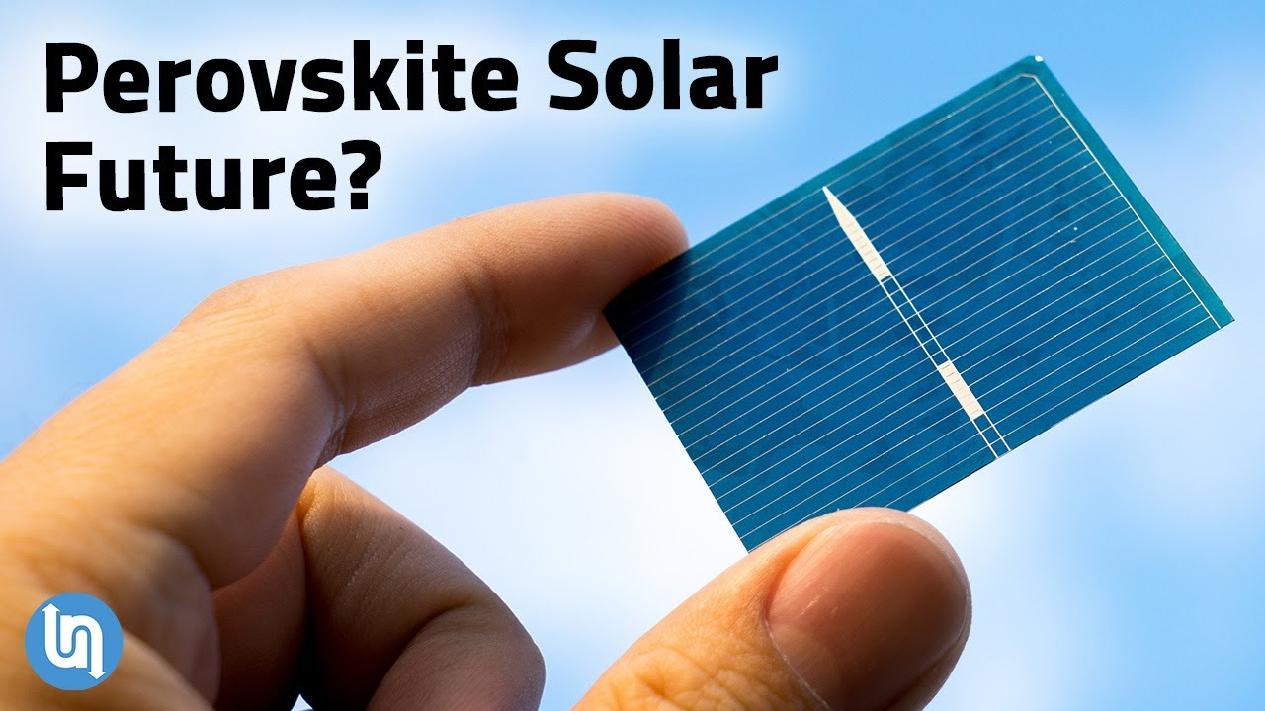
FUTURE
Perovskite solar cells shows remarkable growth in recent years with rapid growth in efficiency from 3% in 2009 to more than 25% in 2022. So, I think Perovskite is going to be one of the top solar cell materials in the coming years. The presence of toxic lead is one of the main reasons, why we don’t see it in the market yet because toxic lead harms the environment. If this problem is solved, then we will see Perovskite solar cells in the market very soon because Perovskite is easier to manufacture and low cost compared to other solar cells.
PEROVSKITE
16

Slide 17
CONCLUSION
Perovskite is easier to manufacture, very fast degrade, and is low cost compared to other solar cells. Perovskite shows remarkable growth in recent years. So, we are not far to see perovskite in the marketplace.
PEROVSKITE
17

Slide 18


