Slide 1
STEEL AUTHORITY OF INDIA LIMITED
SAIL Vocational Training Project Report
CSV Comparison Tool
An Employee Data Comparison & Audit Utility for BSL, Bokaro Steel Plant
By: Ankit Kumar | B.Tech CSE, IILM University, Greater Noida
Guided by: Mr. Chandan Kumar, AGM (C & IT), SAIL Bokaro Steel City
Vocational Training Duration: 02 June 2025 – 28 June 2025 | URN: 5913893

Slide 2
Introduction & Organizational Context
Steel Industry & SAIL
Training Snapshot
India is the 2nd-largest crude steel producer in the world.
SAIL is a leading public sector undertaking, supporting over 2 million jobs directly and indirectly.
Bokaro Steel Plant (BSL) is SAIL's 4th integrated steel plant, with a liquid steel capacity of 5.25 MT, expanding to 7.55 MT by 2025.
IT drives automation (SCADA/DCS), ERP systems, predictive maintenance, and quality analytics across the plant.
Location
SAIL Bokaro Steel Plant, C & IT Department
Duration
4 weeks (02 Jun – 28 Jun 2025)
Domain
Employee / HR & Payroll Data Auditing
Dataset Scale
Validated with 932+ live employee records
Deliverable
Desktop CSV Comparator built in Python
CSV Comparison Tool | SAIL Vocational Training
2

Slide 3
Abstract & Problem Statement
ABSTRACT
A desktop application built with Python's Tkinter that compares master and updated (slave) CSV/Excel datasets, automatically detecting field-level changes and new records — with real-time search, navigation, and one-click Excel report export for HR, finance, and IT audit teams.
PROBLEM STATEMENT
Manually comparing large CSV files to spot updates, new entries, or errors is slow, error-prone, and unscalable — existing spreadsheet tools lack detailed field-level tracking.
1
2
3
4
5
Compare files by unique key columns
Detect field-level differences
Identify new entries in either file
User-friendly browsing & search UI
Export results to readable Excel
CSV Comparison Tool | SAIL Vocational Training
3

Slide 4
Technology Stack & Challenges
Technology Used
Key Challenges Overcome
LA
Language: Python
File Format Compatibility
Reliably reading both .csv and .xlsx inputs
GU
GUI Framework: Tkinter
DA
Data Handling: pandas, csv
Field-Level Accuracy
Column-by-column diffing to flag only real changes
RE
Report Output: Excel (.xlsx via pandas)
Null / Missing Values
NO
Notifications: smtplib (automated email reports)
Special-case logic for mismatched blank fields
User-Friendly GUI
A clean Tkinter interface usable by non-technical staff
Excel Export Reliability
Safe file-save handling without open/lock errors
CSV Comparison Tool | SAIL Vocational Training
4

Slide 5
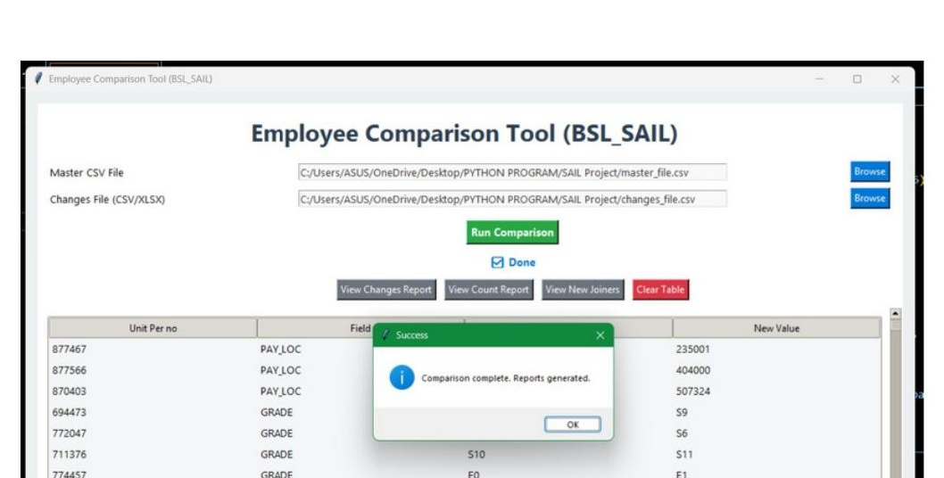
Application in Action — Output
The tool loads master & updated CSV files, runs the comparison, and instantly renders field-level changes with export & email options.
Core Features
Run Comparison — one-click diff engine
View Changes / Count / New Joiners reports
Live results table with search & scroll
Direct Excel export of comparison output
Built-in email delivery of generated reports
CSV Comparison Tool | SAIL Vocational Training
5
5

Slide 6
Conclusion
The CSV Comparator successfully delivers an efficient, user-friendly tool for identifying and analyzing differences between HR and payroll datasets. Leveraging Python's pandas and Tkinter, it enables fast, accurate key-column comparisons, flags discrepancies, and tracks new entries — validated on 932+ live employee records.
Impact Delivered
Future Enhancements
Streamlined comparison of large HR/payroll datasets
Multi-file batch comparison support
Accurate tracking of employee updates & new joiners
Readable Excel exports with automated email delivery
Advanced data-handling & validation rules
Database integration for automated syncing
Ankit Kumar | B.Tech CSE, IILM University | SAIL Vocational Training, Bokaro Steel Plant

