Slide 1


AI Master Class Series – Day 6/30
Object Tracking based on color using OpenCV

Slide 2
Installing Libraries
pyautogui: pip install pyautogui

Slide 3
Object Tracking
Object detection and tracking are the task that is important and challenging such as video surveillance and vehicle navigation.
Image processing is a method of extracting some useful information by converting image into digital inform by performing some operations on it.

Slide 4
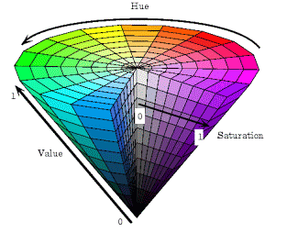
HSV Value
HSL and HSV are alternative representations of the RGB color model, designed in the 1970s by computer graphics researchers to more closely align with the way human vision perceives color-making attributes
HSV Color Space. The HSV color space (hue, saturation, value) is often used by people who are selecting colors (e.g., of paints or inks) from a color wheel or palette, because it corresponds better to how people experience color than the RGB color space does.

Slide 5
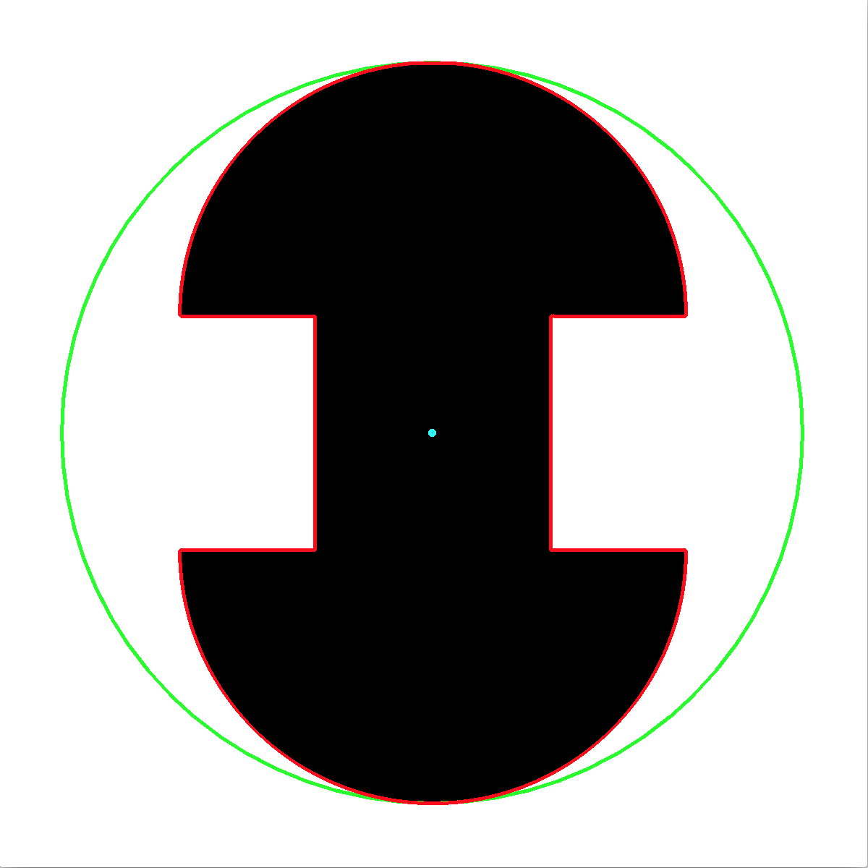
BGR to HSV.
#dst = cv2.cvtColor(src, cv2.COLOR_BGR2HSV)
hsv = cv2.cvtColor(blurred, cv2.COLOR_BGR2HSV)
Minimum Enclosing Circle.
#((x, y), radius) = cv2.minEnclosingCircle(countourArea)
((x, y), radius) = cv2.minEnclosingCircle(c)

Slide 6

Moments to find center of the Area.
Image moments help you to calculate some features like center of mass of the object, area of the object etc.
#var = cv2.moments(contourArea)
M = cv2.moments(c)
center = (int(M["m10"] / M["m00"]), int(M["m01"] / M["m00"]))

Slide 7
Drawing circle
# cv2.circle(src, (x,y), int(radius),colour,thickness)
cv2.circle(frame, (int(x), int(y)), int(radius), (0, 255, 255), 2)
#cv2.circle(frame, center, 5, (0, 0, 255), -1)
cv2.circle(frame, center, 5, (0, 0, 255), -1)

Slide 8
Block Diagram–Workflow of Color Object Tracking.
Reading frame from camera
Pre-processing Image
Finding contours
Drawing Minimum enclosing circle
Finding centre of contour Area
Drawing circle & centre
Direction based on radius & Position

Slide 9
Practical Session…

Slide 10
Tuning color

Slide 11
Object Tracking based on color

