Slide 1
PyReco
An Offline Stack Overflow Q&A Recommender
Ankit Kumar | Ashutosh Chaturvedi | Ayush Gupta | Harshdeep Kaur
{akumar18, achatur, agupta25, hkaur4}@ncsu.edu

Slide 2
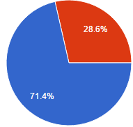
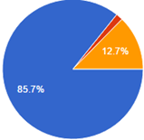

Problem Statement
Syntax Issues- A common programming problem which almost all programmers face.
Finding Solutions?
Online: Search, specially on websites like stackoverflow.com (Major)
Drawbacks? Need for a good internet connection.
Offline: Books, etc (Minor)
Drawbacks? Difficult to obtain (cost and availability)
User Survey: Based on the above findings, we conducted a user survey
Results:

Slide 3
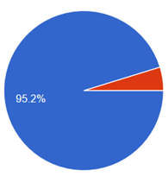
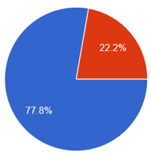
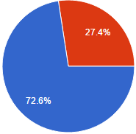


Problem Statement (Cont.)
Percentage of users using StackOverflow.com Percentage of programmers in favor of Percentage of Programmers who would like
to solve their problems offline StackOverflow.com optimized results over simple stackoverflow
search
What does the user need?
An offline solution
Better search results (independent of who is using)
Easy tool to enable quick and efficient debugging!

Slide 4
Idea Formed
Idea:
Design and implement a simple tool, which provides good search results to any user and at the same time does all this work offline!
Where do answers come from?
The most popular search engine for programmers… Stackoverflow.com!
Simple Tool?
Easy select keyword, and click to search using a Sublime Text plugin!
Offline and Portable?
Host a local server using the MEAN stack and display results in a browser.

Slide 5
Solutions Developed
Approach: Build the simplest solution… Aim for a better solution, through improvements and additions to existing solution.
3 Solutions:
Bag of Words
Map bag of keywords to different posts. Enable search through keyword match.
Clustering
Cluster posts on the basis of keywords. Search for clusters, add filters to sort the posts and pick the top 10.
Clustering with Context Matching
Add contextual data matching to clustering, to provide results closer to what the user wants.

Slide 6
Design of Solutions
Overview
Server
(MEAN Stack)
Sublime Plugin
Data
Implementation
Sublime Plugin
Browser
Node.js
GET
POST request
response
mongoDB
Notes:
Design: Same front end and back end, with difference in logic to enable different handling of data in different solutions!

Slide 7
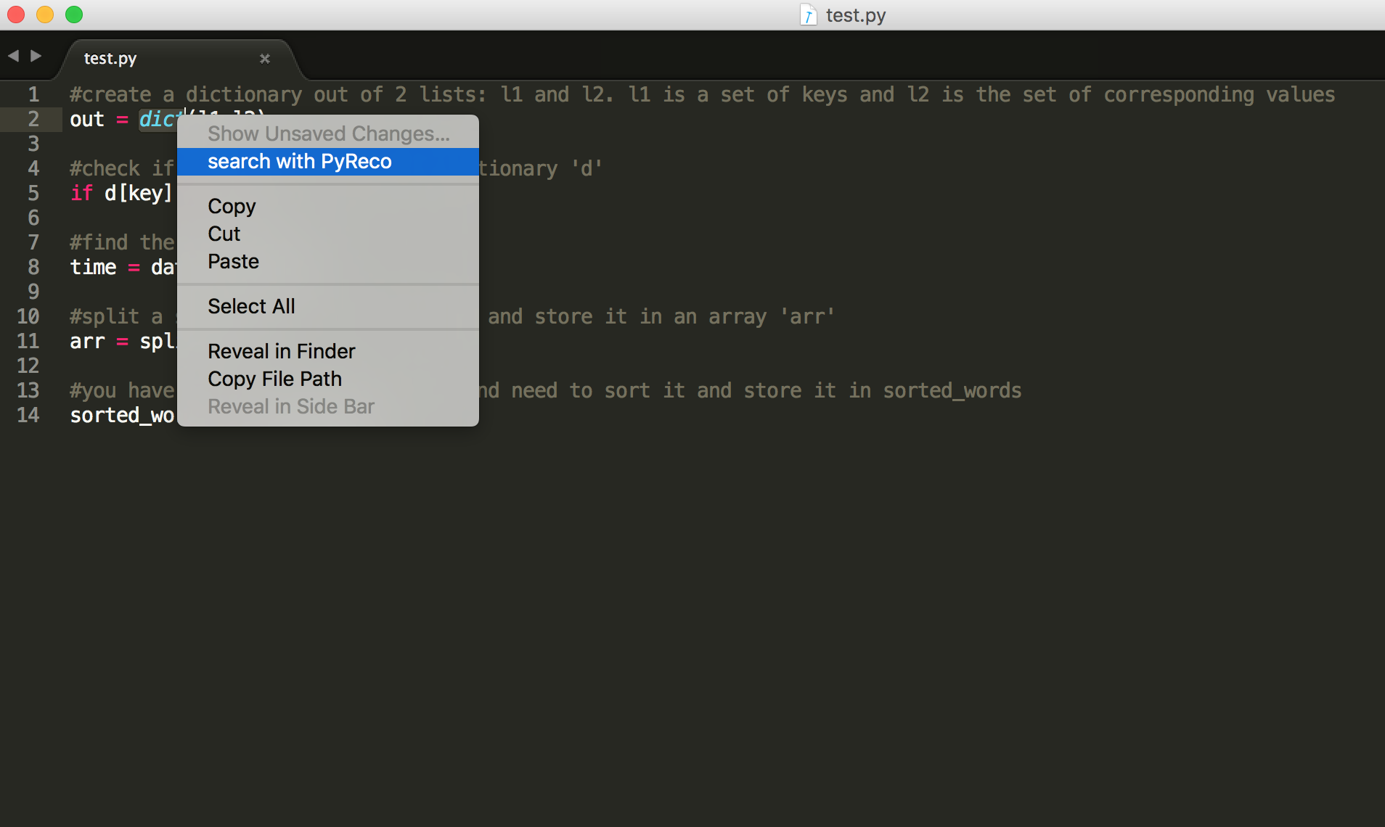
Sublime Plugin

Slide 8
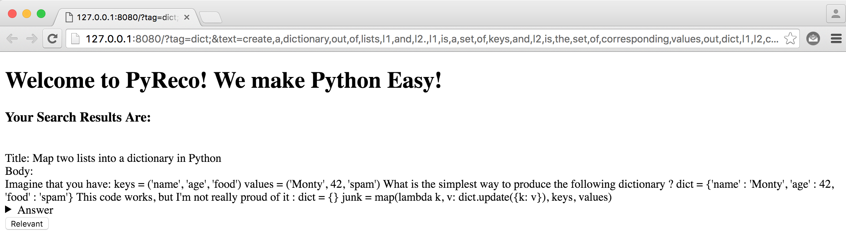
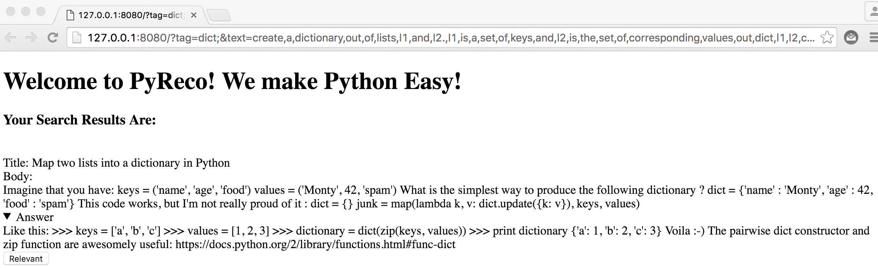
Solutions on Browser

Slide 9
Bag of Words
Naive approach
Map each question to tags/ keywords
Keywords building
Sentence tokenization
Stemming
Stopwords removal
NLTK - 2400
Our own Stopwords - 950
Keywords extraction
Bag of words
Linear search
Keywords matching using MongoDB Text Indexing
Time consuming
Notes:
Tried to focus on keywords: Tags which are the focus of the post;
Id - features mapping

Slide 10
Clustering
Perfect text mining
Fast information retrieval
K-Means unsupervised learning
Easy to implement
Widely used for text based document clustering
Data preprocessing
Tokenization
Vectorization - TF-IDF vectors
Model training
Cosine similarity
Model testing
Results are filtered on Vote Count, Number of Views, Answer rating
Notes:
Clustering makes use of descriptors which are set of words describing the text or document.

Slide 11
Clustering with Context Matching
Built on top of K-Means text clustering solution
How can we improve input data ?
Background contextual keywords from the user’s code
More descriptive data for clusters keywords matching
How can we improve search ?
Find closer posts w.r.t background contextual data
Precalculated SimHash fingerprints of posts
Compute SimHash of input contextual query
Select top few results based on minimization of Hamming Distance( better similarity measure )
Context related result set
Results are further filtered on Vote Count, Number of Views, Answer rating
Notes:
Input search is improved by adding contextual words( from user code) in the query which allows model to return closer results.
Query match with clusters is improved by making use of simhash algorithm.

Slide 12
Setup for Testing
Test: Edit a python code snippet using the tool provided
5 lines of code, with one syntactical error in each line.
Tool Provided: Our 3 Solutions and Stackoverflow.com.
Participants: 20 (5 per solution)
Data Collection for Evaluation
Telemetry: Statistical Evaluation
Answers Expanded
Clicks on the Button called “Relevant”
User Surveys: User’s Perspective
5 questions for both quantitative and qualitative analysis
Bug Fixes: Usability in Syntactical Bug Fixing
Number of bugs fixed out of the 5 bugs given.

Slide 13
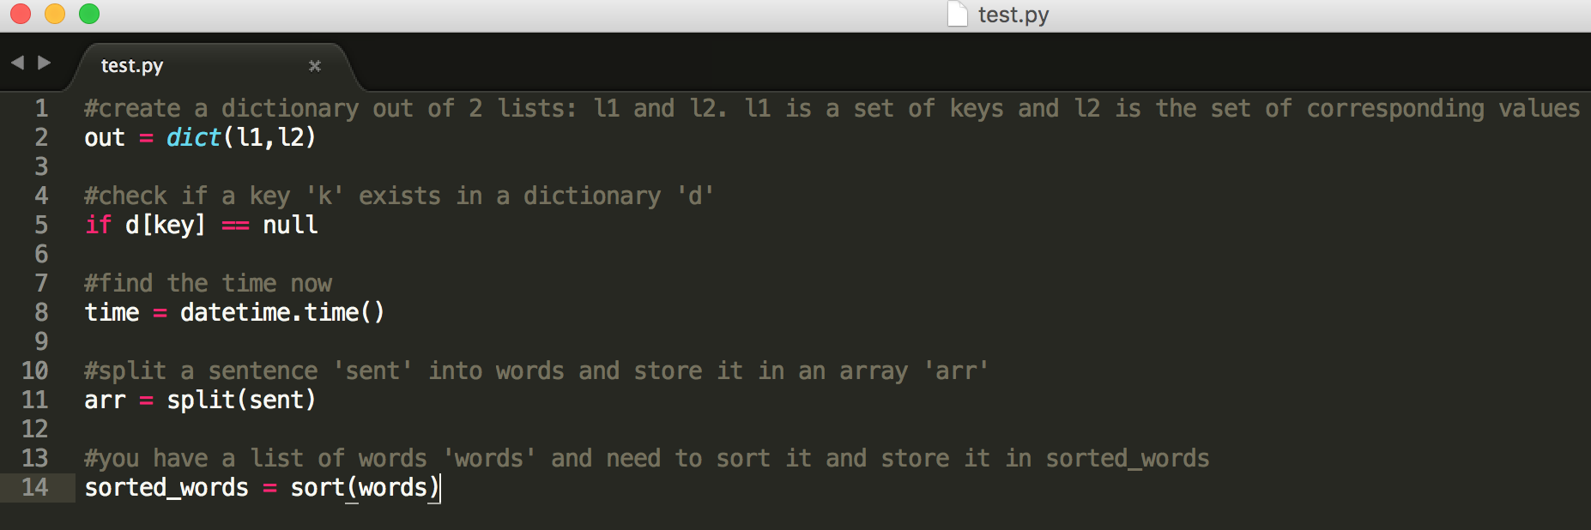
Test Code

Slide 14
Metrics for Evaluation
All the metrics were averaged over all 5 users for every solution and were reported in percent values.
User Surveys:
Helpfulness (H)
Overall Satisfaction (S)
Search Hits (SH)
Recommend? (R)
Telemetry:
Ratio of Click on the Button “Relevant” for a solution to total number of clicks for the button (RC)
Ratio of Answers Expanded for a solution to total number of answers expanded (RA)

Slide 15
Metrics for Evaluation (Cont.)
Telemetry: (Cont.)
For a particular solution, the ratio of clicks on the button “Relevant” that for the top 5 search results, to the total number of clicks on the “Relevant” button for that solution (RCT).
For a particular solution, the ratio answers expanded for the top 5 search results, to the total number of answers expanded for that solution (RAT).
Bug Fixes:
The ratio of bugs fixed to the total number of bugs. (BugF)

Slide 16
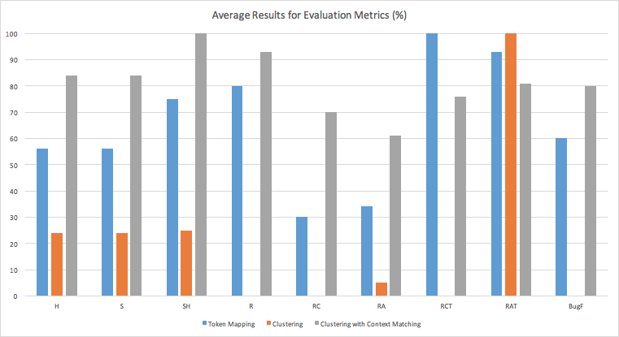
Results

Slide 17
Recommended Solution
Clustering with Context Matching!
Why?
Better evaluation results from telemetry.
Higher RA and RC, which suggests more relevant answers were available to the user.
Most number of bug fixes, which suggests better usability.
Better feedback from users
Higher S, SH, R and H which indicates better user satisfaction.

Slide 18
Comparison with Search on Stackoverflow.com
How did search using stackoverflow.com perform?
Users were able to fix all bugs
User feedback was great!
Why our tool?
Offline!
Easy to use. ( Don’t need to think about how to search)
Some drawbacks
Does not return as optimal results
Does not allow users to search with custom keywords (no user intervention allowed)
Requires more effort and time to deploy!

Slide 19
Future Work
Improve Keyword Search
Tf-idf based K-Means doesn’t necessarily generate optimal models.
Experiment with other learning algorithms to generate better models and hence provide better recommendations.
Provide user intervention
Our tool only allows for selecting keywords and finding solutions.
Provide users a way to search for keywords, not in the document that they are coding up, and with an option of not considering the background contextual data.
Simplify Deployment
Deploying a MEAN server takes some time and effort.
Can use a simple SQLite DB with different types of interfaces
Command Line
Dedicated GUI

Slide 20


