Slide 1

INTERNSHIP PRESENTATION
Game Development
Fruit Merge – Melon Maker and Ball Sort
STUDENT
Ankit Kumar
ROLL NO.
CS-2341524
Section
4CSE8
DESIGNATION
Game Developer Intern
B.Tech CSE • Batch 2023–27
1

Slide 2
OVERVIEW
Agenda
1
Internship Overview
2
Project 1
Role, organization & project focus
Fruit Merge – Melon Maker
3
Project 2
4
Technologies & Architecture
Ball Sort
Game engine, logic & assets
5
Testing & Learning
6
Conclusion
Debugging, skills & outcomes
Key takeaways
2
2

Slide 3
SECTION 01
Internship Overview
IBRA Digital Branding Services Pvt. Ltd.
Game Development Department
• Designation: Game Developer Intern
• Internship duration: 15 April 2026 – 15 August 2026
• Primary focus: mobile game development for Android platforms
• Responsibilities included game functionality, testing and debugging
• Worked toward Play-Store-ready builds for publication
3
3

Slide 4
SECTION 02
Project Overview
1
Project 1 – Fruit Merge – Melon Maker
2
Project 2 – Ball Sort
A mobile puzzle game based on dropping fruits into a confined play area and merging matching fruits. The project combines physics, collision events, scoring, add-ons, audio and game-over flow.
A mobile sorting puzzle in which colored balls are moved between cups. The project includes gameplay states, move and time tracking, level progression, pause/reset flows and leaderboard-related screens.
4
4

Slide 5
SECTION 03 · PROJECT 1
Fruit Merge – Problem & Objectives
The Problem
• Aim and drop fruits into the play area
• Merge matching fruits through collision events
• Progress through Fruit0–Fruit9 stages
• Update score and provide feedback
• Provide swap/blast gameplay aids
• Handle game-over and Play Again flow
The game needs to coordinate player input, fruit movement, physics-based collisions, fruit progression, score updates and game-over handling inside a compact mobile play area.
5
5

Slide 6
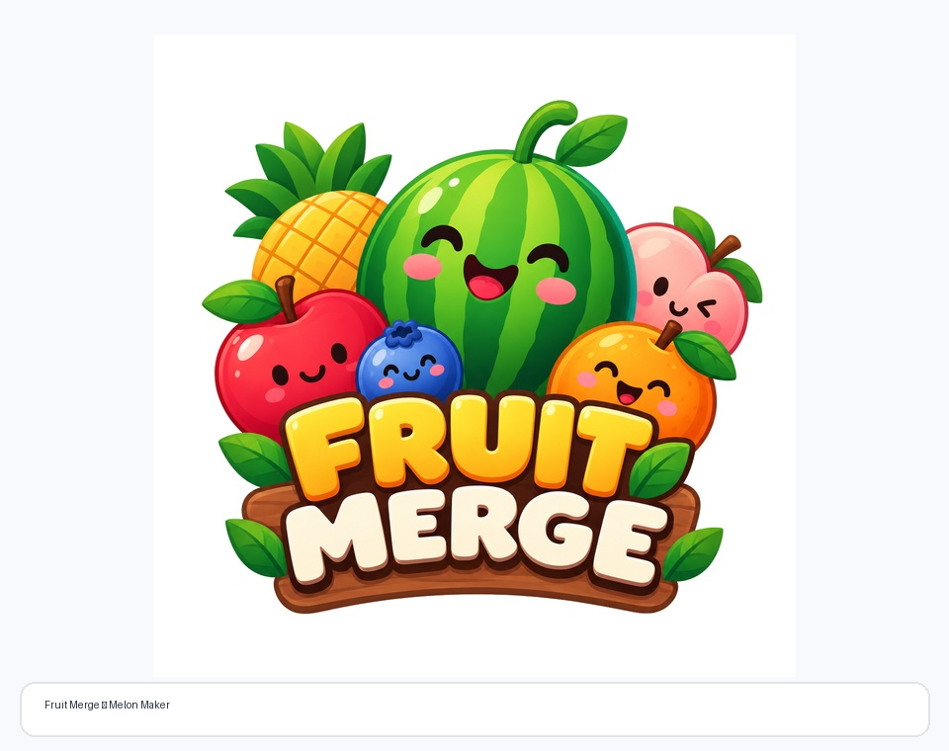
SECTION 03 · PROJECT 1
Fruit Merge – Architecture & Technology
Player Input
→
Fruit Physics
→
Collision
→
Progression
→
Score
→
End State
Aim / drop
Physics2
Matching fruits
Next fruit
Update UI
Game Over
Key project components
• Main, Game and End layouts
• Physics2, Bounce and CrazyGames Ad API extensions
• Fruit0–Fruit9 objects with scale progression
• Scene score variable and formatted score display
• Background music, collision and reward sound effects

Slide 7
SECTION 03 · PROJECT 1
Fruit Merge – Features & Outcomes
10
3
2
1
Fruit stages
Core layouts
Gameplay aids
Score system
Fruit0 through Fruit9
Main, Game, End
Swap and Blast
Live score display
Why it matters
The project demonstrates how event-driven gameplay, physics and collision logic can be combined with scoring, audio and interface feedback to create a complete mobile puzzle experience.
7
7

Slide 8
SECTION 04 · PROJECT 2
Ball Sort – Problem & Objectives
The Problem
• Move colored balls between cups
• Manage selection, dragging and dropping states
• Respect the four-ball cup capacity
• Track moves and elapsed time
• Progress to the next level on completion
• Provide pause, reset, game-over and leaderboard flows
The game must manage selectable balls, valid drop locations, cup capacity, moves, timing and level completion while keeping the puzzle interaction clear and responsive.
8
8

Slide 9
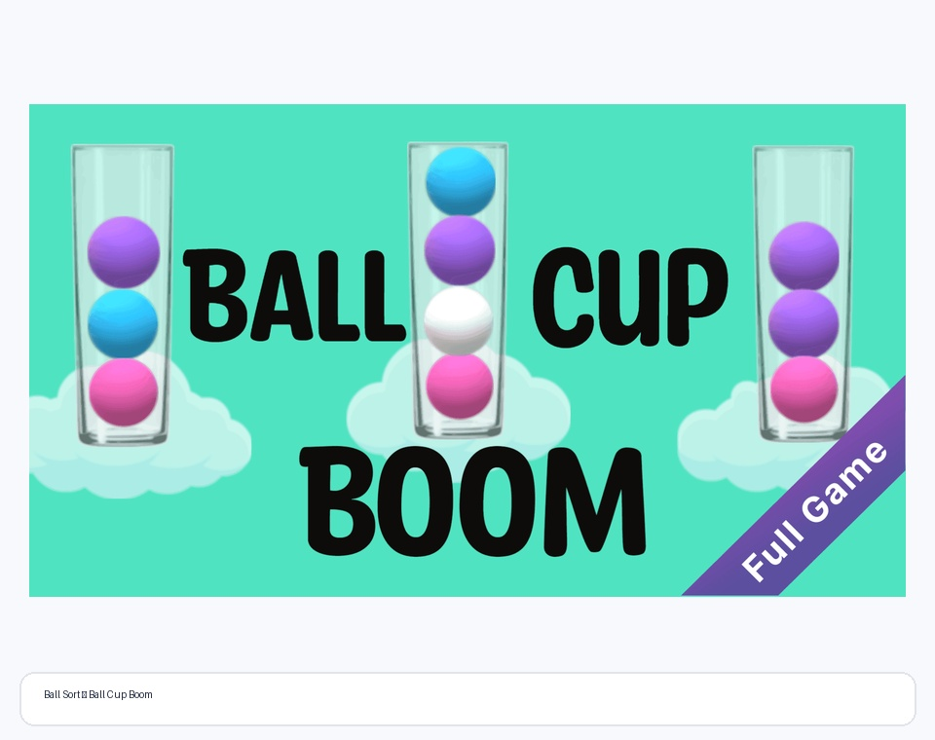
SECTION 04 · PROJECT 2
Ball Sort – Architecture & Technology
Idle
Ball Floating
Dragging
Dropping
Check Complete
Level Complete
→
→
→
→
→
Ready
Selected
Moving
Release
Validate
Progress
Supporting systems
• 7 layouts: Title Screen, Game, GameOver, SubmitScore, ViewLeaderboards, ScreenSaver and PauseMenu
• External events: GameLogic, ExplodeCup, DropBall, GDevelopLogo and ButtonEffects
• Variables: CurrentLevel, MovesMade, PlayTimer and MaxBallsPerCup = 4
• Extensions include ExtendedMath, Sticker, RepeatEveryXSeconds, CameraShake and CopyCameraSettings

Slide 10
SECTION 04 · PROJECT 2
Ball Sort – Features & Outcomes
4
Max balls / cup
6
Ball variants
Capacity control
Ball_1 to Ball_6
7
Layouts
2
Progress metrics
Multiple game screens
Moves + time
Additional player-facing systems: pause/resume, reset progress, game-over, score submission and leaderboard screens.
10
10

Slide 11
SECTION 05
Testing & Debugging
Fruit Merge
Ball Sort
Testing focused on the interaction between player input, physics and event conditions. Key checks included fruit drops, boundary behavior, matching collisions, next-fruit generation, score updates, add-ons and game-over transitions.
Testing focused on the complete move state flow: selection, dragging, valid/invalid drops, cup capacity, move count, timer, level completion, pause/reset, and navigation through game-over and leaderboard screens.
Testing mindset
Functional correctness • Player interaction • UI feedback • Audio/animation • Screen transitions
11
11

Slide 12
SECTION 05
Skills & Learning Outcomes
1
Game Engine Development
2
Gameplay Programming
GDevelop layouts, objects, events, variables and extensions
Input, collisions, state transitions, scoring, levels and timers
3
UI & UX
4
Audio & Effects
Menus, buttons, counters, overlays and navigation flows
Music, sound effects, animations, particles and camera effects
5
Debugging
6
Mobile Development
Testing event conditions, object interactions and gameplay states
Portrait-oriented Android game development and build preparation
12
12

Slide 13
SECTION 05
Overall Outcomes
2
1
2
1
Mobile puzzle games
Game engine workflow
Major gameplay systems
Internship cycle
Completed practical development work on two game projects
Built experience with event-driven GDevelop development
Physics/collision merge logic and sorting/state logic
Exposure to development, testing, debugging and Android build preparation
The internship connected programming concepts with practical interactive software development and mobile-game workflows.
13
13

Slide 14
SECTION 06
Conclusion
The internship provided hands-on experience across the mobile game development cycle.
• Fruit Merge strengthened understanding of physics-based interaction, collision-driven progression and scoring.
• Ball Sort strengthened understanding of puzzle-state management, drag/drop interaction, levels, timers and moves.
• Both projects provided practical exposure to UI, audio, animation, testing and debugging.
• The internship also included Android and Play-Store-ready build preparation responsibilities.
Game Development • GDevelop • Testing • Debugging • Android
14
14

Slide 15
THANK YOU
THANK YOU
Ankit Kumar • Game Developer Intern • IBRA Digital Branding Services Pvt. Ltd.
Ankit Kumar · Game Developer Intern · IBRA Digital Branding Services Pvt. Ltd.
IILM University • B.Tech CSE • Batch 2026–27
IILM University · B.Tech CSE · Batch 2026–27
15

