Slide 1
Blockchain Idea : HashRight!
Theme Selected – Blockchain DRM
Team Name - HashRight
Team Members -
Jaydeep Chauhan
Kamna Jadhav

Slide 2
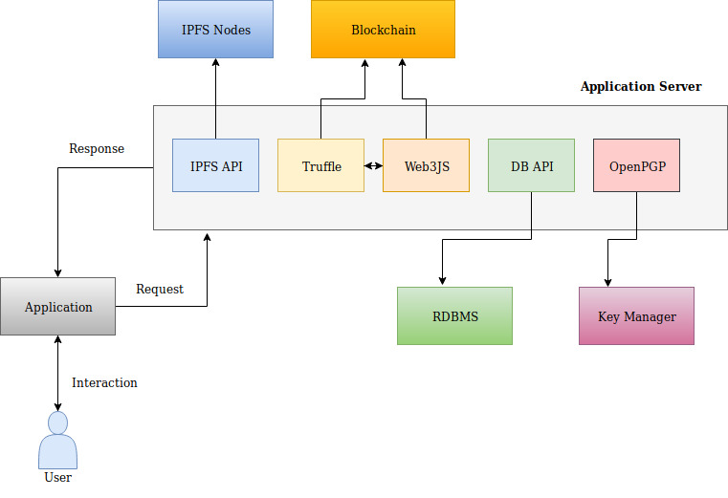
High Level Architecture
<Add image of your architecture here>
IPFS : For storing real assets
Blockchain : It will hold smart contract and mining, full node purpose.
Application Server : It will consists of various API for interacting with different services of application.
RDMS : For storing basic user management and UI purpose like filter page.
Key Manager : It will store Wallet keys and PGP keys for encryption/decryption of assets.
Here none of modules are tightly couples and top of that each modules will be running as independent services. Also, core parts will be available as API which can be easily integreted with other systems

Slide 3
Blockchain Platform Selection
Question | Answer
Which Blockchain Platform have you selected? (eg. Hyperledger Fabric, Ethereum, R3 Corda, Quorum, etc) | Ethereum
Why did you select this platform?
How many different nodes would be required for your solution? Mention each node and it’s type (eg. Full Node, Light Node, Observer Node, etc) | 2 – Full Nodes 2 – Light Node 1 – Observer Node 2 – Mining Node

Slide 4
Actors
Name of the Actor | Role of the Actor
Creator | Digital Asset creator
Publisher | Anyone who wants to publish digital asset with creator’s consent
Users | Users can buy, rent, download or view any registered assets

Slide 5
Table of Smart Contracts
Name of Smart Contract | Description (upto 50 words) | Input Variables | Output Variables | Triggering events
Eg. Smart Contract 1 | Eg. This Smart Contract will be used to … | Eg From_AccountID To_AccountID | Eg. Amount | Eg. Buying a product
Owner | It will contain smart contract owner details | wallets | status | Owner identity events
Token | ERC20 token will be used by Dapp | Transfer, Burn, Freeze, Approve,etc | Wallets address | Transfer event, Burn event, freezeevent
User | It will be used to register and store info of actors . | AddUser, RemoveUser, BlockUser | Wallet address, Basic details | UserRegistration Event, UserDeletion Event, BlockedUser Event
Asset | This will be used for creating assets and storing info regarding assets | AddAsset, RetrieveAsset, AssetDetails and AssetState | Bytes32 assetId | AssetState Event
Trade | If creator wants to sell his assets to publisher, renting to users, giving access to publisher for distribution. | AssetTransfer, AssetRent | Bytes32 assetId | AssettTansfer event, AssetRent Event

Slide 6
Approach
Question | Answer
How would you ensure that the solution is scalable, modular, ensures confidentiality and delivers high throughput for performance? | 1. Modularity : It is an microservice based applicaiton 2. Scalability : Replication and Load balancing. 3. Confidentiality : By using PGP for encryption/decryption and blockchain wallets which will be unique for each users. 4. Throughtput : Smart contract will make instant resettlement of each action.
Provide your high level viewpoint on integration of your solution with other external systems such as ERPs, CRM, IAM, IoT sources, etc? | By consuming application REST API they can easily interact with Dapp and IPFS for data storage.

