Slide 1

VOYAGEFLOW
Dynamic AI Travel Planner
A Premium Spatiotemporal Constraint Solver & Real-Time Event Simulator
Hosted fully Serverless in WebAssembly on Vercel Edge
Prompt Wars May 2026 Submission by Ankit Mathur

Slide 2
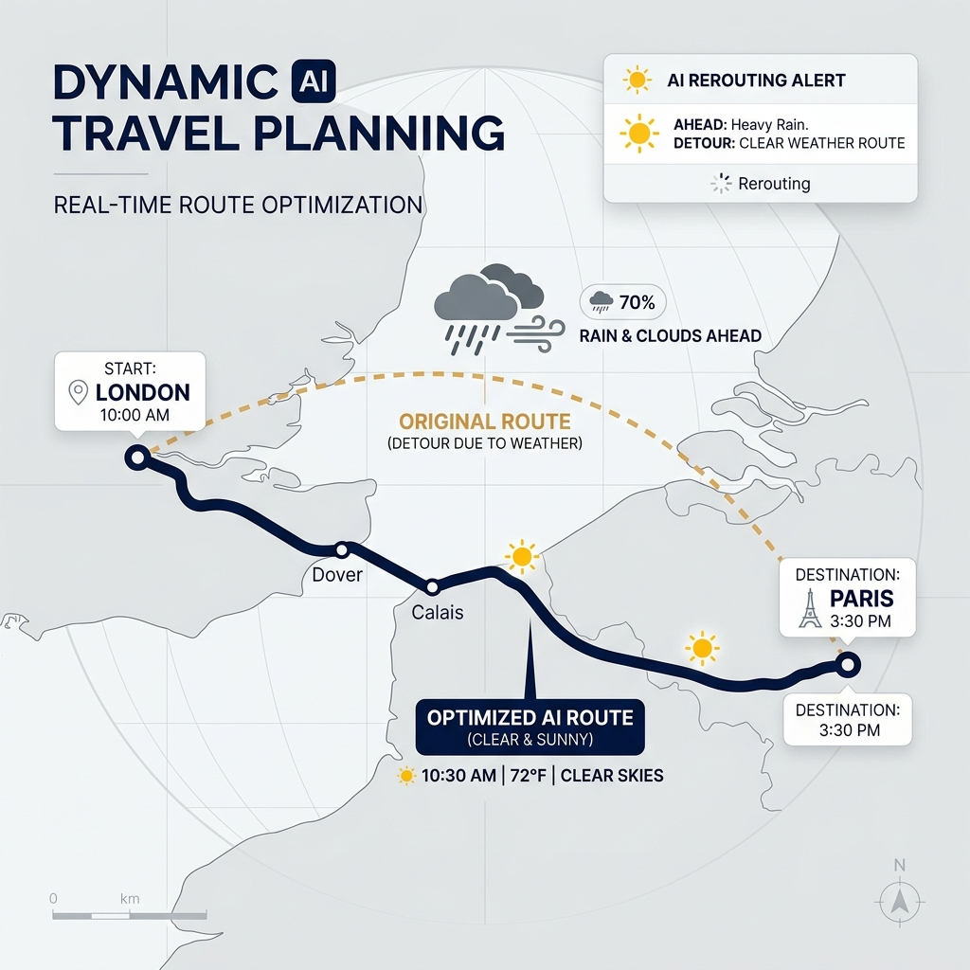
Dynamic AI Travel Re-invented
Bridging multi-constraint spatial optimization with real-time disruption simulation
• 🧭 Tailored Constraint Satisfaction
Dynamically filters and prioritizes geographic points-of-interest based on budget tiers, personal interest weights, wheelchair accessibility requirements, and dietary restrictions.
• 🗺️ Haversine Coordinate Optimization
Resolves traveling route efficiency starting from hotel coords, optimizing lunch/dinner stops nearby, and strictly validating hourly opening times.
• ⚡ Real-Time Active Disruption Simulator
Simulates storms, transit delays, fatigue, and sudden attraction closures on the fly, auto-replanning remaining day slots seamlessly.
• 🌐 Pure Client-Side Edge Execution
Bundled using Stlite WebAssembly to run entirely in the browser, eliminating cold starts, WebSocket limits, and server costs on Vercel.

Slide 3
Heuristic Spatiotemporal Planner
How VoyageFlow designs a perfect, zero-conflict day-by-day travel sequence
01
02
03
Nearest-Neighbor TSP
Constraint Verification
Dietary & Health Integrity
• Starts each day at hotel location coordinates.
• Selects the next highest interest-matched sight close by.
• Calculates walking/driving/transit duration and fare on the fly.
• Minimizes cumulative transit lag dynamically.
• Interest Weighting: Dynamically ranks places based on user vibes.
• Time-Window Matching: Assures arrival + duration matches opening hours.
• Pace Control: Limits daily stops (Relaxed 2-3, Moderate 4-5, Packed 6+).
• Selects budget & dietary-compliant restaurants (Vegan, Halal, Gluten-Free).
• Integrates lunch (12:30 PM) and dinner stops near coordinates.
• Excludes inaccessible landmarks for wheelchair users.

Slide 4
Real-Time Disruption & Replanning Engine
Intercepting real-world events and running delta-optimizations in milliseconds
🌧️ Torrential Rain Storm
⏱️ Transit & Flight Delays
Scans subsequent daily slots, automatically replaces all outdoor attractions with pre-seeded indoor alternatives (or cozy coffee shelters), and recalculates routes.
Shifts subsequent timelines forward. If an activity is pushed past its closing hours, it automatically drops the lowest-priority spot and stretches the remaining schedule.
🚧 Landmark Closed Alert
🥱 Traveler Fatigue Alert
Removes the affected attraction instantly. Searches for nearby equivalent interest matches, seamlessly re-sequencing the transit segments and budget on the fly.
Detects high exhaustion levels. Drops strenuous high-effort sights, inserts coffee rest slots, and pulls forward the hotel return time for quick recovery.

Slide 5
Premium Glassmorphic Interface
Vibrant modern aesthetics designed to wow the traveler at first glance
Legibility & Contrast
3D PyDeck Maps
Interactive Budgets
HTML Timelines
Strictly adheres to White primary and Navy Blue secondary styling. Entirely avoids light gray text/borders on white backgrounds to ensure flawless visual accessibility.
Integrates Mapbox Light styling overlaid with sequential orange paths, deep navy location labels, and emerald restaurant marker dots.
Displays real-time custom Plotly Pie charts outlining financial resource allocation (Hotel, Dining, Activities, Transit fares).
Renders beautiful scrolling custom timelines with color-coded badges, visual efforts, and structured travel and rest metrics.

Slide 6
Serverless WebAssembly Architecture
Running complex Python dashboards on the Edge without backend servers
• The Serverless Barrier
Standard Streamlit apps require active persistent servers and active WebSockets, which are fundamentally incompatible with Vercel's stateless, ephemeral backend functions.
• The Stlite Breakthrough
VoyageFlow bypasses this by utilizing Stlite to compile Streamlit and its heavy data suites (pandas, plotly, pydeck, pydantic) into WebAssembly (Pyodide).
• Single-File HTML Bundle
A custom build compiler (`build_stlite.py`) compresses your complete source code structure into a single Base64 string embedded in a clean index.html.
• Vercel Routing Bypass
Vercel's automatic Python detector tries to build app.py as an ASGI server, failing because Streamlit has no 'app' export. We bypassed this elegantly with static routing.
• Explicit Builds & Ignores
Added explicit vercel.json builders targeting only static index.html and added .vercelignore filters to isolate py scripts from Vercel's compiler.
• Global CDN Performance
Because the app is fully static, it is cached on Vercel's global Edge Network, providing instant load times, zero server cost, and zero cold starts!

