Slide 1
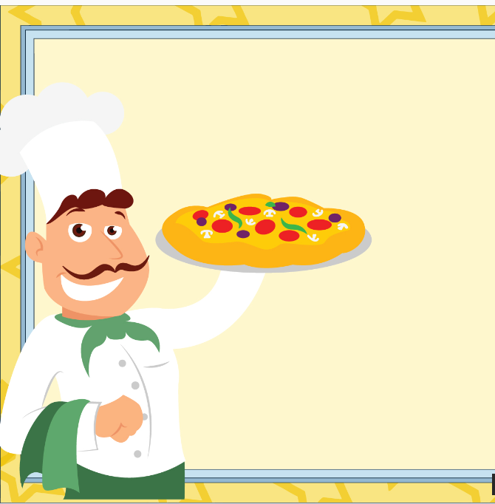
"𝙵𝚛𝚘𝚖 𝙲𝚛𝚞𝚜𝚝 𝚝𝚘 𝙿𝚛𝚘𝚏𝚒𝚝: 𝚄𝚗𝚍𝚎𝚛𝚜𝚝𝚊𝚗𝚍𝚒𝚗𝚐 𝙿𝚒𝚣𝚣𝚊 𝚂𝚊𝚕𝚎𝚜 & 𝙲𝚞𝚜𝚝𝚘𝚖𝚎𝚛 𝚃𝚛𝚎𝚗𝚍𝚜"
Presented By:- 𝘈𝘯𝘬𝘪𝘵 𝘔𝘪𝘴𝘩𝘳𝘢
𝘈𝘴𝘱𝘪𝘳𝘪𝘯𝘨 𝘋𝘢𝘵𝘢 𝘈𝘯𝘢𝘭𝘺𝘴𝘵

Slide 2
Acknowledgement
I sincerely express my gratitude to all those who contributed to the successful completion of this project, “From Crust to Profit: Understanding Pizza Sales & Customer Trends.”
I would like to acknowledge the creators of the dataset, whose comprehensive and structured data enabled in-depth analysis. Special thanks to the resources and tools—SQL, Python, and Power BI—which empowered the extraction of meaningful insights.
This project has been a valuable learning experience, helping me apply analytical methods to real-world business problems. I am deeply thankful for the support and feedback received from my mentors, peers, and the data analytics community throughout this journey.
Their contributions were instrumental in shaping the insights and outcomes presented in this work.
𝘈𝘯𝘬𝘪𝘵 𝘔𝘪𝘴𝘩𝘳𝘢
𝘈𝘴𝘱𝘪𝘳𝘪𝘯𝘨 𝘋𝘢𝘵𝘢 𝘈𝘯𝘢𝘭𝘺𝘴𝘵

Slide 3
This project presents a comprehensive analytical study of a pizza sales dataset, aimed at deriving critical insights into customer purchasing behavior, product performance, and overall business operations. The analysis was executed using an end-to-end data science approach, encompassing data extraction, transformation, visualization, and interpretation.
The primary objective was to translate raw transactional data into meaningful business intelligence that can support strategic decisions related to marketing, product development, and inventory management.
Project Introduction

Slide 4
The primary objective of this analysis is to assess critical business metrics related to customer engagement and revenue performance by leveraging transactional data from pizza sales. This insight-driven evaluation aims to support strategic decision-making in areas such as marketing effectiveness, operational planning, and customer retention.
Project Objective
Key Analytical Focus Areas
Customer Engagement Analysis
Evaluate the volume, timing, and frequency of customer orders to identify behavioral patterns, peak demand periods, and interaction trends.
Gain a deeper understanding of customer purchasing behavior to inform service improvements and targeted promotions.
Revenue Performance Assessment
Quantify total revenue generated across the analysis period to measure financial output.
Analyze high- and low-performing SKUs to inform product strategy, pricing optimization, and inventory planning.

Slide 5

Project Overview
Dataset Overview
• Timeframe: Jan–Dec 2015
• 48,000+ Orders
• Fields: Date, Time, Pizza Type, Size, Quantity, Price
• Categories: Classic, Veggie, Supreme
🧭 Methodology
1. Data Cleaning & Preparation
2. Exploratory Analysis
3. Visualization & Reporting
4. Cross-tool Insight Comparison
5. Business Recommendations
Project Goals:
Identify top-performing products that drive the highest revenue
🍕 Analyze customer preferences across pizza types, sizes, and time of order
Optimize inventory and menu planning through category-level sales insights
Deliver actionable business recommendations to boost strategic growth

Slide 6
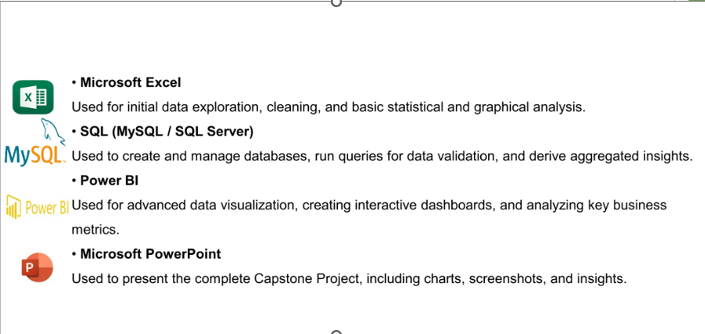
Tools & Technologies Used

Slide 7
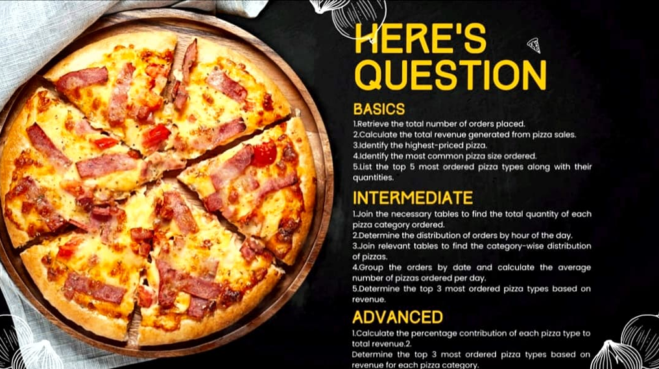
Data Exploration Roadmap

Slide 8
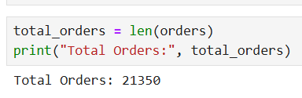
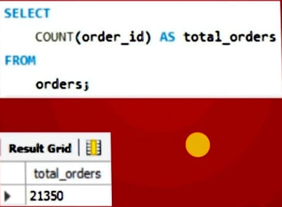
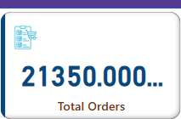
Problem:-Cumulative Number of Customer Orders: Purpose: This will help assess overall customer engagement and determine the volume of customer interaction with the business, which is essential for demand forecasting and operational planning.

Slide 9
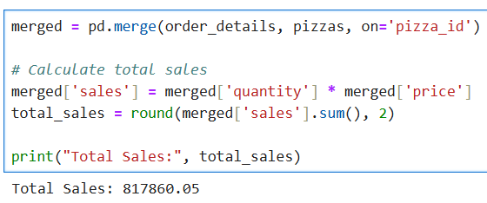
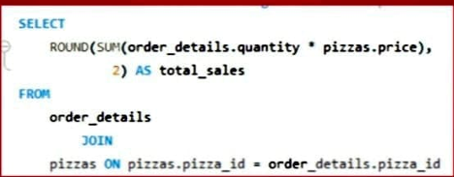
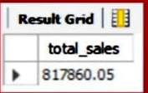
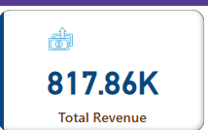
Problem: What is the total revenue generated from pizza transactions across the entire dataset?
Purpose: By analyzing total revenue, we can evaluate the financial performance of the pizza sales, determine growth patterns, and understand which factors contribute most to income generation.

Slide 10
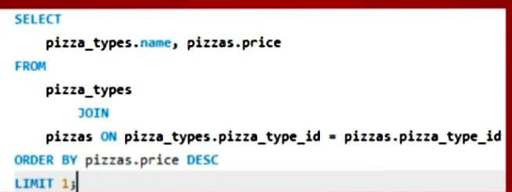
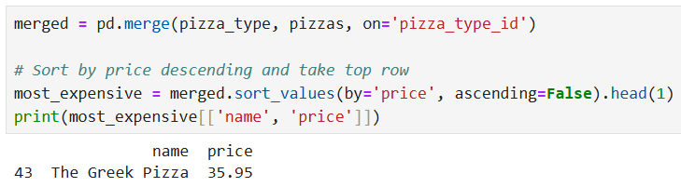
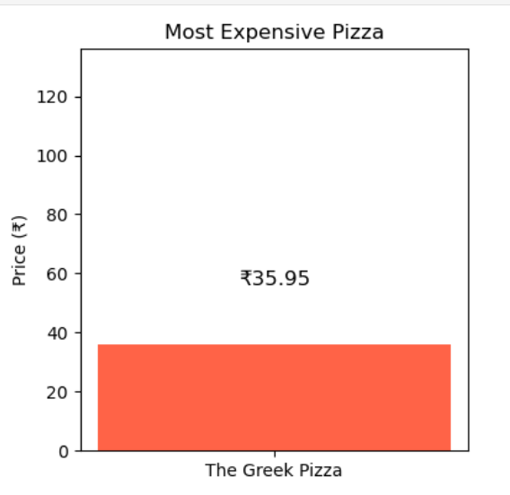
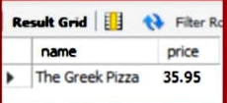
Problem:- Which individual pizza product carries the highest unit price on the menu Purpose:-To determine premium-priced offerings and explore potential revenue drivers.
“The most expensive pizza on the menu is the The Greek Pizza priced at 35.95, representing a premium, high-margin item”

Slide 11
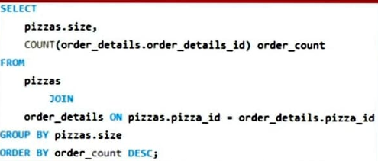
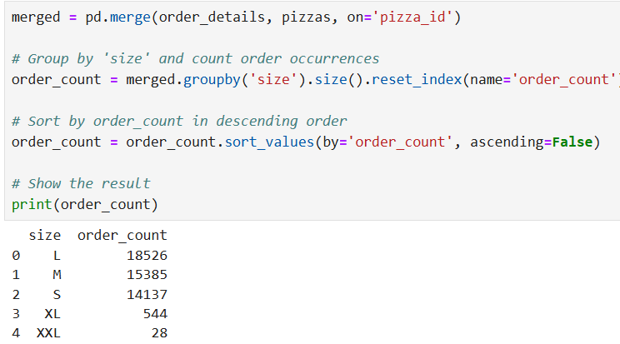
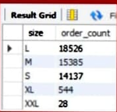
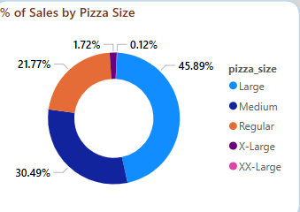
Problem:-Which pizza size exhibits the highest frequency of customer selection Purpose: To optimize inventory management, packaging, and pricing strategies aligned with customer preferences.

Slide 12
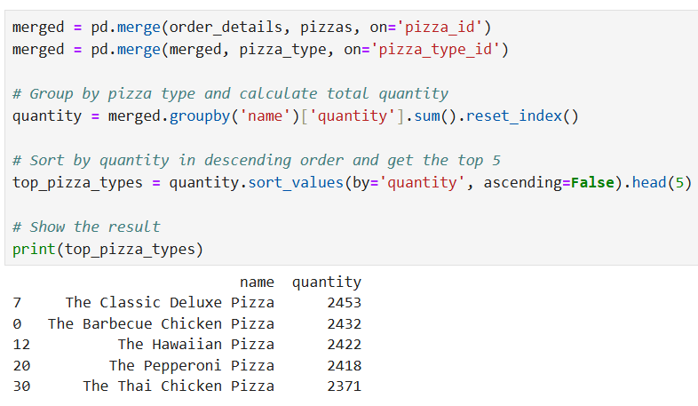
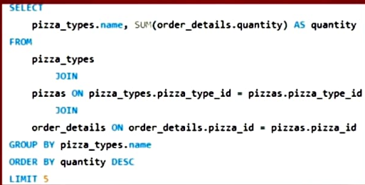
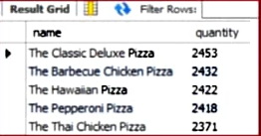
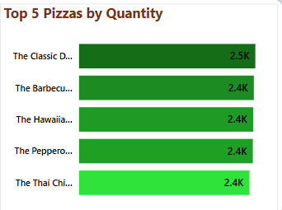
Problem:-Which five pizza varieties are the most frequently purchased in terms of quantity sold? Purpose: To identify best-selling items and inform demand forecasting, promotional planning, and product prioritization

Slide 13
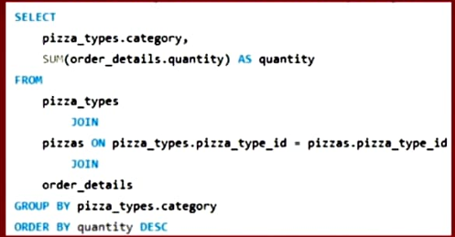
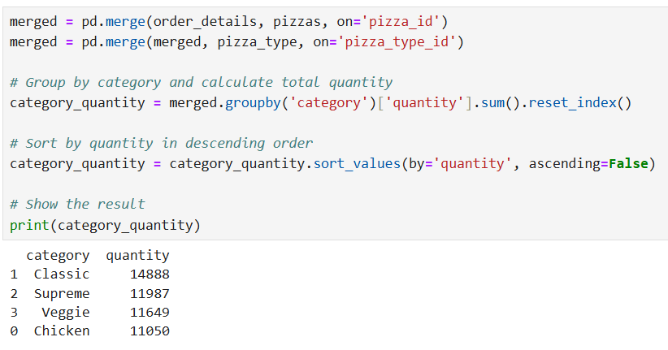
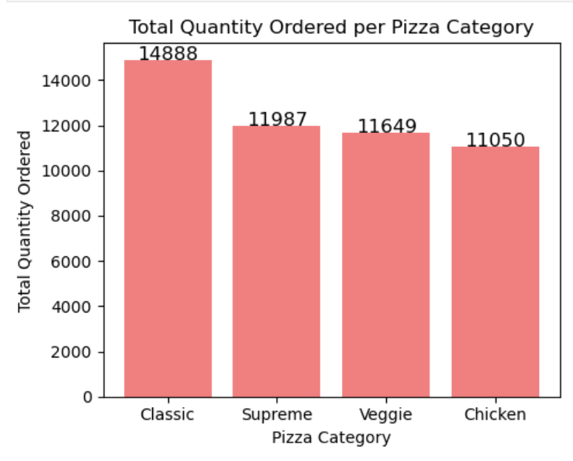
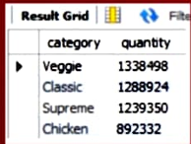
Problem:-How does the total quantity sold break down across each pizza category (e.g., Classic, Veggie, Supreme)? Purpose: To evaluate category-level performance and guide decisions on menu diversification and resource allocation..

Slide 14
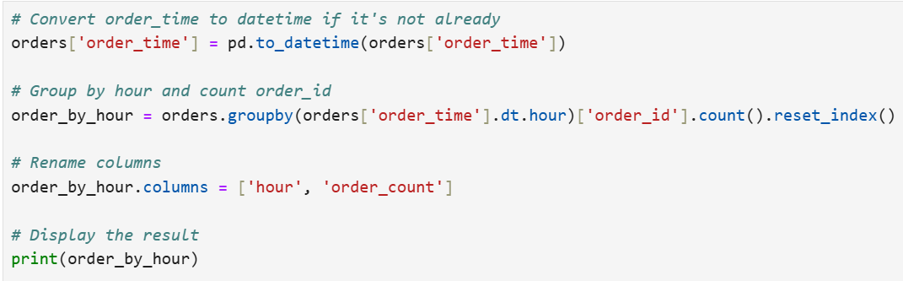
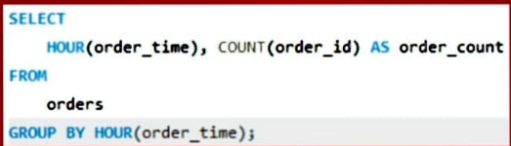
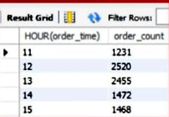
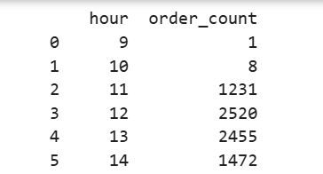
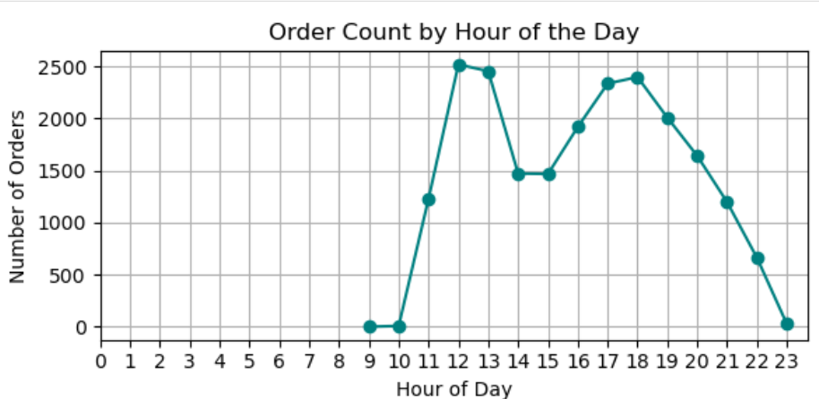
Problem :What is the temporal distribution of order volume across different hours of the day? Purpose: To uncover operational peak periods and inform scheduling, staffing, and marketing timing strategies.

Slide 15

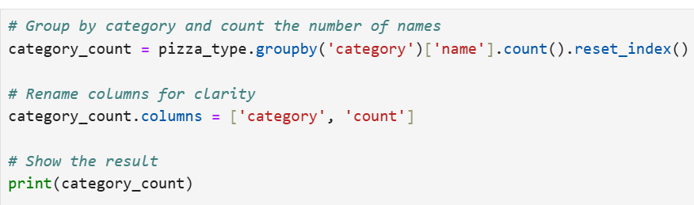
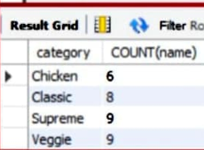
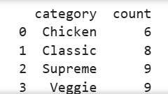
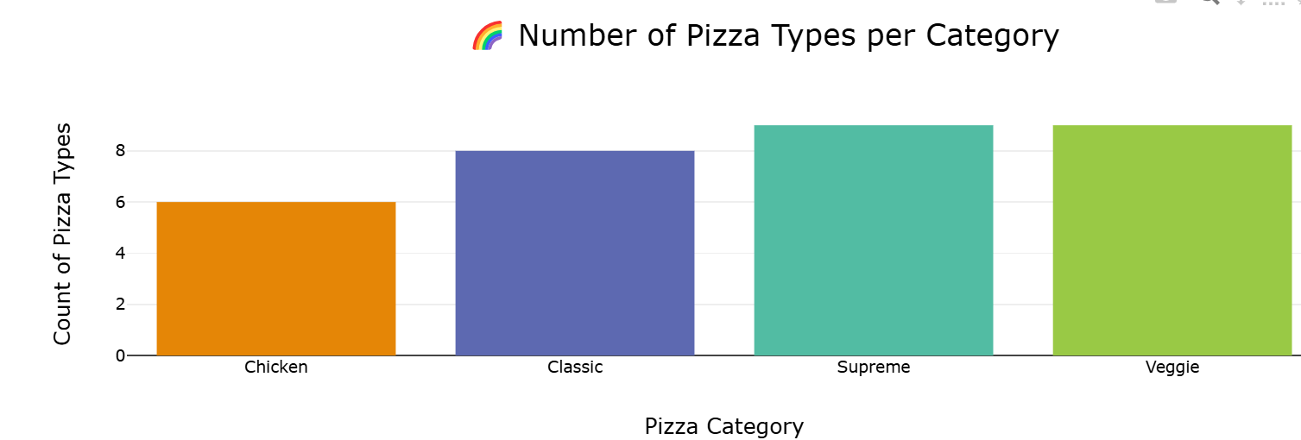
Problem: How is the product catalog distributed across different pizza categories? Purpose: To assess menu structure and ensure balanced representation among offerings.

Slide 16
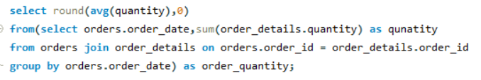
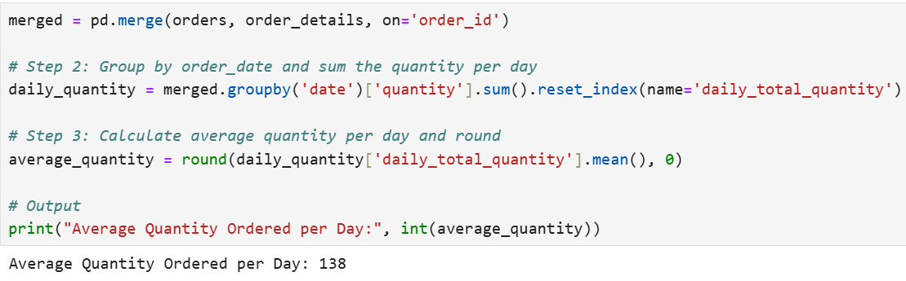
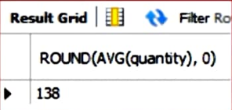
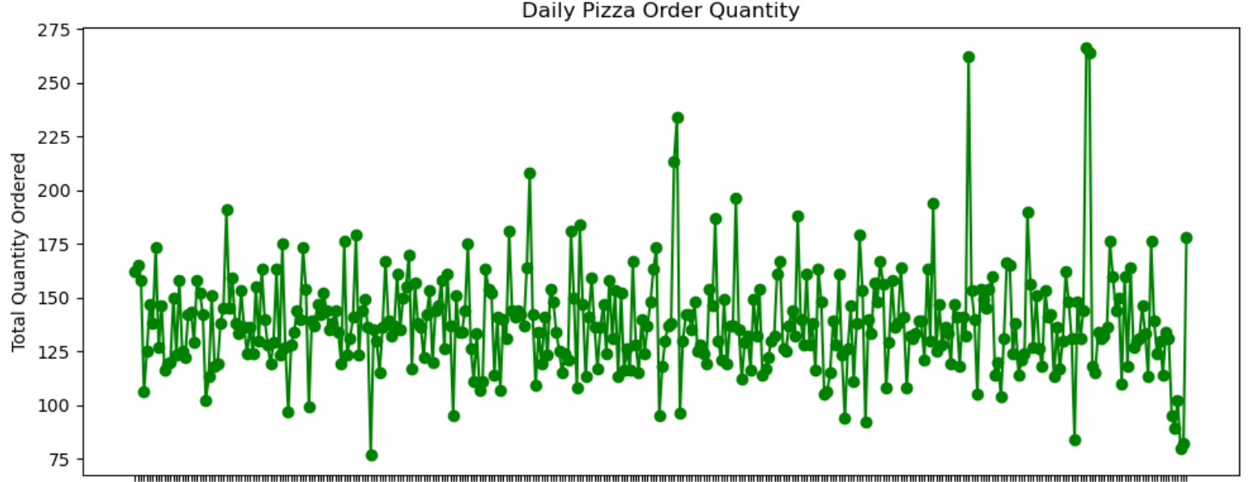
Problem: What is the average daily volume of pizzas ordered over the analysis period? Purpose: To monitor baseline performance and track consumption trends at a daily granularity.

Slide 17
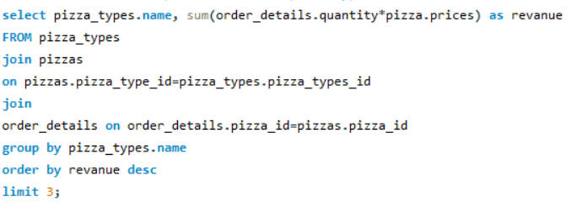
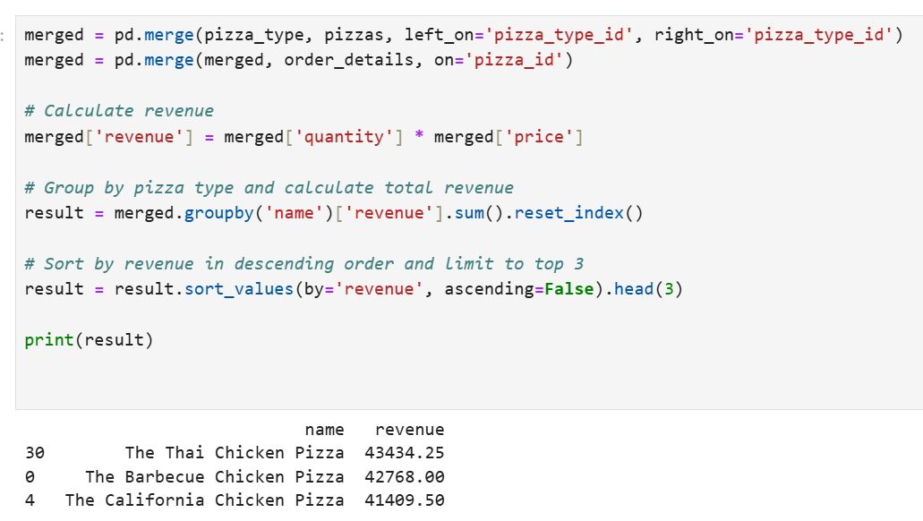
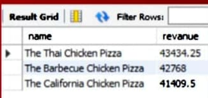
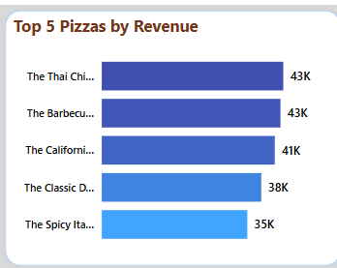
Problem: Which pizza types are responsible for generating the highest total revenue? Purpose: To identify high-performing SKUs (Stock Keeping Units) and support revenue-optimized product placement.

Slide 18
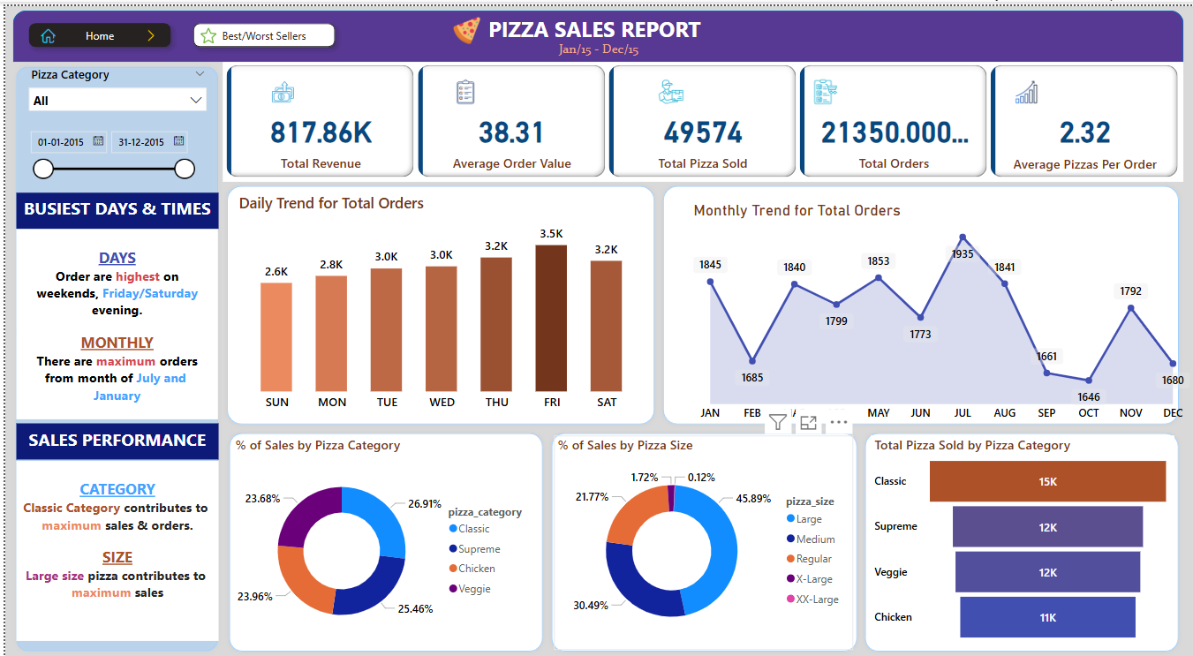
Pizza Sales Performance Dashboard

Slide 19
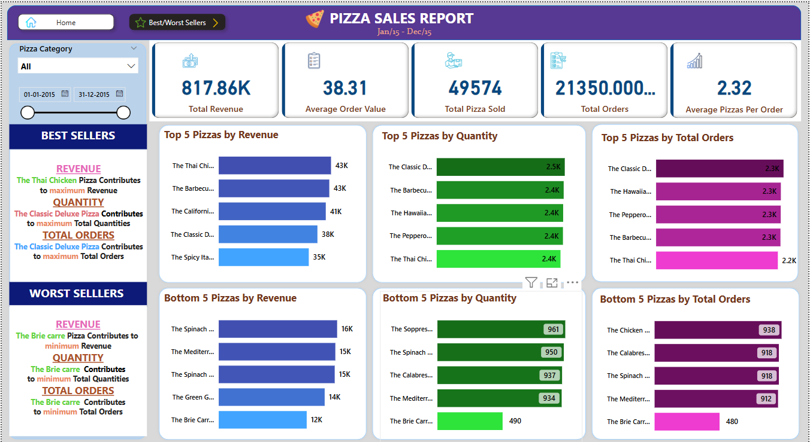
Pizza Sales Performance Dashboard

Slide 20
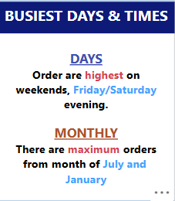
Business Performance Snapshot
🕒 Busiest Days & Times
Days: Orders are highest on weekends, especially on Friday and Saturday evenings.
This highlights peak sales periods, useful for staffing and promotions.
Monthly: The months of July and January show the maximum order volume, indicating seasonal trends.

Slide 21
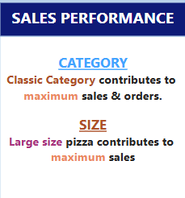
Sales Contribution by Category & Size
Category Performance
The Classic Category stands out as the top contributor to both sales revenue and total order volume.
This suggests strong customer preference and market acceptance for traditional pizza options, making it a strategic focus area for maintaining sales consistency.
Size-Based Performance
Large-sized pizzas account for the maximum sales across all sizes.
This indicates that customers are likely opting for value-oriented or group-sized portions, which could be leveraged in combo deals or bulk promotions to further boost revenue.

Slide 22
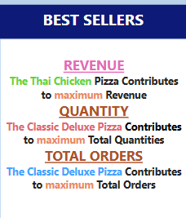
Top Performing Pizzas by Revenue, Quantity, and Orders
Revenue Leader
The Thai Chicken Pizza generates the highest revenue, suggesting it is priced at a premium and well-received by customers.
Quantity Leader
The Classic Deluxe Pizza accounts for the highest quantity sold, indicating high-frequency customer preference.
Order Volume Leader
The Classic Deluxe Pizza also leads in total number of orders, reinforcing its status as a top-performing product across multiple dimensions.
Business Implication:
The Thai Chicken Pizza is a revenue driver, while the Classic Deluxe Pizza is a volume leader, both in quantity and orders. This dual insight allows for differentiated marketing strategies.

Slide 23
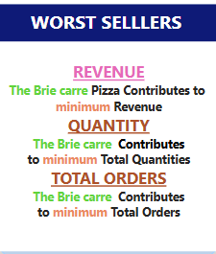
Least Performing Product
Lowest Revenue Generator
The Brie Carre Pizza contributes the least to total revenue.
Fewest Total Orders
With the lowest total number of orders, the Brie Carre Pizza underperforms across all key dimensions.
Business Implication
The Brie Carre Pizza is a consistent underperformer across revenue,
units sold, and orders. This may indicate:
Poor product-market fit
Ineffective promotion or visibility
Unappealing flavor or price point

Slide 24
Executive Summary
Title: Strategic Insights & Business Recommendations
Product Performance Insights
Greek Pizza is the highest-priced item at $35.95, positioning it as a premium offering for high-margin opportunities.
Medium-sized pizzas dominate sales volume, indicating customer preference for mid-range options in both price and portion.
The top 5 best-selling pizzas account for a disproportionately high share of total orders, suggesting a concentrated product appeal.

Slide 25
Executive Summary
Title: Strategic Insights & Business Recommendations
Customer Behavior Trends
Classic category pizzas show consistent dominance in sales, highlighting strong brand loyalty and taste alignment.
Peak ordering hours fall between 6:00 PM – 9:00 PM, signifying optimal windows for marketing campaigns and increased staffing.
Strategic Recommendations
Focus promotions around evening peak hours to maximize order volume.
Enhance visibility and bundling for medium-sized and top-selling pizzas to drive higher conversion.
Maintain premium positioning of high-priced items like Greek Pizza, with tailored offerings or combos for upselling.

Slide 26


